Slide 1
UEMS update
CESMA MEETING
5th MAY 2023
Bertrand DAVAL – MAY 2023

Slide 2
UEMS Council update – Brussels Oct 2023
  Adoption of the European Training Requirements for
    Interventional Radiology
    Gastroenterology and Hepatology
    Medical Oncology
    Physical and Rehabilitation Medicine
    Urology
Creation of an MJC in Balneology
Motion to extend the duration of the TF CESMA
Report on the first ETR Conference
EACCME 3.0

Slide 3
UEMS Council update - Brussels Oct 2023
Reports from the 5 newly created Groupings on
Common Projects Group
Quality Indicators
Finances
Collaboration with ESS/NSS
Promoting EACCME
Notes:
Group preparing proposals for the next UEMS Council
Promote EACCME
Quality indicators
Collaboration with the national scientific societies and ESS
Common projects

Slide 4
How can the UEMS OFFICE support CESMA?
(…and how can this be financed?)
Logistic and Secretarial support to CESMA bureau (continuing work)
Strengthening the legal ground of EU exams (policy documents, conflictual cases with applicants)
Reinforcing the financial basis of UEMS Examinations (insurance: COVID, legal case…)
Support in future projects (centralized platform for UEMS Exams, centralized registry of candidates…)
Notes:
Liability insurance – Third party liability insurance
Secretariat for a continuing all year long work

Slide 5
next UEMSmeetings
UEMS Autumn Council meetings – Malta 20-21 October 2023
UEMS Advisory Council meeting – Brussels THON EU JAN 2024
UEMS EACCME Conference - Brussels 8-9 March 2024
UEMS Spring Council meetings – Brussels April 2024

Slide 6
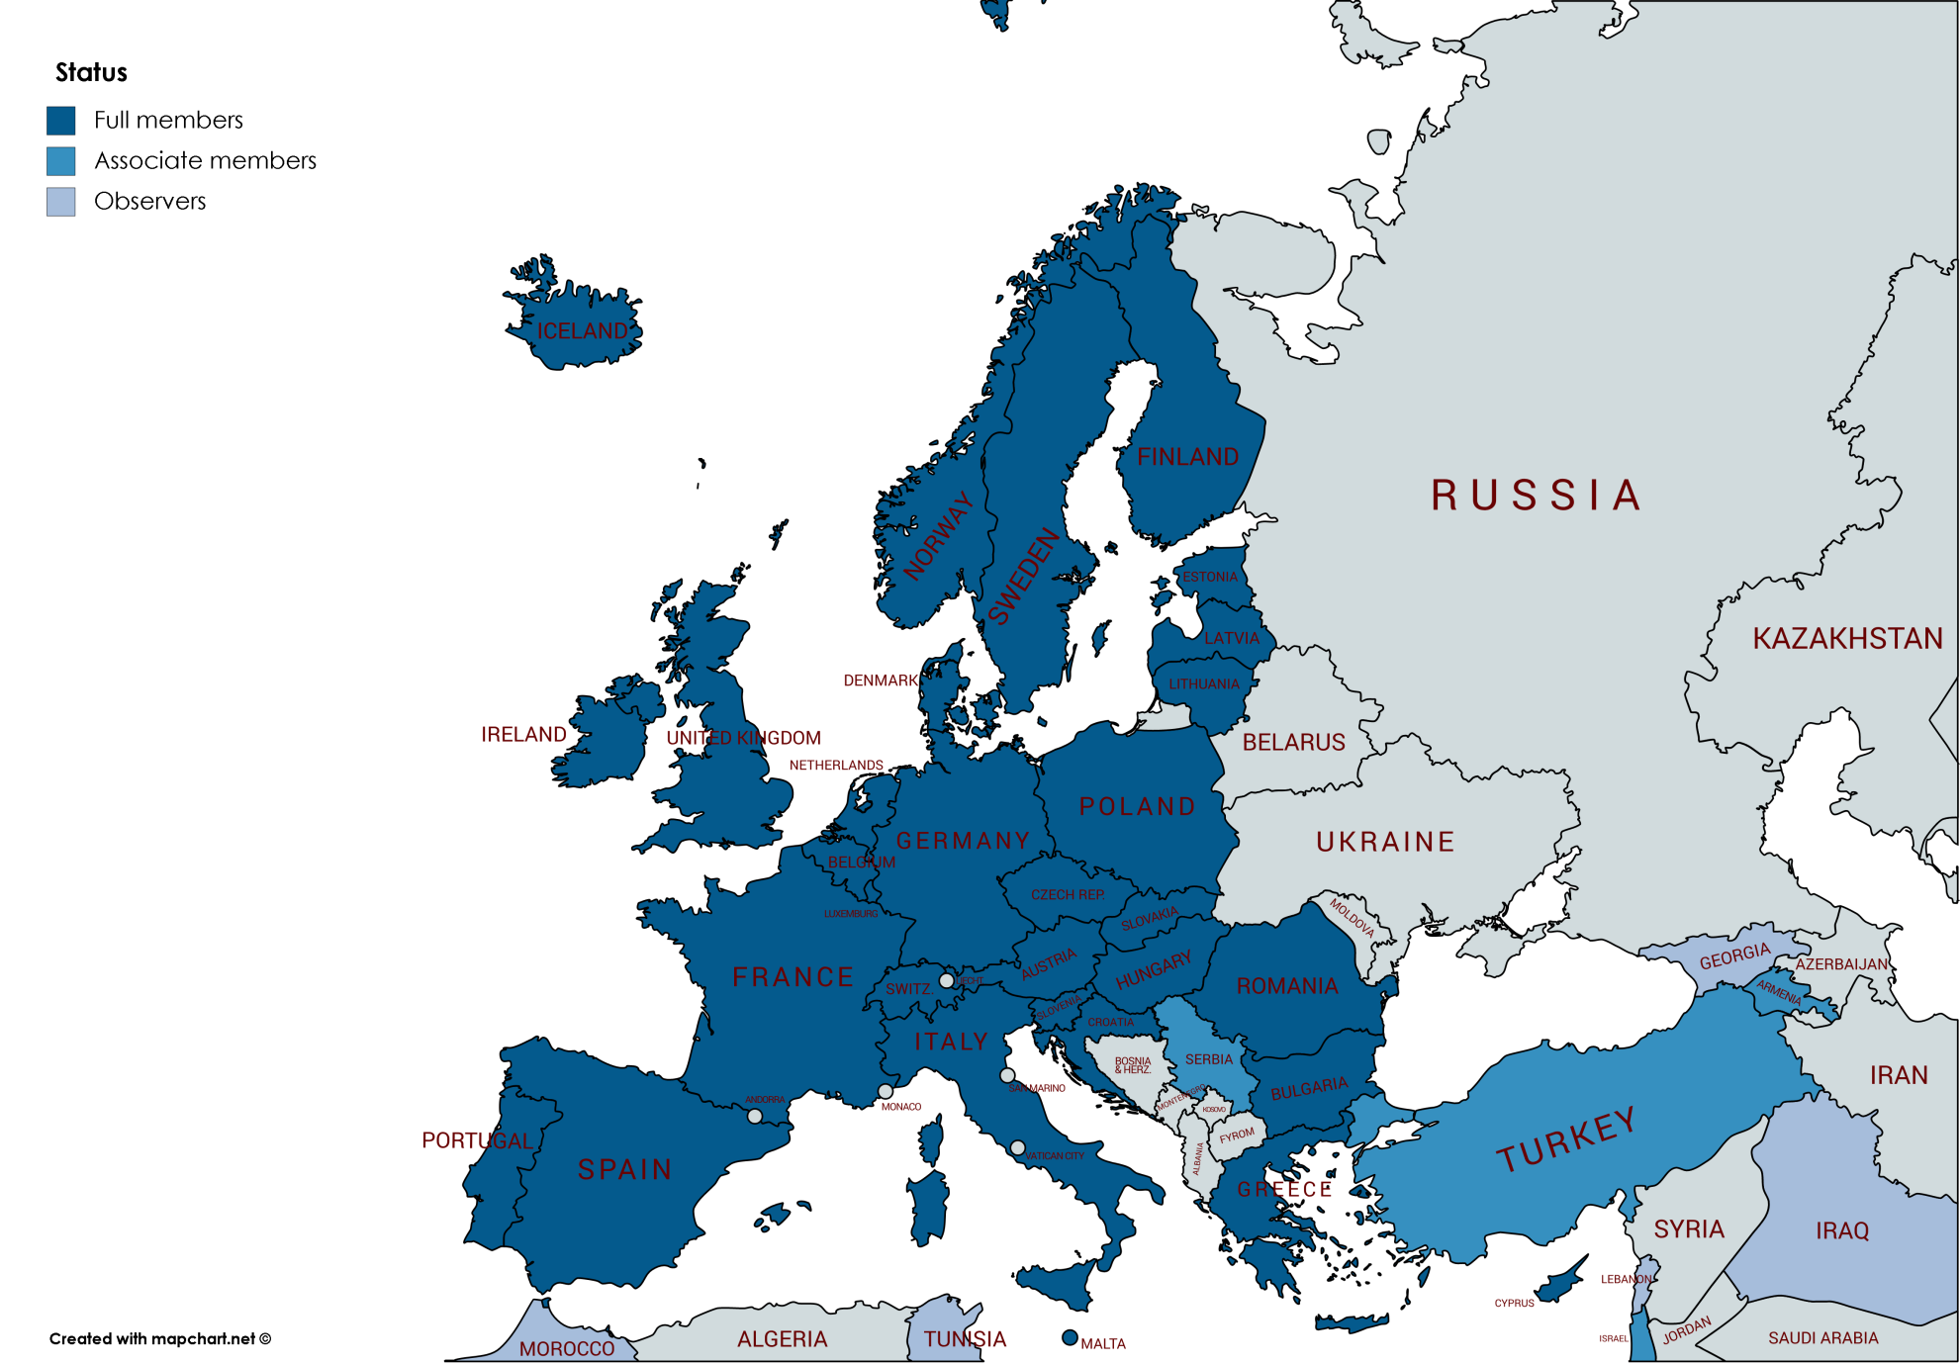

THANK YOU
FOR YOUR
ATTENTION
Bertrand DAVAL – ceo@uems.eu

