Slide 1

The European Examination in Medical Microbiology:
Blueprint
Albert J Mifsud
CESMA meeting
Brussels
5th & 6th December 2025

Slide 2

Background
Section of Medical Microbiology founded in 2008.
Now:
26 full members, 3 associate, 3 observers

Slide 3
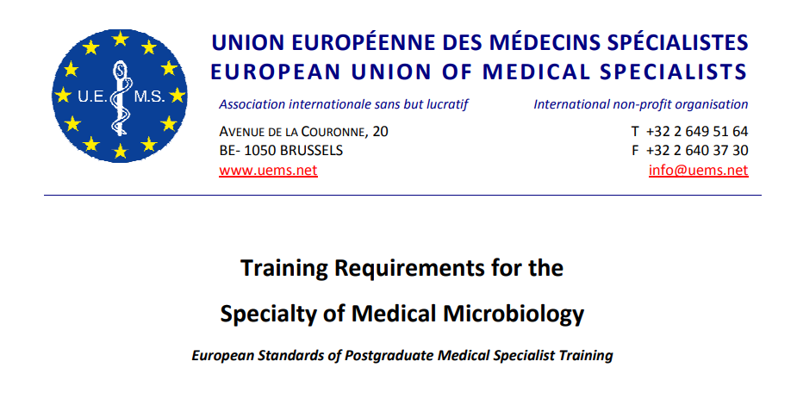
ETR
Approved 2013

Slide 4
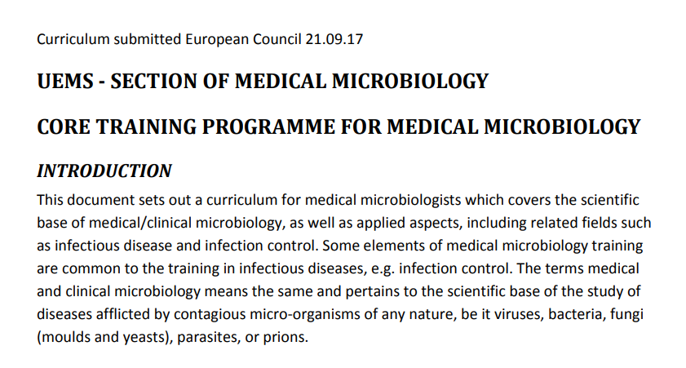
Curriculum
Approved 2017

Slide 5
Examination Committee
Section meeting, 2017:
  Resolved to develop European Examination in Medical Microbiology
July 2017:
  Examination Committee formed & work began
Working in collaboration with European Society for Clinical Microbiology and Infectious Diseases

Slide 6
Examination format & delivery
Single paper
100 SBA questions
Based on UEMS ETR and curriculum
Examinations held:
  Pilot (on-line) March 2021
  First Diploma exam (in person): May 2022
  Second Diploma exam (on-line): Dec 2024

Slide 7
Blueprint development
Based on curriculum
Contains 9 major sections
  General Microbiology
  Bacteriology
  Virology
  Mycology
  Parasitology
  Antimicrobials
  Infection Prevention and Control
  Clinical medicine
  Laboratory management

Slide 8
Blueprint development (2)
2019:
Questionnaire sent to representatives of all UEMS-SMM member countries enquiring about practice of medical microbiology
Questions asked relating to each curriculum section

Slide 9
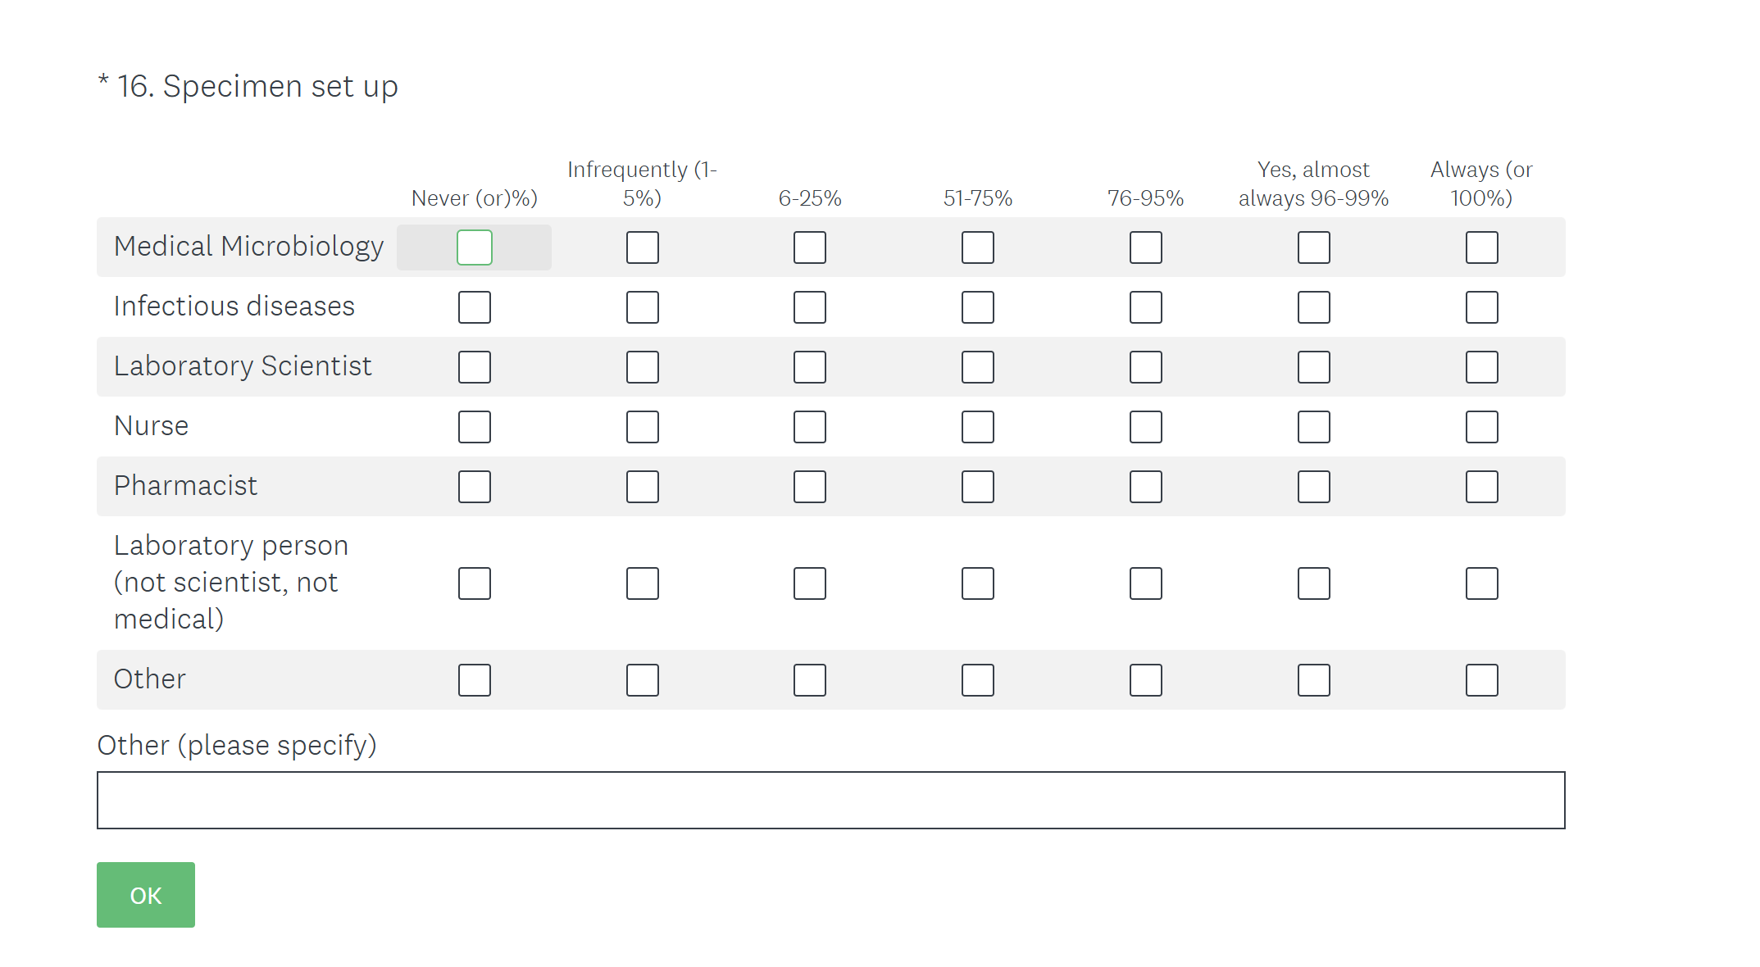
Example page from questionnaire

Slide 10
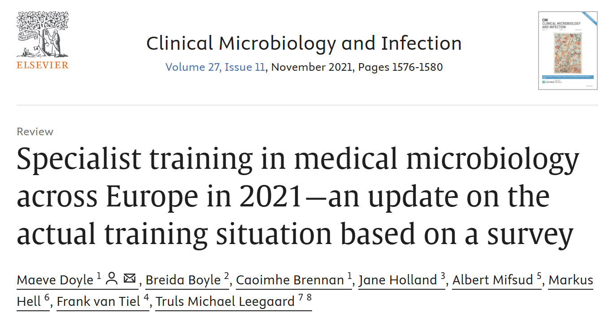
Questionnaire outcome

Slide 11
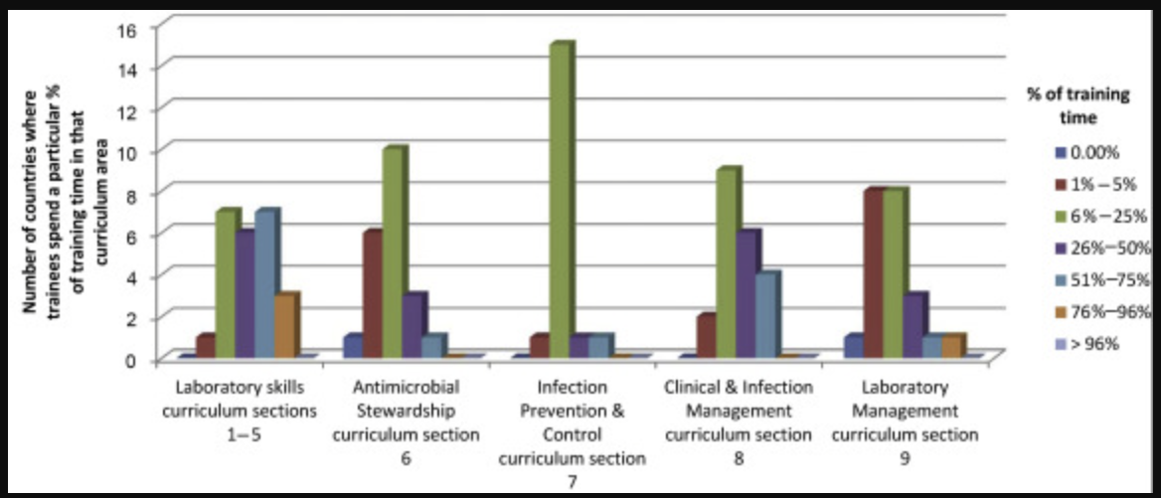
Training time spent in various activities

Slide 12
Illustration of outcome of blueprint development
Curriculum area | Nos. of Qs
General Microbiology | 33
Bacteriology | 11
Virology | 8
Mycology | 6
Parasitology | 5
Antimicrobials | 10
Infection Prevention and Control | 11
Clinical medicine | 13
Laboratory management | 3

