Slide 1
Spring Council Meeting 24th – 25th April 2026
Tunis – Carthage Thalasso Resort
Report of the Office for EU & International Affairs
Dr. Marc H.M. HERMANS
Officer EU & Int’l Affairs
Mrs. Isabelle DUMAINE
Policy & Public Affairs Manager

Slide 2
Activities of the Officer for EU & Int’l Affairs
Follow-up of the PANACEA project
  online meeting the Bureau of the MJC on Pain Medicine
Interview with Mrs. Salome Chkheidze (Georgia)
  Active dialogue on postgraduate medical education
  in search of action
  An extensive online interview allowing for more in depth exploring
  after the common GAMS-UEMS symposium in Tbilisi
…

Slide 3

Activities of the Officer for EU & Int’l Affairs
  FEMS event (27th January 2026)
  hosted by MEP Rafaele Topo
  in the EU parliament
  UEMS contributed
  The Risk of Being a Doctor

Slide 4
Activities of the Officer for EU & Int’l Affairs
Attending meetings of European Medical Organisations
  and meetings of the EMOs’ presidents in Brussels
An invitation to co-authoring a paper
  Working conditions and mental health among
  doctors and nurses in the EU, Iceland and Norway
  Leading author Dr. Roberto Mediavilla Torres (Madrid)
…

Slide 5
Activities of the Officer for EU & Int’l Affairs
Focus Group on the Study Supporting an
  Impact Assessment of Directive 2005/36/EC
online on the 23th February organised by Ernst & Young
initiative of the European Commission
part of the Study on the EU Portability Study
Mutual recognition of competencies => pragmatics ?

Slide 6
Activities of the Officer for EU & Int’l Affairs
The Multidisciplinary Joint Committee on Disaster Medicine
Online election of the Bureau chaired by Prof. Roberta Petrino
impressive numbers of attendants
elected president Prof. Michael MALLOY
secretary Prof. Georg-Teo VOICESCU
treasurer Prof. Aivars VETRA
UEMS EC delegate: Dr. Marc H.M. Hermans

Slide 7
Activities of the Officer for EU & Int’l Affairs
The Multidisciplinary Joint Committee on Disaster Medicine
The Resilience Academy – Lviv 17th – 18th February
European cities invited by the Town Council of Lviv
Mechelen, Frankfurt, Breda, Tallinn, Riga, Timisoara
my home town Mayor, Bart SOMERS, invited UEMS to take part
delegation: police comissar, fire brigade, emergency help coordinator

Slide 8
Activities of the Officer for EU & Int’l Affairs
The Multidisciplinary Joint Committee on Disaster Medicine
The Resilience Academy – Lviv 17th – 18th February
a review of measures undertaken to protect civil infrastructure
the solidarity shown by the Lvivian citizens
receiving more than 5.000.000 internally displaced persons
information shared with EU cities as a gesture of precaution

Slide 9
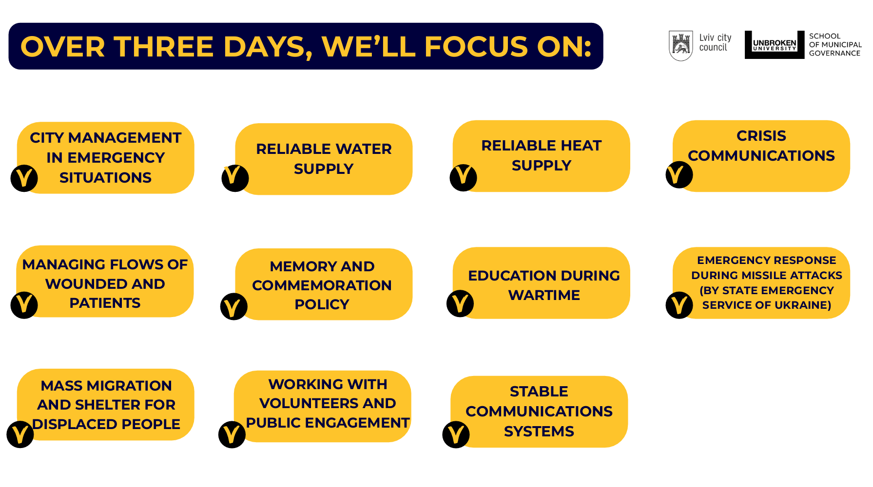
Activities of the Officer for EU & Int’l Affairs
The Multidisciplinary Joint Committee on Disaster Medicine
measures
undertaken
to protect
civil infrastructure

Slide 10
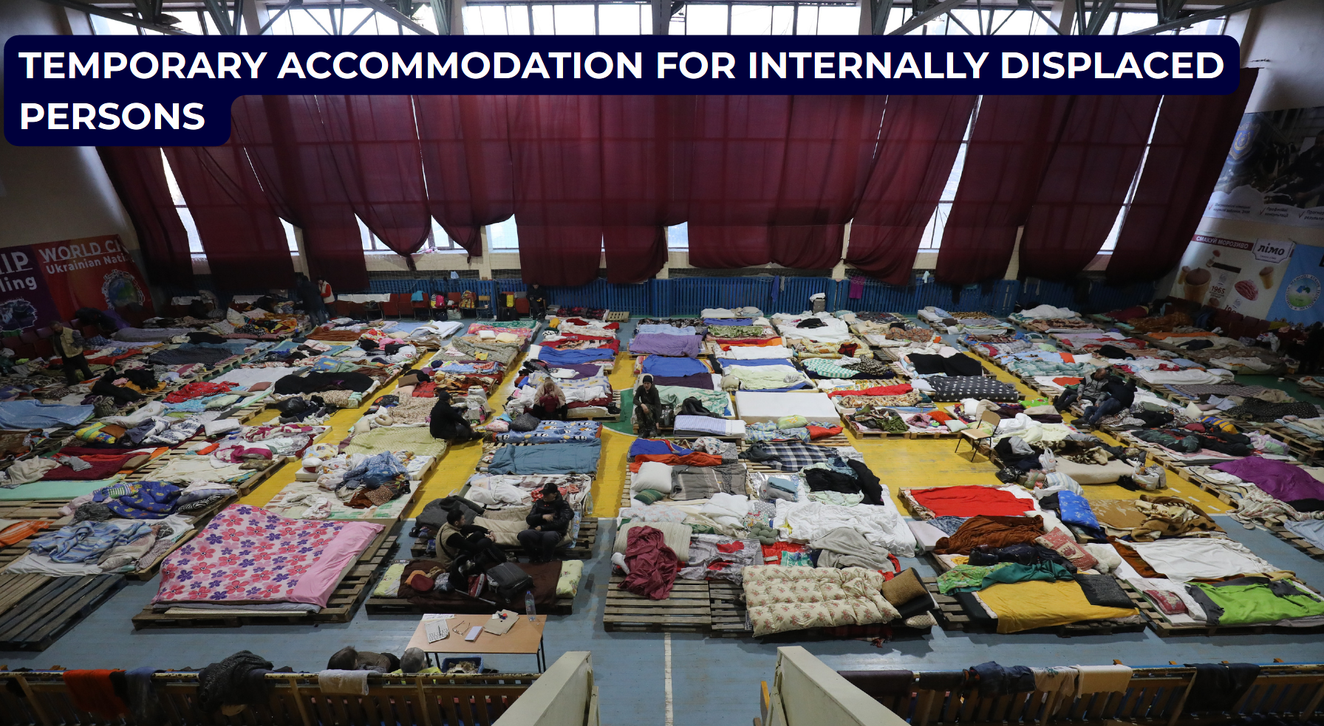
Activities of the Officer for EU & Int’l Affairs
The Multidisciplinary Joint Committee on Disaster Medicine
The Resilience Academy
providing shelter
for
Internally Displaced Persons

Slide 11
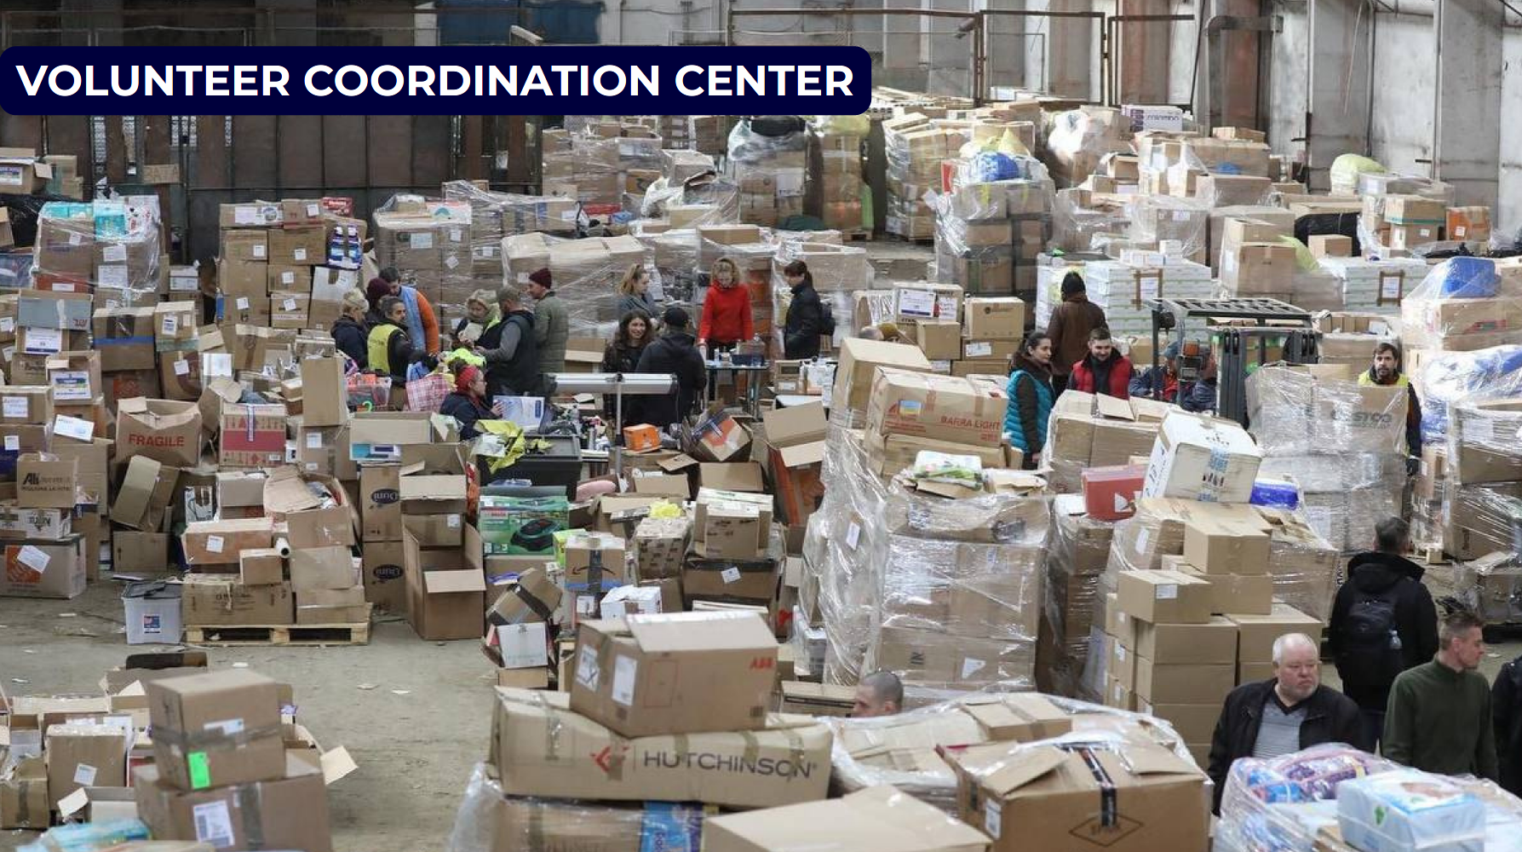
Activities of the Officer for EU & Int’l Affairs
The Multidisciplinary Joint Committee on Disaster Medicine
the solidarity
shown by the
Lvivian citizens

Slide 12
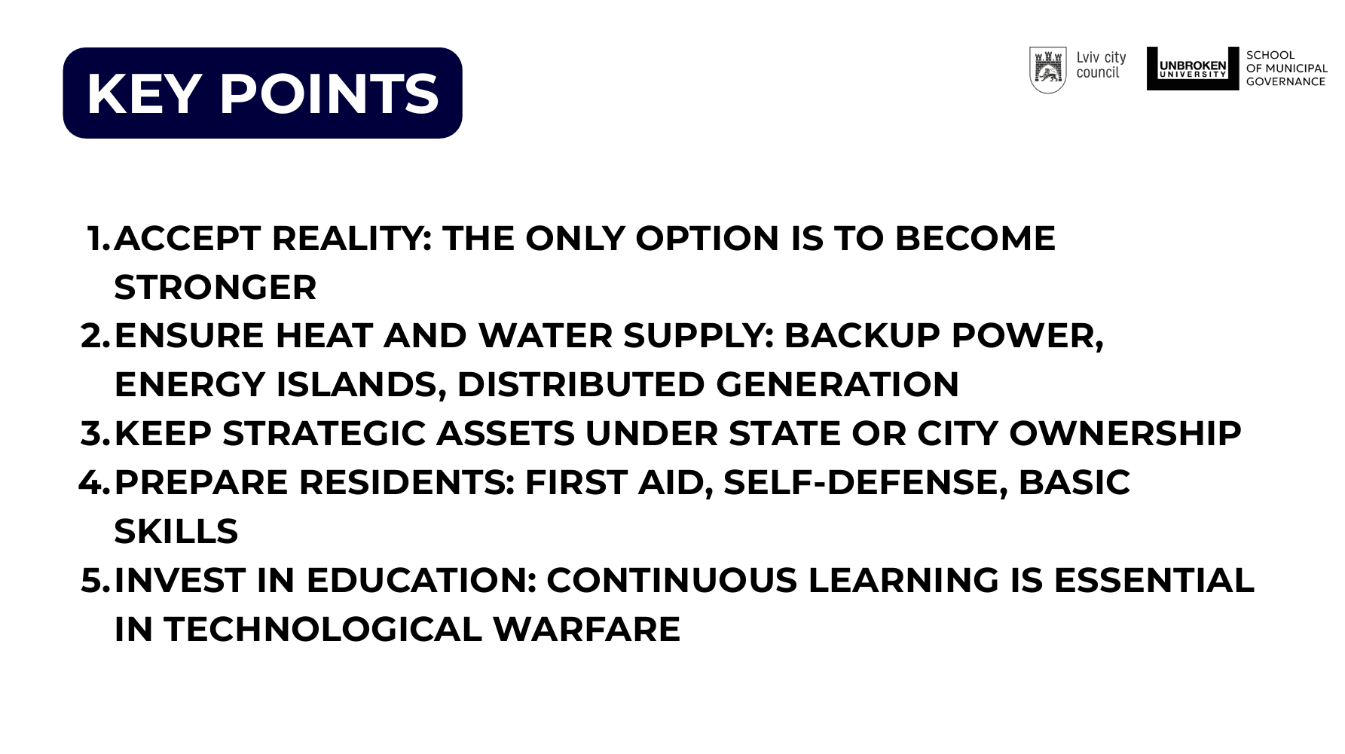
Activities of the Officer for EU & Int’l Affairs
The Multidisciplinary Joint Committee on Disaster Medicine

Slide 13
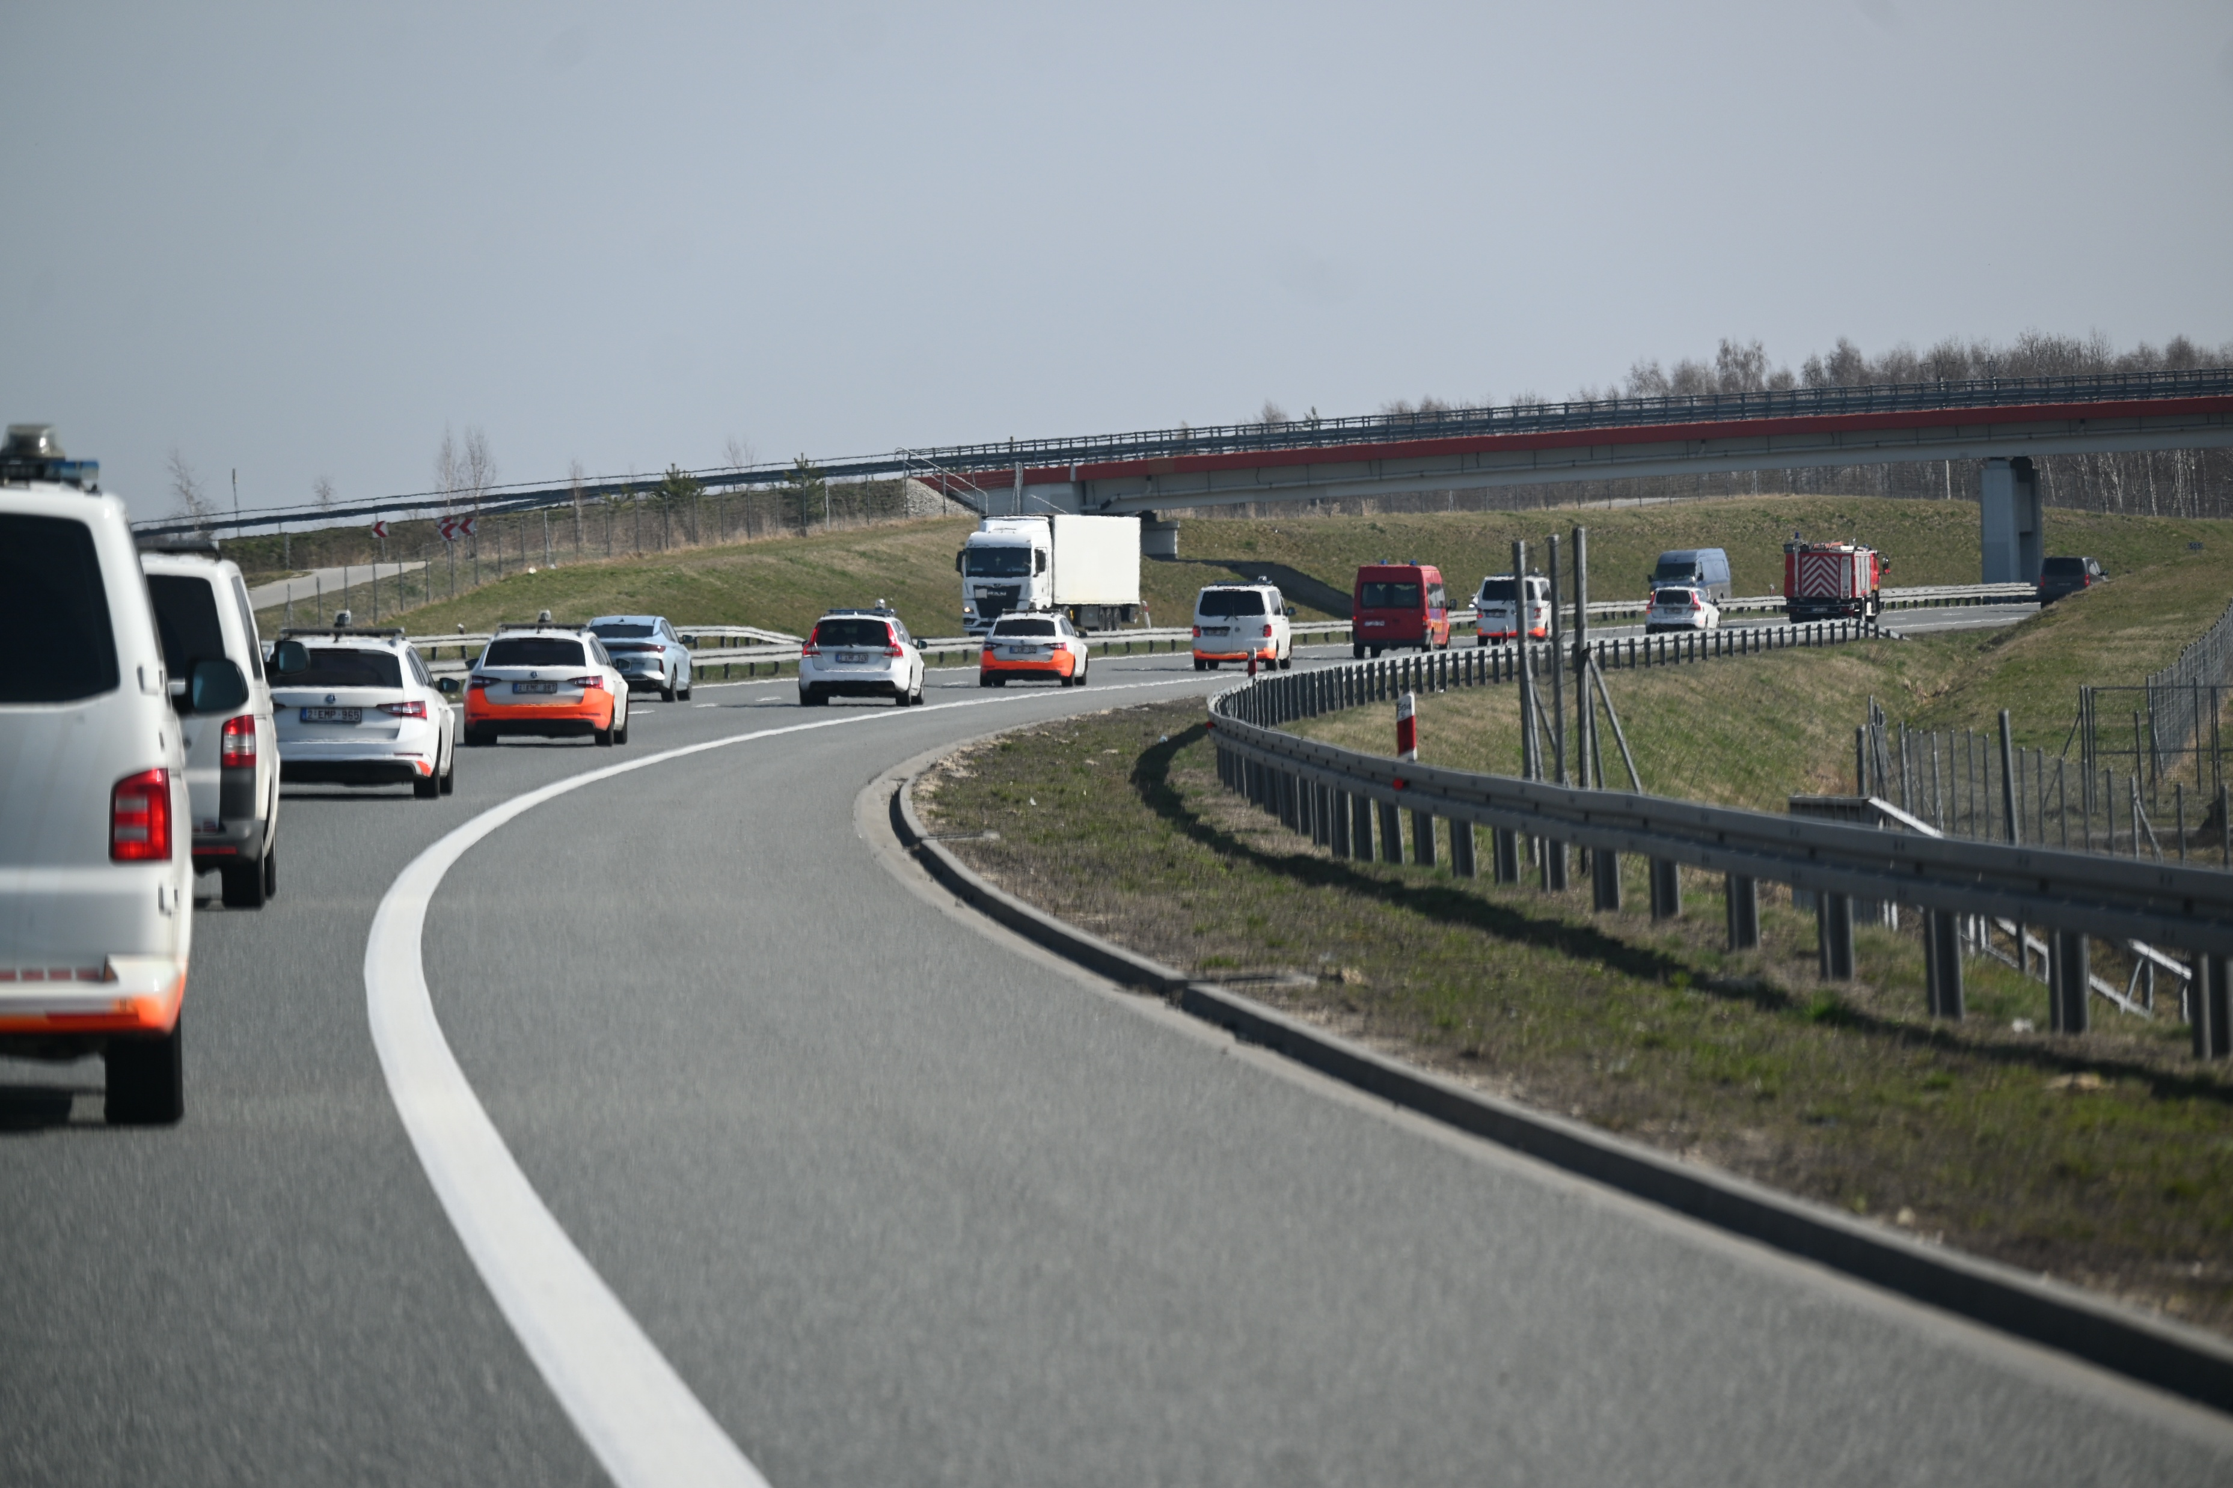
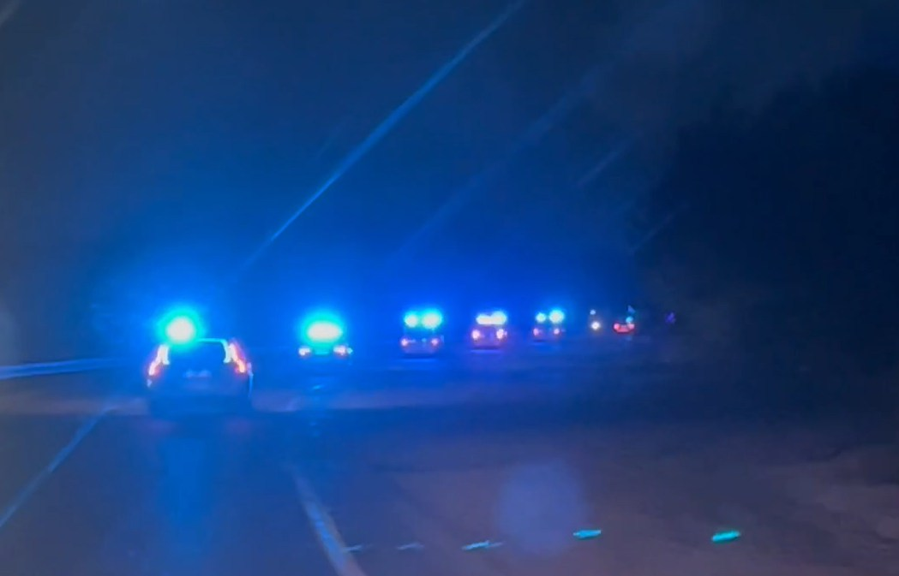
Activities of the Officer for EU & Int’l Affairs
The Multidisciplinary Joint Committee on Disaster Medicine
The Second Mission – Lviv 22nd – 25th March

Slide 14
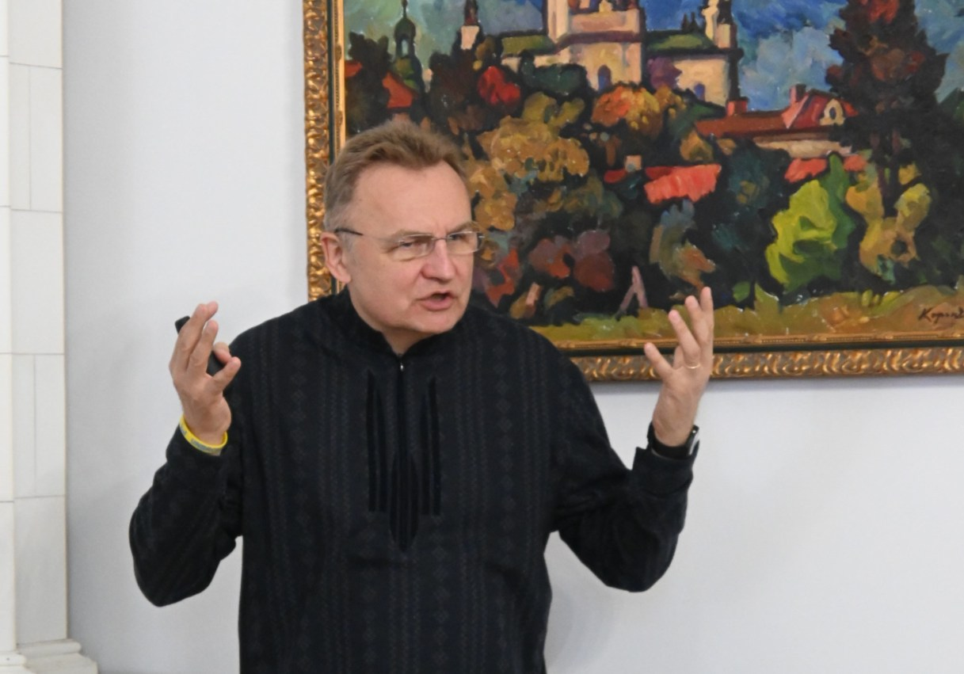
Activities of the Officer for EU & Int’l Affairs
The Multidisciplinary Joint Committee on Disaster Medicine
The Second Mission – Lviv 22nd – 25th March
informing
Mayor Andriy Sadovyy
about the UEMS

Slide 15
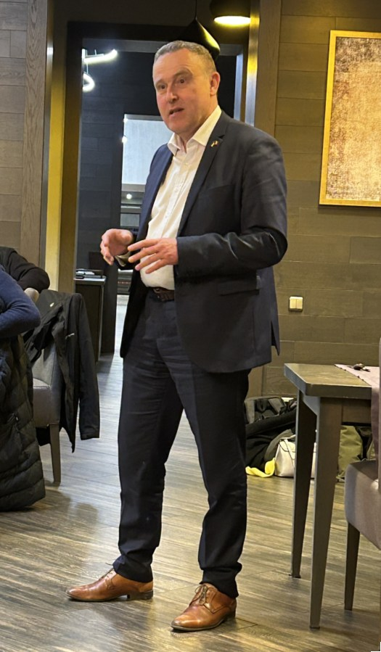
Activities of the Officer for EU & Int’l Affairs
The Multidisciplinary Joint Committee on Disaster Medicine
The Second Mission – Lviv 22nd – 25th March
informing Mr. Luc Jacobs
Belgian Ambassador for Ukraine

Slide 16
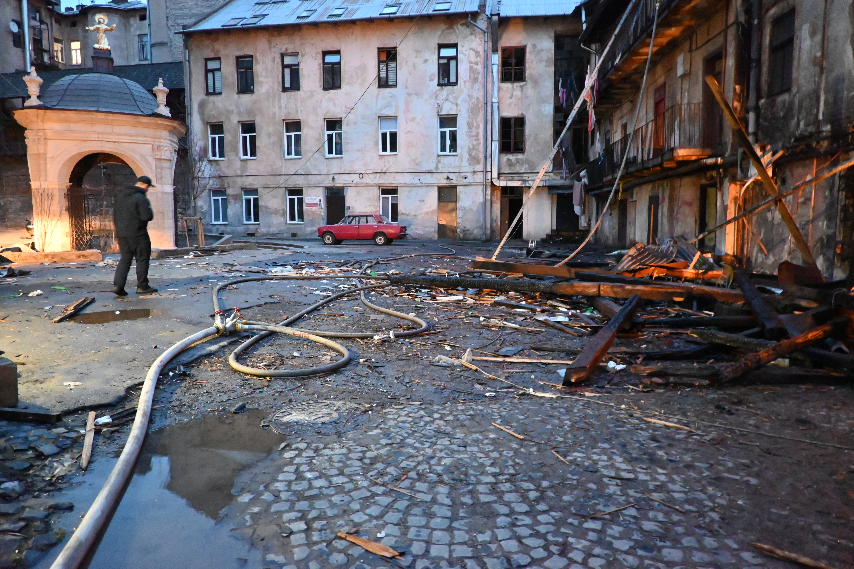
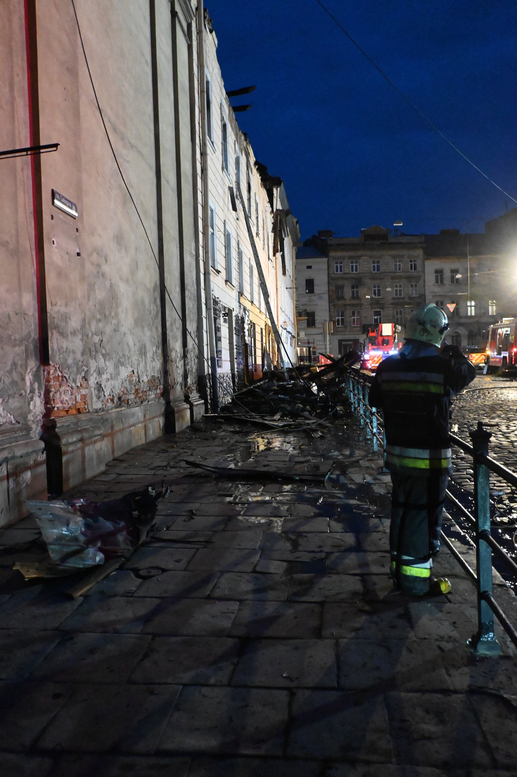
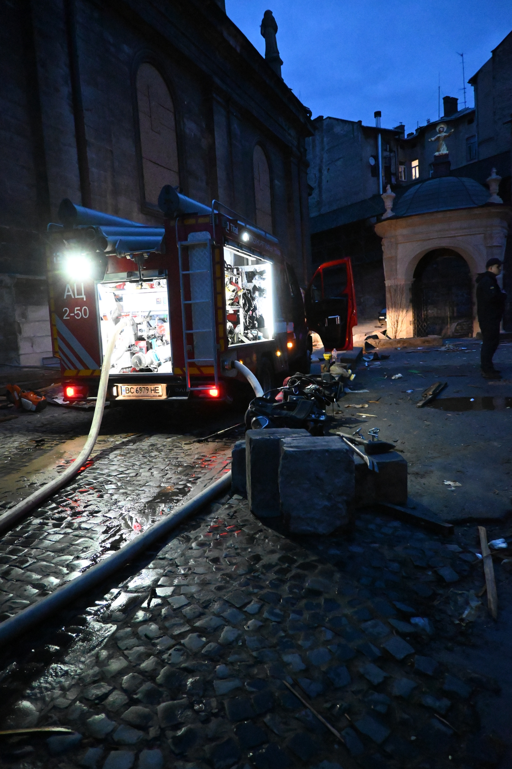
Activities of the Officer for EU & Int’l Affairs
The Multidisciplinary Joint Committee on Disaster Medicine
the shelling of a UNESCO protected building

Slide 17
Activities of the Officer for EU & Int’l Affairs
The Multidisciplinary Joint Committee on Disaster Medicine
The broader impact of UEMS – request to the Officer 4 EU & IA
Federation of Medical Specialists asked for training program
on Military and Disaster Medicine
contacts with Brig. General Medical branch Belgian Army, the
Royal Flemish Academy of Medicine and Antwerp University

Slide 18
Activities of the EU Policy
& Public Affairs Manager
KEEPCARING • HORIZON EUROPE
The KEEPCARING project is funded by the European Union’s Horizon Europe research and innovation programme under grant agreement No. 101137244.
Funded by the European Union. Views and opinions expressed are however those of the author(s) only and do not necessarily reflect those of the European Union or the European Health and Digital Executive Agency (HADEA). Neither the European Union nor the granting authority can be held responsible for them.

Slide 19



















Project overview
PROJECT GOAL
Reducing stress and preventing burnout among healthcare workers
by developing innovative, co-created solutions combining non-digital, digital, and AI-driven approaches
19 PARTNERS
TIMELINE
Ends on 31st July 2028

Slide 20
Where we stand as of now
Change Management Platform (WP5)
Clinical studies
Study on biomarkers of stress using hexoskin has started (WP2)
Development of the online portal which will aim to provide support to individuals, teams and organisations using profiling approach
Study on effects of VR on mental wellbeing at the wards: preliminary observations from Amsterdam (18 participants) shows reduction in stress levels (WP3)
UEMS Congress - Saturday
Session dedicated to the project preliminary results on stress & mental wellbeing & more
Study using daily diary to evaluate stress level for nurses has started in Copenhagen, and in Germany (WP4)

Slide 21
Activities of the EU Policy
& Public Affairs Manager
DISCERN DSS • ERASMUS +
DISCERN-DSS: DIgitally enhanced SCenario basEd leaRNing for Digital Soft Skills, Project number: 101179391, is a project co-funded by the Erasmus+ programme of the European Union, Key Action 2 – Cooperation for innovation and the exchange of good practices – Capacity-Building projects in the field of Higher Education,
Funded by the European Union. Views and opinions expressed are however those of the author(s) only and do not necessarily reflect those of the European Union or European Education and Culture Executive Agency (EACEA). Neither the European Union nor the granting authority can be held responsible for them.

Slide 22







Project overview
PROJECT GOAL
6 PARTNERS
Developing modules of training
on telemedicine, & digital soft skills
using digital tools of teaching,
i.e. scenario-based learning
TIMELINE
Ends on 31st December 2027

Slide 23
Where we stand as of now
WP3 Train the trainers
2nd international workshop
26th to 30th January 2026, in Thessaloniki
Local workshops, organised subsequently within each Indonesian partner
WP4 Co-design of D-SBL content
15 scenario being developed for training on digital soft skills

Slide 24
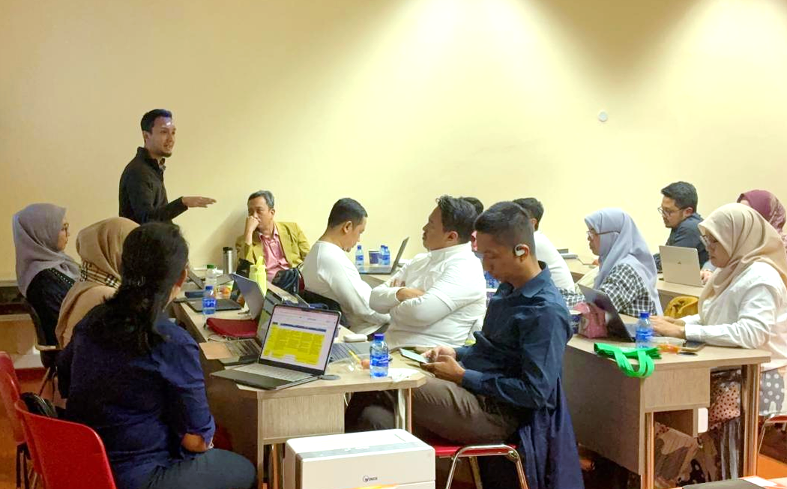
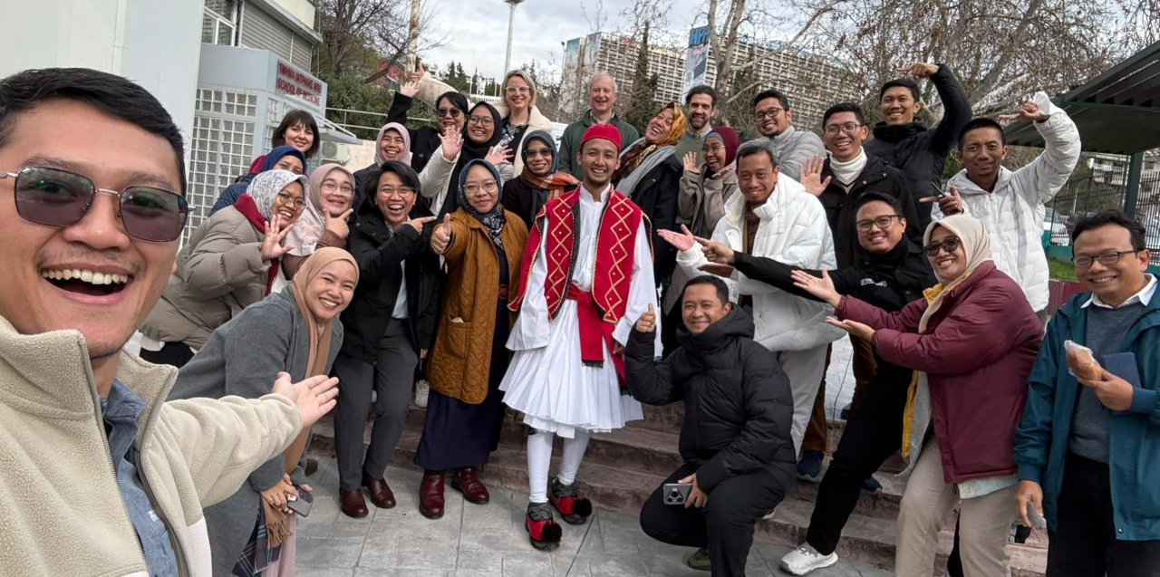
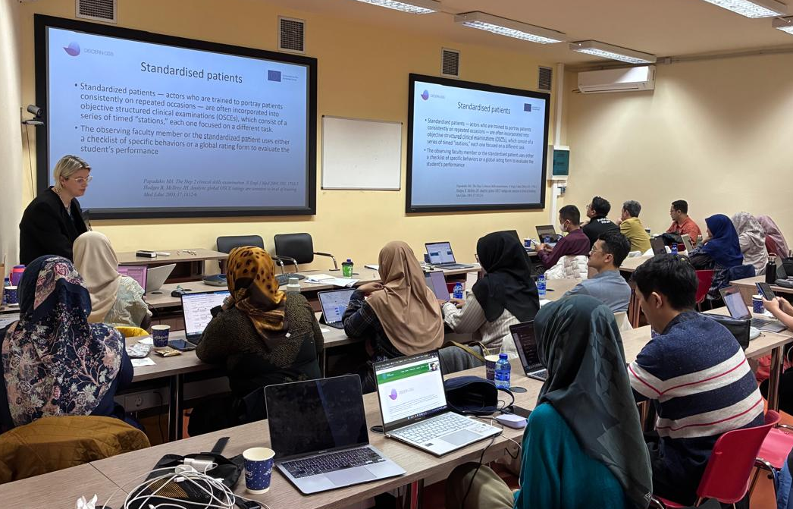
26th to 30th January 2026
Train the trainer workshop II
4 days of training, hosted by University Aristotle of Thessaloniki
UEMS represented by Ms I. Dumaine and
Dr A. Brittlebank

Slide 25
Activities of the EU Policy
& Public Affairs Manager
UM-HEART-VR • ERASMUS +
Upskilling Malaysian Healthcare for empathy and communication through Virtual Reality, Project number: 101237216, is a Project co-funded by the Erasmus+ programme of the European Union, Key Action 2 – Cooperation for innovation and the exchange of good practices – Capacity-Building in the field of Higher Education.
Funded by the European Union. Views and opinions expressed are however those of the author(s) only and do not necessarily reflect those of the European Union or European Education and Culture Executive Agency (EACEA). Neither the European Union nor the granting authority can be held responsible for them.

Slide 26





Project overview
PROJECT GOAL
6 PARTNERS
Developing training on communication & empathy
using VR-based problem-based learning educational activities
TIMELINE
Ends on 31st December 2028

Slide 27
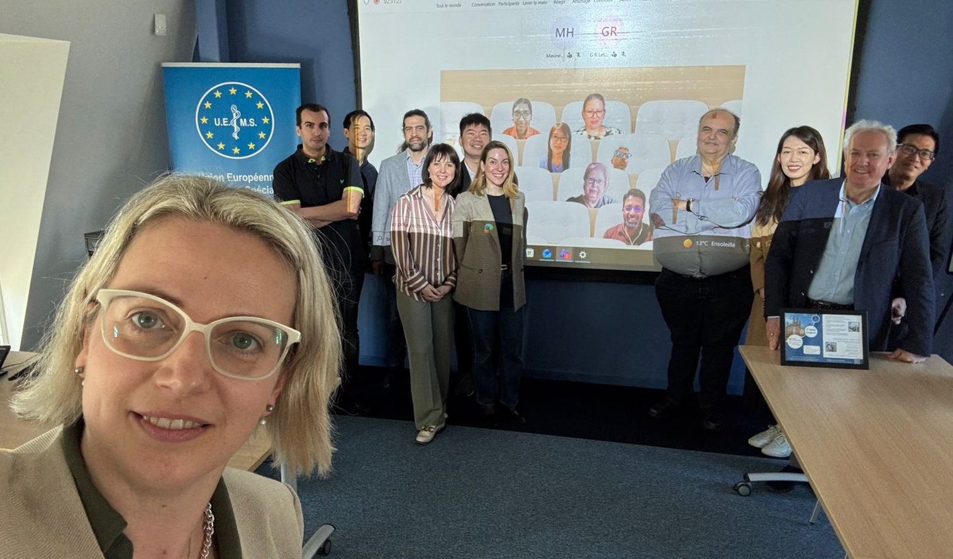
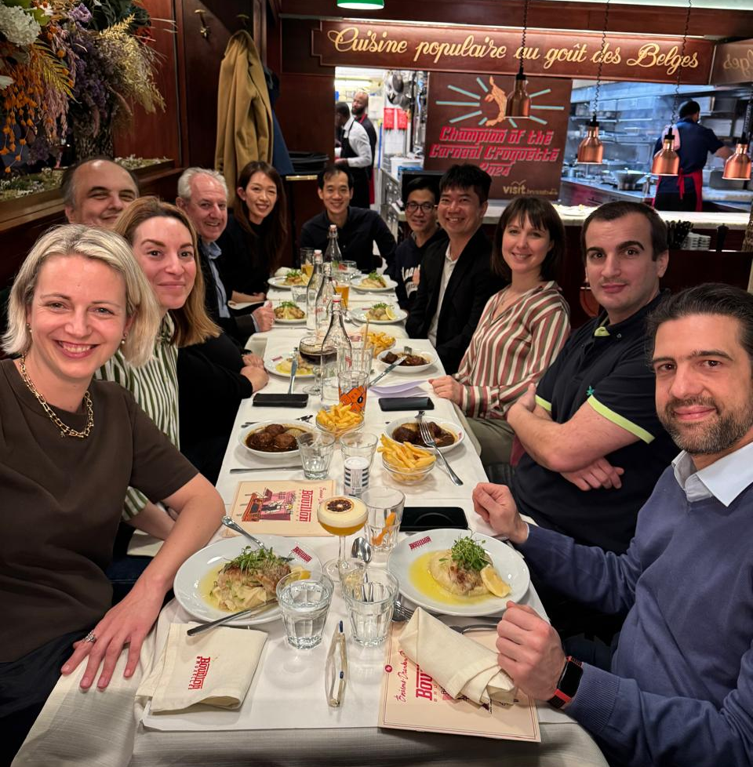
17th to 19th March 2026
Hybrid kick-off meeting
3 days of coordination Hosted by UEMS
UEMS represented by Ms I. Dumaine and Mr M. Sartori

Slide 28
Where we stand as of now
WP2 Specification, design & implementation of VR-based training resources
Malaysian partners are performing curriculum analyses to identify the training curricular content to be developed (learning objectives, etc) under the project
WP3 Train the trainers
UEMS coordinates the preparation of training materials
International workshop planned on 11th, 13th and 14th July 2026 in Thessaloniki, and then followed by local workshops

Slide 29
Activities of the Officer for EU & Int’l Affairs
Conclusion
no seperate meeting for Task Force members
increased workload of the Office
    increased diversity of tasks
=> adjusting the initial concepts ?

