Slide 1

FINANCIAL REPORT
UEMS Council Meeting – 25.04.2026 – Gammarth, Tunisia

Slide 2

Profit and loss account
2025 VS 2024

Slide 3

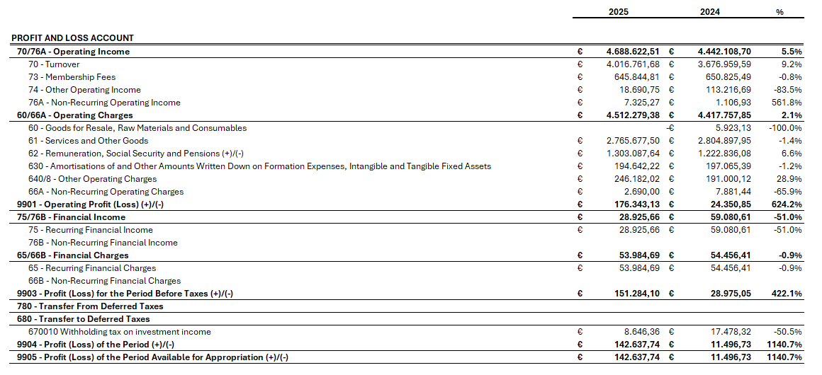
Consolidated Profit and Loss account

Slide 4
Balance Sheet
2025 VS 2024

Slide 5
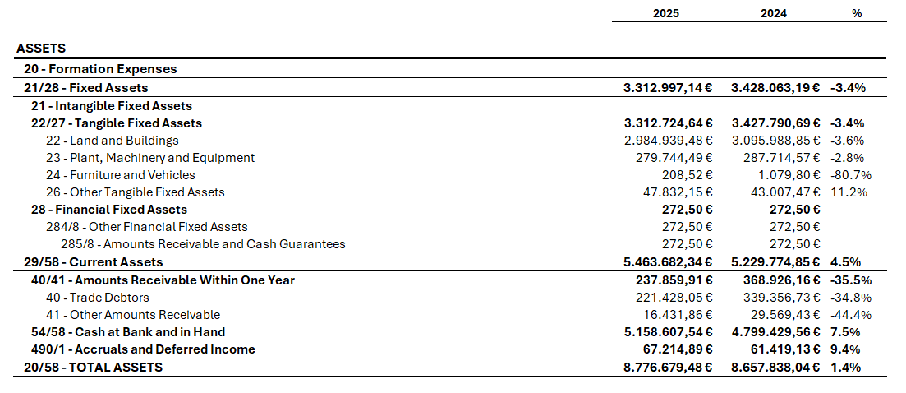
Balance Sheet - Assets

Slide 6
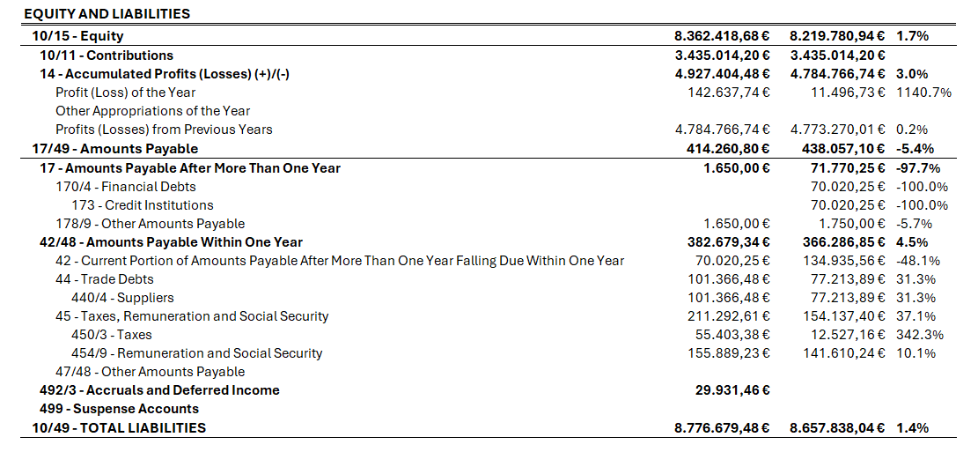
Balance Sheet - Liabilities

Slide 7
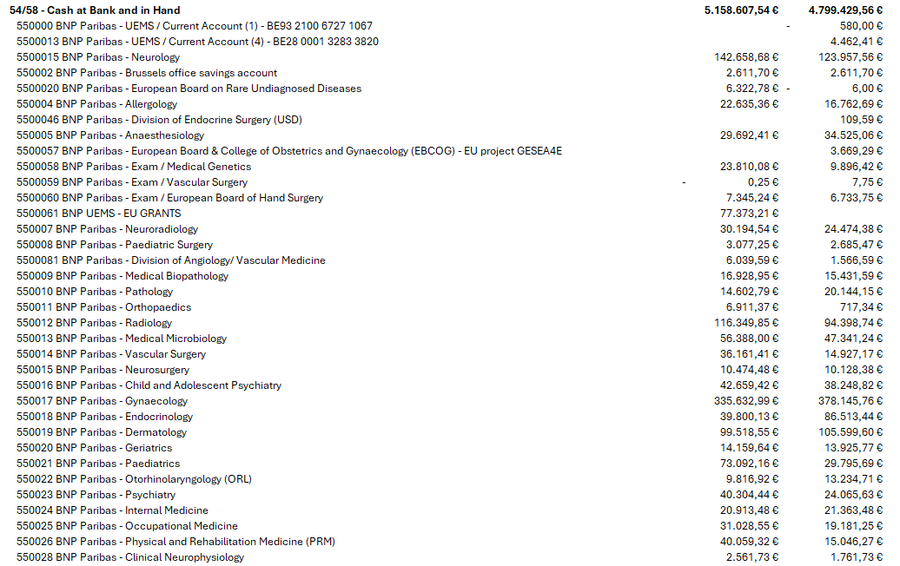
Balance Sheet – Current Cash

Slide 8
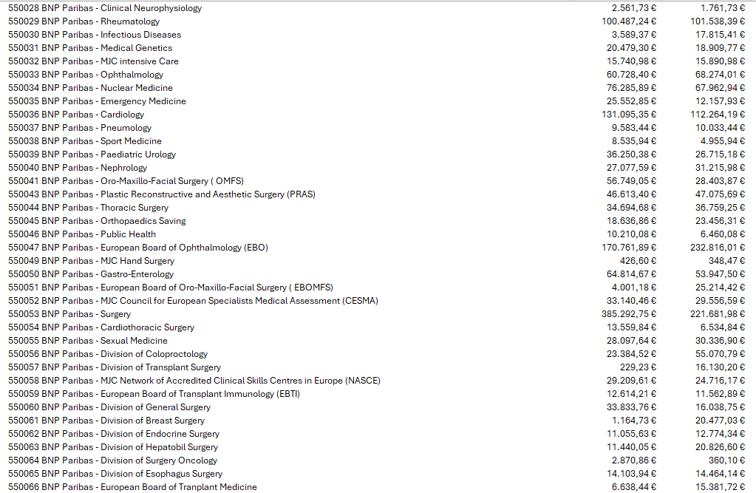
Balance Sheet – Current Cash

Slide 9
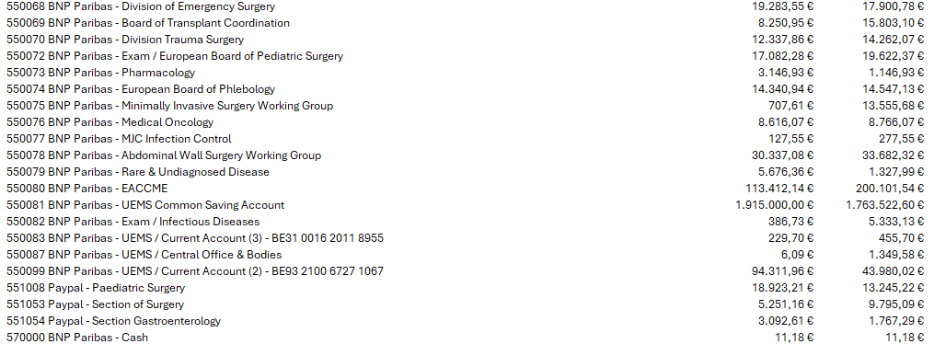
Balance Sheet – Current Cash

Slide 10
Profit and loss account
January – April 2026

Slide 11
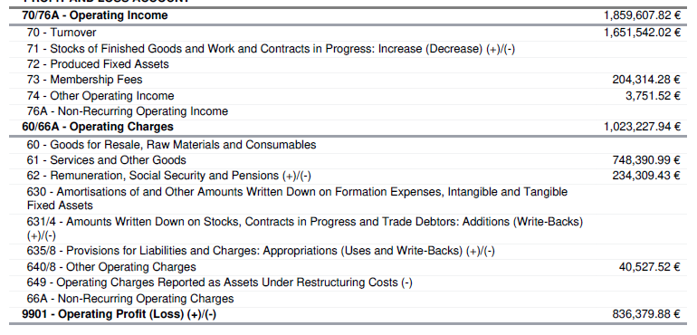
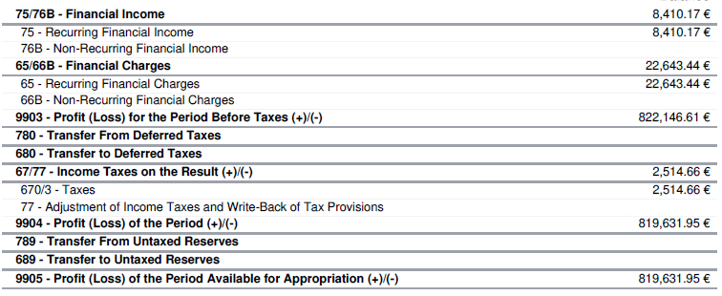
Profit and Loss account

Slide 12
Profit and Loss account – Key Data’s
705000: Income EACCME: € 744.636,78
705400: Income European Examination: € 547,607.50
705500: Income Certification Fee: € 17,400.00
703002: Membership Fee: € 204,314.28
613251: EACCME fees Retrocession: € 129.285,00
613301: Administrative expenses: € 315.733,06
615100: Travel & Transport expenses (airplane): € 45.529,43
640700: Non-deductible VAT: € 37.297,79

Slide 13
UEMS COMMON INVESTMENT

Slide 14
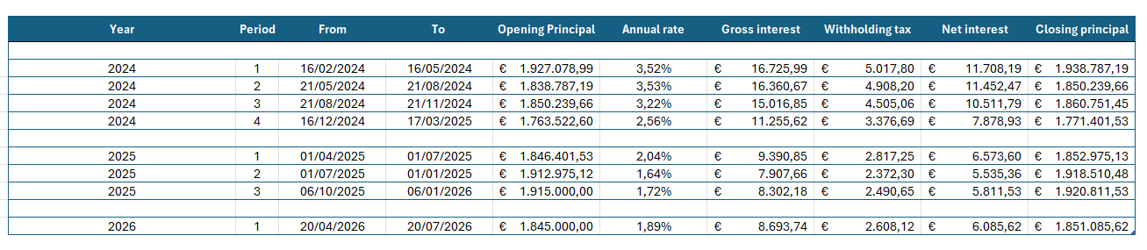
3-Month Fixed-Term Deposit
The Brussels office: € 460.126,38
UEMS Bodies: € 1.390.959,24

Slide 15
UEMS LOAN

Slide 16
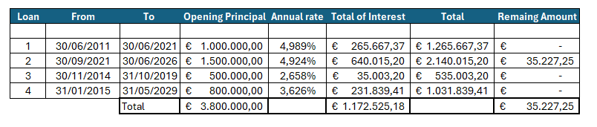
Loan – UEMS is almost Debt Free!
As of 30 June 2026, UEMS will be free of external debt, having reimbursed a total of € 4.972.525,18 across all loans

Slide 17
UEMS – EACCME Reviews

Slide 18
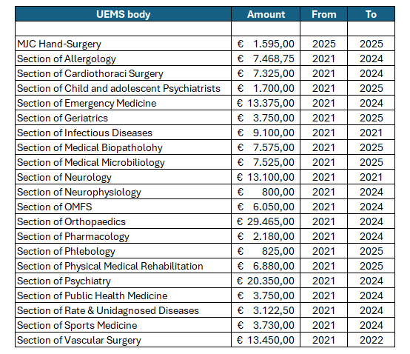
Reimbursements made in 2025 and 2026!

Slide 19
Key points to note
All National Medical Societies for which invoices have been received have now been fully reimbursed by the Brussels Office
The internal EACCME fee redistribution will continue throughout 2026 but was temporarily suspended from February due to high operating costs at the Brussels Office. The reimbursement process is expected to resume in mid-July 2026 and remains a priority for the EEC.

Slide 20
Financial targets 2026

Slide 21
Key Financial Considerations
PEPPOL Platform
As of 1 January 2026, it is mandatory to send invoices through the PEPPOL platform.
Accordingly, UEMS bodies are no longer permitted to issue invoices independently.
All invoicing activities must be centralised through the Brussels Office in order to ensure compliance and to mitigate the risk of financial penalties and tax-related issues.
Examination Activity
The process has been formally approved.
All UEMS bodies engaged in examination activities will be provided with a dedicated secondary account to ensure proper financial tracking and clear separation of activities.
Common Investment
The common investment will continue on a tacit quarterly renewal basis, as this remains the most efficient approach to optimise returns while minimising associated fees
Each UEMS body retains the right to withdraw from it , provided that a minimum notice period of 20 days prior to the end of the investment period is given, along with a duly justified explanation.
Annual Budget Submission
Each UEMS body is required to submit its annual budget to the Brussels Office in a timely manner. (mid-June 2026)

