Slide 1

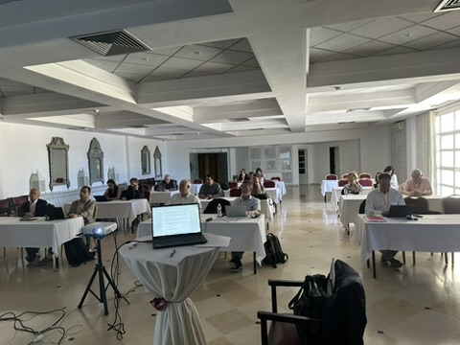
UEMS
Working Group of
CME/CPD
April 24, 2026, Tunisia
Dr. Hannu Halila
Chair of the WG
UEMS Past President, UEMS Honorary Member
Gynecology, Finland

Slide 2
CME / CPD Working Group meeting
Meeting well attended by 20 colleagues representing widely the UEMS countries and various specialities, lively and constructive discussion
Main items on the agenda were the discussion about the utilization of UEMS CPD Charter and Questionnaire about the CME/CPD situation in the UEMS member countries

Slide 3
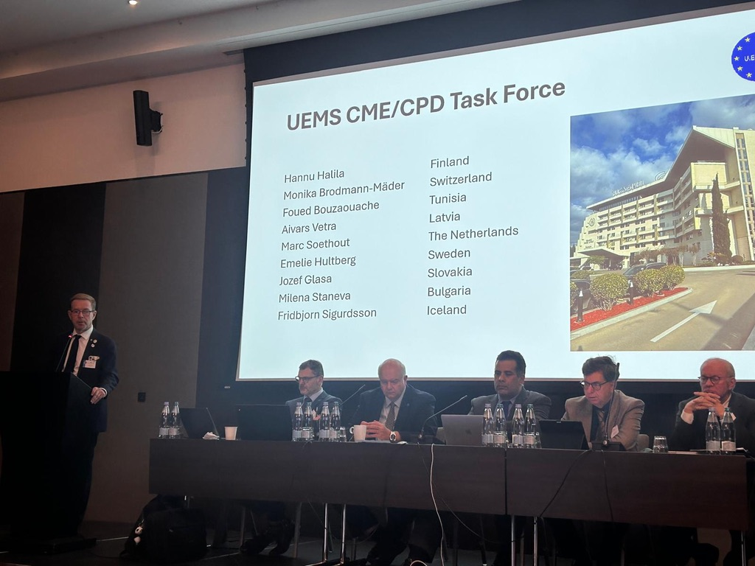
https://www.uems.eu/documents

Slide 4
UEMS CPD Charter , UEMS 2025/28
CPD Charter was accepted in October 2025 Council in Georgia. After that it has been distributed widely within the UEMS bodies, NMAs as well as outside partners and stakeholders
A short Executive summary of key points has been provided
NMAs are asked to distribute it in their countries, at the same time make publicity of UEMS in their national medical journals
It was also suggested to make translations to other languages
Social media important in the publicity of the Charter

Slide 5
Questionnaire about the current situation about
CME/CPD situation in the UEMS Member Countries
There is no current comprehensive information about this topic
Will be sent to UEMS Member Countries/NMAs
Draft questionnaire has 19 short questions
The WG had a fruitful conversation about the content and made proposals for some changes
Important to understand what is meant by about the different terms (voluntary, compulsory, mandatory, recertification/revalidation, potential sanctions …)

Slide 6
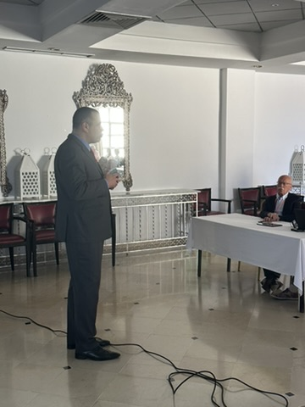
New developments withing EACCME
Presentation by Secretary General Joao Grenho
EACCME 3.0 : Accredited provider status etc.
Collaboration with UEMO, CME events for General Practitioners
Use of Artificial Intelligence in CME
  ELMs created by AI ?
  The role of AI in medical education and learming in general

Slide 7
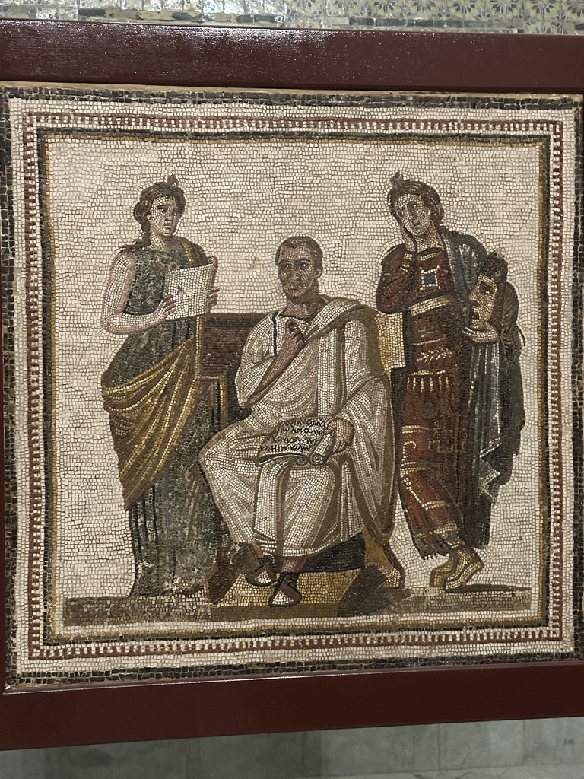
Discussion about the future of UEMS WGs in general
Two types of Working Groups ?
  Permanent
  Temporary
Clearer definition and assignment for the WGs
Lengt of term of the chairperson (and rapporteur)
Procedure to choose chairpersons
(and rapporteurs)

Slide 8

Next meeting of the WG
October 16, 2026 in Brussels.
Thank you ! Kiitos !

