Slide 1

European Professional Development Module PDM in Disaster Medicine for ANAESTHESIOLOGISTS
Prof. Oleg Sabelnikovs
President of EBA
UEMS SPRING COUNCIL MEETING
2026

Slide 2
The concept of a professional development module in anaesthesiology

Slide 3

Training and CPD in Anaesthesiology
ETR
Continuing professional development (CPD)
Undergraduate training
Residency training (PGT)
The European Professional Development Modules (PDMs) for anaesthesiologists summarize learning objectives to enrich and increase competencies raising clinical experts and professional leaders to a higher level of qualification.

Slide 4
Training and CPD in Anaesthesiology
PDM in Pain medicine
PDM Geriatric Anesthesiology
Undergraduate training
ETR Anaethesiology
PDM Obstetric Anesthesiology
PDM in Disaster medicine
ETR is for Trainees and PDM is for Specialists

Slide 5

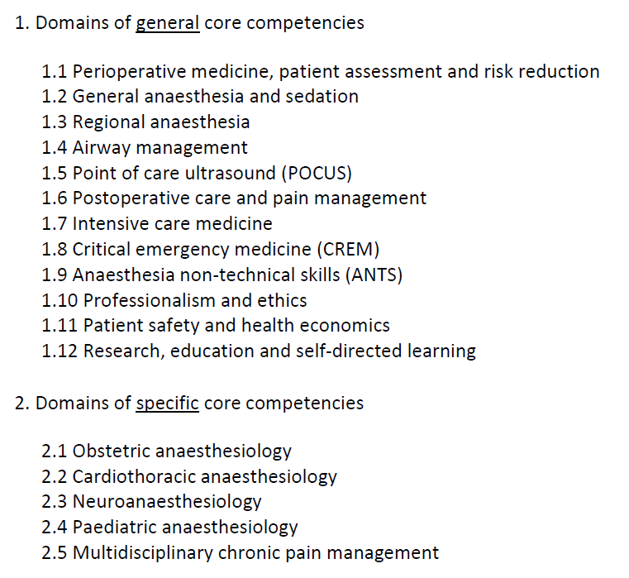
European Training Requirements
for the Specialty of Anaesthesiology
A candidate for the PDM in Disaster Medicine needs as a prerequisite to have acquired the knowledge, skills, attitudes and behaviours required of a specialist anaesthesiologist.
Levels of competencies
A: observer level (has knowledge of, describes)
B: performs, manages, demonstrates under direct supervision
C: performs, manages, demonstrates under distant supervision
D: performs, manages, demonstrates independently

Slide 6
European Training Requirements
for the Specialty of Anaesthesiology
General core competencies should be achievable by most national training programmes
Specific core competencies - basic competence levels proposed
Not all learning objectives listed in the ETR reach level D and E
(D: perform and manage independently)
Levels of competencies
A: observer level (has knowledge of, describes)
B: performs, manages, demonstrates under direct supervision
C: performs, manages, demonstrates under distant supervision
D: performs, manages, demonstrates independently

Slide 7
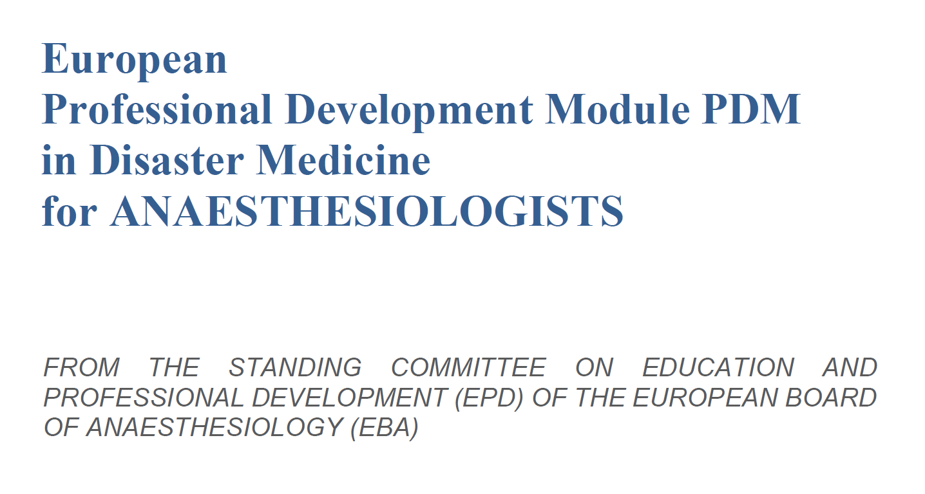
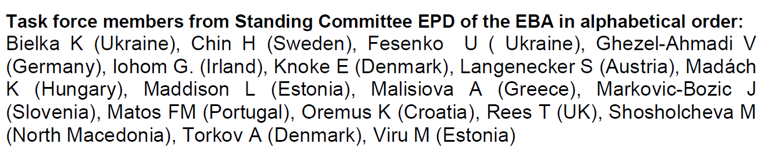
European Professional Development Module PDM in Disaster Medicine for ANAESTHESIOLOGISTS
Section 1
Section 2
Section 3

Slide 8
Section 1: General Information about the European PDM in Disaster Medicine for anaesthesiologists
The path to excellence: From ETR for Trainees to the PDM for Specialists
Scope of the PDM
Development of the PDM
Alignment of the PDM in Disaster Medicine with ETR and EBA policies
Candidate eligibility
The PDM training programme
Trainers
Training institutions
Assessment
Completion of the PDM
References

Slide 9
Section 2. Domains and competencies in the PDM Disaster Medicine for anaesthesiologists
Disaster medicine content in the ETR
Learning objectives
  knowledge
  skills
  specific attitudes
Descriptions of domains

Slide 10
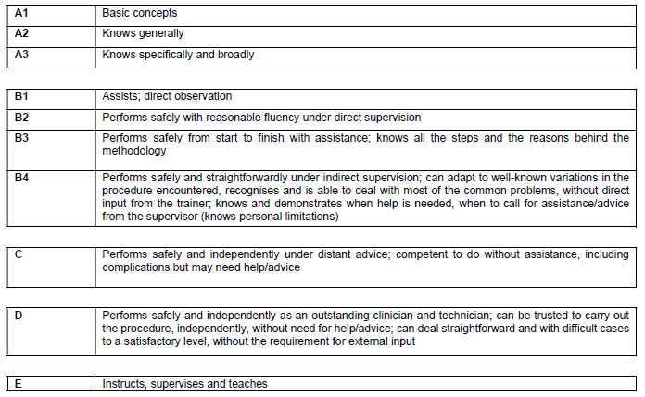
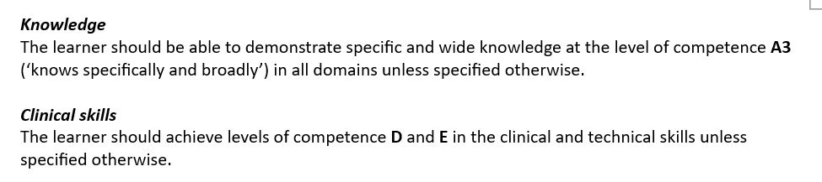


Section 2. Required levels of competence for the PDM

Slide 11
Section 2. Domains of learning
1. Domains of disaster definition and management
  1.1 Disaster definition, classification and characteristics of different types of disasters
  1.2 Different phases of disaster management and preparedness
  1.3 Mass-casualty disposition, triage and primary assessment
2. Domains on patient assessment and anaesthesia during disasters
  2.1 Preoperative anaesthetic evaluation and risk assessment during disasters and in
  low-resource settings
  2.2 General anaesthesia during mass-casualty incidents and disasters
  2.3 Regional anaesthesia during mass-casualty incidents and disasters
3. Domain on postoperative care and pain management during disasters
4. Domain on perioperative and critically ill patients evacuation and transfer during disasters
5. Domain on critical and intensive care during disasters
6. Domains of psychosocial care, burnout syndrome and fatigue prevention
  6.1 Treatment approaches to acute and delayed critical incident stress reactions
  6.2 Burnout and fatigue during disasters
7. Debriefing, reporting data and analysis

Slide 12
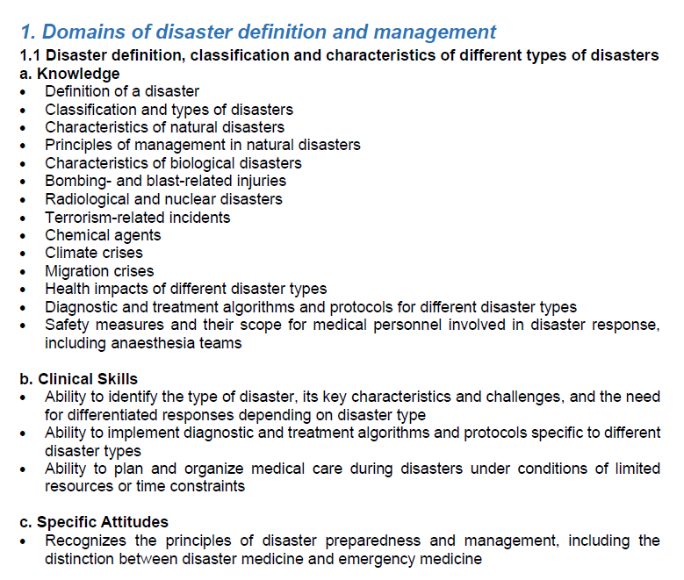
Section 2. PDM Domains and Competencies – knowledge, skills and specific attitudes

Slide 13
Section 3. Entrustable Professional Activities (EPAs)
Definition and Implementaton of EPAs in the Training of Medical Specialists
Proposed EPAs for Specialists in Disaster Medicine
These EPAs are designed to align with the competencies outlined in the Disaster Medicine for ANAESTHESIOLOGISTS

Slide 14
Section 3. Definition and Implementation of EPAs in the Training of Medical Specialists
Key Characteristics of EPAs
Implementation in the Training of Medical Specialists
  Identification of EPAs
  Structuring Training Programs around EPAs
  Assessment of EPAs
  Entrustment Decisions
  Continuous Improvement
Suggestions for Implementation

Slide 15
Section 3. Proposed EPAs for the PDM Disaster Medicine for Anaesthesiologists
EPA 1: Participate in disaster triage and primary assessment in a simulated or real masscasualty scenario. This includes applying recognized triage systems, prioritizing interventions, and documenting findings in accordance with disaster protocols.
EPA 2: Provide airway management for trauma or chemically contaminated victims in hazardous, resource-limited, or contaminated environments. This includes preparation, use of personal protective equipment (PPE), selection of induction techniques, and management of trauma or chemically exposed patients.
EPA 3: Function as a clinical leader within a Hospital Incident Command System (HICS). This includes coordinating teams, allocating resources, communicating with command structures, and supporting decision-making.
EPA 4: Organize escalation of ICU capacity and manage critically ill patients during disaster surge. This includes planning, prioritizing, staffing adaptation, and ensuring safe ICU care under disaster conditions.
EPA 5: Conduct a structured debriefing after a simulated or real disaster event. This includes analyzing performance, identifying system gaps, and generating recommendations for improvement.
EPA 6: Provide disaster-appropriate postoperative care and analgesia in low-resource or overwhelmed environments. This includes adaptation of monitoring, multi-modal analgesia, and prevention of complications with minimal equipment.
EPA 7: Ensure safe anaesthesia and analgesia delivery in austere environments. Adapt anaesthesia techniques (regional, minimal monitor anaesthesia) to minimal ressources (equipment improvisation).
EPA 8: Perform POCUS-guided assessment for triage, trauma evaluation and critical decision-making during disasters. This includes eFAST, lung ultrasound, basic cardiac POCUS, and use of ultrasound to guide resuscitation.
EPA 9: Apply ethical decision-making and resource allocation principles in extreme scarcity situations. This includes triage ethics, prioritisation for ICU beds or ventilators, and communication of difficult decisions.
EPA 10: Deliver psychosocial support and manage acute stress reactions in patients, relatives and healthcare staff. This includes recognition of stress responses, basic psychological first aid, and team support strategies.

Slide 16
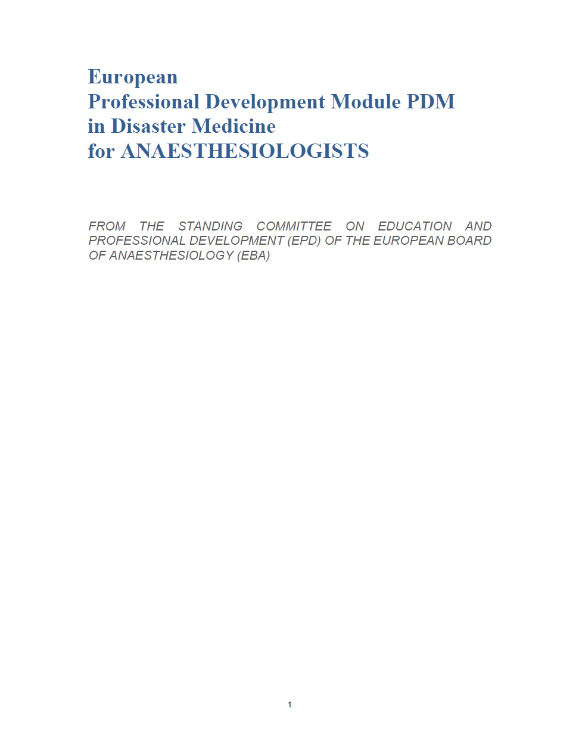
Summary
The aim of the European PDM ­­­in Disaster Medicine for ANAESTHESIOLOGISTS is to provide a framework for harmonising the practice and teaching across Europe by expert specialist clinicians.
“This Professional Development Module (PDM) is intended to harmonise and support continuing professional development. It does not imply or introduce any new mandatory qualification and must not be used to question or limit the competence of anaesthesiologists who have completed specialist training according to the European Training Requirements (ETR). The PDM is a voluntary framework designed to promote lifelong learning and excellence in clinical leadership, education, and quality improvement within the discipline.”

Slide 17

Thanks !
Special thanks – to all EBA members!!!
https://www.eba-uems.eu/

