Slide 1


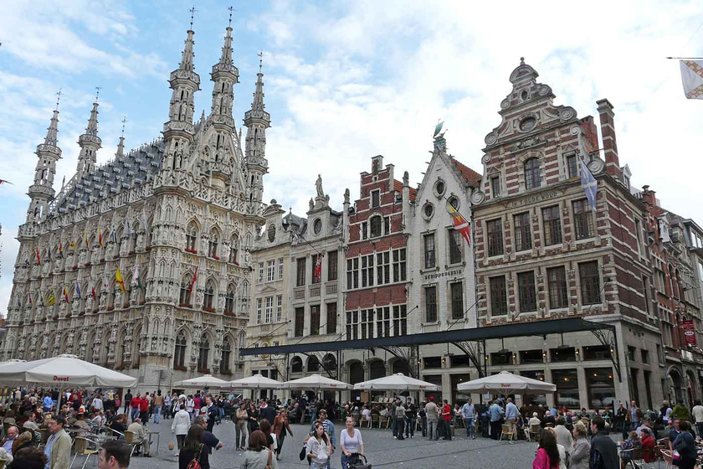

UEMS Congress 2026 – Developments Update
Leuven, 27–30 May 2026
Learning • Networking • Impacting

Slide 2



Congress Overview
    1st UEMS Congress bringing together European and international stakeholders
    Strong scientific, educational, and policy-focused programme
    65 sessions + Opening & Closing Plenary Sessions
    Wide participation across specialties and organisations

Slide 3


Accreditation
    Congress is accredited with 20.5 European CME Credits (ECMEC®s)
    Recognition by UEMS-EACCME®
    Credits convertible to AMA PRA Category 1 Credits™
    Recognised for Canadian CPD (Royal College)
    Key quality indicator for scientific excellence

Slide 4


Programme & Sessions
  Total: 65 sessions including 4 plenary sessions
  Sessions structured across key strategic and clinical themes
  UEMS team members assigned to sessions based on expertise
  Strong involvement of European and international stakeholders

Slide 5
Main Congress Themes
AI and Digital Health
Green and Sustainable Healthcare
Mental Health and Wellbeing
Work-Life Balance
UEMS and the World
Specialties and Clinical Practice
ETR and Accreditation
Ethics and Law

Slide 6
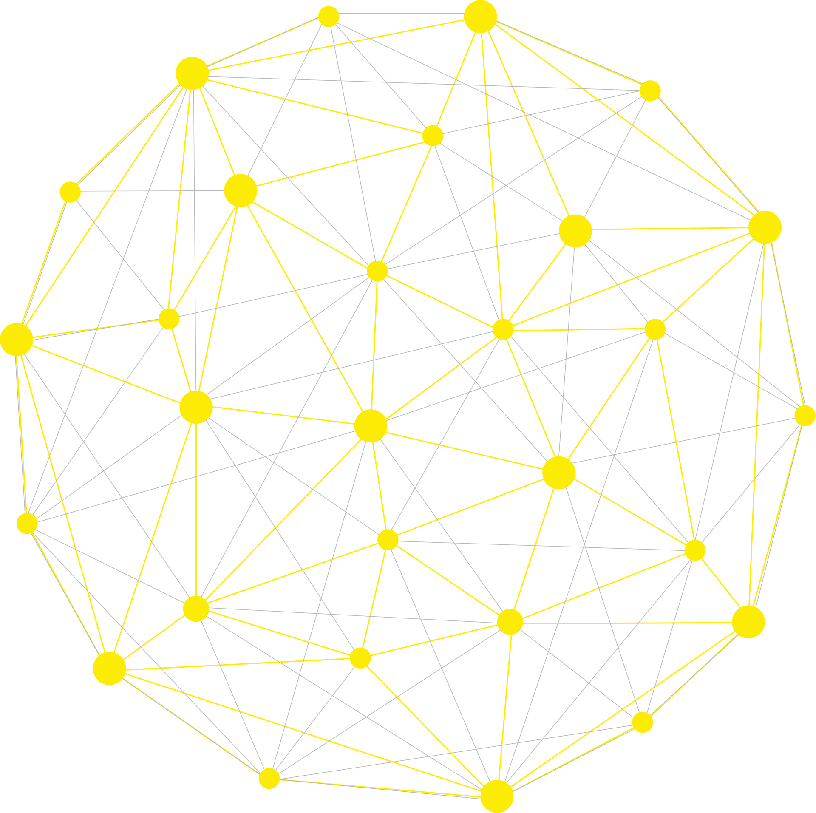
Opening Plenary Session
Theme: European Health: connectivity and interdependence
Speakers:
  Prof. Vassilios Papalois (UEMS President)
  Dr Marc Hermans (UEMS)
  Dr Theodorakis Pavlos (WHO Europe)
  Prof. Paul Herijgers (UZ Leuven)
  Mr Mario Nava (European Commission, DG EMPL)
  Includes opening video
  High-level EU and international representation

Slide 7

Closing Plenary Session
Theme: European medical workforce & future challenges
Speakers:
  Hannu Halila (UEMS)
  Alessandra Spedicato (FEMS)
  Jose Santos (CEOM)
  Tiago Villanueva (UEMO)
  Sarada Das (CPME)
  Closing address by Prof. Papalois
  Includes Journal presentation + closing video

Slide 8
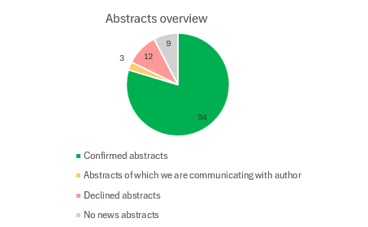
Abstracts
  94 abstracts confirmed from 67 authors
  Broad thematic coverage (education, AI, workforce, sustainability, etc.)
  Structured evaluation and selection process
  Commentators:
  Top abstracts selected per theme
  ~20 commentators confirmed
  Preparatory materials shared

Slide 9

Mentorship Programme
  Nearly all participants successfully matched
  Early engagement between mentors and mentees
  Example: mentorship supporting scientific publication

Slide 10


Parallel Meetings
  European Medical Alliance on Planetary Health
  ~17–20 confirmed participants
  Section Meetings (e.g. Laboratory Medicine)
  EACL Examinations
  Important:
  Rooms available free of charge for side meetings
  Members encouraged to organise additional discussions

Slide 11


Fundraising
  € 80,500 confirmed to date
  6 exhibition spaces confirmed
  UEMS & EACCME booths secured
  80+ potential sponsors identified
  ~60 approached so far (ongoing outreach)
  Additional non-commercial fundraising ongoing

Slide 12

Promotion
    Advertisement on BMJ website (1 month)
    Articles in Artsenkrant (An online news site for Belgian physicians)
    Promotion within Leuven hospital & university networks
    Presence on multiple congress websites
    Outreach to nearby universities & medical schools

Slide 13

Registrations
      307 registrations to date
      Some speakers still to register
      Gala Dinner: 103 registrations currently

Slide 14
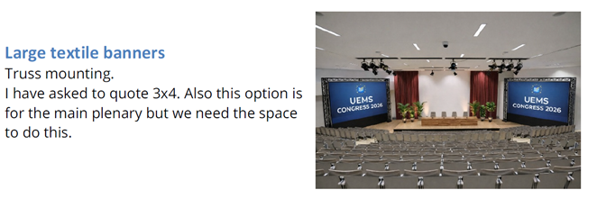

Booths, Materials & Visibility
    Two UEMS booths:
      EACCME
      UEMS Office activities
    Brochures under development (activities + accreditation)
    Direct engagement with attendees throughout congress

Slide 15


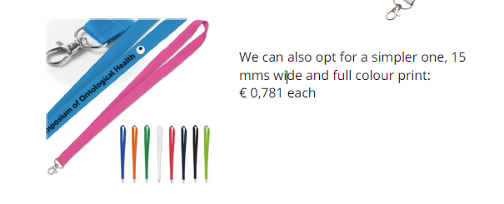
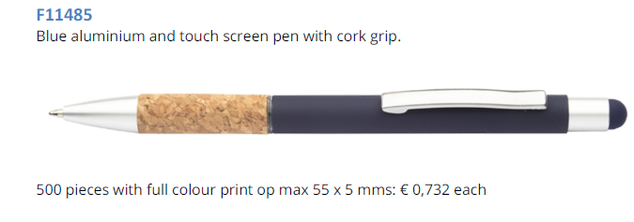
Congress Materials (Goodies)
      Branded UEMS items for participants:
      Flower seeds (sustainability focus)
      Peppermints
      Sticky notes
      Hydroalcoholic gel
      USB keys
      Pens & pins

Slide 16

Videos
UEMS presentation & history (opening)
UEMS presentation & history (opening)
Closing/thank-you video with UEMS team
  Designed to enhance engagement and identity

Slide 17







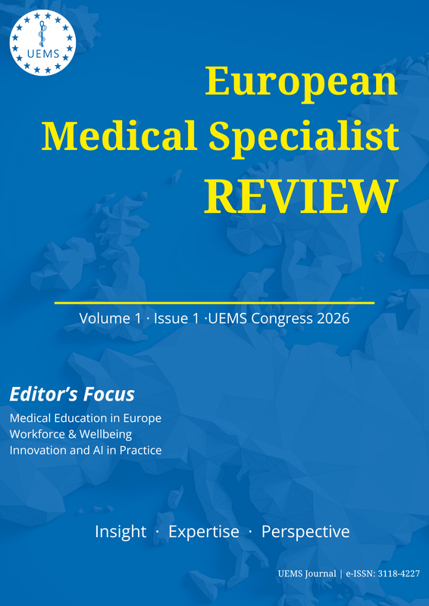
European Medical Specialist Review
The UEMS Journal
Journal launched and operational at uems.eu
ISSN registered - the essential first credential
Open to submissions
Establishment of editorial Board
13 submitted articles and first published article on Friday 17ᵗʰ of April
Composition of the first Issue as a Special Edition before the UEMS Congress
A separate website is being built to facilitate the publications and visibility of the Journal

Slide 18

Key Highlights
  Strong European Commission presence
    Opening plenary
    Session on free movement & quality
  High-level institutional engagement
  Broad multidisciplinary participation

Slide 19

Conclusion
  Congress preparation well advanced
  Strong programme, accreditation, and participation
  Positive engagement across all workstreams
  Final phase focused on delivery and attendance

Slide 20

Please add this information on your website !

