Slide 1

Secretary General Report
UEMS Council Meeting
Tunis, April 25, 2026

Slide 2




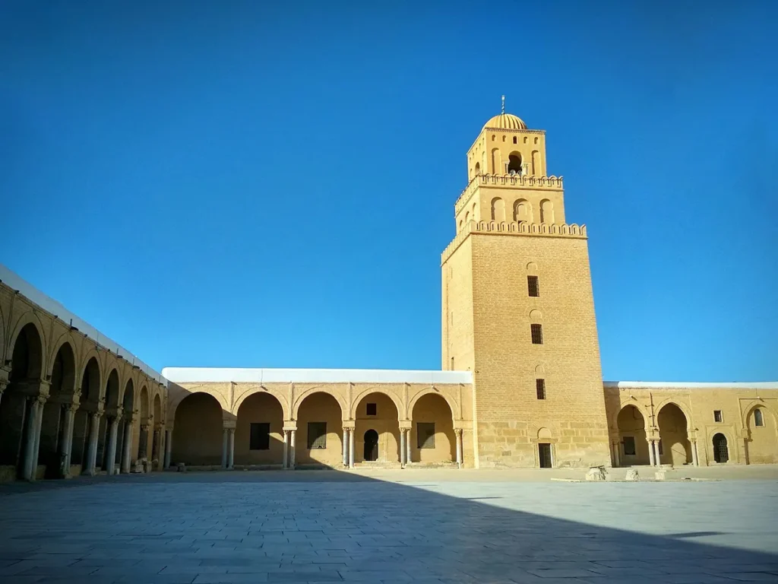
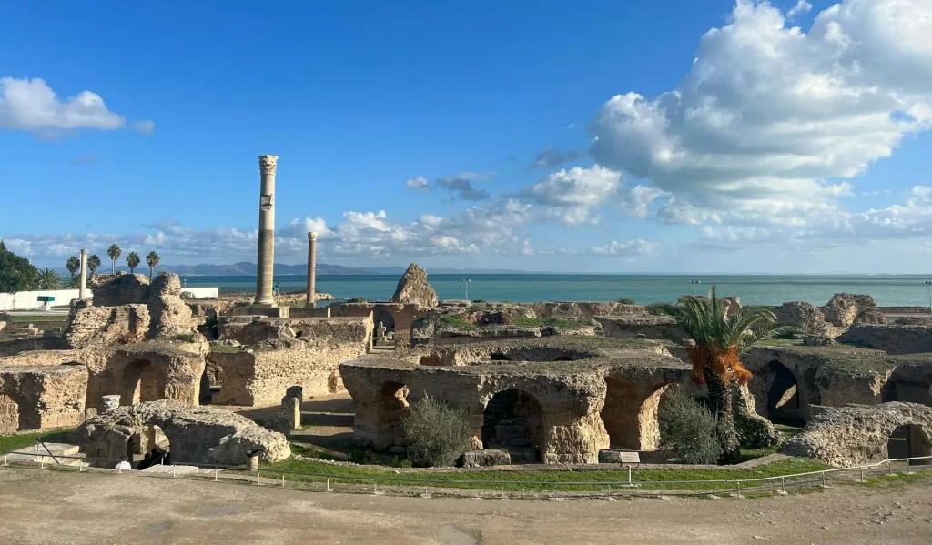
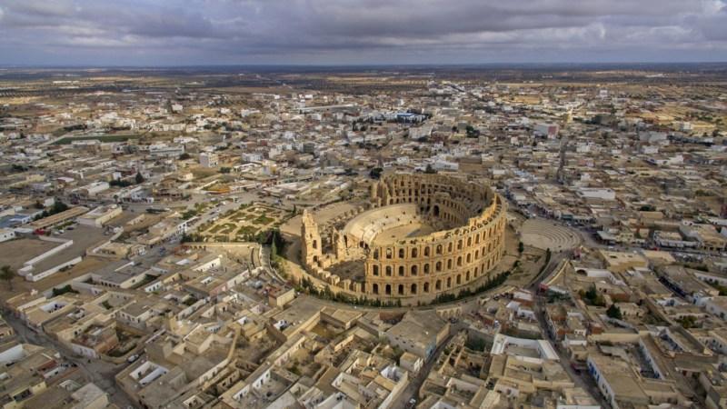
Nous remercions le Conseil National de l'Ordre des Médecins de Tunisie
شكرًا للمجلس الوطني لوسام الأطباء في تونس
3 presenters + 3 panellists+ 1 moderator
Participant preparatory contributions
Follow-up expert interviews

Slide 3

UEMS: A Project Built to Last
The UEMS starts 2026 from its strongest position yet — financially secure, well organized, and clear about where it is going. The consolidation work has not slowed things down. It has given us a solid base for the next phase of European medical work.
FORMAT
Financial Strength
Operational Excellence
3 presenters + 3 panellists+ 1 moderator
Participant preparatory contributions
Follow-up expert interviews
An operating surplus of €142,637, cash reserves of more than €5M, and a self-sustaining Domus Medica Europaea point to long-term independence.
19.3 FTEs, Odoo-powered infrastructure, and a record EACCME result of 2,476 events show a Brussels Office working steadily and well.
Strategic Alignment
Accredited Provider Status, an expanded ETR framework, the EMSR journal, and the first-ever UEMS Congress show an organization that is looking outward and helping shape the future of European medicine.

Slide 4



Consolidation, not disruption
Strong financial position
Increased operational capacity
Clear strategic direction
UEMS is now a mature, resilient European organization with its eyes on the future.

Slide 5

The Era of Consolidation: A Self-Sustaining Cycle of Excellence
THE BEDROCK
Financial and structural stability
THE ENGINE
Setting Standards: EACCME & ETRs
THE VANGUARD
Congress • Policy • EMSR Journal
FORMAT
3 presenters + 3 panellists+ 1 moderator
Participant preparatory contributions
Follow-up expert interviews

Slide 6
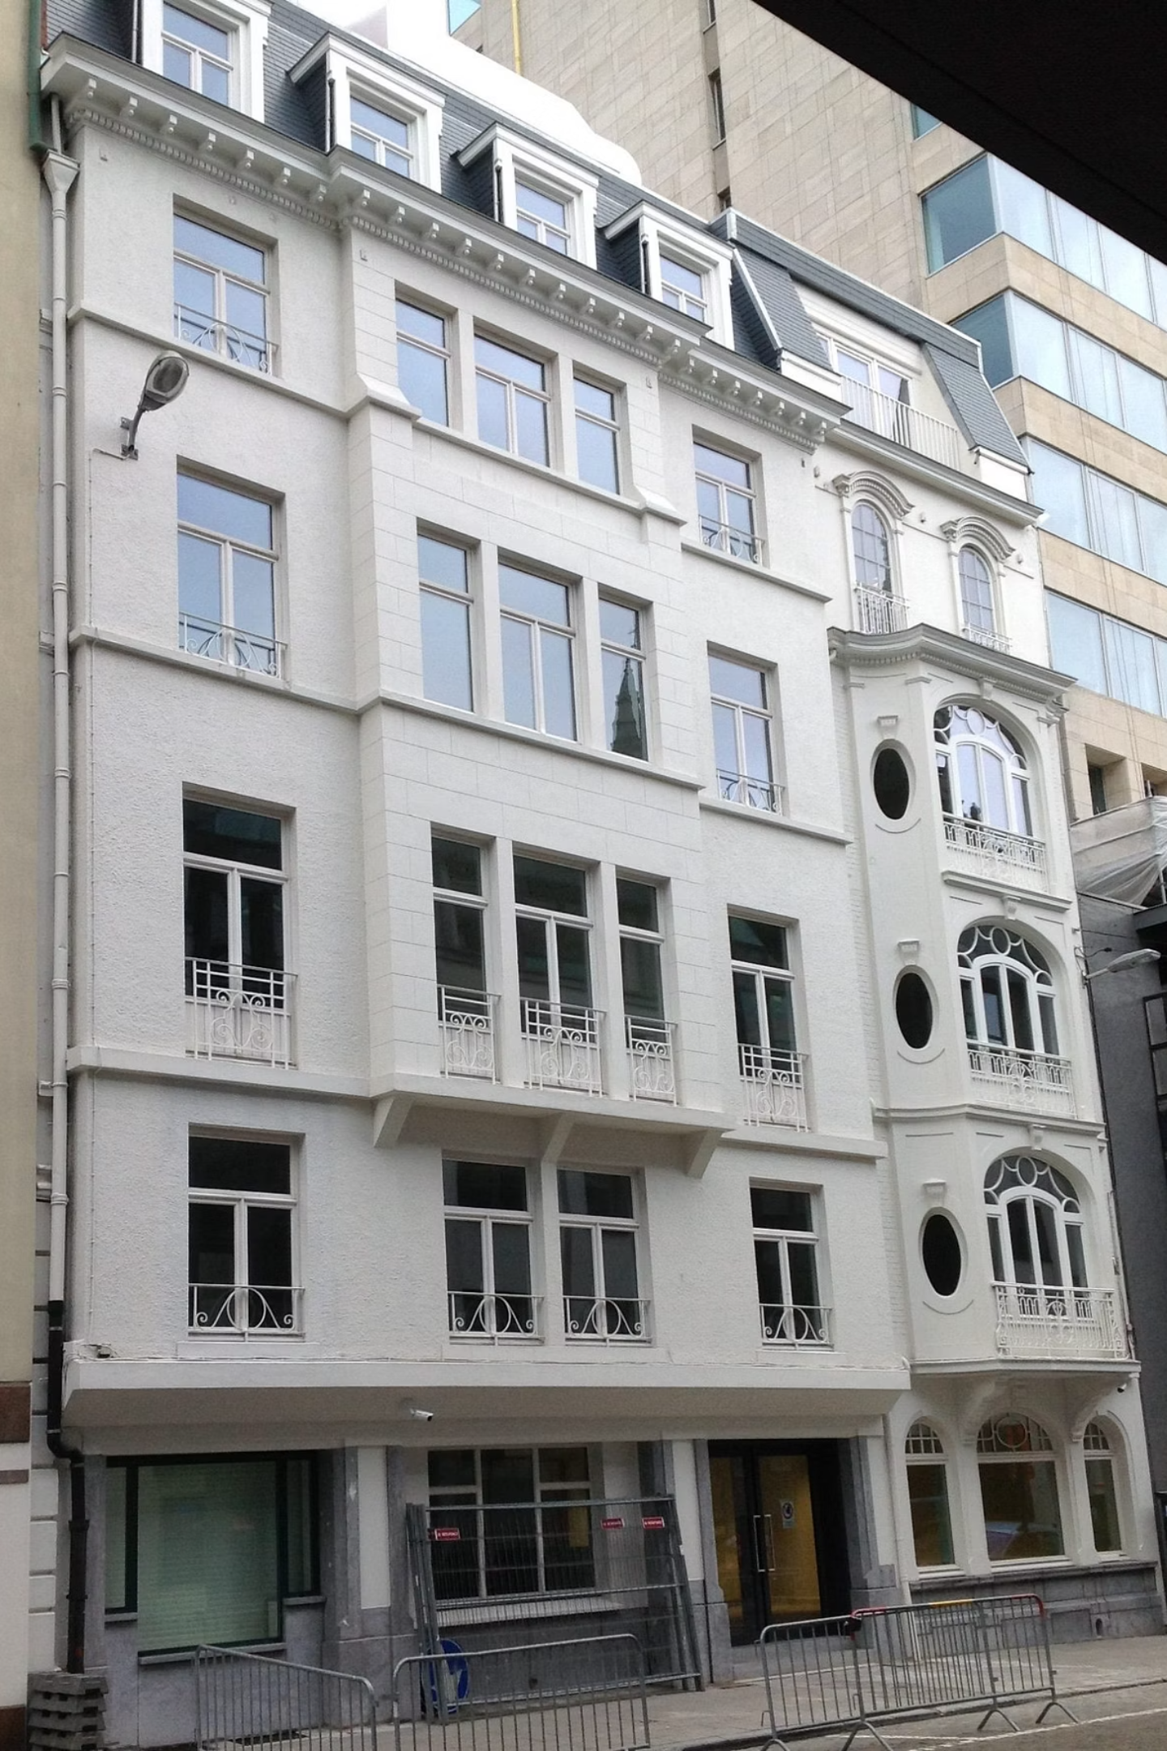

Securing Long-Term Strategic Autonomy
Core Financial Performance — 2025
Fully operational
Fully rented
Debt free
Domus Medica Europaea - DME
€142K
€120K
FORMAT
Operating Surplus
Revenue
3 presenters + 3 panellists+ 1 moderator
Participant preparatory contributions
Follow-up expert interviews
>€5M
Cash Reserves

Slide 7

Growing Internal Capacity to Meet European Demand
Key Operational Investments
Bringing Digital Tools Together
Odoo platform fully deployed.
Application tracking,
Reviewer coordination
Financial management into one place.
19.3
FORMAT
FTEs in 2025
3 presenters + 3 panellists+ 1 moderator
Participant preparatory contributions
Follow-up expert interviews
A careful increase from 18.6 in 2024
Stronger Brussels Office
Getting the IT Setup Ready for What Comes Next
New IT provider (Nalios)
Accredited Provider pathway
Digital setup is ready for the next stage.

Slide 8


EACCME 3.0: Handling Record Demand Without Lowering Standards
Live Educational Events (LEEs)
E-Learning Materials (ELMs)
Record 2,476 accredited events in 2025
Single-month peak of 337 applications in July.
264 applications
FORMAT
3 presenters + 3 panellists+ 1 moderator
Participant preparatory contributions
Follow-up expert interviews
Webinar Packages
57 applications
Growth without loss of quality

Slide 9

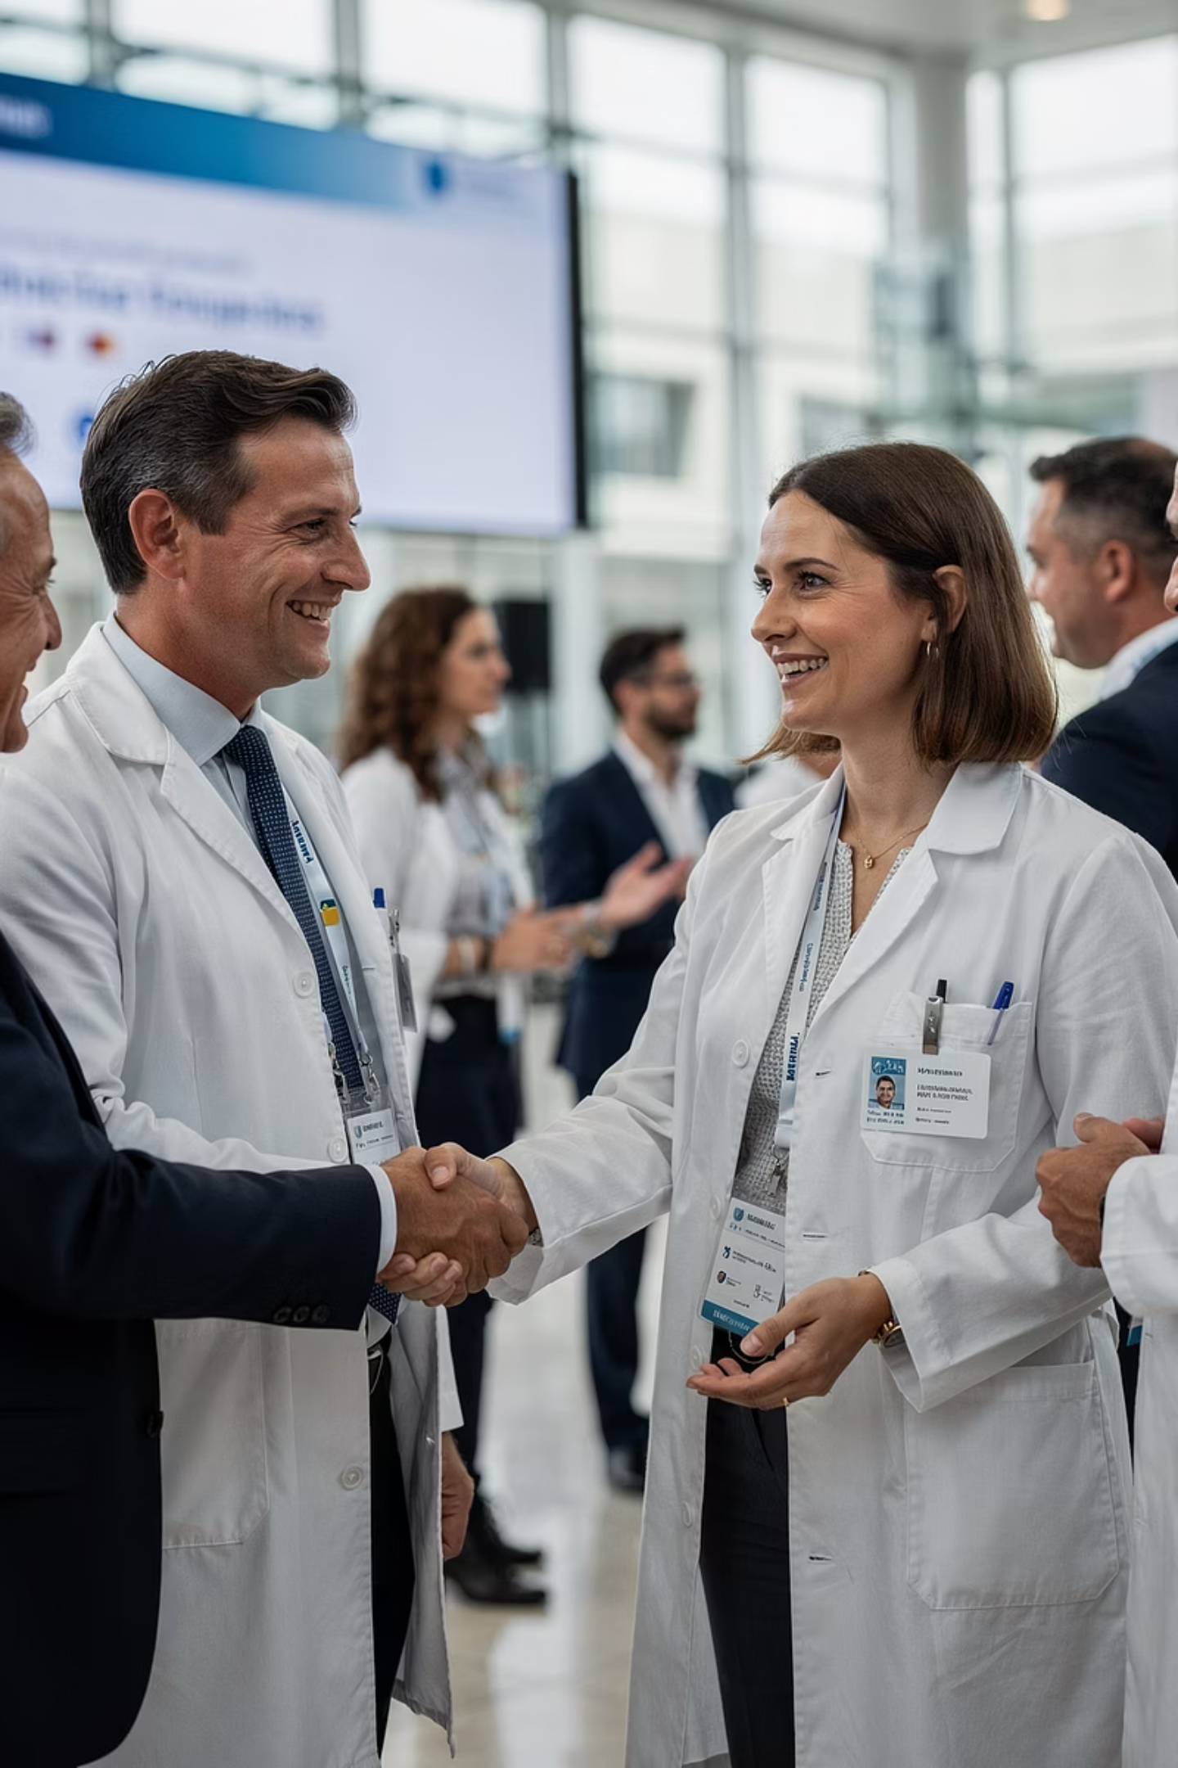
Scaling Through National Integration
Spain / SEAFORMEC
Live Events increased by 43% (322 applications in 2025)
E-Learning increased by 29% (186 applications in 2025)
Greece / PhMA
Live Events surged from 176 (2024) to 603 (2025)

Slide 10


The next step: Accredited Provider Status
LAUNCHING JULY 2026
The EACCME framework is adding Accredited Provider Status as a new, additional pathway that will run alongside the existing event-by-event model. The current accreditation process continues as before, while providers with a strong track record can also choose a simpler path with clearer recognition.
FORM
AT
Existing Model: Event-by-Event Accreditation
Additional Pathway: Accredited Provider Status
3 presenters + 3 panellists+ 1 moderator
Participant preparatory contributions
Follow-up expert interviews
Focus
Each activity is reviewed on its own merits
The provider's overall track record and ongoing compliance
Process
One application at a time, with a separate review for each event
A simpler application route with broader quality checks built in
Best For
Occasional organizers and new groups
Trusted, long-standing providers with a solid EACCME 3.0 record
Simplification + stronger trust

Slide 11

European Training Requirements: Keeping Pace with Clinical Practice
Framework maturing under Competency-Based Medical Education (CBME).
Expansion across specialties and competences
Increasing Multidisciplinary scope
Adopted: April 2025 (Brussels Council)
Adopted: October 2025 (Tbilisi Council)
PDM for Competence in Anaesthesiology for Geriatric Patients
ETR for Child and Adolescent Psychiatry
ETR for Competency in Gynaecological Oncology
ETR for Laboratory Medicine / Medical Biopathology
ETR for Paediatric Haematology and Oncology
ETR for Competence in Wound Healing
PDM for Competence in Obstetric Anaesthesiology
ETR for Geriatric Medicine (revision)
ETR for Reproductive Medicine
ETR for Transitional Care of Adolescents and Young Adults
ETR for Pathology
Proposed for Adoption: April 2026 (Tunis Council)
PDM for Disaster Medicine for Anaesthesiologists
ETR for the Competence in Abdominal Wall Surgery
ETR for the Specialty of Endocrinology
ETR for the Competence in Hand Surgery
ETR for the Specialty of Obstetrics and Gynaecology
ETR for the Competence in Paediatric Allergology
ETR for the Competence in Paediatric Emergency Medicine
ETR for the Competence in Paediatric Gastroenterology, Hepatology and Nutrition
ETR for the Competence in Paediatric Rheumatology
ETR for the Specialty of Urology

Slide 12

Expanding UEMS Influence: Policy, Research and Knowledge
European Policy & Solidarity
Structural Agility
We are setting up focused Multidisciplinary Joint Committees (MJCs) for Palliative Care Medicine, Perinatal & Infant Mental Health, and Disaster Medicine. The goal is to bring specialties together where the work overlaps.
We are taking part in EU-funded work on workforce resilience, including KeepCaring, DISCERN, and MaMoMS. We also continue to stand with the medical community in Ukraine through ongoing solidarity efforts.
FORM
AT
3 presenters + 3 panellists+ 1 moderator
Participant preparatory contributions
Follow-up expert interviews
Intellectual Expansion
The launch of the European Medical Specialist Review (EMSR) — UEMS's first official peer-reviewed scientific journal — gives the organization a direct way to share and build medical knowledge.

Slide 13

The 1st UEMS Congress: A Milestone for UEMS visibility and cohesion
Bringing Europe together
This will be a rare chance to bring European specialist expertise into one room, linking day-to-day clinical work, medical education, and governance.
Strenghtening partnerships
The Congress will strengthen ties with national member organizations and European institutions, and it will open the door to more practical collaboration.
Linking practice, education and policy
It will help establish UEMS as a clear voice for European medical specialist education — not just as a coordinator, but as a trusted source of expertise.

Slide 14





Strategic Priorities 2026 - 2027
Launch Accredited Provider Status
Giving trusted EACCME partners a simpler, institution-based path to accreditation.
Expand ETR Coverage
Extend Competency-Based Medical Education frameworks to more specialties, with the aim of covering the full range of European practice areas.
Develop EMSR Journal
Develop the European Medical Specialist Review into a well-recognized, indexed scientific publication — strengthening UEMS's role in sharing medical knowledge.
Strengthen EU engagement
Take part more deeply in EU-funded programs and strengthen UEMS's voice in shaping European healthcare workforce policy.
Deliver the 1st UEMS Congress
The Congress in Leuven (27–30 May 2026) is a key milestone — bringing together specialist societies, national associations, and policy leaders for the first time under one European roof.

Slide 15
UEMS: A Project Built to Last
The UEMS starts 2026 from its strongest position yet — financially secure, well organized, and clear about where it is going. The consolidation work has not slowed things down. It has given us a solid base for the next phase of European medical work.
FORM
AT
3 presenters + 3 panellists+ 1 moderator
Participant preparatory contributions
Follow-up expert interviews
Financial Strength
Operational Excellence
An operating surplus of €142,637, cash reserves of more than €5M, and a self-sustaining Domus Medica Europaea point to long-term independence.
19.3 FTEs, Odoo-powered infrastructure, and a record EACCME result of 2,476 events show a Brussels Office working steadily and well.
Strategic Allignement
Accredited Provider Status, an expanded ETR framework, the EMSR journal, and the first-ever UEMS Congress show an organization that is looking outward and helping shape the future of European medicine.

Slide 16

Final Remarks
2025: Consolidation achieved
UEMS is a stronger and more unified voice across Europe.
Solid foundations in place
Financial stability and structural strenght
Leuven ahead
A moment to connect and align.
The path forward is clear
Continuity, coherence and shared purpose.
“The strength of the UEMS lies in its people — our Members, Sections, Boards, committees, and the Brussels Office team.”

Slide 17
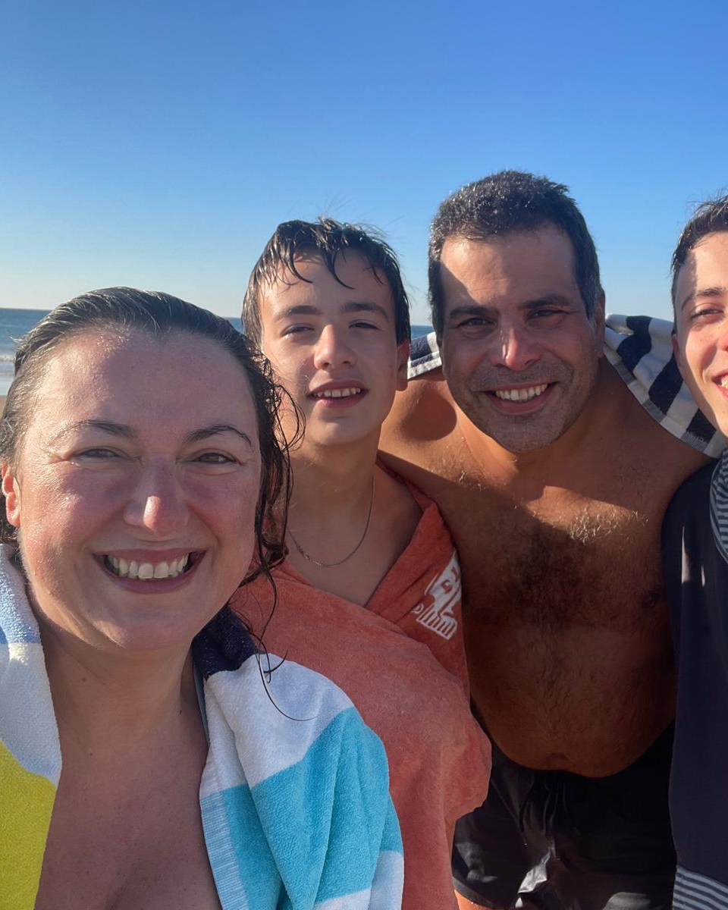
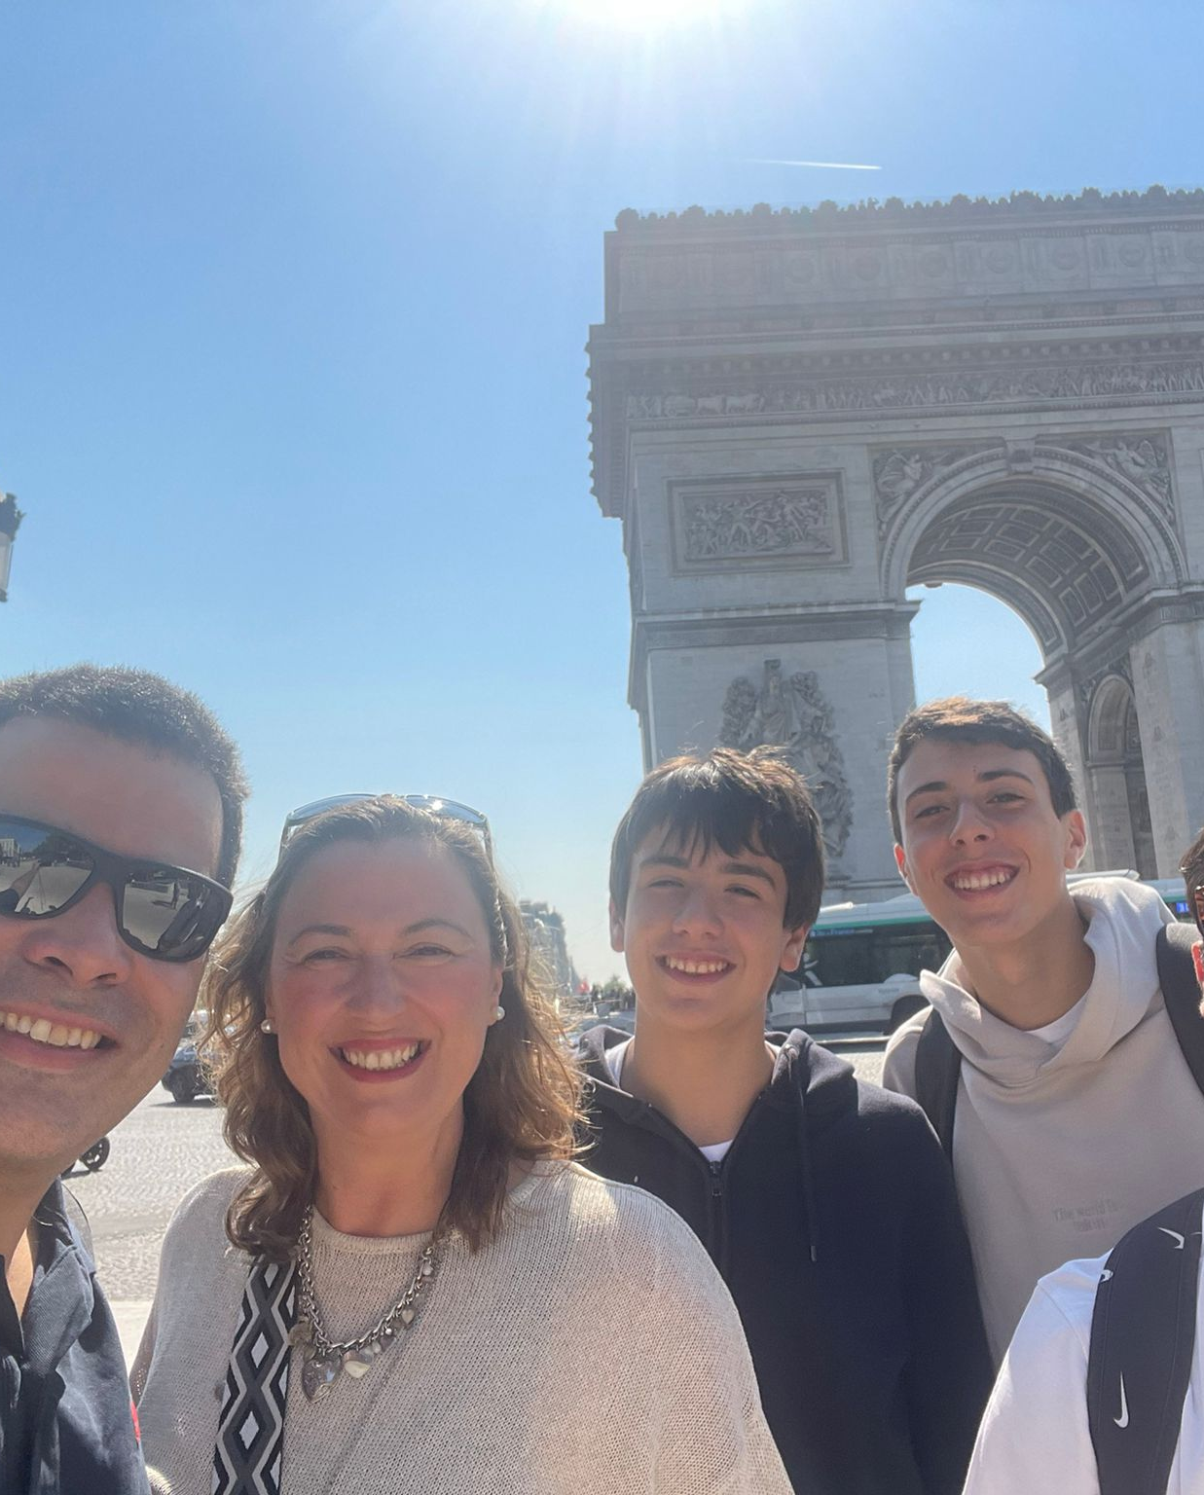
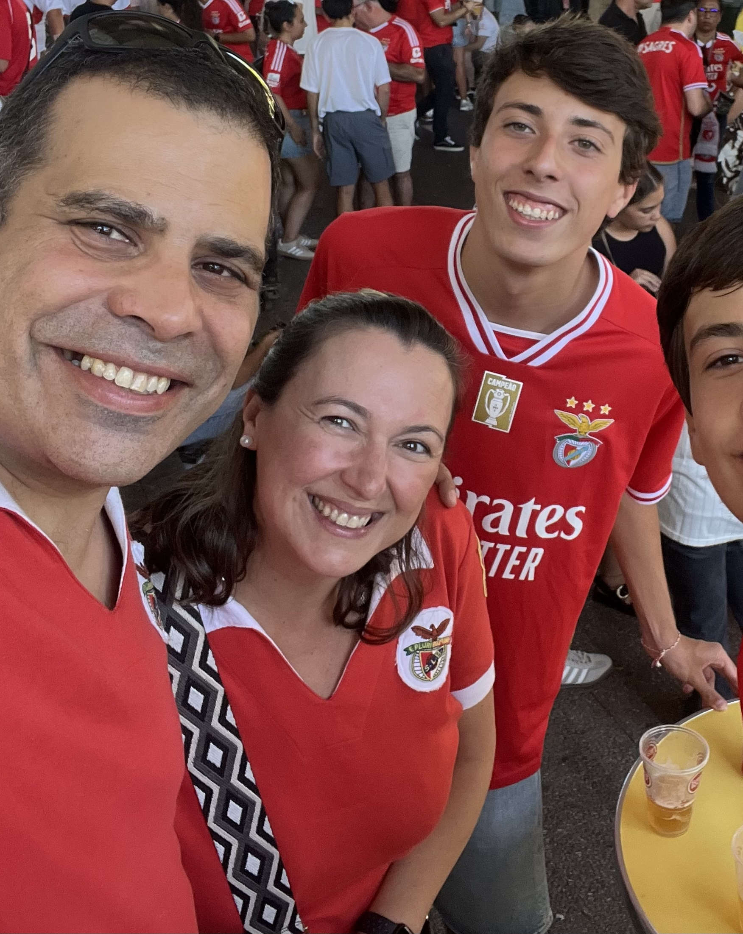
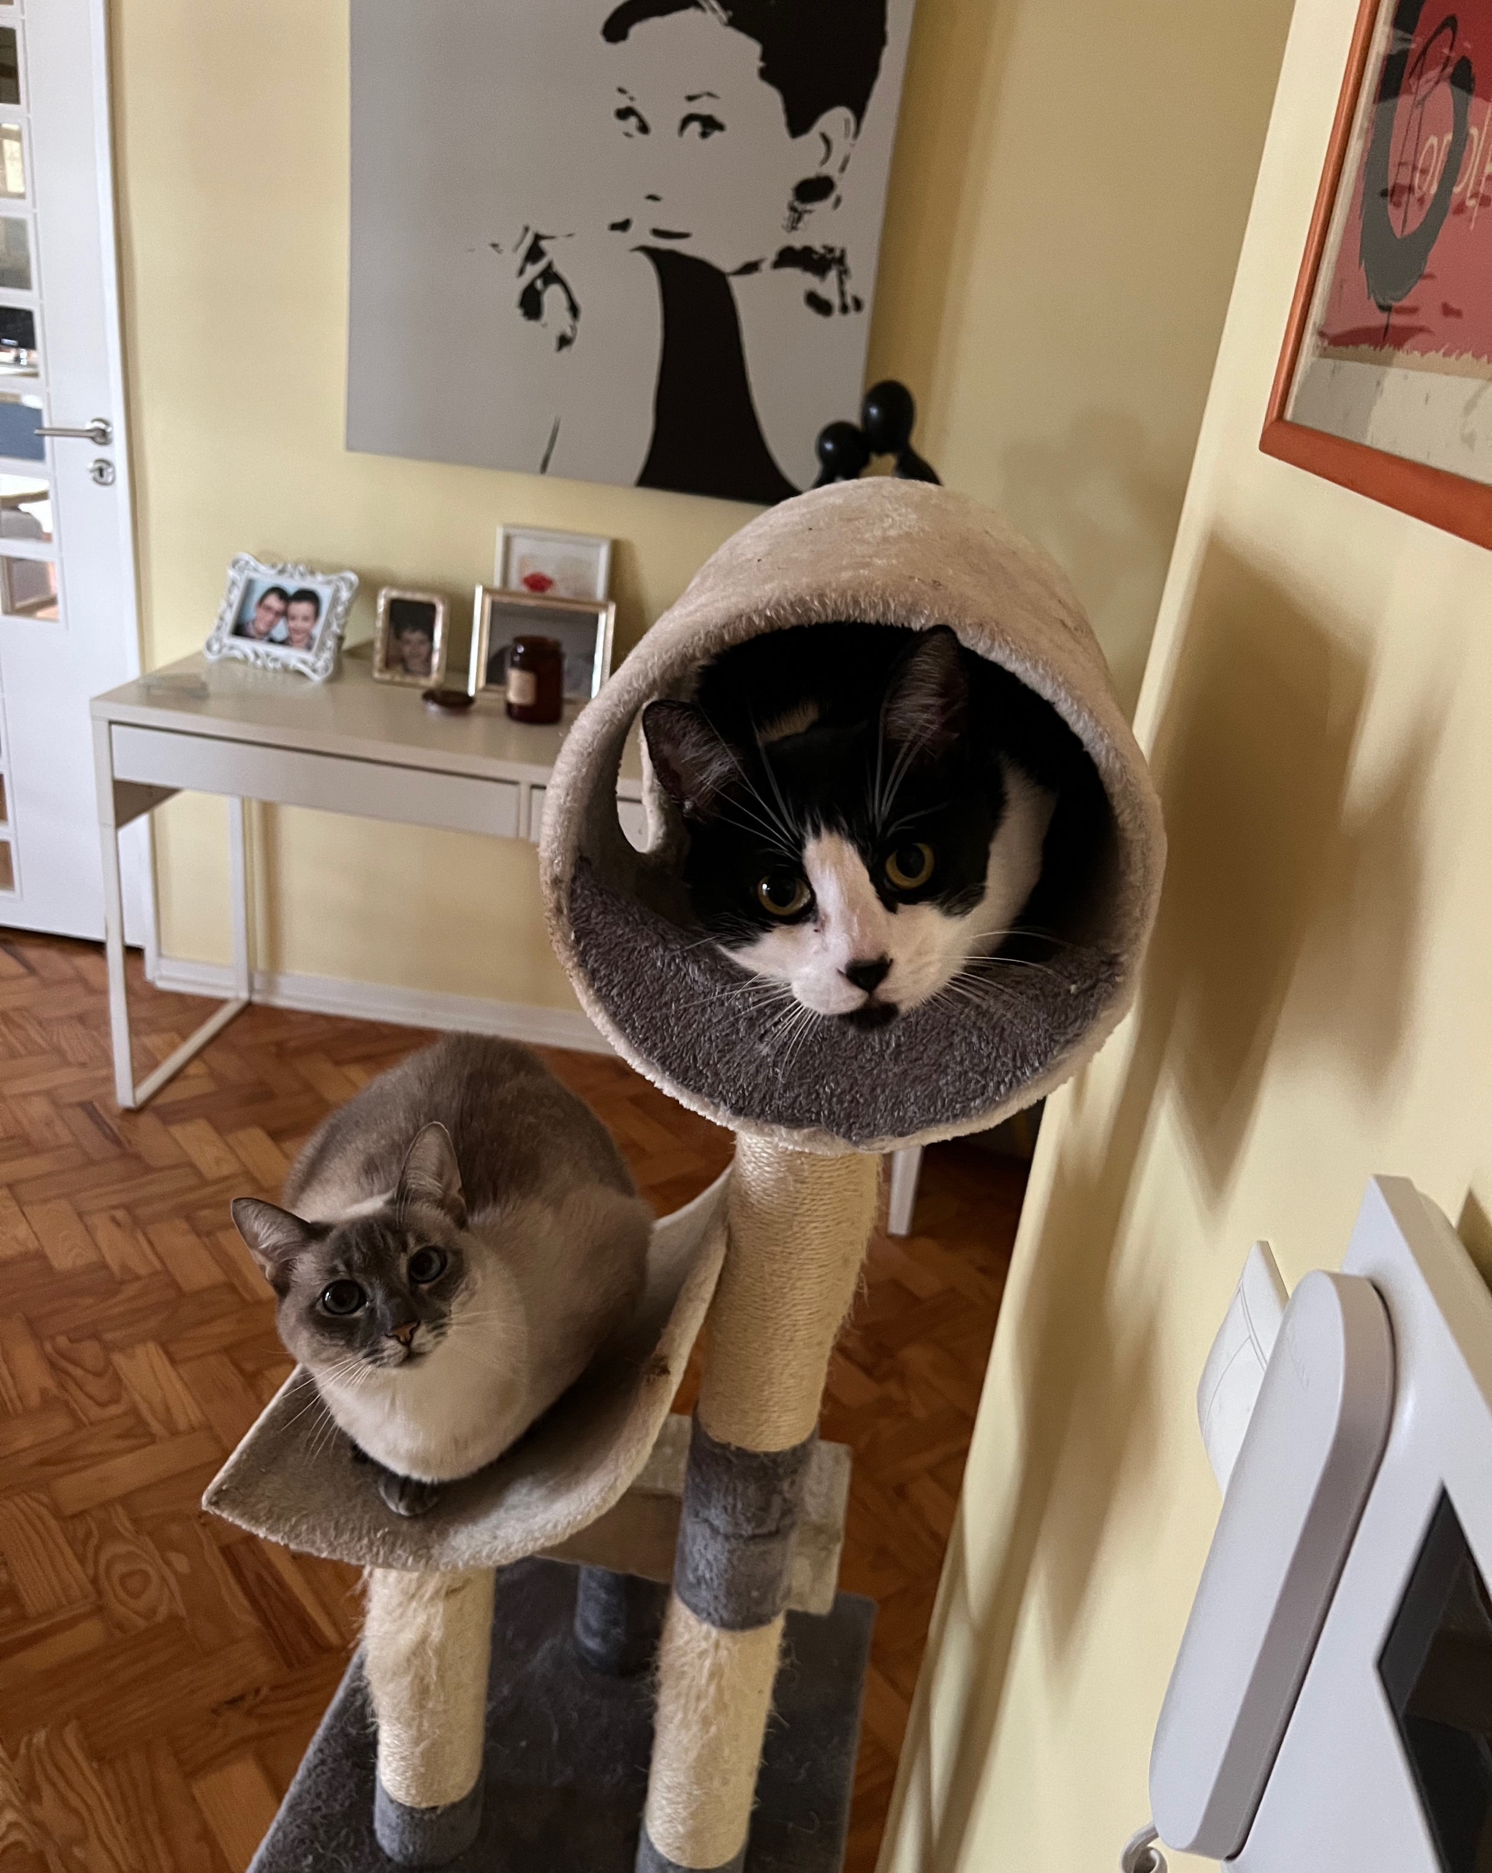
Thank You

