Slide 1

UEMS Section and Board of Endocrinology European Training Requirements
Section and Board
of Endocrinology
Josanne Vassallo MD PhD FRCP
President UEMS Section and Board of Endocrinology

Slide 2

The Journey
Section and Board of Endocrinology
The endocrinology trainee

Slide 3
Our Aims
Section and Board of Endocrinology
to instill a holistic approach to patient care whereby endocrinologists have the knowledge, skills and competences inherent to being an expert clinician, academic scholar, professional leader, collaborator, communicator, health advocate and inspired humanitarian thereby encouraging the adoption of the highest standards of care
to offer a comprehensive and robust training framework created by medical specialists and based on Europe-wide educational and training experience
to provide guidance and complement individual national/institutional training programs whilst leaving scope for adoption/inclusion of any additional skills, competences and practices that national associations and institutions may wish to add in cognizance of local needs and practices
to facilitate professional mobility across Europe by promoting and supporting standardisation and quality of training and qualifications

Slide 4
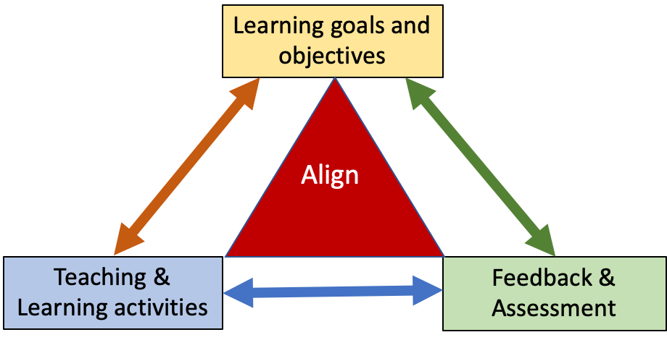
Constructive
Alignment
Section and Board of Endocrinology
Biggs, J., & Tang, C. (2014). Constructive alignment: An outcomes-based approach to teaching anatomy. In Teaching anatomy: A practical guide (pp. 31-38). Cham: Springer International Publishing.

Slide 5
Ideally harmonisation of training should encompass the use of :
Section and Board of Endocrinology
a detailed curriculum including
  Reference to published guidelines from recognised societies, reliable educational materials relating to each expected area, peer reviewed, scientific articles in high-impact endocrine journals, textbooks
defined knowledge, skills and competencies
recognised and accredited national centres
different training activities, including fellowships and exchanges at national and international expert centres
assessment linked to specific outcomes, including knowledge and overall professional development (skills, competences and attitudes)

Slide 6
Curriculum and Training Recommendations in Endocrinology
Section and Board of Endocrinology
Historically
2017: the European Society of Endocrinology (ESE) Curriculum was established
2018: UEMS Section and Board of Endocrinology published the first European Training Requirement (ETR)
2023: ESE Curriculum and Training Recommendation in Endocrinology – jointly developed by ESE and UEMS Section and Board of Endocrinology
Living documents
2025: UEMS Section and Board of Endocrinology submitted the European Training Requirements in Endocrinology document for review by the UEMS ETR Review Committee.

Slide 7
ETR for trainees
Section and Board of Endocrinology
The endocrinology trainee

Slide 8
Core training in Internal Medicine
Section and Board of Endocrinology
Recommendation for a minimum of 2 years training in Internal Medicine after completion of undergraduate medical studies
  Differences across our region in the requirement for type/duration/need for Internal Medicine exposure and rotations of Endocrinology trainees
Definition of core knowledge, skills, attitudes and competencies in internal medicine training which will ensure a solid basis for training and service provision in endocrinology
  https://www.uems.eu/__data/assets/pdf_file/0017/44450/UEMS-2016.13-European-Training-Requirements-Internal-Medicine.pdf

Slide 9
Core training in Endocrinology
Section and Board of Endocrinology
Recommendation for a minimum of 3-5 years training in endocrinology post internal medicine training
  2 yrs fulltime endocrinology training
  1-3 yrs in a department of endocrinology and/or relevant medical disciplines – pursuing clinical, laboratory and research activities

Slide 10
Core areas specified in the ETR
Section and Board of Endocrinology
Diabetes mellitus
Lipid disorders
Obesity and Nutrition
Pituitary and Neuroendocrine Disorders
Thyroid disease
Reproductive endocrinology, andrology and seuxual medicine
Electrolyte and Fluid Balance
Neuroendocrine Tumours
Inherited endocrine tumour syndromes
Autoimmune and other polyendocrinological syndromes
Treatment induced endocrine dysfunction
Endocrine Disruptor chemicals
Diagnostic techniques and technology

Slide 11
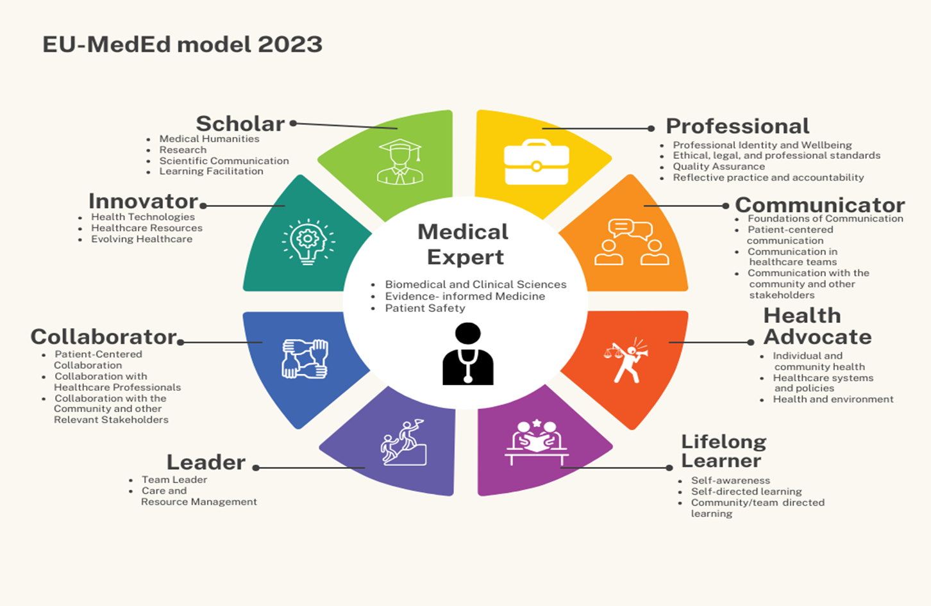
Domains and Competences in Endocrinology
Section and Board of Endocrinology
Technical Skills and Competences
Non-technical Skills and Competences
The Can MEDs Model
https://www.tuning-calohex.eu/medicine

Slide 12
Endocrinologists function at the centre of a network of other medical specialists and allied health professionals
Section and Board of Endocrinology
Multidisciplinary Team Approach
Knowledge, skills and competences in a team approach involving important input and pillars provided by other specialties including clinical specialties, diagnostic techniques (procedures, imaging. laboratory medicine, medical genetics)
Endocrinology and Patient Care across the Life Course
Appreciation and consideration of the needs of patients at different ages from birth to death

Slide 13

Organisation of Training and Assessment
Section and Board of Endocrinology
Portfolio
  Documentation of Learning experiences
  Logbook summarizing clinical experience, including diagnoses and treatments
  Courses
  Academic experience, scholarly work, presentations, scientific articles
  Personal development plan, with regular updates of progress in training, reflective reports and reports of discussions with the tutors.
Supervision: Clinical and Educational Supervisors
  Clinical skills: problem-oriented history taking, physical examination, diagnostic decision-making ability, appropriate selection of investigations, investigation interpretation. clinical judgement, management plans
  Professionnalism: multisource feedback : patient surveys, feedback from colleagues and other HCPs and relevant MDTs.
  Assessment of procedural skills need to be documented by the trainee in conjunction with the trainer.
  Assessment
  Formative
  Summative

Slide 14
ETR for Trainers
Section and Board of Endocrinology
The endocrinology trainee

Slide 15
Core competencies for trainers
Section and Board
of Endocrinology
Trainers should
Know all aspects of the Endocrinology curriculum and the problems related to its clinical implementation
Have experience in teaching theoretical and practical aspects of endocrinology including acquisition of procedural skills
Be familiar with modern medical education principles, leadership and mentorship
Understand the needs of the trainees and supporting their progress throughout the training period
Promote in their mentees scientific curiosity, professionalism, ethical behaviour and humanistic values

Slide 16
Requested Qualifications and Experience
Section and Board of Endocrinology
Trainers will be expected to have achieved the appropriate nationally recognized qualification to allow them to practise as a specialist in Endocrinology and should have at least three years experience as practising endocrinologists..
Clinical and educational supervisors should be actively practising endocrinologists and be committed to residency training
Trainers will be responsible to the Programme Director for delivering the required training in their area of practice.
Processes for recognition of endocrinologists as trainers is strongly recommended with the provision of access to Train The Trainer courses and support in the development of competences as a trainer

Slide 17
Quality Management
Section and Board of Endocrinology
Recommendations include:
Trainers and institutions must be commited to specialist education with dedication of time, space, facilities and funding to protect the needs of education from the demands of service.
Trainers should be experienced endocrinologists and tutors, committing time, effort and enthusiasm to the training programme
Trainers should regularly attend updates on education principles, training, assessment, and mentorship
The faculty should be large enough to supervise the clinical and practical work of the trainees and follow a satisfactory trainer: trainee ratio

Slide 18
ETR for Training Centers
Section and Board of Endocrinology
The endocrinology trainee

Slide 19
Staff and clinical activities
Section and Board of Endocrinology
The Training Centre should be located in a hospital or institution which provides a broad spectrum of endocrinology services as well as other medical services such as cardiology, pneumonology, gastroenterology, hepatology, haematology, nephrology, neurology, infectious diseases, rheumatology,, dermatology and venerology, surgery obstetrics and gynaecology, oncology, intensive care, radiology, laboratory medicine and medical genetics.
A multidisciplinary team approach is core to ensure optimal are and training
The balance between service provision and training needs to be safeguarded.

Slide 20
Equipment, accomodation of training centres
Section and Board of Endocrinology
The Training Centre should be housed in quality buildings, and must have facilities for inpatients and outpatients, a Diabetes unit and access to clinical Investigation rooms and laboratory facilitites.
Specific premises for educational activities are needed with teaching space, library, and contemporary information technology and audio-visual teaching aids.
Quiet spaces dedicated to trainee well being, reflection and rest should be available.
Physical space for research purposes is also recommended.
Administrative support is essential.
Access to and support in the use of information technology required for research, use of healthcare information systems, patient data, electronic or distance learning resources should be provided

Slide 21
Rotation-Training Centres and Single Affiliated/Accredited Training Centres
Section and Board of Endocrinology
  It is acknowledged that certain centres with high quality endocrine clinical facilities and training may lack the full complement of training facilities and opportunities but may be recognised as a Rotation-Training Centre of sufficient merit such that an endocrine trainee will receive sufficient training there for a period of 1-2 years.
  Such centres must be recognised by their national authorities to be of such quality and to provide sufficient training for the specialty of endocrinology.
  A trainee may therefore fulfil the training by rotating between a number of recognised training centres.

Slide 22
Quality management within training institutions
Section and Board of Endocrinology
Currently across Europe it is the remit of the national authorities and institutions to determine recognition and/or accreditation as training hospitals or institutions.
This ETR recommends that
  Accreditation, once obtained, should be reviewed after a maximum period of 5 years
  Appraisers should be granted access to the self-evaluation report, internal documentation, annual reports and results of internal audits committee minutes and recommendations, staffing and trainee ratios, assessments, outcomes and interviews with all stakeholders.
  On a trans-European level, UEMS-CESMA, EACCME, UEMS-NASCE provide important resources and frameworks for quality assurance and improvement.
  Training institutions in different member countries are encouraged to refer to the Curriculum and the European Training Recommendations They are also assured of access to the above mentioned UEMS tools and expertise to ensure standards.

Slide 23
Section and Board of Endocrinology
Summative assessment
Entry/exit exams
Knowledge based questions - eg SBA MCQs
Vivas
Objective Structured Clinical Exams (OSCEs)
Formative assessment
Continuous feedback and assessment throughout training of a trainee.s knowledge, skills and competences and when carrying out a given professional activity.
DOPS, mini-CEX, MSF
EPAs
Portfolio

Slide 24
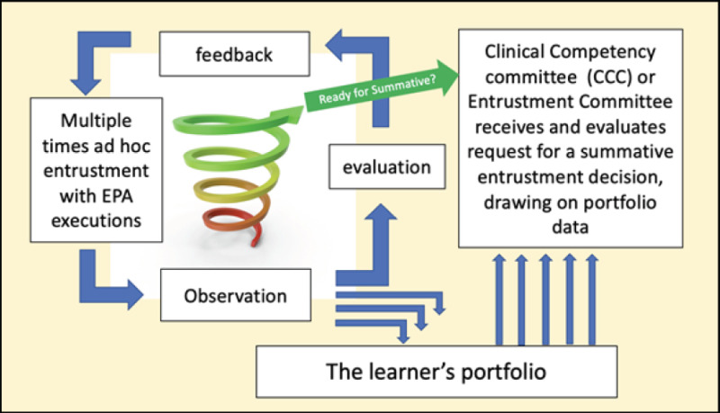
Section and Board of Endocrinology
EPAs, Olle ten Cate

Slide 25
Entrustable Professional Activities
Section and Board of Endocrinology
1. Planning diagnostics and treatment for endocrinology patients in a clinical setting
2. Emergency patient care
3. Inpatient management
4. Planning care and FUP in an MDT collaboration
5. Planning diagnostics and treatment for patients with diabetes in a clinical setting
6. Researching diagnostic dilemmas, evidence based management options including rare disease, appreciating the advantages and disadvantages of different modalities
CanMEDS roles and competences
Risk management
Performance expections
Formative feedback
Assessment
Identification of next goals to be attained at key time points

Slide 26

Thank you
Section and Board of Endocrinology
Acknowledgements
Co-Authors
Anton Luger, Maeve Durkan, Hans Perrild, Saara Metso, Teri Brouer, Richard Quinton
Advisors and colleagues
Delegates of the UEMS Section and Board of Endocrinology
European Society of Endocrinology
Reviewers at UEMS
Presidents and Secretaries of UEMS Sections and Boards, Divisions, MJCs and TFs
UEMS ETR Review Committee

Slide 27
Section and Board of Endocrinology
The UEMS Section and Board of Endocrinology ETR, in accordance with UEMS policy, aims at setting standards of knowledge, skills, and competencies that specialists must acquire during their post-graduate training in order to practice independently and safely in their chosen specialty.
The final responsibility to define the duration, content, organization and assessment of postgraduate education remains with the national authorities. Individual countries may decide to use this ETR for quality control or partly or in total as their national postgraduate training requirement.

