Slide 1
European Training Requirements (ETRs) for the Specialty of Paediatric Gastroenterology, Hepatology and Nutrition (PGHN)
Ilse Broekaert on behalf of the ESPGHAN Education Committee and Council

Slide 2
Aims of ETRs in Paediatric Gastroenterology, Hepatology and Nutrition (PGHN)
Improve the level of care for children with GI, liver, pancreatic and nutritional conditions.
Align training programmes in PGHN between different European countries.
Develop a framework for PGHN training that serves European countries and other regions globally where formal national PGHN training options are not available.
Establish clearly defined standards of knowledge and skills required to practice PGHN.
Foster the development of a European network of competent PGHN care centres.
Pic europe

Slide 3
Content of training and learning outcomes
2-year long training or equivalent
CanMEDS Framework for PGHN Paediatric Care
  I. Theoretical knowledge
  II. Practical and clinical skills
  III. Non-technical skills and professionalism
Levels of Competences in PGHN
  Syllabus and Entrustable Professional Activities (EPAs)

Slide 4
Entrustable Professional Activities (EPAs)
An EPA is a unit of professional practice that can be entrusted to a trainee to perform without supervision, once they have demonstrated sufficient competence.
The key concept is entrustment — it's not just about what a trainee knows, but whether a supervisor trusts them to act independently.

Slide 5
Entrustable Professional Activities (EPAs)
EPA 1: Diagnosis and Management of Paediatric Inflammatory Bowel Diseases and Diarrheal Disorders
EPA 2: Recognition and Initial Management of Life-Threatening Gastrointestinal Conditions
EPA 3: Diagnosis and Management of Upper Gastrointestinal Disorders
EPA 4: Management of Food Allergies and Eosinophilic Gastrointestinal Disorders

Slide 6
EPAs
EPA 5: Management of Disorders of Gut-Brain Interaction and Motility Disorders
EPA 6: Surveillance and Management of Polyps, Tumours, and Anorectal Disorders
EPA 7: Manage Nutritional Assessment and Support for Children with Acute, Chronic, and Complex Nutritional Needs
EPA 8: Manage Intestinal Failure and Coordinate Intestinal Rehabilitation Programs

Slide 7
EPAs
EPA 9: Perform and Interpret Diagnostic and Therapeutic Procedures Including Gastrointestinal Endoscopy, Liver Biopsy, Motility Studies and Know about Radiological Investigations
EPA 10: Diagnose and Manage Acute and Chronic Liver Disease in Children
EPA 11: Evaluate and Manage Children with Cholestasis and Other Hepatobiliary Disorders
EPA 12: Manage Liver Transplantation Process

Slide 8
EPAs
EPA 13: Assess and Manage Pancreatic Disorders in Children
EPA 14: Coordinate Multidisciplinary and Transitional Care for Complex and Chronically Ill PGHN Patients
EPA 15: Demonstrate Leadership, Scholarship, and Advocacy within the PGHN Discipline
  → emergency situations, multidisciplinary team approach, transition to adult medicine, use of AI, genetic testing, obesity

Slide 9
Assessment | Purpose | Method
Mini-CEX (Mini clinical evalution exercise) | Provides feedback on skills needed in clinical care. | Trainer observes a trainee examining a patient and explaining the management plan to the parents/caregivers.
CbD (Case-based discussion) | Assesses clinical reasoning or decision making. | Trainee presents a more complex case to the trainer and discusses the evidence or basis for diagnosis or treatment.
DOPS (Directly observed procedural skills) | Assesses practical skills. | Trainee undertakes a practical skill whilst being observed. E.g., paediatric gastroscopy DOPS, paediatric ileo-colonoscopy DOPS.
LEADER | Focuses on leadership skills. | A trainee is observed leading a team (e.g., during resuscitation).
HAT (Handover assessment tool) | Evaluates handover skills. | Handover episodes are supervised and discussed.
DOC (Discussion of correspondence) | Assesses letter writing skills. | Outpatient care letters or discharge letters are reviewed and discussed.
MSF (Multi-source feedback) | Provides wider feedback on the performance of the trainee. | Confidential comments from a wide range of colleagues, patients, and trainee are sought.
Formative and summative assessment

Slide 10
TRAINING REQUIREMENTS FOR TRAINERS
Process for recognition as a trainer
Requested qualification and experience as well as the roles of programme director and mentor
Core competencies of trainers
Quality management for trainers
→ Train-the-trainer courses

Slide 11
TRAINING REQUIREMENTS FOR TRAINING INSTITUTIONS
Process for recognition as a training center
  Requirement on staff and clinical activities
  Requirements on equipment, accommodation
Quality management within training institutions
  Accreditation and reaccreditation by the national competent authority, regular report, internal and external auditing

Slide 12
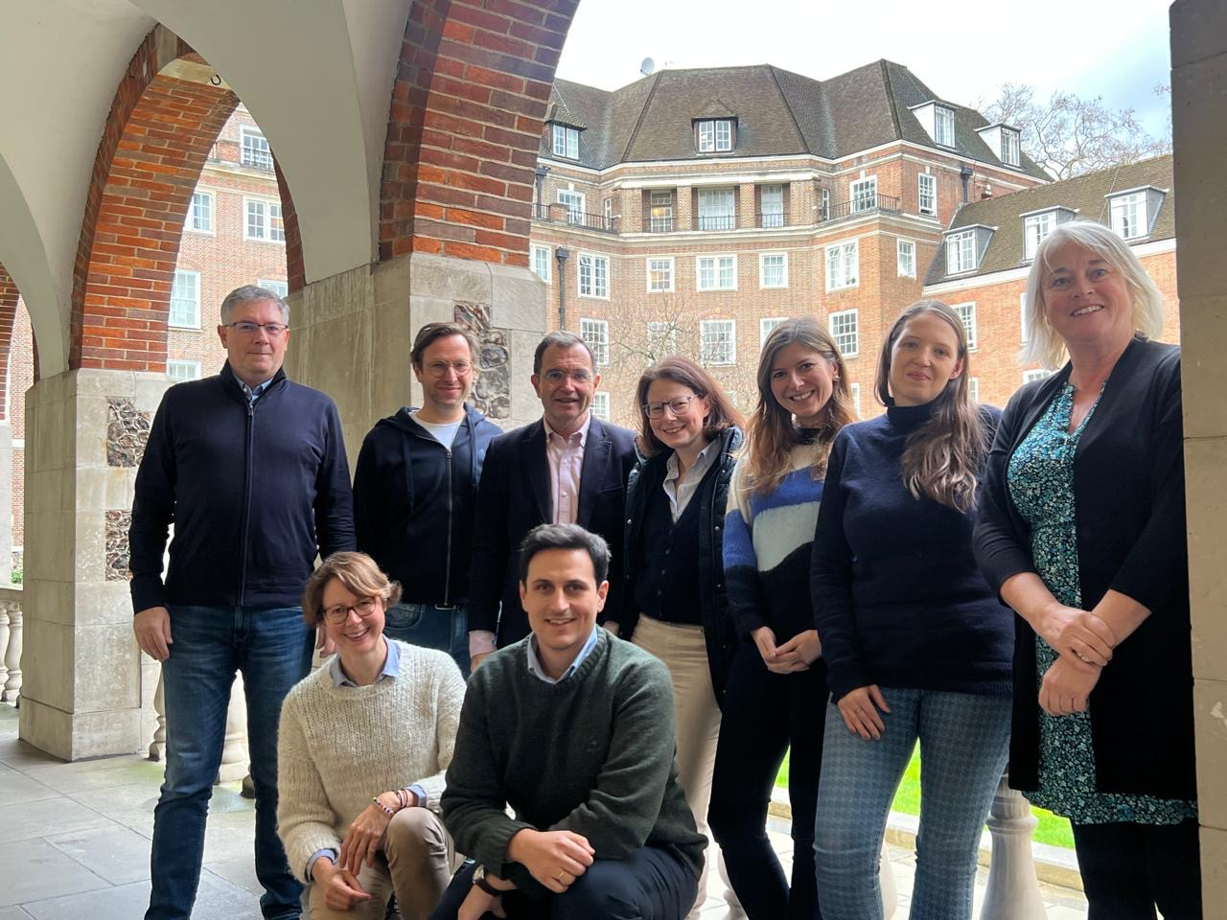
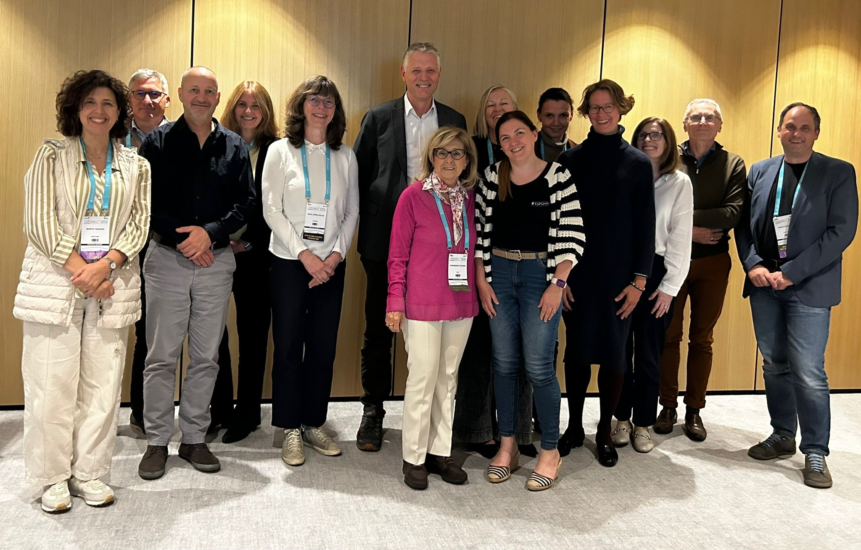
Composition of authors/ reviewers

Slide 13
Future: European PGHN certification
Countries without PGHN programme and/or PGHN certification
Mobility
Harmonisation of national and European standards
Accreditation
Lable of excellence, objective self-assessment

Slide 14
A heartfelt Thank You to:
Council: Ulrich Baumann, Annamaria Staiano
Education Committee
Endoscopy Special Interest Group
Public Affairs Committee
Executive Committee: Berthold Koletzko, Ann de Guchtenaere
Peter Hoyer
All European National PGHN societies
Executive Committee
Brussels Office: Amelia Donighian
CESMA: Danny Mathysen, Sandrine Tshimbulu
Education Committee

