Slide 1




Prof Fionnuala McAuliffe
Chair Standing Committee for Training and Assessment
Dr Anna Aabakke
Prof Sam Mukhopadhyay
President EBCOG centraloffice@ebcog.eu
European Training Requirements for Specialty of Obstetrics & Gynaecology
April 2026 UEMS Council Tunis

Slide 2


Slide 3
EBCOG Education and Training
Core activities
Standing Committee on Training and Recognition
Standing Committee on Training and Assessment
Standing Committee on Examination
Standing Committee on Standards of Care & Position Statements

Slide 4
European Training in O+G
EBCOG has made an important contribution to European health care by formulating the Standards of Care for Women’s Health in Europe
Training ranging from 4-8 years – wide variation
Increase the mobility of Obstetricians and Gynaecologists and trainees in Europe
Need to standardise training across Europe

Slide 5


2018
2026

Slide 6
Aim
To develop standardised training in Obstetrics & Gynaecology across Europe
DELPHI methodology to assess minimum skills required for O+G training
  Consensus core to the curriculum development (PhD project)
Competency based approach rather than numbers based approach
First 2018 curriculum - Revision presented to council 2026
  Revision process involved a Europe wide survey of trainees, trainers, professional colleges and subspecialty societies in 2022-2025

Slide 7
Key Competencies (CanMeds)
Medical expert
Communicator
Collaborator
Leader
Health advocate
Scholar
Professional

Slide 8
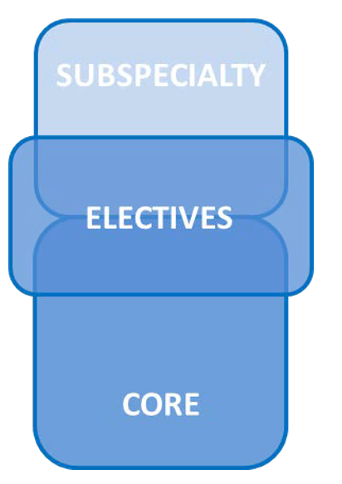
Structure
Core modules
  the knowledge, skills and attitudes required of every European Obstetrician & Gynaecologist have been defined
Elective modules (6 months)
  Each trainee should be trained in at least one elective
Engagement with Specialty Societies

Slide 9
Core modules
  General Medical Knowledge & Skills
  Prenatal Care
  Intrapartum & Postpartum Care
  Benign Gynaecology
  Reproductive Medicine
  Urogynaecology
  Premalignancy and Gynaecological Oncology
  Paediatric and Adolescent Gynaecology
  Sexual Health and contraception
  Breast Disease

Slide 10
Elective modules
  Fetal Medicine
  Maternal Medicine
  Benign Gynaecology
  Reproductive Medicine
  Urogynaecology & Pelvic Floor
  Low Genital Tract Disease & Sexual health
  Paediatric & Adolescent Gynaecology
  Gynaecological Oncology
  Breast Disease

Slide 11
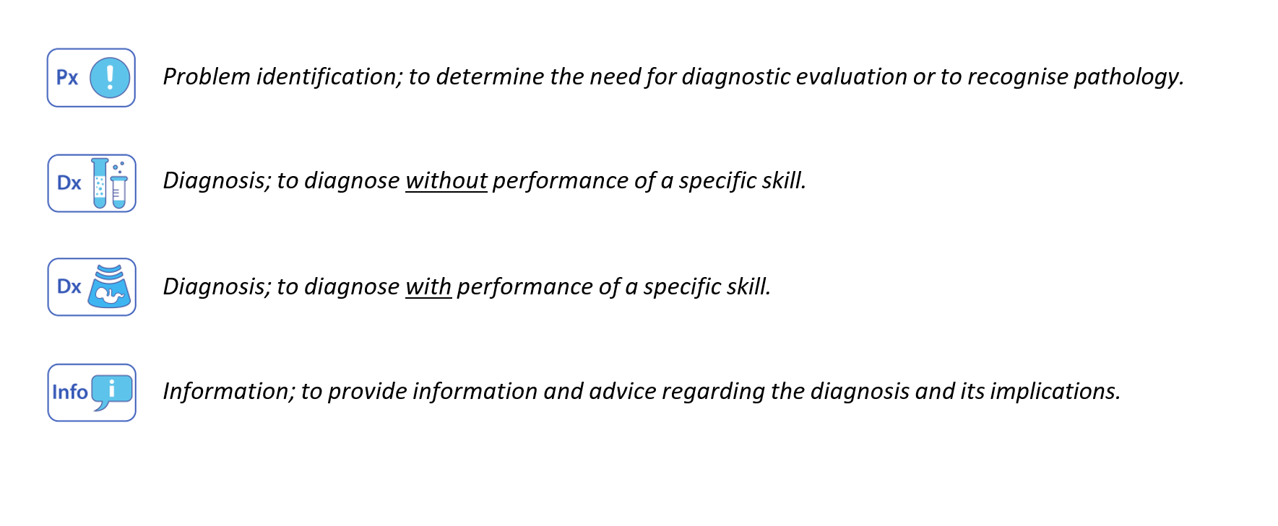
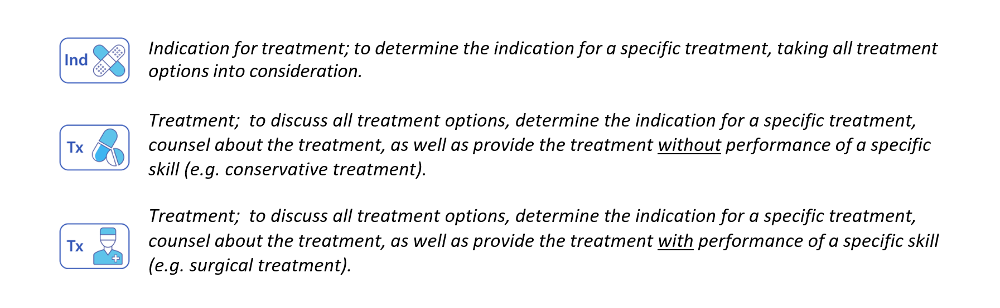

Slide 12
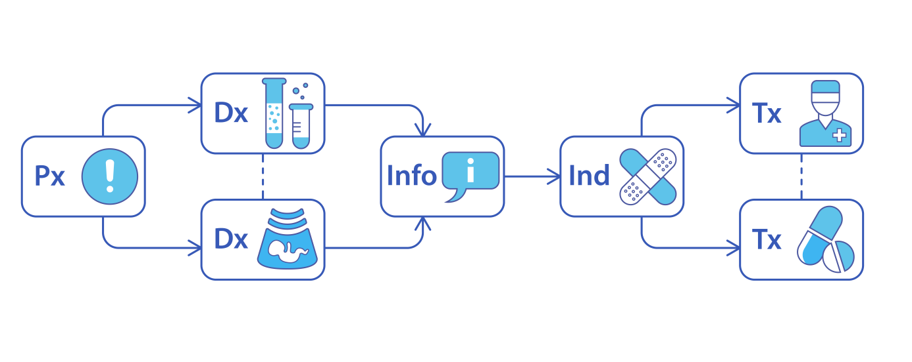
Simulation training as an important pillar of the training system – strengthened with GESEA4 EU project (gynaecological simulation)

Slide 13
Human Factors and Non Technical Skills
Human Factors - how individuals interact within their job environment, includes organisational and job factors, and individual characteristics.
Non-technical skills - individual factors: cognitive, social and personal resource skills that do not relate directly to the clinical job but are complementary to the technical skills and crucial to delivery of safe and effective patient care.
Assessed by teamwork/systems based practice/patient centered care/personal and professional development

Slide 14
Clinical Leadership
Recognises role of clinician in leadership positions within the clinical team and clinical service
‘Having the knowledge, skills and competencies needed to effectively balance the needs of patients and team members within resource constraints’.
Important foundation for good quality, well-run and safe healthcare services and systems

Slide 15
Clinical Leadership - examples
Quality Improvement within healthcare is the effort made to improve patient outcomes, delivery of care and professional development
Clinical audit is a cyclic quality improvement tool that is aimed at reviewing clinical practice against evidence-based standards and introducing change with aim to improve patient care and outcomes when standards are not met.
Just Culture takes a systems approach to incidents, where there is a shared accountability to maintain patient safety, enabling healthcare professional to learn without fear of retribution

Slide 16
Entrustable Professional Activities
A professional activity includes all the tasks and aspects needed to execute such an activity in the context of patient care.
Entrustment of a professional activity to the trainee means that the trainee is considered competent on all aspects of the professional activity in such a way that he/she can perform the activity independently
Based on portfolio of learning experiences, assessments and evaluation by a competence committee / trainer

Slide 17
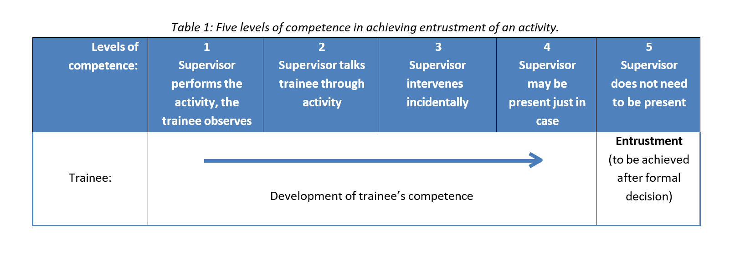
Competency based training – Entrustment of Professional Activities

Slide 18
Entrustment of Professional Activities (EPA)
Non-Technical Skills

Slide 19
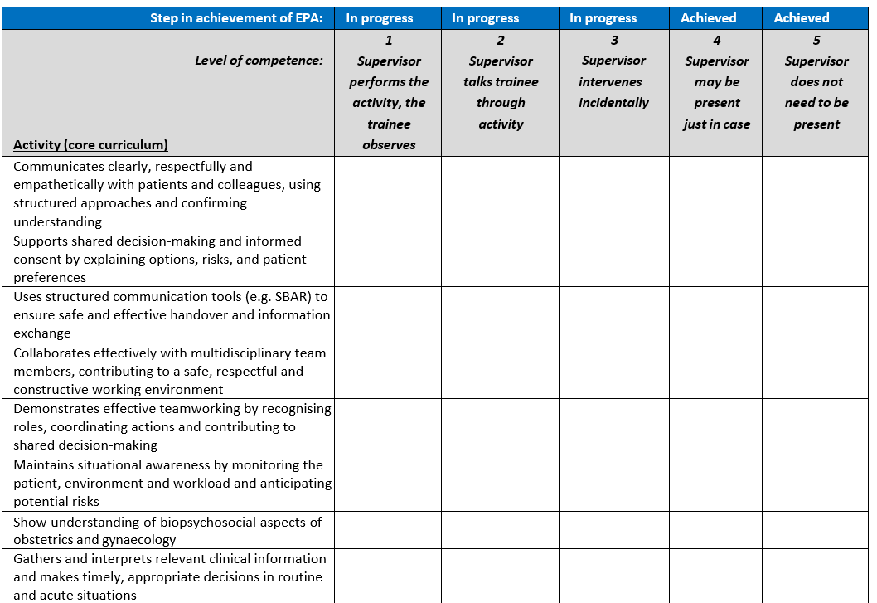

Slide 20
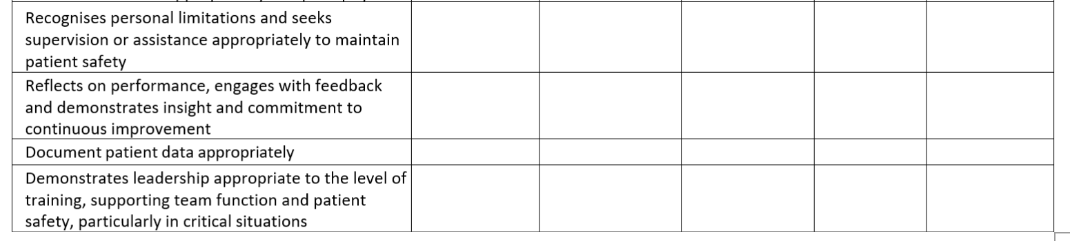

Slide 21
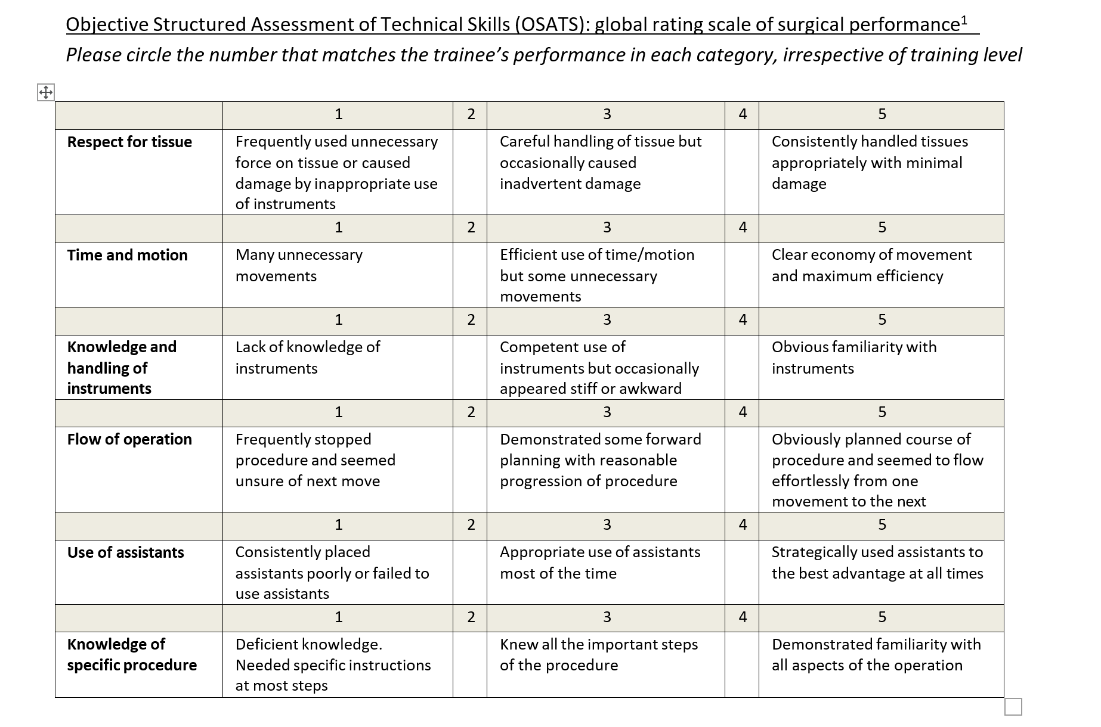

Slide 22
Challenges Solutions
Hospital accreditation – curriculum promoted and supported
Train the Trainers courses
Europe wide questionnaires from Specialists and trainees to obtain feedback on O+G curriculum
Revision based on extensive trainee and trainer feedback
Different health systems and funding models
Implementation and dissemination

Slide 23


Thankyou!
centraloffice@ebcog.eu
SCTA committee
EBCOG Council

