Slide 1



A European Framework (ETR) for
Certification of Paediatric Rheumatology
Prof. Marija Jelusic, MD, PhD, Zagreb, Croatia
Chair of PReS Education and Training Committee, ETR Subcommittee
UEMS Spring Council Meeting
24-25th of April 2026, Tunisia

Slide 2
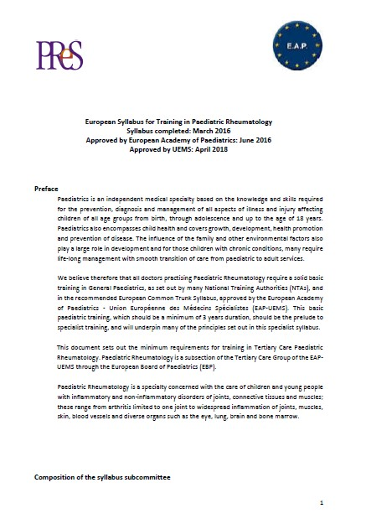
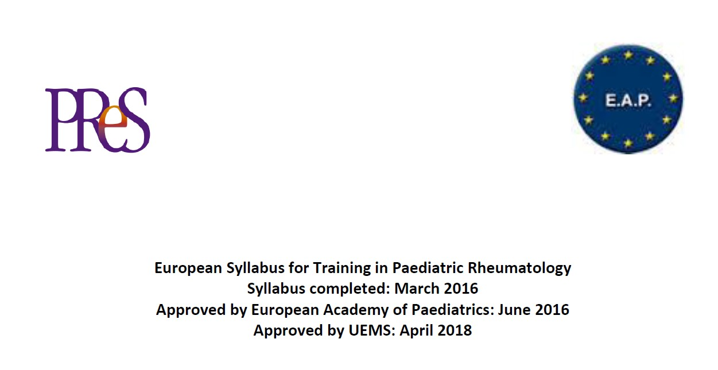
According to the new European requirements - UEMS, the Syllabus or European Training Requirements (ETR) should be updated every 3 years.
Notes:
It was really time to update the ETR

Slide 3
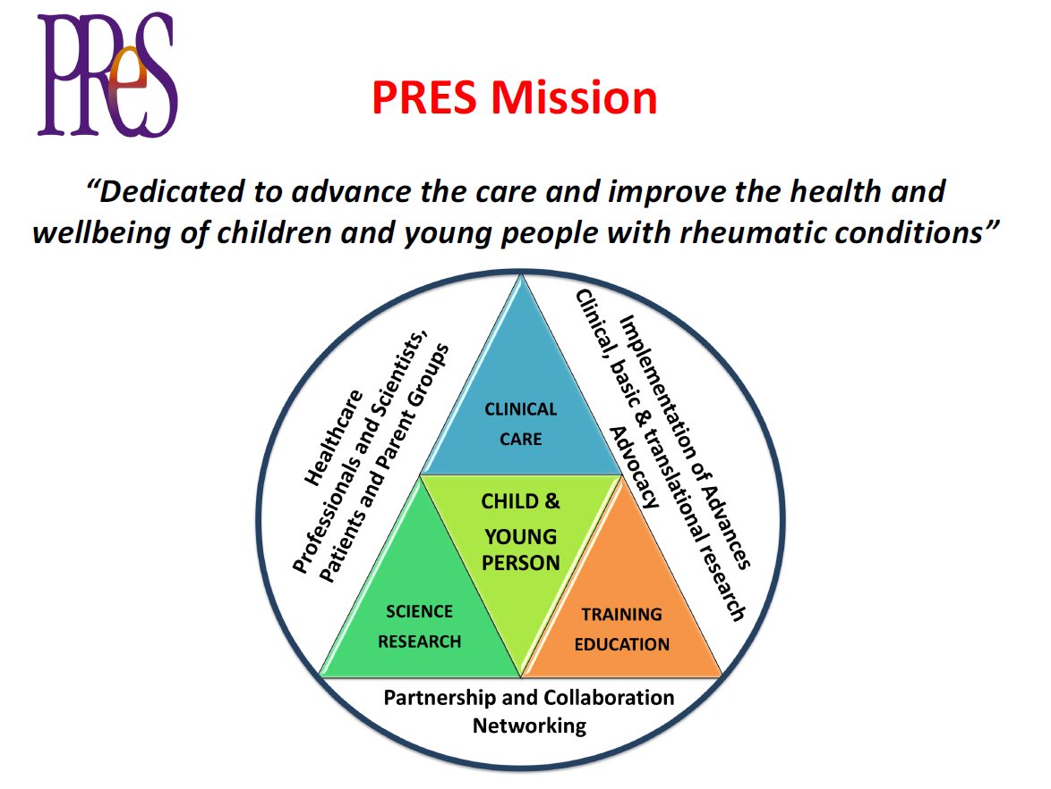

Education and Training

Slide 4
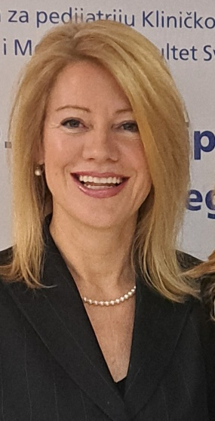



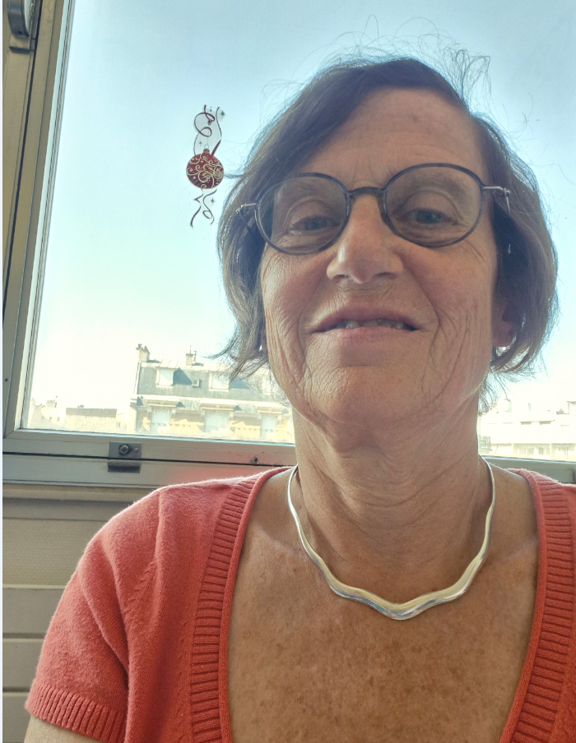





Natasa Toplak,
Ljubljana, Slovenia
Edoardo Marrani,
Florence, Italy
Brigitte Bader-Meunier
Paris, France
European Training
Requirements
Working Group
Jordi Antón López,
Barcelona, Spain
Marija Jelusic, Chair,
Zagreb, Croatia
Petra Hissink Muller
Leiden, Netherlands
Erdal Sağ,
Ankara, Turkey
Sónia Melo Gomes,
London, UK
Ezgi Deniz Batu,
Ankara, Turkey
Joost F Swart,
Utrecht, Netherlands
„ A picture is worth a thousand words”

Slide 5
DEVELOPMENT PROCESS of the ETR for Pediatric Rheumatology
PReS ETR WORKING GROUP
Prof. Marija Jelusic (Chair) and ETR WG members
PReS COUNCIL – REVISION of the ETR
Development Process
+ National representatives of the Education and Training Committee
JAN
01-08.2024
Working Group Upadated Original ETR
PReS EXECUTIVE
ETR WG
Reviewed and approved
SEP
2024
PReS Council Approved Revised ETR- GA
UEMS national representatives and PReS Executive consented and approved
OCT 2024
JAN 2025
Evaluation by the EAP
Approved with minor comments
JUN
06-07.2025
UEMS ETR Committee Review
Comments & recommendations
March
2026
Final Revisions Complete
Ready for UEMS Council Approval

Slide 6
Key innovations in updated ETR for Paediatric Rheumatology:
Competency-based education (CBME - CanMEDS-aligned)
Integration of EPAs (real clinical tasks)
Workplace-based assessment (mini-CEX, DOPS, case-base discussion)
Focus on non-technical skills (communication, teamwork, leadership, profesionalisam)
Patient-centred care (shared decision-making and communication)
Multidisciplinary approach
Transition (AYA) medicine
Emphasis on lifelong learning and reflective practice (harmonisation across Europe)
The updated ETR reflects a shift from time-based training to competency-based education, integrating EPAs and focusing on real-world clinical practice and patient-centred care

Slide 7
Core competencies in pediatric rheumatology:
clinical expert with the ability to diagnose, manage, and prevent a wide spectrum of inflammatory and non-inflammatory conditions affecting the joints, muscles, and connective tissues in children and adolescence
expertise in clinical immunology, genetics, imaging, and the long-term multidisciplinary management of chronic conditions
holistic care - physiotherapy, occupational therapy and psychological support
transitional care - collaboration with adult rheumatologists to address developmental, psychological, and logistical challenges
˝Pediatric rheumatic disease require dedicated expertise to ensure timely diagnosis, apropriate treatment and optimal long-term outcomes.˝
- EULAR/SHARE, 2015-2019
˝Children with rheumatic diseases have distinct clinical presentation and treatment needs that reguire specialised expertise.˝
- EULAR/SHARE, 2015
˝Optimal care for children with rheumatic diseases requires multidisciplinary ecpertise and structured transition to adult care.˝
- EULAR, 2019,

Slide 8
The aim of ETR for Paediatric Rheumatology: to ensure every child and young person with rheumatic disease in Europe receives equitable, high-quality, and continuous care.
Defines core competencies across Europe (clinical, immunological, multidisciplinary care)
Strengthens training in rare and complex diseases (JIA, vasculitis, autoinflammatory diseases)
Embeds transitional care and AYA medicine as essential competencies
Promotes cross-border consistency while respecting national systems
Supports lifelong learning and subspecialty recognition
“Standardising training is not about uniformity — it is about guaranteeing quality for every child, everywhere.”

Slide 9
Impact of ETR acros stakeholders:
PATIENTS
Earlier and more accurate diagnosis
Access to specialised, evidence-based care
Multidisciplinary and holistic management
Improved long-term outcomes and quality of life
TRAINEES (SUBSPECIALISTS)
Clear, harmonised competency framework
Structured training in rare and complex diseases
Exposure to multidisciplinary care
Recognition of expertise across Europe
TRAINERS & INSTITUTIONS
Standardised training and supervision framework
Quality assurance and measurable outcomes
Strengthened academic and clinical excellence
Alignment with European standards (UEMS/EULAR)
“ETR ensures that expertise is not dependet on geography, but guaranteed by standards.”

Slide 10
The document is consistent with European Union legislation on the recognition of professional qualifications (Directives 2005/36/EC and 2013/55/EU) and on cross-border healthcare (Directive 2011/24/EU).
Reflects key principles of transparency, competency-based education, and professional mobility within Europe.
Supports harmonisation and mutual recognizion of specialist training across Europe.
The curriculum follows the CanMEDS framework and is implemented through Entrustable Professional Activities (EPAs), with assessment methods that support a stepwise progression towards independent practice.
ETR is devided in three parts + two appendixs:
TRAINING REQUIREMENTS FOR TRAINEES
TRAINING REQUIREMENTS FOR TRAINERS
TRAINING REQUIREMENTS FOR TRAINING INSTITUTIONS
Appendix 1 – Entrustable Professional Activities (EPAs) in Paediatric Rheumatology
Appendix 2 – Transitional care for Adolescents and Young adults (AYA) in Pediatric Rheumatology

Slide 11
Structure of ETR: modular, flexible, and interdisciplinary
TRAINING REQUIREMENTS FOR TRAINEES
Component | Description
Duration | Require a solid basic training in General Paediatrics, as set out by many National Training Authorities (NTAs), which should be a minimum of 3 years duration. After that, minimum of 24 months full-time equivalent training in paediatric rheumatology
Format | Competency-based, modular training integrating clinical practice with theoretical learning. Includes workplace-based learning, case-based discussions, and structured educational activities.
Settings | Accredited paediatric rheumatology training centres, including inpatient and outpatient care. Exposure to multidisciplinary management and collaboration with related specialties is required.
Supervision | Supervised training under qualified paediatric rheumatology specialists. Ongoing feedback based on workplace-based assessments (including EPAs) and structured mentoring.
Evaluation | Continuous formative assessment with documented progress in competencies. Summative evaluation based on Entrustable Professional Activities (EPAs), portfolio review, and certification according to national frameworks (e.g. CAQ where applicable).
End of training | Under the responsibility of NTAs - a final examination at the end of training that covers the entire curriculum. From 2023. PReS has established a paediatric rheumatology knowledge-based exam (KBE)

Slide 12
Domains and learning outcomes in paediatric rheumatology
TRAINING REQUIREMENTS FOR TRAINEES
Domain | Learning Outcomes
Clinical Immunology & Autoimmunity | Understand immunopathogenesis of paediatric rheumatic diseases; apply biomarkers and genetic tools
Paediatric Musculoskeletal Medicine | Perform MSK examination, identify abnormalities, recognise developmental variants
Disease-Specific Management | Manage JIA, SLE, JDM, vasculitis, systemic sclerosis, autoinflammatory diseases
Emergency Rheumatology | Recognise and manage MAS, acute vasculitis, SLE flare, pulmonary haemorrhage
Pharmacology & Therapeutics | Use DMARDs, biologics, JAK inhibitors; apply steroid stewardship
Imaging | Interpret X-ray, ultrasound, MRI in paediatric rheumatology
Procedural Skills | Perform intra-articular injections, aspiration, US-guided techniques
Rehabilitation & ICF Model | Collaborate with PRM; optimise patient functioning
Transition | Prepare adolescents for transition to adult care
Ethics & Professionalism | Apply consent/assent, confidentiality, cultural competence
Communication | Deliver difficult news; enable shared decision-making
Health Advocacy | Address social determinants of health; support vulnerable populations
Scholarship | Apply research literacy, quality improvement, and critical appraisal

Slide 13
CanMed framework
TRAINING REQUIREMENTS FOR TRAINEES
Role | Competency | Examples
Medical Expert | Core clinical expertise in paediatric rheumatology. | JIA, SLE, vasculitis; MSK exam; imaging; DMARDs/biologics; injections
Communicator | Effective, age-appropriate communication and shared decisions. | Explain disease; difficult conversations; care plans
Collaborator | Multidisciplinary, coordinated care. | MDT work; transition care (facilitate structured transition to adult rheumatology services; cross-specialty collaboration
Leader | Quality care and system improvement. | QI projects; clinical pathways; resource use
Health Advocate | Equity and access to care. | Access to therapy; school support; vaccination, raising awareness of paediatric rheumatic diseases
Scholar | Lifelong learning and research. | Teaching; research; critical appraisal
Professional | Ethics, accountability, professionalism. | Consent; confidentiality; reflective practice

Slide 14
Entrustable Professional Activities (EPAs)
TRAINING REQUIREMENTS FOR TRAINEES
- Appendix 1. -
Assessment and long-term management of Juvenile Idiopathic Arthritis
Early recognition and acute management of Macrophage Activation Syndrome
Care of paediatric connective tissue and overlap diseases
Evaluation and treatment of childhood vasculitic disorders
Management of autoinflammatory and periodic fever syndromes
Comprehensive paediatric musculoskeletal examination
Delivery of intraarticular steroid therapy in children
Clinical interpretation of laboratory and imaging findings
Individualised therapeutic planning and monitoring
Prevention and management of treatment-related risks
Leadership and coordination of multidisciplinary care
Advanced communication with children and families
Structured transition to adult rheumatology services
Engagement in research, audit, and service improvement
Professionalism, ethics, safeguarding, and advocacy

Slide 15
TRAINING REQUIREMENTS FOR TRAINERS
The Training Programme Director (TPD) must have been paediatricians and practising paediatric rheumatology for at least five years.
Trainers must have strong clinical expertise and formal training in medical education, including supervision and assessment.
High-quality training requires structured mentorship, regular feedback, and individualised learning plans (PDP).
They are responsible for monitoring progress, assessing competencies, and guiding professional development.
Continuous professional development and engagement in teaching, research, and quality improvement are essential.
“ Excellence in training depends not only on curriculum, but on the quality of mentorship.”

Slide 16
TRAINING REQUIREMENTS FOR TRAINING INSTITUTIONS
Training centres must provide comprehensive clinical exposure with access to multidisciplinary specialties (ophthalmology, nephrology, dermatology, immunology, orthopaedics, rehabilitation, psychology, physiotherapy).
They should ensure advanced diagnostics and facilities, including imaging (US, MRI, CT), laboratory services, and emergency/ICU care.
A high-quality environment includes structured education, modern equipment, and access to scientific literature and digital resources.
Centres must support research, audit, and collaboration across national and international networks.
Accreditation and governance ensure quality, standardisation, and continuous improvement of training programmes.

Slide 17
APPENDIX 2 – Transitional care for Adolescents and Young adults (AYA) in Pediatric Rheumatology
structured, goal-oriented process that prepares and supports adolescents and young adults (AYAs) with rheumatic and autoinflammatory diseases as they move from paediatric to adult healthcare systems
transitional care in paediatric rheumatology goes far beyond disease management — it integrates developmental, psychosocial, and self-management aspects to prepare young people for independent adult care
focus is on structured, patient-centred transition, ensuring continuity, autonomy, and safe long-term outcomes.

Slide 18
APPENDIX 2 – Transitional care for Adolescents and Young adults (AYA) in Pediatric Rheumatology
Core Competencies in AYA Transitional Care for Paediatric Rheumatology
Domain | Expected Competencies
Biopsychosocial Development | Understand developmental stages, impact of chronic inflammation, functional limitations, and medication effects.
Disease-Specific Transition Needs | Integrate knowledge of JIA, cSLE, JDM, vasculitis, autoinflammatory syndromes into transition planning; anticipate flares and adherence issues.
Readiness Assessment | Use validated tools; evaluate autonomy, health literacy, and self-management skills.
Communication | Deliver adolescent-centred, culturally sensitive communication; address confidentiality, consent, and caregiver roles.
Coordination of Care | Organize joint clinics, MDT meetings, school/social support engagement, and continuity with adult rheumatology.
Self-Management Promotion | Guide AYAs in shared decision-making, treatment understanding, goal setting, and long-term health planning.
Professionalism | Uphold ethical practice, manage risk behaviours and sensitive disclosures, maintain boundaries, demonstrate reflective practice.
Transition is a multidimensional process

Slide 19
APPENDIX 2 – Transitional care for Adolescents and Young adults (AYA) in Pediatric Rheumatology
Learning Outcomes by Transitional Care Domain
Domain | Knowledge
Adolescent development & chronic rheumatic disease | Adolescent development, autonomy, risk-taking, and disease-specific challenges in JIA, cSLE, JDM
Transitional care frameworks | Structured transition models (EULAR, Got Transition), readiness assessment, transfer planning
Chronic disease activity & AYA monitoring | Disease activity monitoring (JIA indices, nephritis, muscle strength, vasculitis, AID)
Medication safety & adherence | DMARDs/biologics, risks, teratogenicity, vaccination principles
Psychosocial & mental health / school-work needs | Mental health, school/work challenges, pain and fatigue
Reproductive and sexual health | Pregnancy risks, contraception, therapy-related considerations
Interdisciplinary coordination | Roles of MDT (ophthalmology, nephrology, dermatology, PT/OT, psychology, social care)
Self-management & empowerment | Health literacy, behaviour change, shared decision-making
Digital health & remote care | eHealth, telemedicine, data protection (GDPR)
These domains ensure a holistic and patient-centred transition to adult services

Slide 20
APPENDIX 2 – Transitional care for Adolescents and Young adults (AYA) in Pediatric Rheumatology
EPAs for Transitional Care in Paediatric Rheumatology
Conduct an AYA-appropriate rheumatology consultation
Manage confidentiality, autonomy & consent
Coordinate paediatric–adult rheumatology transfer
Perform musculoskeletal examination & documentation
Interpret imaging for transitional-age patients
Lead MDT care planning
Counsel AYAs & caregivers; deliver difficult news
Transition management for JIA
Transition management for cSLE
Transition management for JDM
Transition management for vasculitides
Transition management for autoinflammatory diseases
Medication safety & biologic continuity
Psychosocial & functional assessment

Slide 21
Heartfelt gratitude to all contributors
PReS ETR Working group members / Composition of the syllabus subcommittee
Prof. Nada Cikes, prof. Paollo Ricciand, UEMS ETR Review Bord
UEMS Adolescent Medicine and Health Multidisciplinary Joint Committee
European Academy of Paediatrics (EAP)
UEMS coordination team

