Slide 1
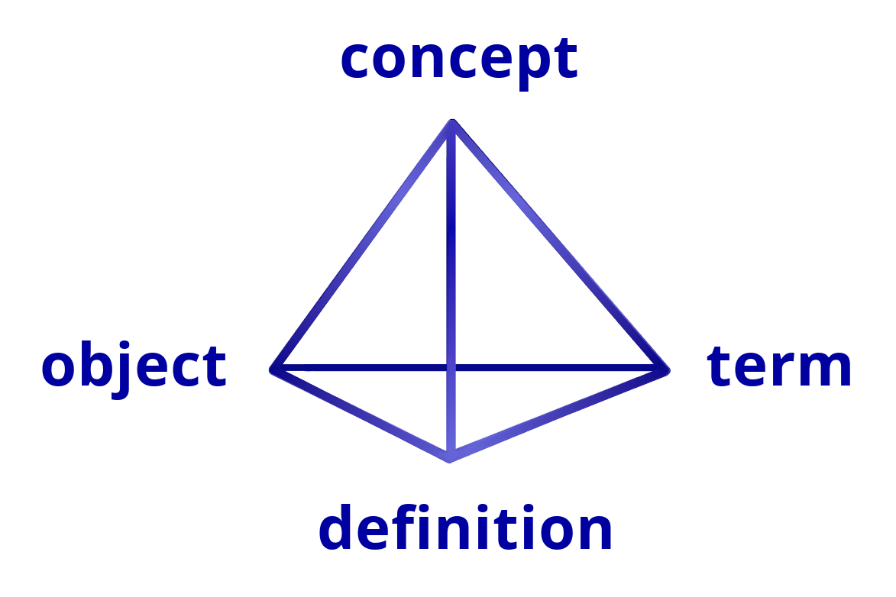
Beyond a Glossary
– Standardisation of
Terminology
Arthur Felice, MD, MSc, FEBS, FRCS Ed.
President of the European Board of Surgery
Vice-President UEMS Division of General Surgery
University of Malta

Slide 2
There is a dynamic interplay between words, concepts and context. Terms should not be considered in isolation but through this dynamic interplay with wider contexts.

Slide 3
Definitions are essential for effective discussion

Slide 4
Language and terminology
Words (terms) are based on Convention not a logical conclusion.
One can look at this from two perspectives:
    Names Model: Words are seen as names (labels) that refer to things.
    Tools Model: Words are considered as tools we use as a practical instrument for communication and expression.
Whichever of these two perspectives one uses, there are practical and important consequences.
Definition of terms avoids equivocation.
For clear understanding relationship between terms and concepts should not be subject to a continuous state of flux

Slide 5
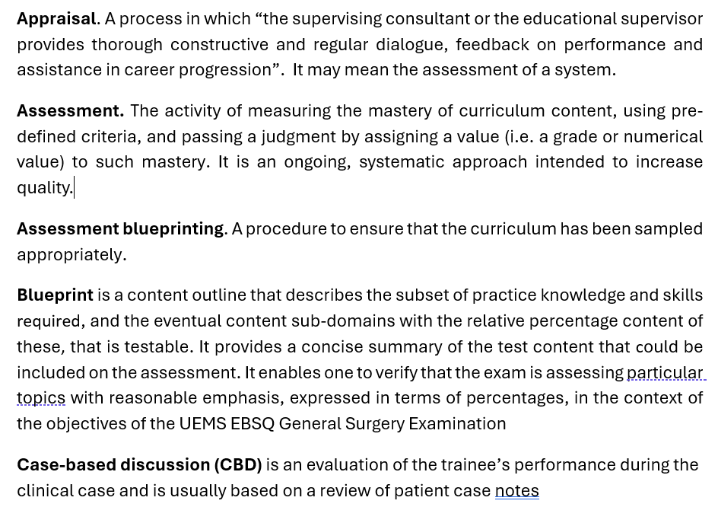
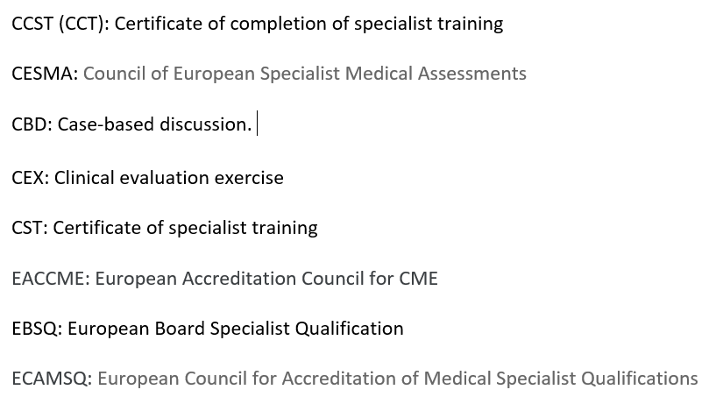
Examples involving Standardisation of Terminology
The Glossary of Terms
A list of Acronyms

Slide 6
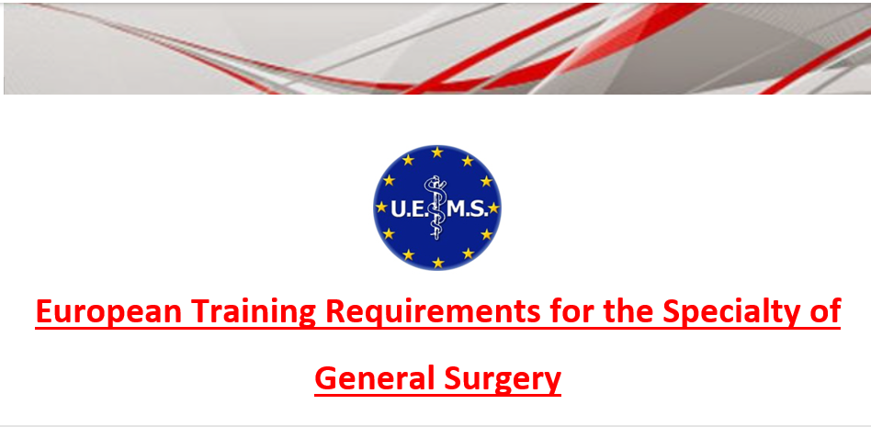
Within the context of the UEMS…..
I was initially involved with compiling a Glossary and list of Acronyms when writing the ETR for the Specialty of General Surgery in 2012
In 2023 the 1st draft of the Glossary and list of Acronyms within the UEMS WGPGT
In April 2026 the 3rd draft presented at the UEMS Council WGPGT Meeting in Tunisia

Slide 7
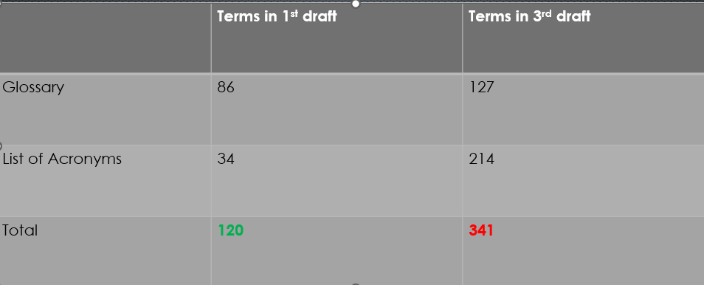
Document development – Essential statistics

Slide 8
This Glossary and list of Acronyms should now be published and opened for debate within the UEMS WGPGT.

Slide 9
Conclusion
Standardisation of terminology using the methods mentioned, is essential to avoid equivocation and aid debate.
The rapidly expanding volume of evidence and information overload necessitates clarity and a standard use of terms to express the same concept.
This standardisation may be subject to periodic review but not a continuous state of flux.
To resolve our problems with Terminology, we need to go beyond a Glossary.

Slide 10

Any Questions?

Slide 11

Thank you!

