Slide 1


Current 2026 FEMS Key Activities and Future Developments
Alessandra Spedicato
FEMS President

Slide 2
FEMS
Recognition of Medical Profession as an Arduous Job
FEMS Position Paper on EWTD
Declaration of Doctors’ Fundamental Rights
Shaping the Future of Doctors’ Health
UEMS Council Meeting 24-25 April 2026
Alessandra Spedicato
FEMS President

Slide 3
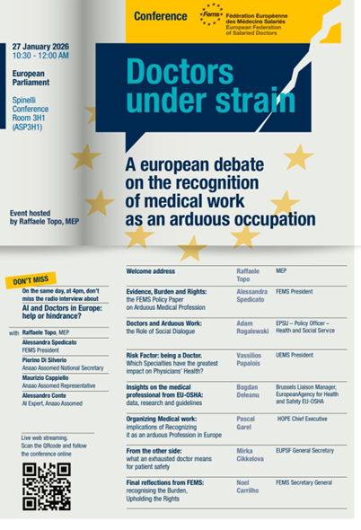
Recognition of Medical Profession as an Arduous Job
27 October 2025: FEMS Policy Paper submitted to the Cabinet of Ms MINZATU
9 December 2025 : Follow-up contact initiated with the Head of Unit for Health and Safety at Work
21 January 2026: meeting held to present FEMS priorities and discuss key concerns
OUTCOME: constructive dialogue, leading to further contacts with relevant stakeholders
27 January 2026: FEMS Conference at the European Parliament
29 May 2026: The risk factor of being a doctor: recognising the medical profession as an arduous job – UEMS Congress
EU – OSHA
OCCUPATIONAL Physical and mental Strain INDEX
UEMS Council Meeting 24-25 April 2026
Alessandra Spedicato
FEMS President

Slide 4

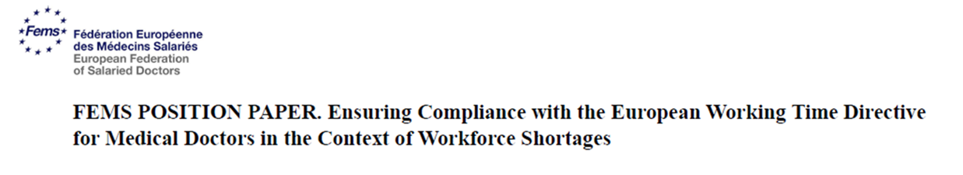
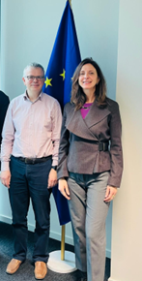
FEMS Position Paper on EWTD
WHICH SOLUTIONS?
To provide for a minimum number of mandatory rest days to compensate for the failure to
ensure compliance with the rest break
working time must be tied to appropriate staffing levels, with staffing calculations based on the real Full time Equivalent (FTE) of physicians
to enhance the attractiveness of the medical profession, including appropriate financial compensation for particularly demanding or antisocial working hours
To enhance monitoring of Member States
To set a maximum number of overtime hours – Healthy ageing at work and CPE
Meeting with Adam POKORNY
UEMS Council Meeting 24-25 April 2026
Alessandra Spedicato
FEMS President

Slide 5
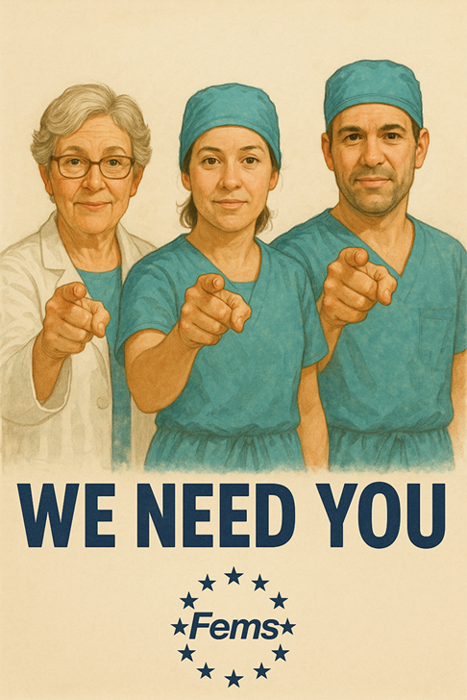

28 May 2026: UEMS Congress
Dissemination and presentation of the document at European and national levels
Engagement with the media
Declaration of Doctors’ Fundamental Rights
Shaping the Future of Doctors’ Health
KEY HYPOTHESES VS
Preliminary results
Doctors may face specific health challenges
Medical profession could be considered as an arduous work
Doctor’s health status could influence the organization of work
Work organization could have an impact on doctor’s health
Full Time Equivalent – FTE- less than 1
CONFIRMED
UNDER INVESTIGATION
UNDER INVESTIGATION
CONFIRMED
CONFIRMED
GENDER DIFFERENCES IN IMPACT
ATTRACTIVENESS OF THE MEDICAL PROFESSION
EFFECTS OF WORKING TIME ON HEALTH STATUS
UEMS Council Meeting 24-25 April 2026
Alessandra Spedicato
FEMS President

Slide 6
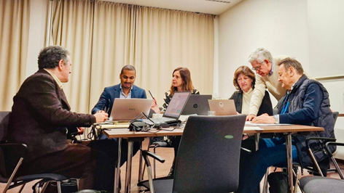
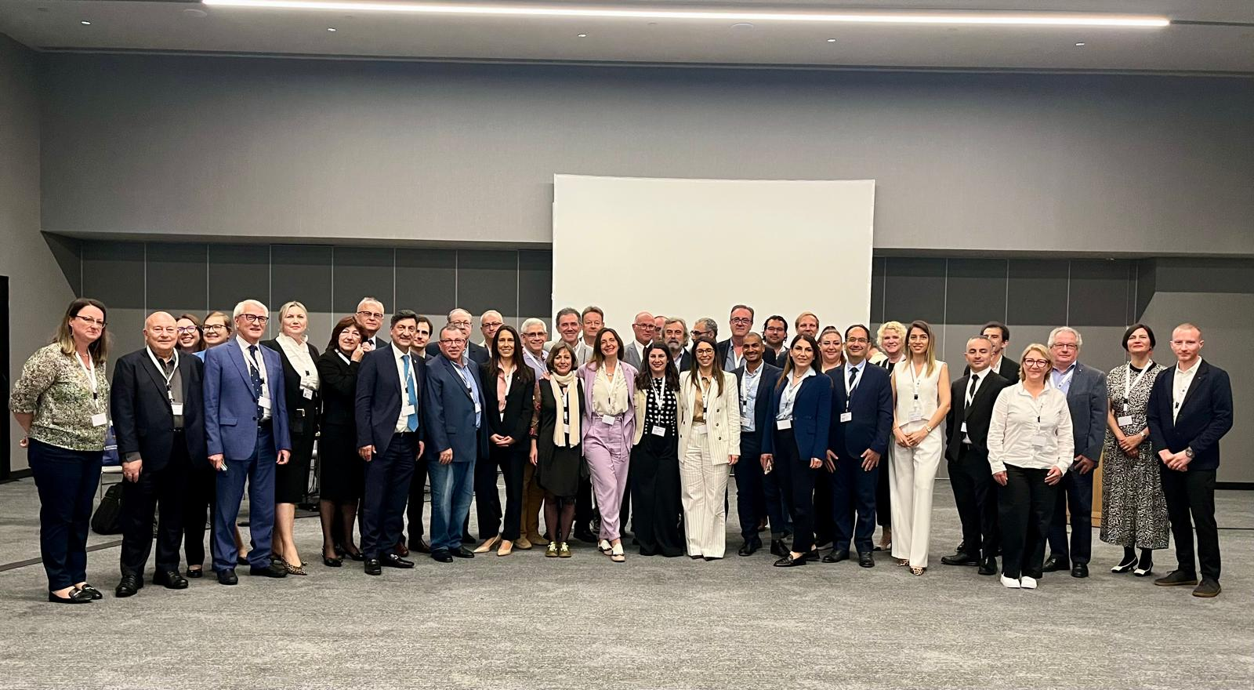



UEMS Council Meeting 24-25 April 2026
Alessandra Spedicato
FEMS President

