Slide 1
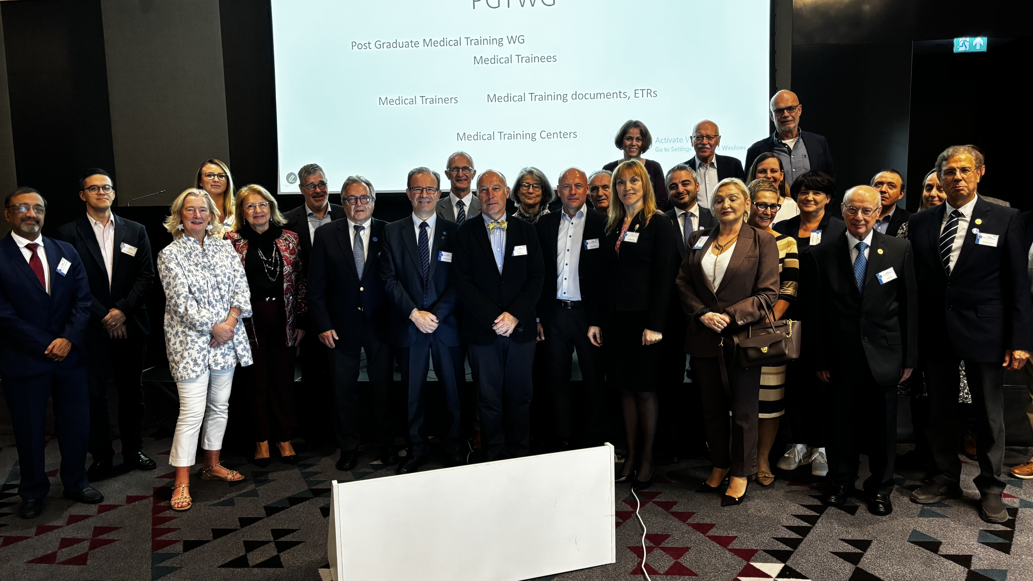
WG PGT, 17/10/2025, Tbilisi

Slide 2
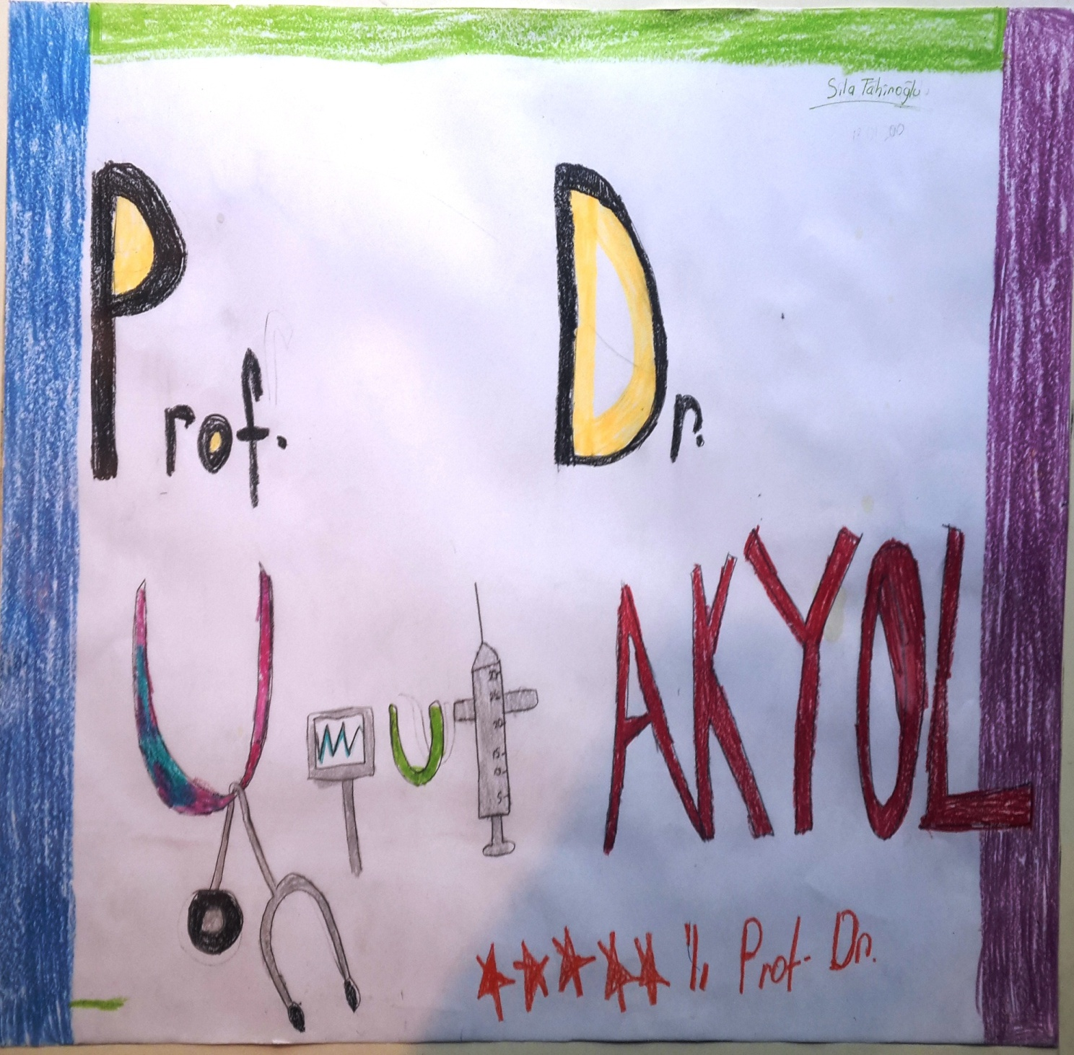
Thank You

Slide 3
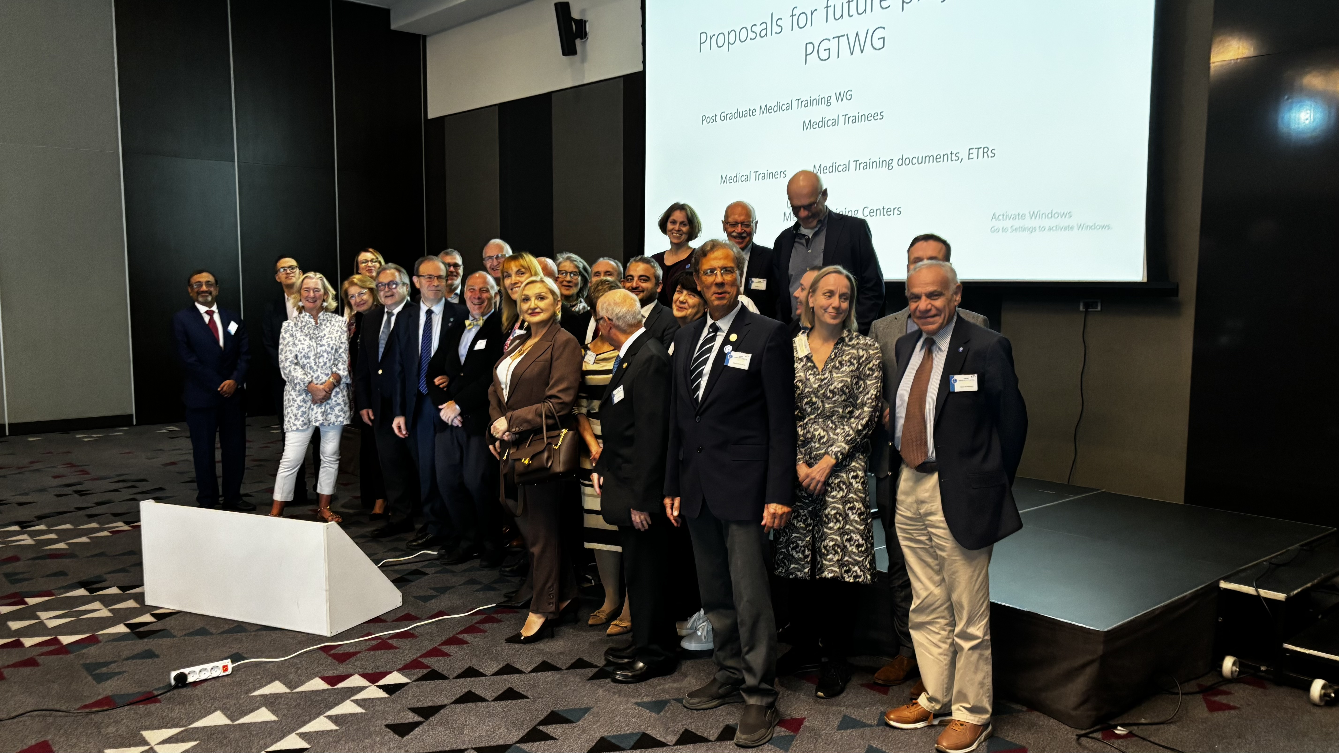

Slide 4
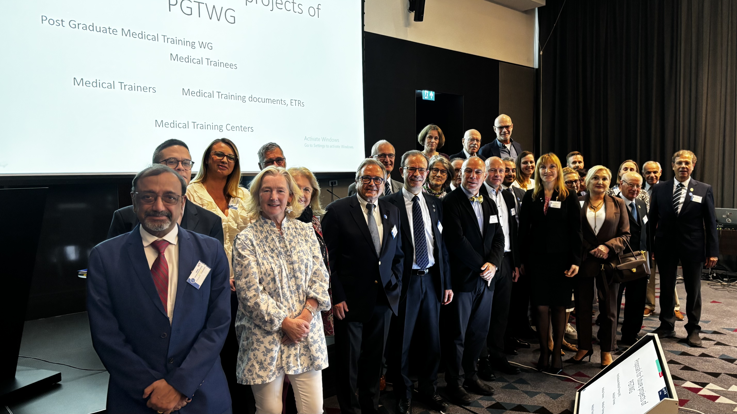

Slide 5
WG PGT, Tbilisi 17/10/2025
Guidelines for Appraisal and Accreditation of Post-Graduate Training Center
UEMS Glossary
Future Projects

Slide 6
PGTWG
Post Graduate Medical Training WG
Medical Trainees
Medical Trainers Medical Training documents, (ETRs)
Medical Training Centers

Slide 7
Guidelines for Appraisal and Accreditation of Post-Graduate Training Centers
This document aims to clearly define the motive and the process of appraisal of training centers (programs) in UEMS member countries. Appraisal / accreditation is one of the main pillars of post graduate medical training. The document is written to open a new boulevard in UEMS Works, which will evolve in time like the ETRs.
Appraisal / accreditation progression is not mandatory at the moment and will not be over the national processes. It is like a CE mark indicating the center has met UEMS standards for high quality PGT. It aims to assist each center for a better PGT.
This work is based on the previous, valuable efforts of our colleagues who prepared similar papers under UEMS years ago.
Special thanks to Andreas Papandroudis and Naishadh Patil

Slide 8
Guidelines for Appraisal and Accreditation of Post-Graduate Training Centers
The present version of the document will be edited in order to be easier to follow, prevent duplicating parts etc.
It will be distributed among the WG and the UEMS bodies and NMAs for consultation for the final feed-back.
And will be directed to executive for endorsement and acceptance during our spring council meeting.
Your feedback is important. Thank you in advance for your further contribution!

Slide 9
UEMS Glossary
Prof. Arthur Felice (General Surgery, Malta) has been in charge of this important Project aiming for all of us in UEMS family to use the right words and be sure we are talking about the same thing during our discussions, papers, daily work.
Please find the current final draft’s E-address written below and send any feedback to Prof. Felice, who has leading this project with great passion. Thank you very much Arthur!
UEMS Autumn Council Meeting: 17-18 October, 2025 Tbilisi, Georgia | uems.eu

Slide 10
Future Projects
Documentation and safekeeping of Lists of UEMS Fellows and using the potential and needs of Experienced Fellows for Training.
  This will be a win-win situation for all sides!
  It needs legal, statutory changes in UEMS regulations, legislations, ROPs
  We may begin with a practical approach, with small projects in our WG ?
Overlapping competencies in UEMS Specialty ETRs
  Our working group may work on specific cases, which will be assigned by executive committee.

Slide 11
«non-professional» subjects which could/should be implemented into the PGT (by means of ETRs and CME/CPD activities)
The very fast changing world and technology brings serious “opportunities and threats” for PGT as well as whole medicine. There are serious challenges present and on the way for our trainees, trainers and training centers/programs, all the actors of PGMT.
We should act fast and pro-active to protect our trainees, our self, our patients and use these changes as a potential to higher our quality standards.

Slide 12
Some of the proposed subjects here are well beyond the borders of the CanMEDS and UEMS thematic studies. They are current, evolving very fast and are and will be more challenging in near future.

Slide 13
Proposed non-professional training subjects for PGM
Infodemic management, (medical mis-information) non-scientific, false data, leading people wrong distributed by media, social media, politicians, leaders, states.
Technical advances like Artificial Intelligence, Digital health, Virtual medicine, distant PGMT.
Affect of climate crisis, migration, racism on PGT
Disaster management
Ageing of the doctors and health professionals, Physicians’ health status, Exhaustion in doctors and health care workers, decreasing life expectancy of doctors (WHO data).
Violence against doctors and health care workers

Slide 14
Most of these topics are being studied in UEMS bodies as well as other sister European medical organizations.
Our WG should be cooperating with these bodies, and may constitute sub groups to work on effect of these massive challenges on PGMT.
We need colleagues who will be interested to work in our WG, who have experience and interest on these subjects from NMAs and S&Bs or anywhere from UEMS family as well as your colleagues from your academic, teaching centers, hospitals, family etc.

Slide 15
Our WG will go on meeting with bi-monthly virtual meetings.

Slide 16
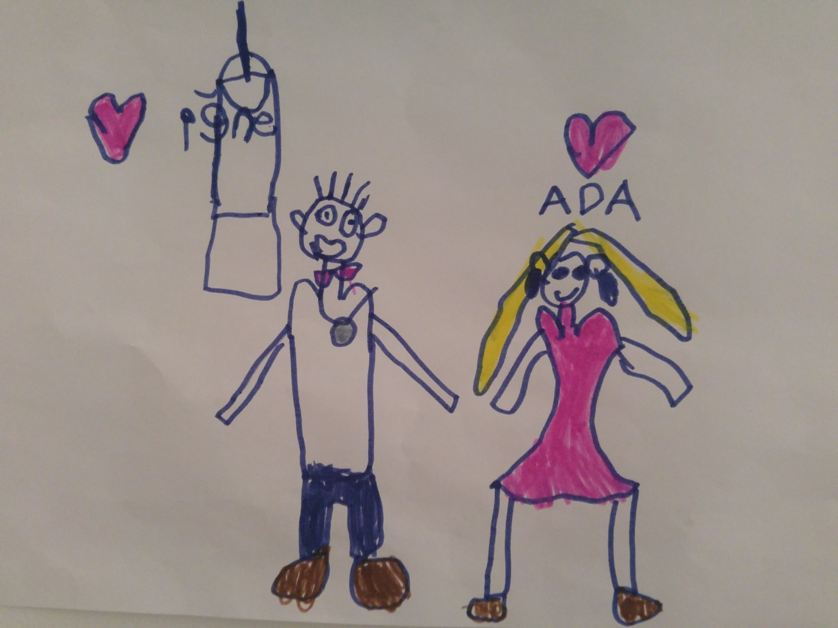
Thank you !

Slide 17
İncluded
  Arthurs glossary address
  Meave preanble the papers being constructive not excluding, no legal consequences at the momeb-nt (hans peter) but should be mendatory in time, preventing Hans peters legal problem for now.
  Tariners training and accreditation. Training centers should have educated trainers not other senior doctors7 surgeons
  Arthur Fellows position and should be clearly statad and recognised by UEMS rops and …s
  Program accrreditation should be done after each center in the program will be accredited
  Nsh being like a CE mark for trainers and trainees to choose the center

Slide 18
Preamble amaç niye çalışıyoruz daha önce de çalışmalar vardı bizim gurubun yeri
Sonra non Professional etc
Overlapi engelle colloboration

