Slide 1

EUROPEAN UNION OF
MEDICAL SPECIALISTS
The advocate of medical specialists
Working Group for Ukraine
October 2025

Slide 2

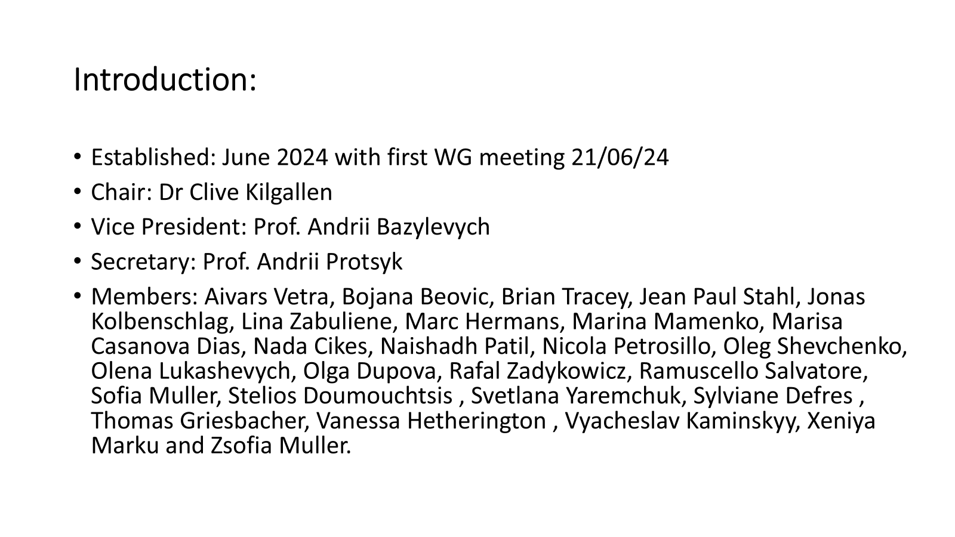

Slide 3

WG Ukraine aims
•Identify areas where UEMS can provide support to colleagues in Ukraine to rebuild and develop a modern healthcare system post-war. This goal is aligned with the overall objective of the UEMS to study, promote and harmonize the highest level of training, Continuing Medical Education, Continuing Professional Development and quality assurance of the medical specialists, medical practice and healthcare across the European Union and Europe.
•Promote Ukrainian advances in medicine to the UEMS European medical community.

Slide 4
Some of our activities:
•We hold monthly WG meetings over Teams.
•There are other focused meetings by Teams.
•We have presented at the last two UEMS Council meetings.

Slide 5
Examples of Current Projects:
•Questionnaire on infectious disease and antimicrobial surveillance.
•Promote adoption of UEMS ETR’s.
•Promote collaboration in simulation medicine.
•Lancet Commission on health in Ukraine - Marisa Casanova Dias.
•Preparation for Congress 2026 – present exemplar examples of medical advances in Ukraine, disseminate the learnings of Ukraine medical service to the rest of UEMS medical community.
•Many members are actively perusing many other allied interests.

Slide 6
Examples of WG Ukraine Achievements:
•Meeting with Simulation RCSI.
•Working with Prof Soroka - Medical RCSI Archives & Ukraine Military Medicine.
•30 Microscopes sent from the Pathology Department here in Royal College of Surgeons Ireland to Bogomoletz Medical University and Kyiv Medical University, Ukraine.
•Met with Occupational Therapy Ukrainian Specialists and Sections.

Slide 7
Thank you
•We would like to thank all WG Ukraine members and everyone we have collaborated with over the last year.
•We would also like to thank the Secretariat of the UEMS for their help and support.
•We want to extend our gratitude and best wishes to our medical colleagues in Georgia.

