Slide 1
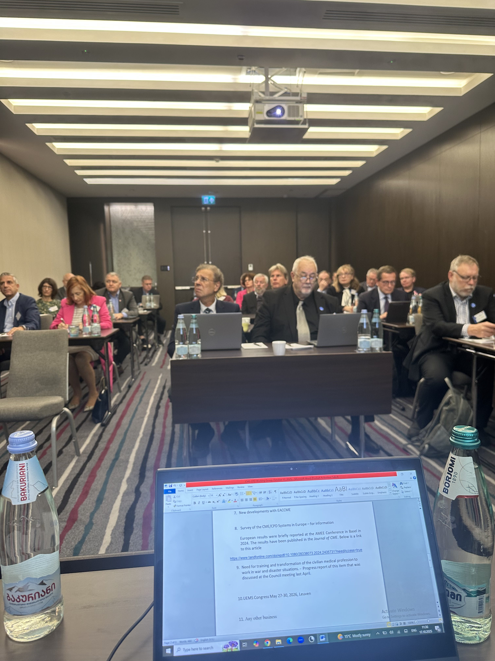
UEMS
Working Group of
CME/CPD
October 17, 2025
Tbilisi, Georgia
Dr. Hannu Halila
Chairman of the WG
UEMS Past President, Honorary Member
Gynecology, Finland

Slide 2
CME / CPD Working Group meeting
Meeting well attended by 33 colleagues representing widely the European countries and various specialities, lively and constructive discussion
Main items on the agenda were the discussion about the UEMS CPD Charter and Questionnaire about the CME/CPD situation in the UEMS member countries

Slide 3
Discussion about next steps
CPD Charter will be distrubuted widely: UEMS members, all UEMS structures, EMOs, EU Commission, European Parliament, WHO, WFME World Federation of Medical Education, EHMA European Health Management Association …
NMAs will be asked to distribute it in their countries
Social media important in the publicity of the Charter
A short summary of key points will be provided
Will be a key point a the UEMS Congress 2026

Slide 4
Questionnaire about the current situation about
CME/CPD situation in the UEMS Member Countries
There is no recent comprehensive information about this topic
Will be sent to UEMS Member Countries
Current draft questionnaire has 17 short questions
The WG had a fruitful conversation about the content
Important to define what is meant by about the different terms (voluntary, compulsory, mandatory, recertification/revalidation, potential sanctions …)
Results to be presented in UEMS Congress in May 2026

Slide 5
Other items at the WG meeting
New Developments within EACCME – SG Joao Grenho
News from UEMS member countries and specialities about CME/CPD situation
Need for training for disaster situations including war
Survey of the CME/CPD systems in Europe - for information
  Publication in the Journal of CME (open access)
  Lawrence Sherman, Hannu Halila, Kathy Chappell: An Overview of Continuing Medical Education/Continuing Professional
  Development Systems in Europe: A Mixed Methods Assessment

Slide 6
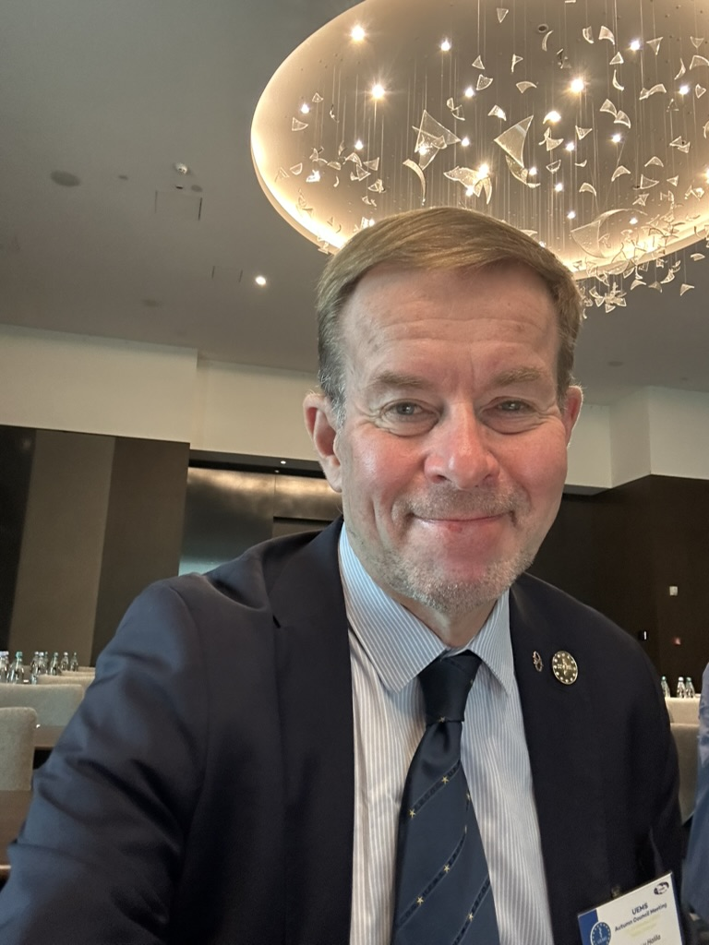
Next meeting of the WG
April 24, 2026 in Tunis
Thank you ! Kiitos !

