Slide 1



UEMS Spring Council 2026 – Tunisia
A Meeting at the Crossroads of Continents and Cultures
Dr Foued Bouzaouache
Tunisian NMA (CNOM) delegate
Notes:
It is a great pleasure for Tunisia to be your next host for the UEMS Spring Council in April 2026 - a meeting at the crossroads of continents, cultures and friendships.

Slide 2
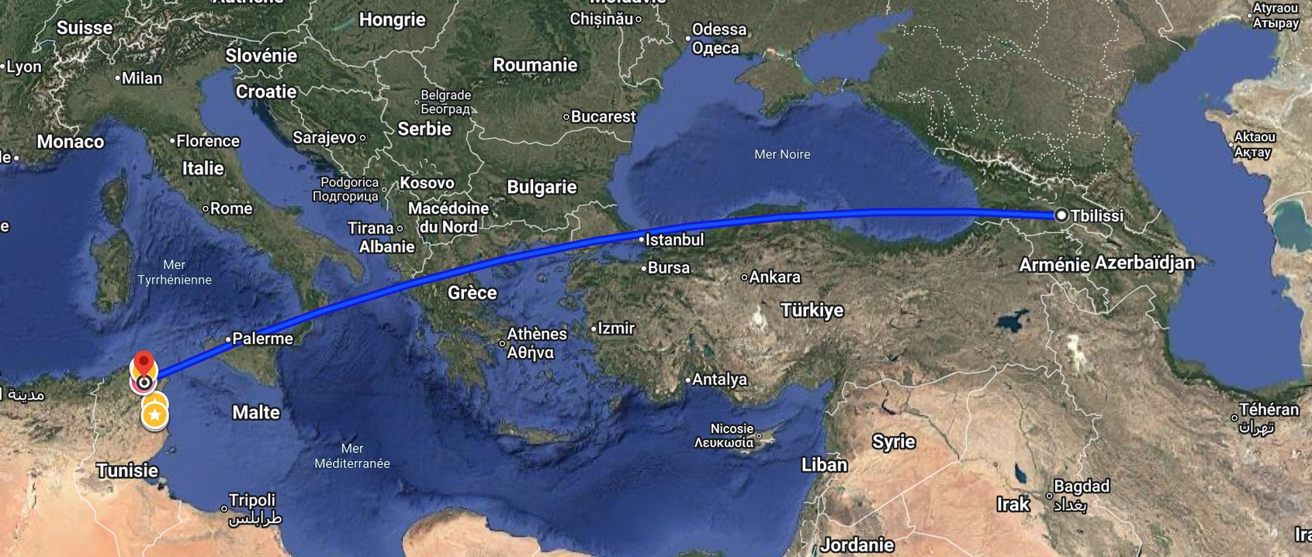
From Tbilisi تفليس to Tunis تونس
Notes:
Before talking about Tunisia today, allow me a small historical wink to our very kind Georgian hosts.

Slide 3
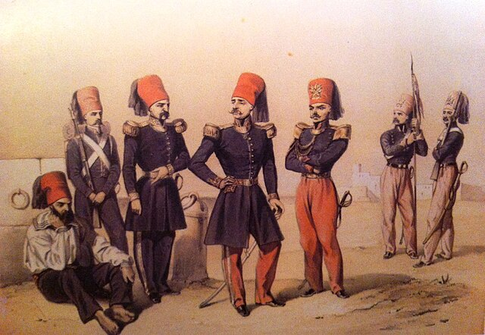
A little-known link between Georgia and Tunisia
Moustapha Khodja
Born 1720 in Georgia, died in 1800 in Tunis
Prime Minister of the Beylik from 1782 until his death
Reformer and patron of the arts
Major influence in achieving independance from direct Ottoman domination
Played a role in the early contacts between Tunisia and the United States, at the time when one of the first treaties of peace and friendship was signed in 1797.
Notes:
One of the most influential ministers of 18th-century Tunisia, Mustapha Khodja, was actually born in Georgia. A reformer, a patron of the arts — and even involved in Tunisia’s early contacts with the United States in 1797.
So perhaps, symbolically, our meeting here in Tbilisi revives a very old connection between our peoples.

Slide 4
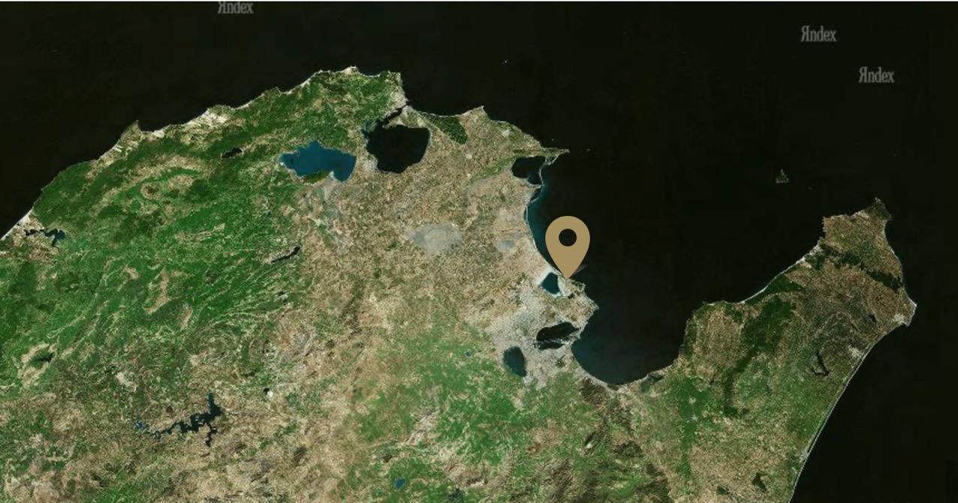

Tunisia, Host of the UEMS Spring Council 2026
Notes:
With that same spirit of openness and dialogue, Tunisia is proud to welcome you next spring for the UEMS Council.
The meetings will take place in Tunis, a safe, sunny and welcoming city at the heart of the Mediterranean. You will find both the efficiency you expect , and the warmth we can’t help offering!

Slide 5
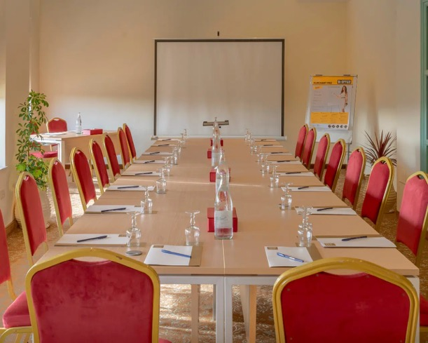
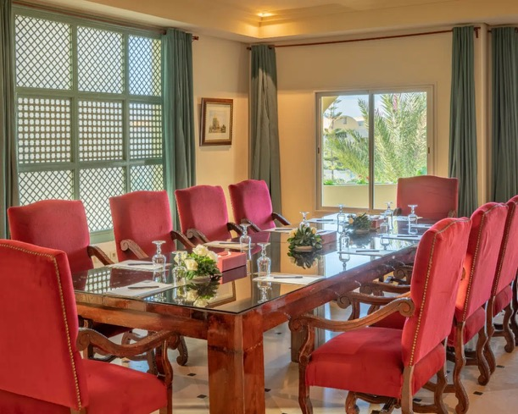
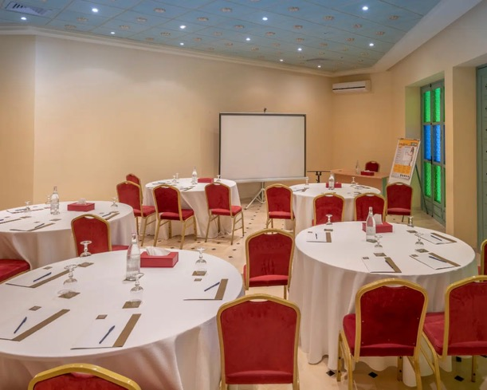
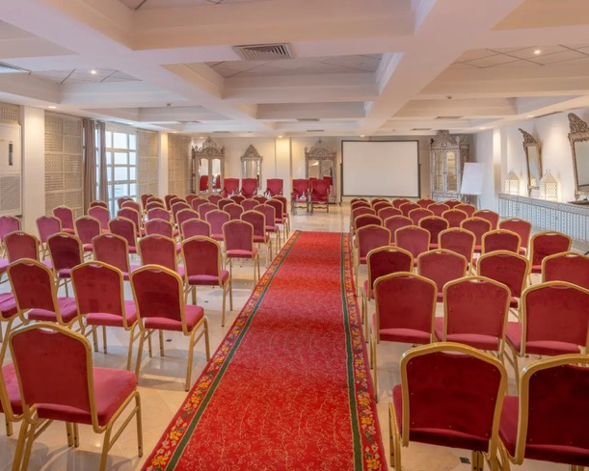
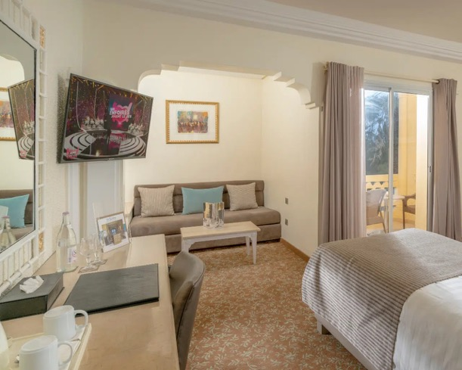
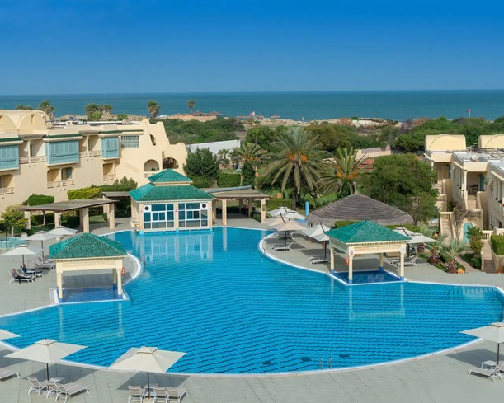
Notes:
Our venue will be the Carthage Thalasso Resort in Gammarth, overlooking the sea, just a few minutes from historic Carthage and the charming village of Sidi Bou Saïd.
It’s an ideal place to combine productive sessions with peaceful surroundings… and maybe a gentle sea breeze.

Slide 6
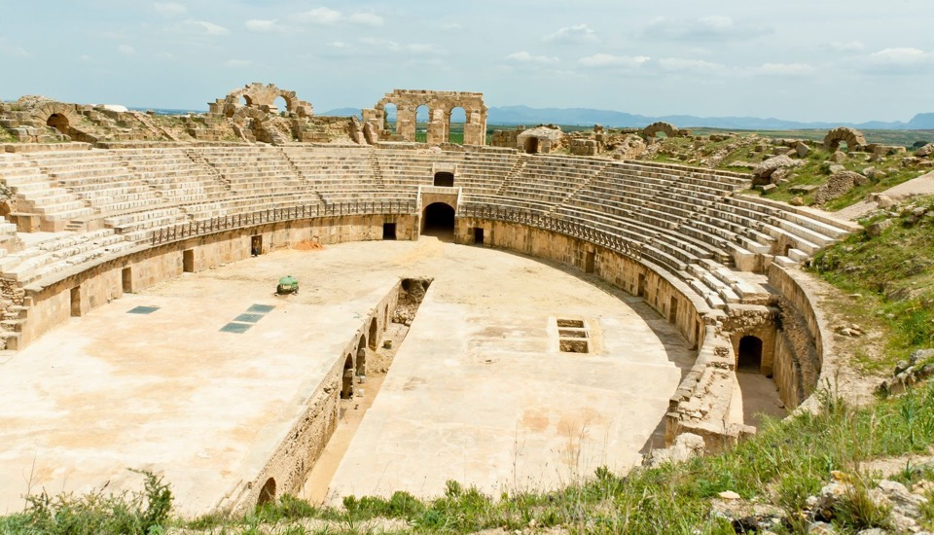
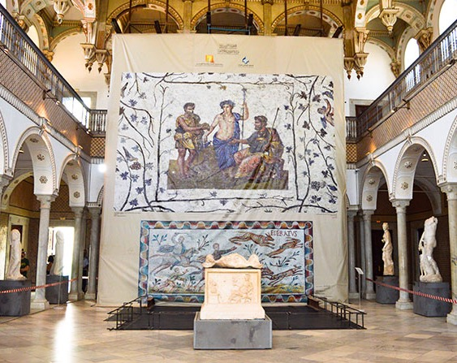
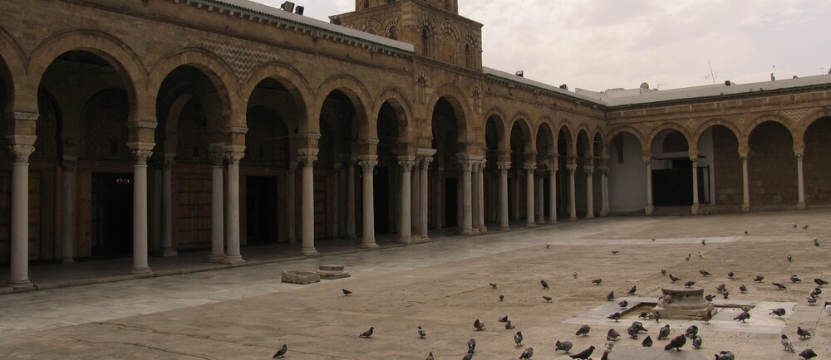
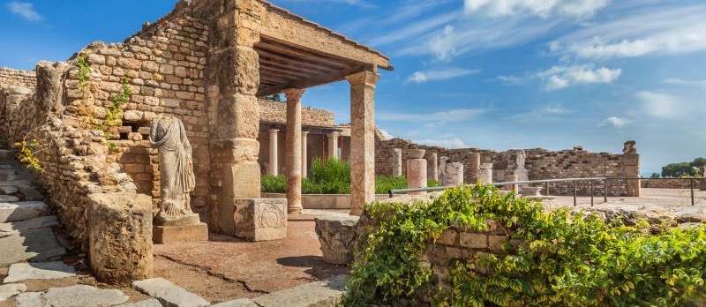
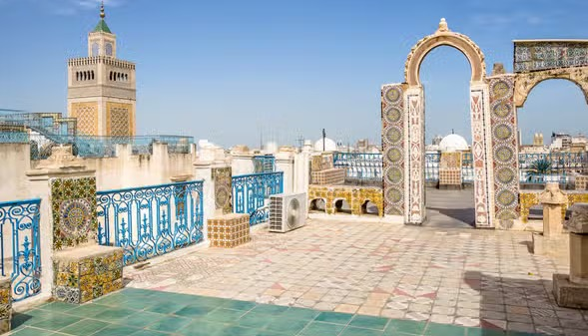
Notes:
For those who haven’t visited us yet, here’s a quick glimpse of what awaits you - sunshine, history, colours, and the Mediterranean spirit.
From the Roman mosaics of the Bardo to the blue-and-white streets of Sidi Bou Saïd - Tunisia will be happy to share both its heritage and its hospitality.

Slide 7
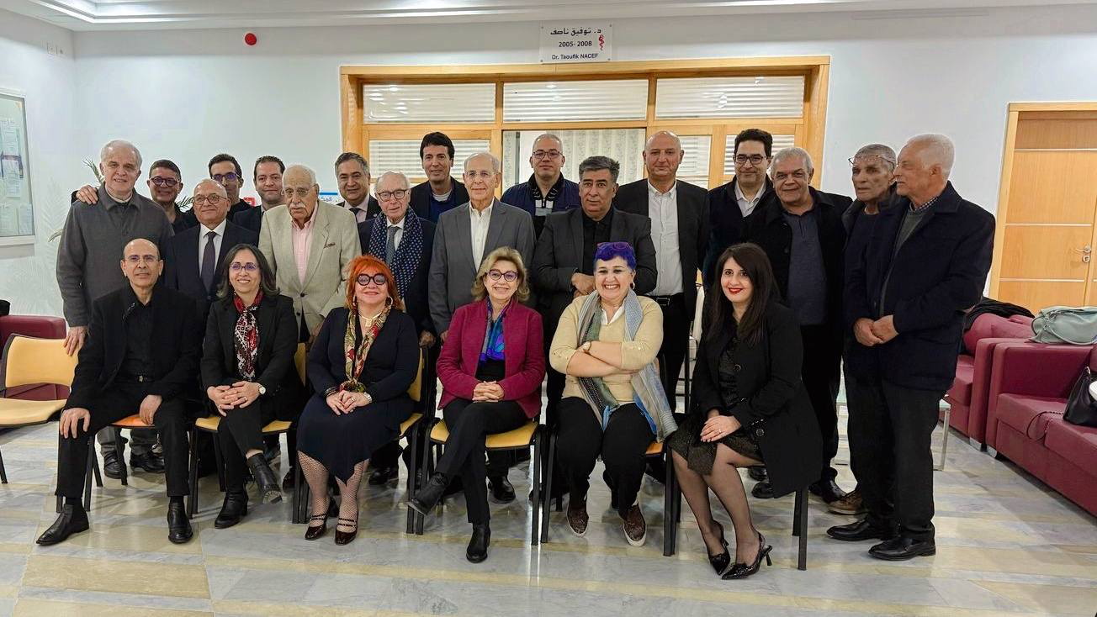
See you in Tunis!
Notes:
And finally, a small preview of your hosts – some members of the Tunisian National and Regional Medical Councils.
You’ll notice we have our own colour code for our feminine hierarchy :
orange for our President, Pr Rym Ghachem psychiatrist
violet for our Secretary General, Dr Rim Horchani, haematolgist
and yellow for the Editor-in-Chief of our journal, Pr Hanen Tiouiri in the middle, retired infectiologist.
As you can see, we take professionalism - and colours - very seriously! ;)
We look forward to meeting you all again, this time under the Tunisian sun.
Thank you, and see you in Tunis!

