Slide 1
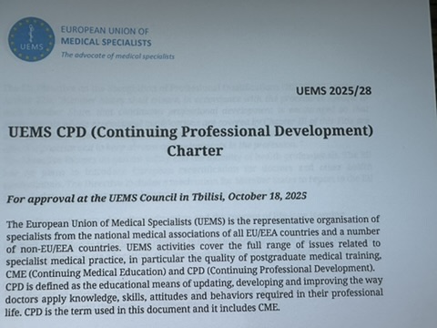
UEMS CPD Charter
October 18, 2025
Tbilisi
Dr. Hannu Halila
Chairman of the CME/CPD Working Group
UEMS Past President, UEMS Honorary Member
Gynecology, Finland

Slide 2
CPD Charter, Background
UEMS Standing CPD (Continuing Professional Development) policy is very old, Basel Declaration from 2001
UEMS CME/CPD Working Group has discussed the new policy at earlier meetings and nominated a smaller Task Force to construct a draft
The Draft was dealt at the UEMS Council in April 2025
The final Draft for the Tbilisi Council meeting was accepted at the UEMS Enlarged Executive meeting on September 16
The proposal is from the WG and also from the UEMS EEC

Slide 3
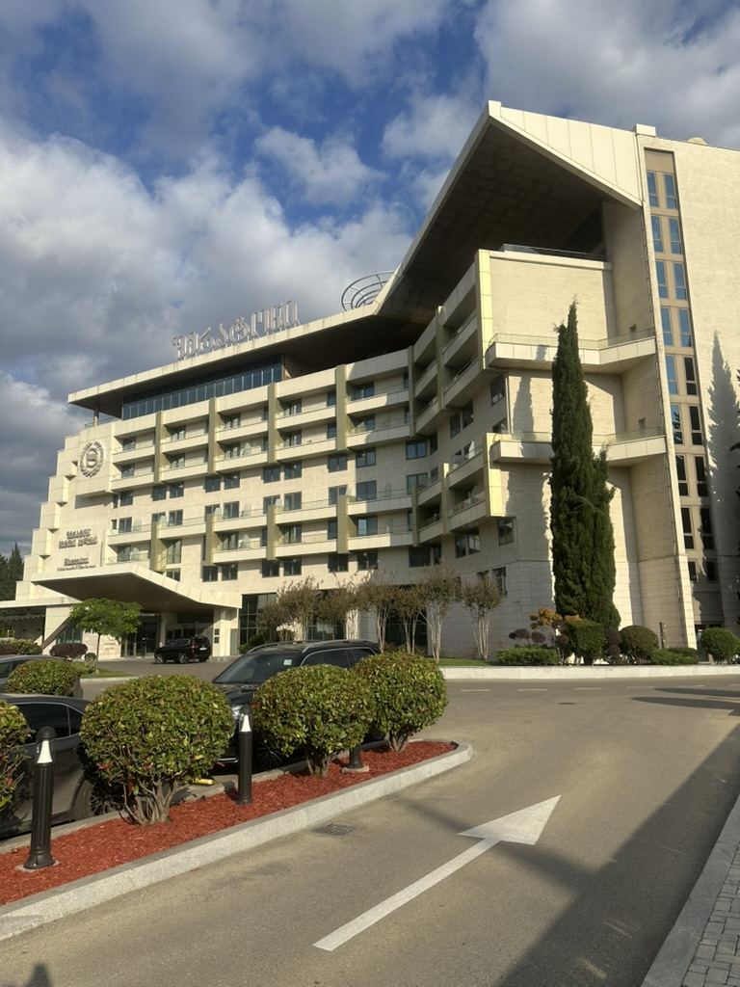
UEMS CME/CPD Task Force
Hannu Halila Finland
Monika Brodmann-Mäder Switzerland
Foued Bouzaouache Tunisia
Aivars Vetra Latvia
Marc Soethout The Netherlands
Emelie Hultberg Sweden
Jozef Glasa Slovakia
Milena Staneva Bulgaria
Fridbjorn Sigurdsson Iceland

Slide 4
UEMS CPD Charter 2025
General
CPD and Professionalism
Rights and Responsibilities
CPD and Medical Education
Accreditation
  Glossary
  References
  Annex: CPD and modern adult learning

Slide 5
Discussions during the process about main political statements
CPD must have a specific budget in the health care system
  Special attention paid also to private practice/self-employed doctors
  Stressing also the protected time for CPD
When does CPD start?
  After becoming a physician
    (but the concept of life-long learning already at the beginning of medical school)

Slide 6

Discussions about main political statements in in the Draft
CPD content suggested as a part of
the (yearly) discussion between
the doctor and peers
(colleagues, superior/
mentor)

Slide 7
Positive statement (not: UEMS does not support current recertification systems…)
UEMS endorses systems and procedures for doctors to facilitate their participation in CPD activities and supports methods that can improve quality of care and quality of medical specialist practice.

Slide 8
Further steps – if the Charter is accepted
CPD Charter will be distrubuted widely: UEMS members, all UEMS structures, EMOs, EU Commission, European Parliament, WHO, WFME World Federation of Medical Education, EHMA European Health Management Association …
NMAs will be asked to distribute it in their countries
Social media important in the publicity of the Charter
A short summary of key points will be provided
Will be included in the agenda at the UEMS Congress 2026

Slide 9

Thank you !
Kiitos !

