Slide 1

PROPOSAL FOR THE CREATION OF A MJC IN DISASTER MEDICINE
Roberta Petrino
President UEMS Section of Emergency Medicine

Slide 2
DISASTER
A serious disruption of the functioning of a community or a society at any scale due to hazardous events interacting with conditions of exposure, vulnerability and capacity, leading to one or more of the following: human, material, economic and environmental losses and impacts (UN GA 2017).
Disaster Hazard + Vulnerability + Exposure
Risk Capacity
United Nations General Assembly on February 2nd, 2017.in 2017

Slide 3
WHAT IS DISASTER MEDICINE
Disaster medicine is the branch of medicine concerned with the preparation for, response to, and recovery from mass casualty incidents and disasters, aiming to optimize medical care and resource use when normal healthcare systems are overwhelmed.
It includes areas such as:
Disaster preparedness and planning
Triage and mass casualty management
Medical logistics and coordination
Public health surveillance and outbreak control
Psychological support and rehabilitation

Slide 4

DISASTER MEDICINE
Emergency
Clinical Care
*
Disaster Management
Emergency
Public Health
Notes:
Clinical medicine, public health, and disaster incident management are core disciplines underlying expertise in disaster medicine.

Slide 5
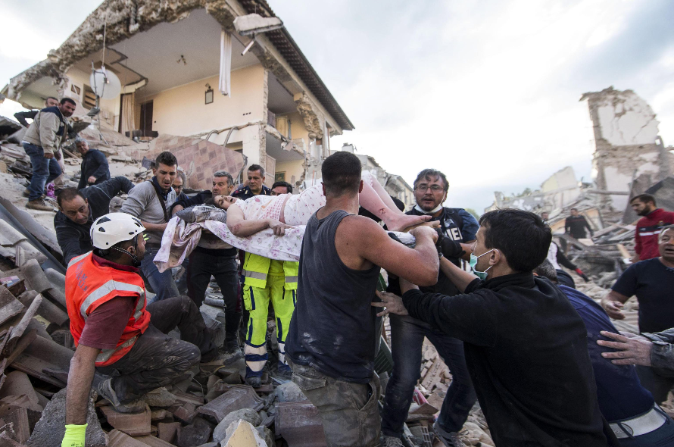
Central Italy Earthquake - Amatrice
August 2016

Slide 6
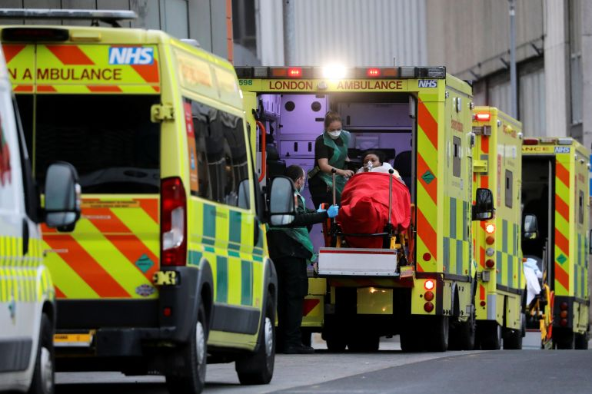
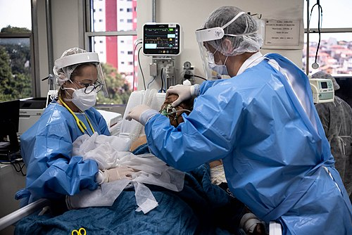
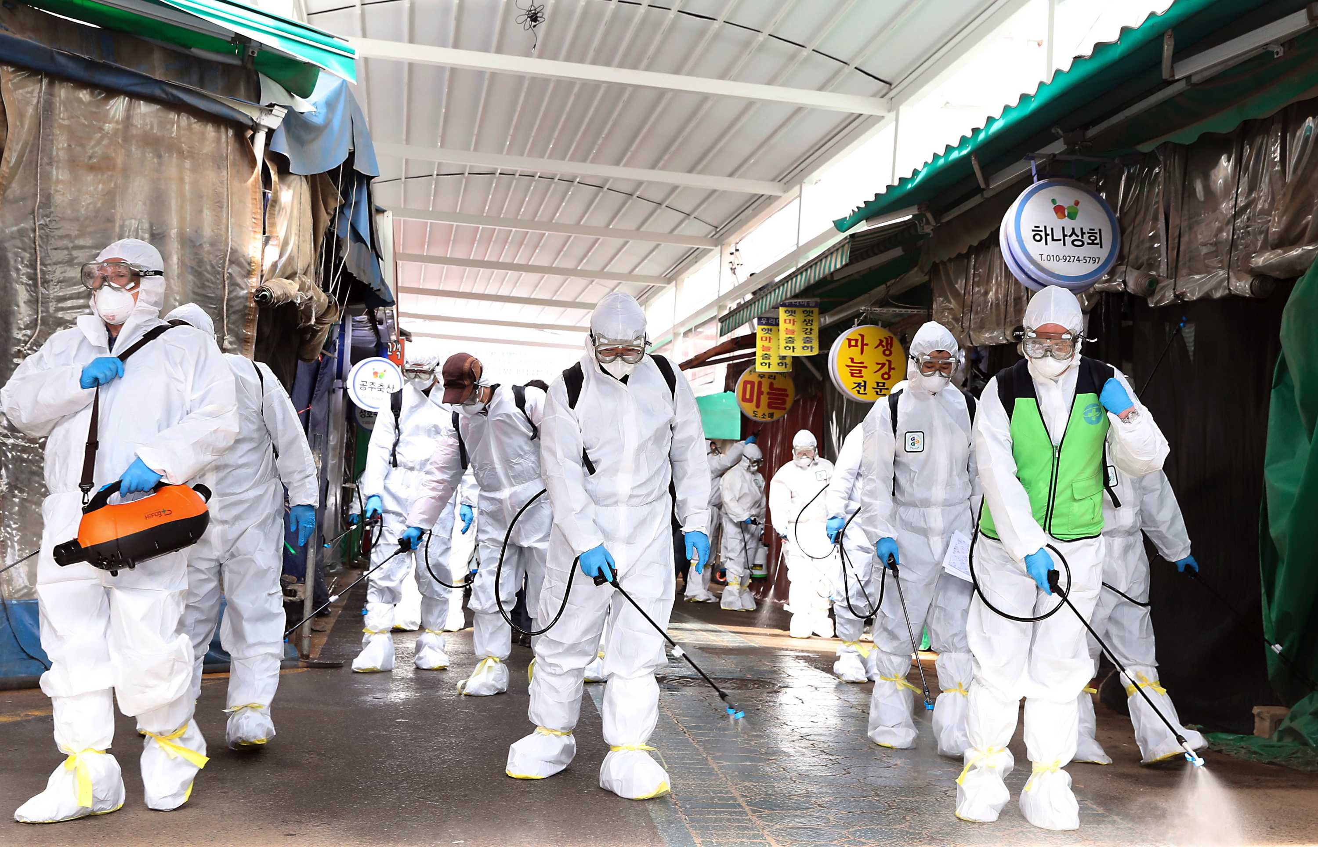
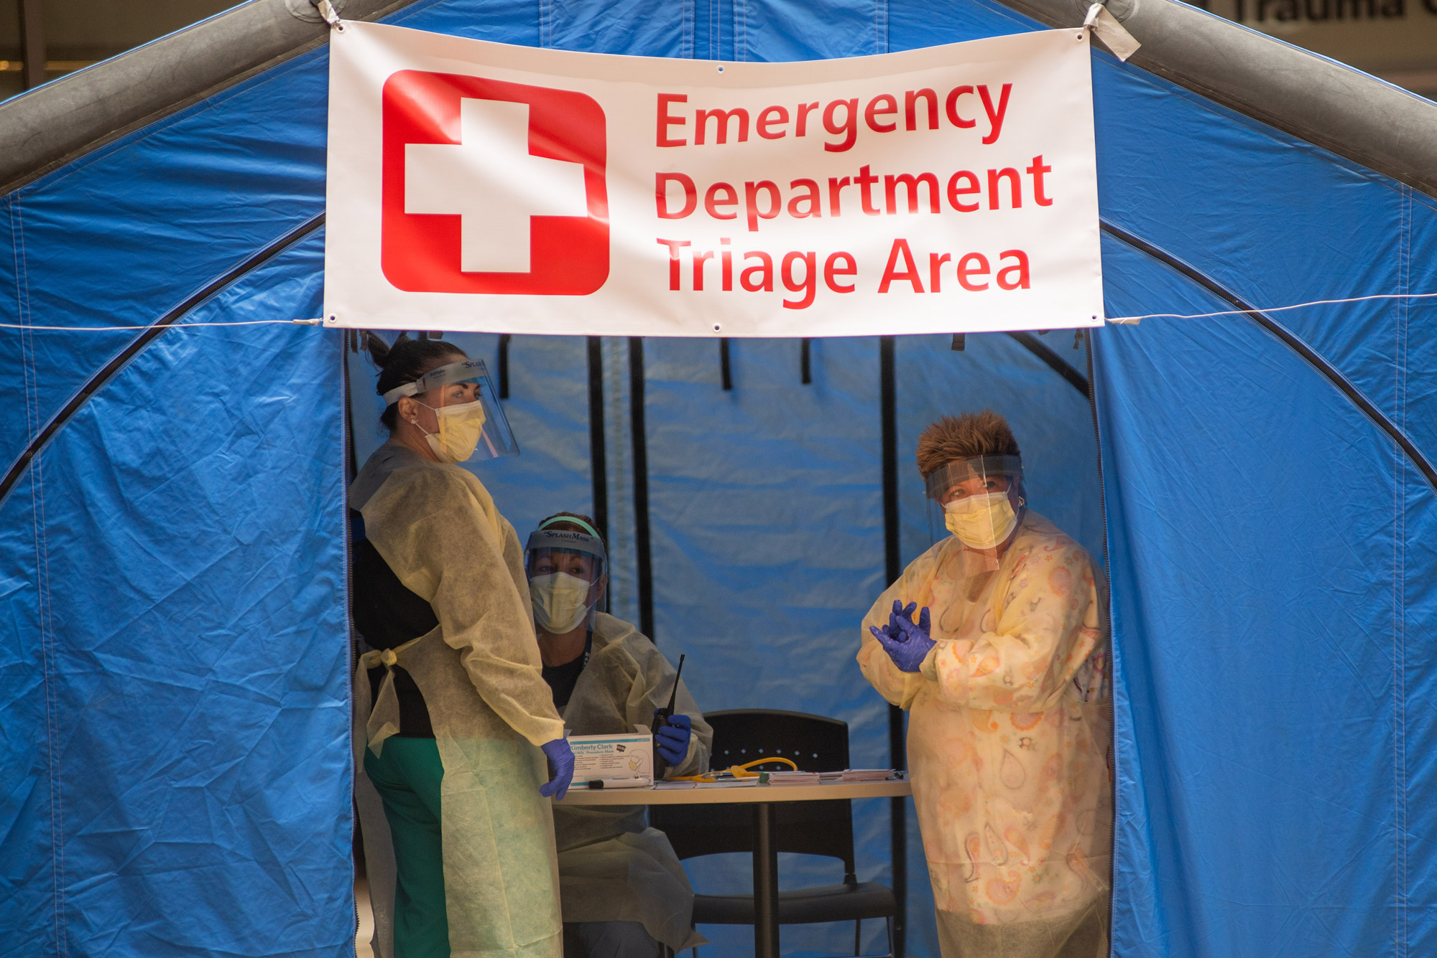
Covid 19, the worlds 2020-2022
Covid 19, the world, spring 2020

Slide 7
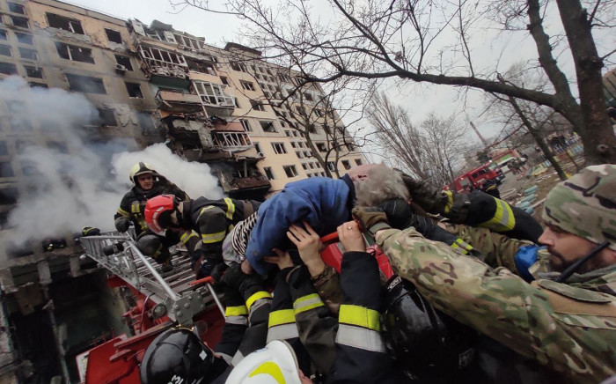
Ukraine, October 2022
Notes:
Ukraine

Slide 8
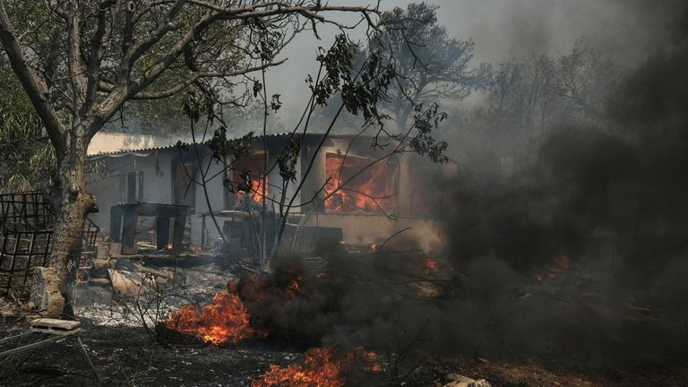
Athens,wildfire 2024

Slide 9
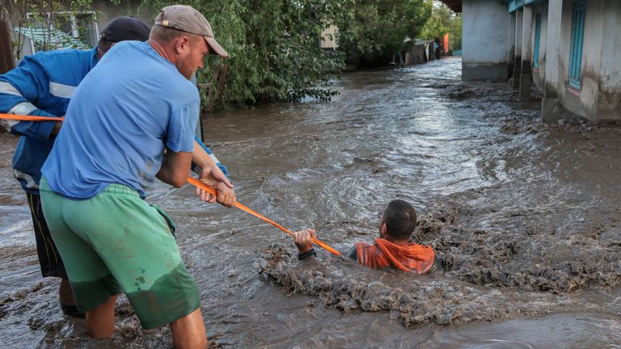
Rumenia, flood 2024

Slide 10
CLIMATE CHANGE CONSEQUENCES
Centre for Research on the Epidemiology of Disasters (CRED) Université Catholique de Louvain

Slide 11
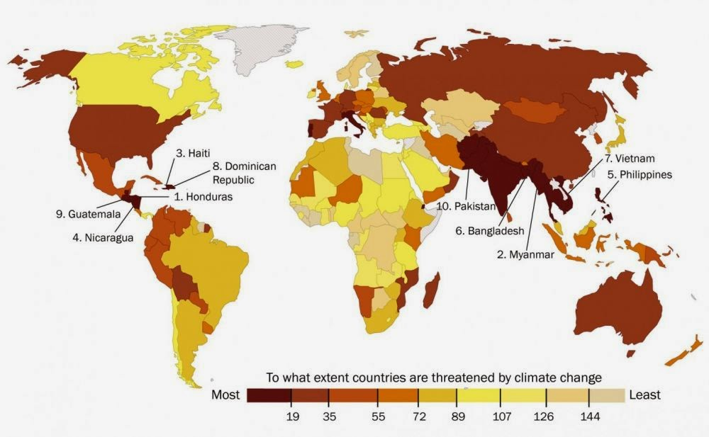
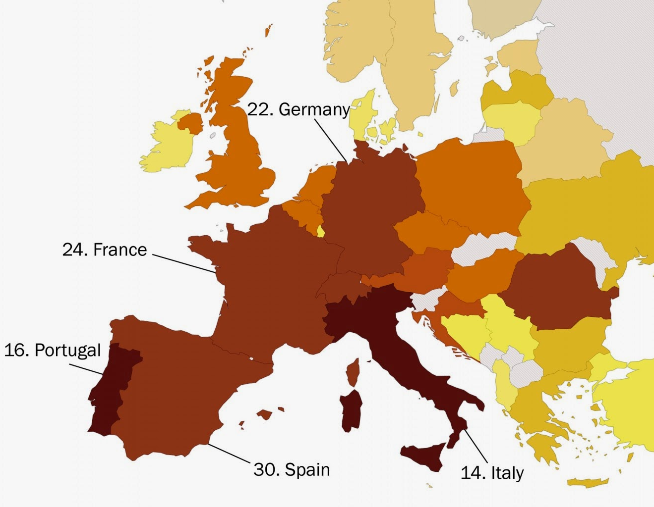
VULNERABILITY TO CLIMATE CHANGE
Centre for Research on the Epidemiology of Disasters (CRED) Université Catholique de Louvain

Slide 12
THE DISASTER CYCLE
Mitigation
Preparedness
Response
Rehabilitation
Prevention
Pre-impact
Post -impact

Slide 13
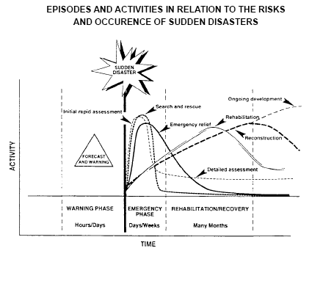
Public health
Emergency Medicine
Orthpedic surgery
Pediatrics
Anesthesiology
Infectious disease
Psichiatry
Reahabilitation
Surgery
Orthopedic surgery
Intensive care
Notes:
Even in response to international disasters, our action was mostly focused on Emergency phase, quite scotomising that recovery and rehabilitation as well prevention and preparedness were mostly out of our tasks

Slide 14
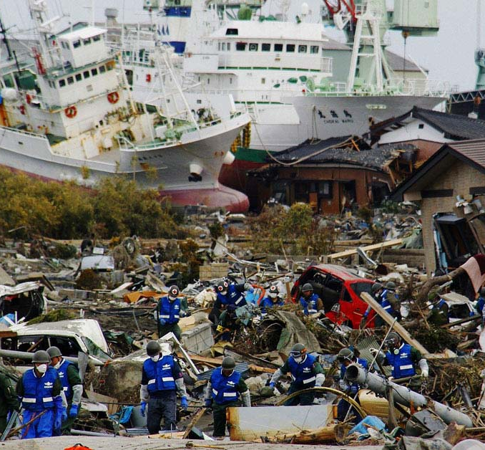
The management of the medical effects of a disaster requires:
  specific knowledge
  ability to plan and organize a health system adapted to the disaster situation
  professional skill to provide medical care of high quality in an austere environment.
Need of education and training of the involved personnel;
understanding of the medical disaster plans, procedures and protocols;
high levels of skill and competence.

Slide 15
Reasons for the creation of a MJC in Disaster Medicine
Provide a platform to integrate diverse specialties in preparedness, response, and mitigation of disasters.
Provide a European Curriculum in Disaster Medicine with the definition of the various aspects and phases of management skills and comptences
Harmonisation of training in Disaster Medicine with the preparation of a ETR, with the aim to create competent doctors.
Become interlocutor, under the aegis of the UEMS Executive, to the EU authorites and other relevant bodies to support the response to disasters in Europe

Slide 16

The proposal comes from the Section of Emergency Medicine and the Section of Publich Health as most involved specialists in disaster preparedness and early response
We are sure that many other sections and MJC, like anesthesiology, orthopedic surgery, general surgery, intensive care, pediatrcs, psichiatry, infectious disease and others will respond to the invitation, aware of the increasing threatens and challenges we are facing.

Slide 17
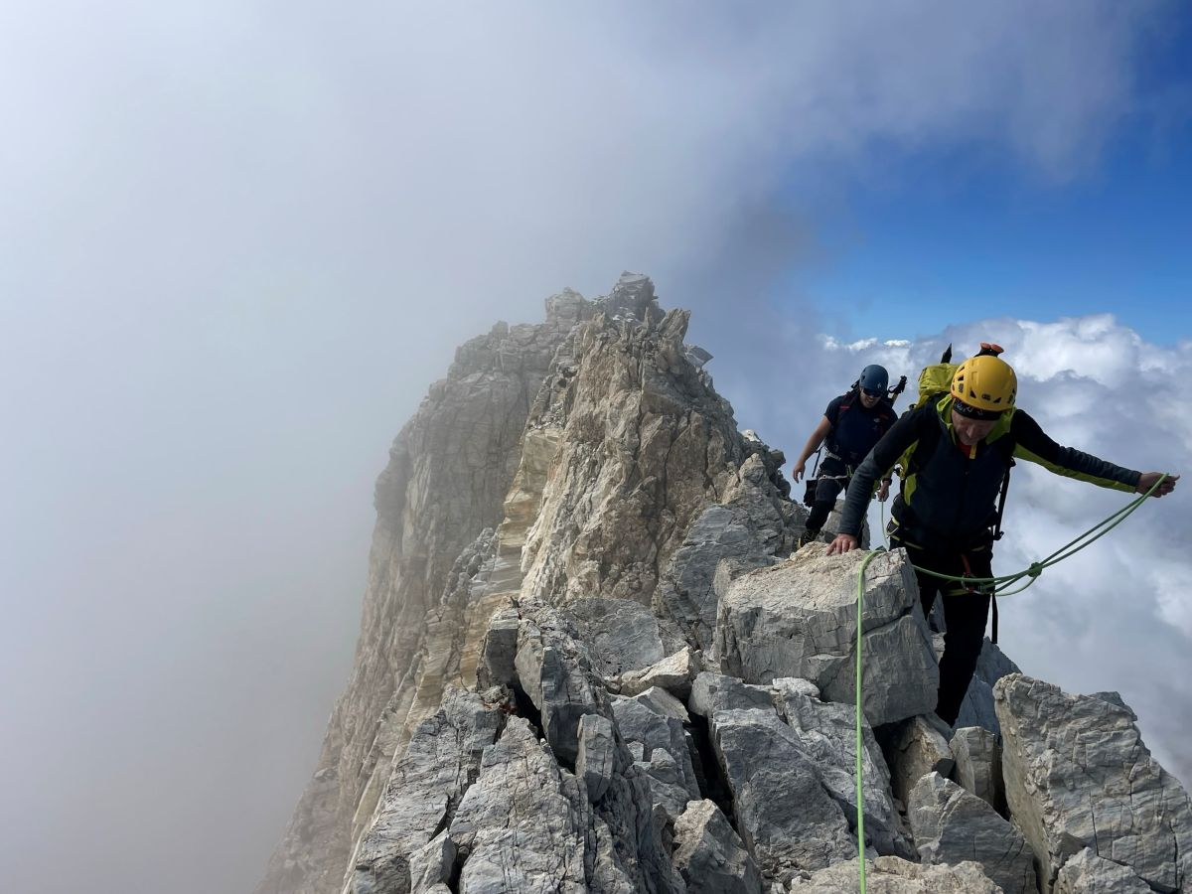
“We live at the edge of disaster, but that edge is where we learn to balance.”
— T.S. Eliot, inspired by Four Quartets (1943)

