Slide 1

European Professional Development Module
OBSTETRIC ANAESTHESIOLOGY
Prof. Oleg Sabelnikovs
President of EBA
UEMS SPRING COUNCIL MEETING
2025

Slide 2
The concept of a professional development module in anaesthesiology

Slide 3
Training and CPD in Anaesthesiology
Continuing professional development (CPD)
Undergraduate training
Residency training (PGT)
There is a continuum from undergraduate medical education through postgraduate training (PGT) to continuing professional development (CPD).
Notes:
The Professional Development Module, or PDM, is the next stage in the continuum of education for anaesthesiologists.
The PDM is designed for specialists who have completed their training and wish to advance their competence, leadership, and educational contribution.

Slide 4

Training and CPD in Anaesthesiology
ETR
Continuing professional development (CPD)
Undergraduate training
Residency training (PGT)
The European Professional Development Modules (PDMs) for anaesthesiologists summarise learning objectives to enrich and increase competencies raising clinical experts and professional leaders to a higher level of qualification.

Slide 5
Training and CPD in Anaesthesiology
ETR
PDM in Pain medicine
PDM Geriatric Anesthesiology
Continuing professional development (CPD)
Undergraduate training
Residency training (PGT)
ETR is for Trainees and PDM is for Specialists
Notes:
Professional Development Module is a way to implement more structure in CPD.

Slide 6

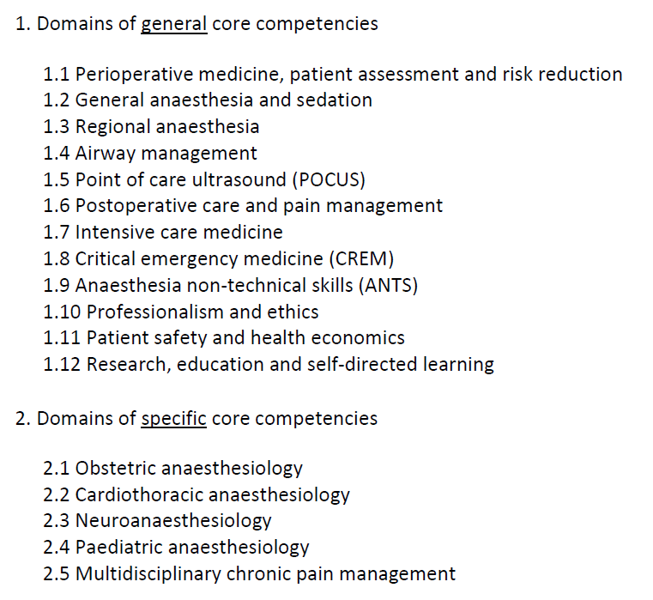
European Training Requirements
for the Specialty of Anaesthesiology
General core competencies should be achievable by most national training programmes
Specific core competencies - basic competence levels proposed
Levels of competencies
A: observer level (has knowledge of, describes)
B: performs, manages, demonstrates under direct supervision
C: performs, manages, demonstrates under distant supervision
D: performs, manages, demonstrates independently

Slide 7
European Training Requirements
for the Specialty of Anaesthesiology
General core competencies should be achievable by most national training programmes
Specific core competencies - basic competence levels proposed
Not all learning objectives listed in the ETR reach level D
(D: perform and manage independently)
Levels of competencies
A: observer level (has knowledge of, describes)
B: performs, manages, demonstrates under direct supervision
C: performs, manages, demonstrates under distant supervision
D: performs, manages, demonstrates independently

Slide 8
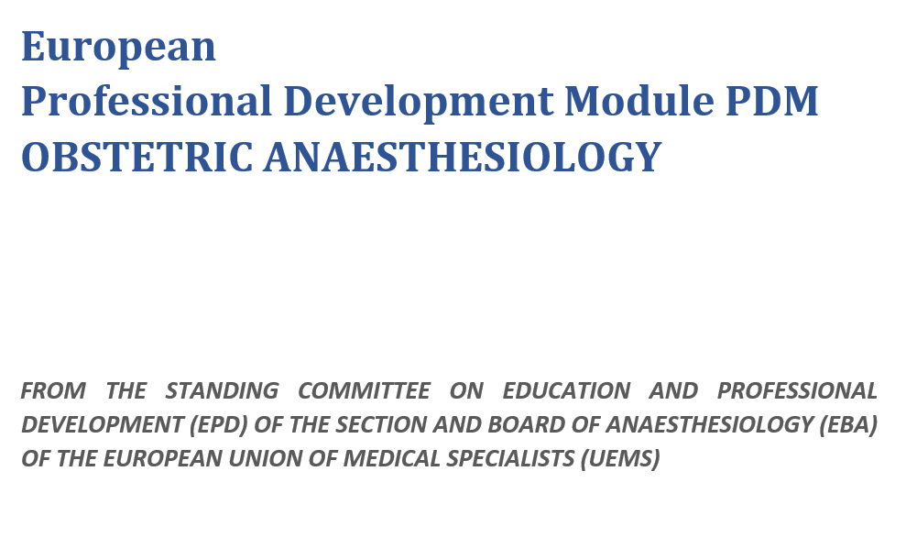
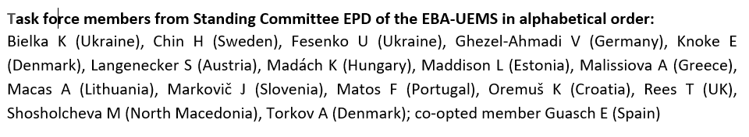
European PDM in
OBSTETRIC ANAESTHESIOLOGY
Section 1
Section 2
Section 3

Slide 9
Section 1: General Information about the European PDM in Obstetric Anaesthesiology
The path to excellence: From ETR for Trainees to the PDM for Specialists
Scope of the PDM in Obstetric Anaesthesiology
Development of the PDM
The PDM training programme
Candidate eligibility
Trainers
Training institutions
Assessment
Completion of the PDM
References

Slide 10
Section 2. Learning Objectives, Domains and Competencies
Learning objectives
Domains of learning
Required levels of competence for the PDM
Obstetric anaesthesiology content in the ETR
PDM Domains and Competencies – knowledge, skills and specific attitudes

Slide 11
Section 2. Learning Objectives
On completion of the PDM, the learner should be:
Able to provide safe analgesic and anaesthetic care for a wide variety of complex obstetric cases independently
Capable of leading the delivery and organisation of education in obstetric anaesthesiology, including of the wider multidisciplinary team
Capable of leading the obstetric anaesthesiology service, to the benefit of patients/service users and the organisation

Slide 12
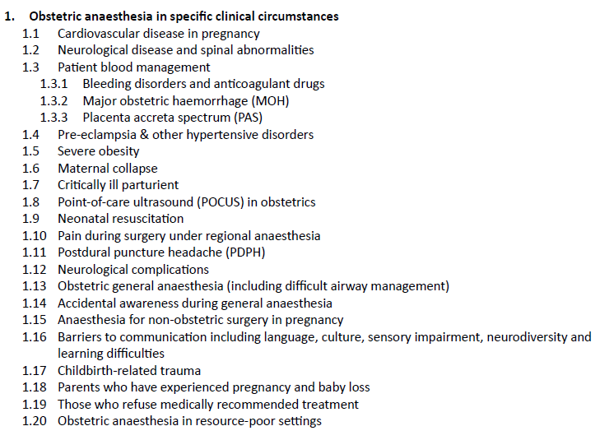
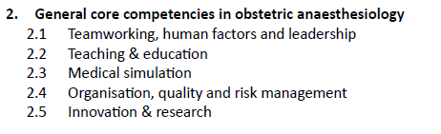
Section 2. Domains of learning

Slide 13
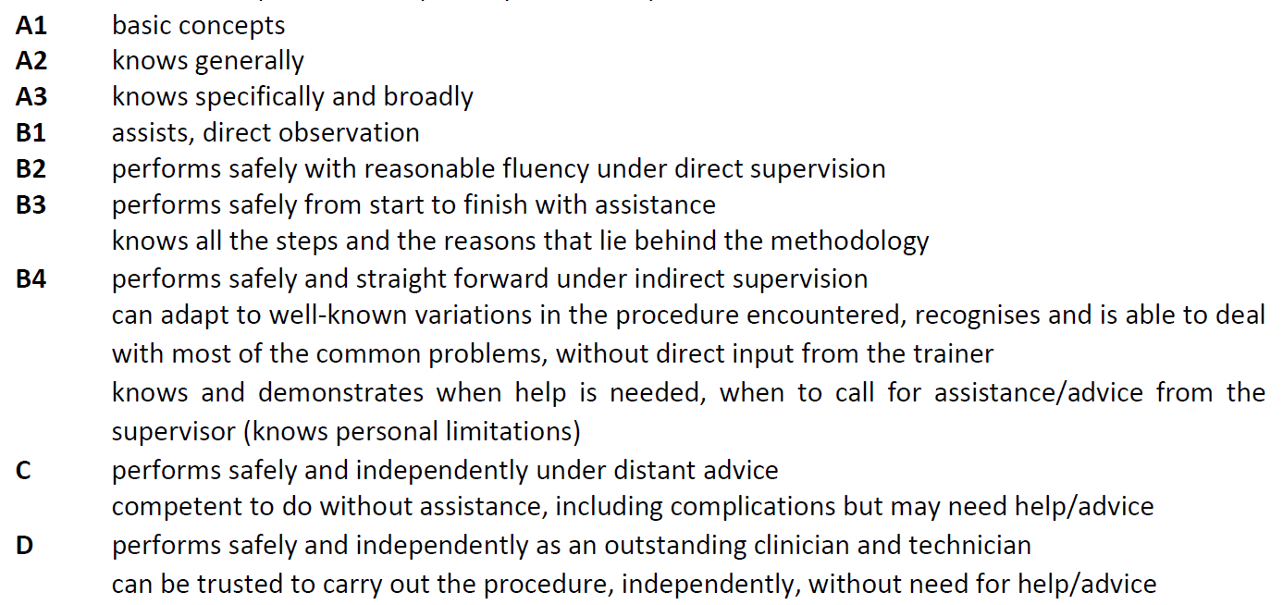
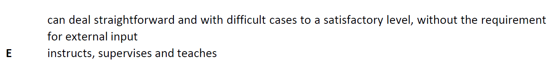

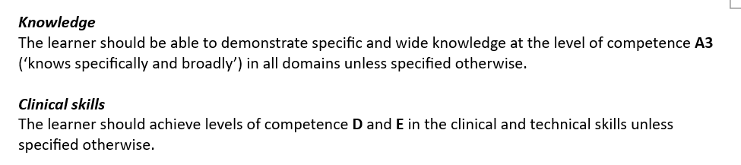


Section 2. Required levels of competence for the PDM

Slide 14
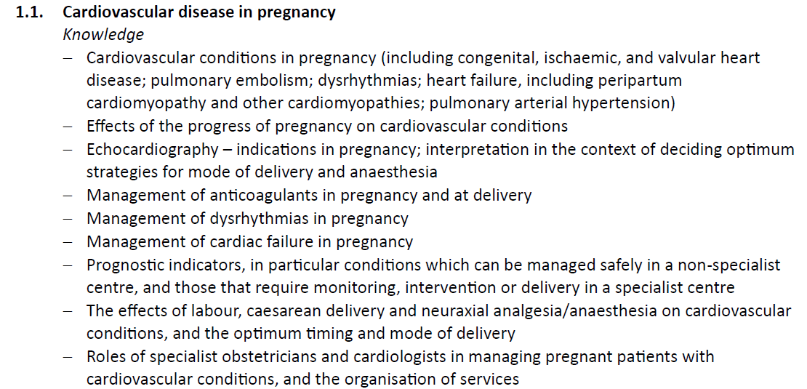
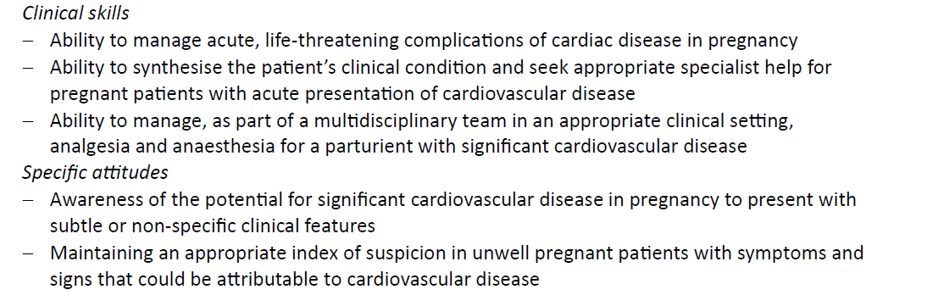

Section 2. PDM Domains and Competencies – knowledge, skills and specific attitudes

Slide 15
Section 3. Entrustable Professional Activities (EPAs)
Definition and Implementaton of EPAs in the Training of Medical Specialists
Proposed EPAs for Specialists in Obstetric Anaesthesiology
These EPAs are designed to align with the competencies outlined in the PDM in Obstetric Anaesthesiology

Slide 16
Section 3. Definition and Implementation of EPAs in the Training of Medical Specialists
Key Characteristics of EPAs
Implementation in the Training of Medical Specialists
  Identification of EPAs
  Structuring Training Programs around EPAs
  Assessment of EPAs
  Entrustment Decisions
  Continuous Improvement
Suggestions for Implementation

Slide 17
Section 3. Proposed EPAs for Specialists in Obstetric Anaesthesiology
EPA 1: Antenatal anaesthetic assessment and planning of peripartum anaesthetic care
EPA 2: Anaesthetic management for operative delivery in complex cases
EPA 3: Prevention and management of complications of obstetric analgesia and anaesthesia
EPA 4: Education of trainee obstetric anaesthesiologists
EPA 5: Quality management in obstetric anaesthesia

Slide 18
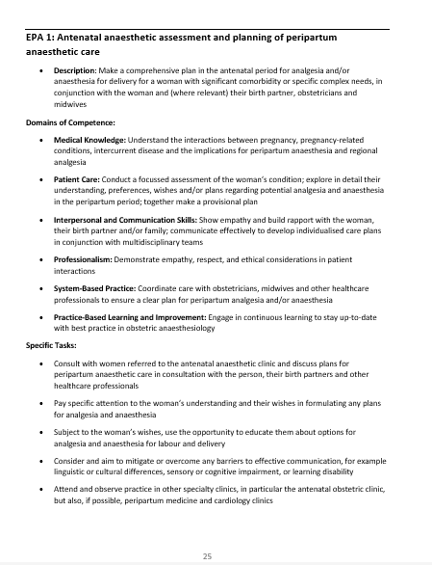
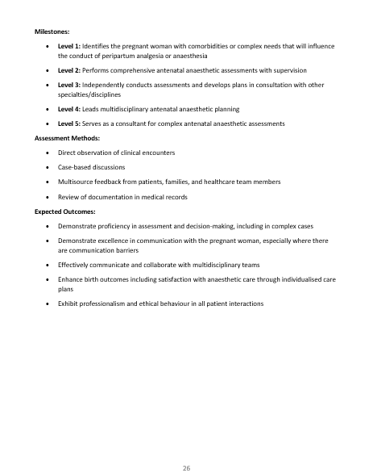

Slide 19
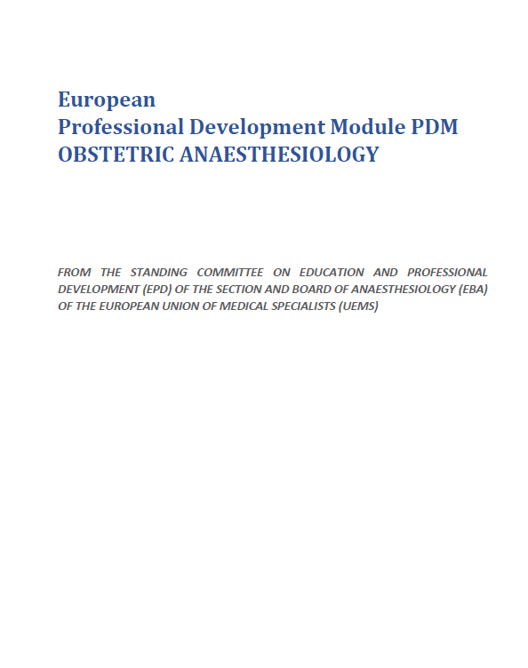
Summary
The aim of the European ­­­PDM in OBSTETRIC ANAESTHESIOLOGY is to provide a framework for harmonising the practice and teaching across Europe by expert specialist clinicians.
“This Professional Development Module (PDM) is intended to harmonise and support continuing professional development in the field of obstetric anaesthesiology across Europe. It does not imply or introduce any new mandatory qualification and must not be used to question or limit the competence of anaesthesiologists who have completed specialist training according to the European Training Requirements (ETR). The PDM is a voluntary framework designed to promote lifelong learning and excellence in clinical leadership, education, and quality improvement within the discipline.”

Slide 20

Thanks !
Special thanks – to all EBA members!!!
https://www.eba-uems.eu/

