Slide 1
Introduction of the submitted ETRs and feedback of the ETR Review Committee
Nada Čikeš
Chair, ETR Review Committee
Paolo Ricci
UEMS Vice president
Member, ETR Review Committee
COUNCIL MEETING
Tbilisi, October 18th 2025

Slide 2
ETR review and appraisal process
Terms of Reference (ToR) for ETR Review Committee (ETR RC)
New ETR proposals to be submitted 4 months before the UEMS Council
The draft ETRs are published on the Google Drive
All UEMS Bodies and NMAs are invited to participate in consultation
ETR Review Committee
  leads the review process
  facilitates dialogue in areas of conflicting approaches
  ensures that the UEMS procedure for ETR development is followed
  reports to the UEMS EEC
Advisory Board Meeting (Specialty Sections & Boards, MJCs)
  ETR presentation and discussion – advisory capacity
UEMS Council meeting (National Medical Associations)
  ETR presentation and discussion - voting for adoption

Slide 3

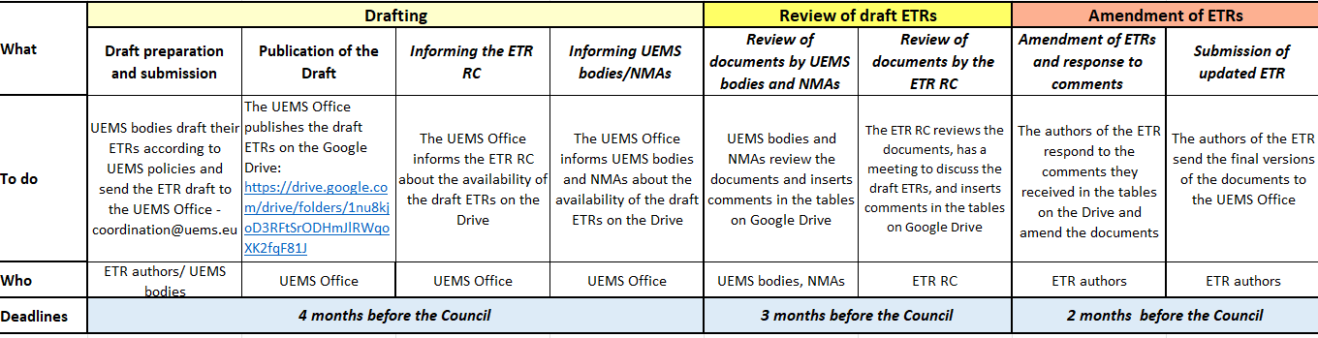
ETR Review and Approval Process Timeline
...
Whole review process, i.e. latest date submission draft ETR to UEMS Council 4 months
1st obligatory meeting ETR Review Committee (RC) in the month following submission of ETRs

Slide 4
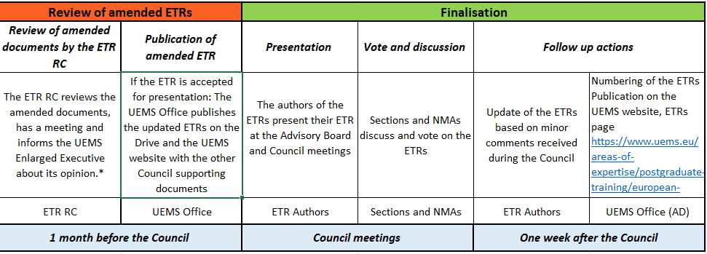
ETR Review and Approval Process Timeline
...
2nd obligatory meeting ETR RC in the month following submission of amended ETRs
* not in scheme, but has to follow: decision by UEMS EEC on presentation at Council meeting

Slide 5


Slide 6
ETR draft documents submitted for the
UEMS Council Meetings, October 2025
PDM for the Competence in Obstetric Anaesthesiology
ETR for the Specialty of Geriatric Medicine
ETR for the Specialty of Obstetrics & Gynaecology
ETR for the Competence in Paediatric Gastroenterology, Hepatology and Nutrition
ETR for the Competence in Paediatric Rheumatology
ETR for the Competence in Phlebology
ETR for the Competence in Reproductive Medicine
ETR for the Competence in Transitional Care of Adolescents and Young Adults
ETR for the Competence in Upper Gastrointestinal Surgery
ETR for the Specialty of Pathology
Review process ended 25th of August (date of the ETR Review Committee Meeting)
after Authors’ responses and corrections of the proposed texts (deadline: 19th of August)

Slide 7
Amended ETRs to be presented at the UEMS Advisory Board and Council Meetings - Tbilisi (Georgia) 17-18 October 2025
Professional Development Module (PDM) for the Competence in Obstetric Anaesthesiology
submitted by UEMS Section and Board of Anaesthesiology (EBA)
ETR for the Specialty in Geriatric Medicine
submitted by UEMS Geriatric Medicine Section
ETR for the Competence in Reproductive Medicine
submitted by European Society for Human Reproduction and Embriology (ESHRE)/
European Board and College of Obstetrics and Gynaecology (EBCOG)
ETR for the Competence in Transitional Care of Adolescents and Young Adults
submitted by UEMS Adolescent Medicine and Health MJC
ETR for the Specialty of Pathology
submitted by UEMS Pathology Section
ETR for the Competence in Upper Gastrointestinal Surgery
submitted by UEMS MJC Upper GI Surgery

Slide 8
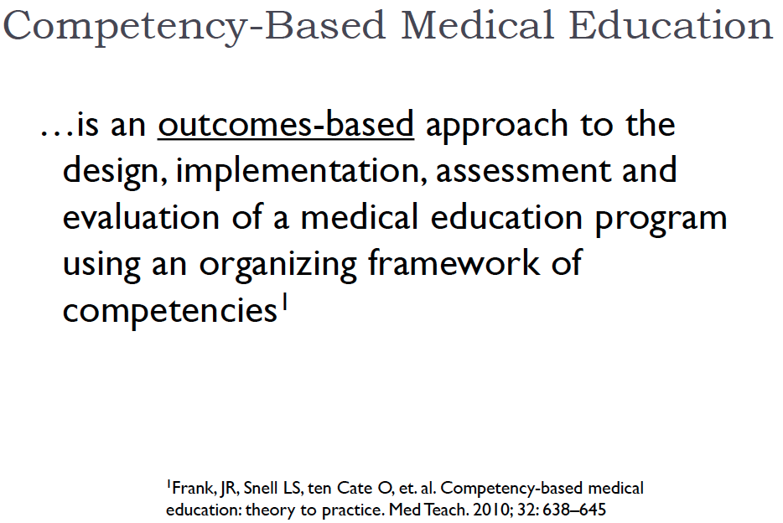
Challenges
  Implementation of CBME
http//canmeds.royalcollege.ca/
Entrustable Professional Activities (EPA)
Mandatory in all ETRs

Slide 9
Competency Based Medical Education (CBME)
paradigm in professional education
central principle in the ETR
shifts the focus of training from the traditional time-based model to a competency-based approach
key question is not how long a doctor has trained, but what he/she is actually able to do independently and safely in clinical practice.
CBME values define the knowledge, skills, and professional behaviours/ attitudes
oriented to outcomes
tracks learners progress and performance
promotes greater learner-centerness

Slide 10

Competency Based Medical Education
CanMEDS
The Can MEDS framework is a set of competencies grouped thematically into 7 roles.
Physicians’ roles
Medical Expert
Communicator
Collaborator
Leader
Health Advocate
Scholar
Professional
The framework sets high educational standards aiming to contribute to and enhance patient care.

Slide 11

CanMEDS in UEMS ETRs
Based on the document:
Insertion of CanMEDS competences is mandatory in line with the revised ETR Template document

Slide 12
Entrustable Professional Activity (EPA)
Entrustable: acts that require trust – by colleagues, patients, public
Professional: confined to occupations with extra-ordinary qualification and right
Activities: tasks that must be done
EPAs ground competencies in daily practice; they break medical practice down in units that can be overseen, assessed, monitored, documented and certified.
Ten Cate: UEMS ETR Webinar, June 22, 2021

Slide 13
Entrustable Professional Activity (EPA)
An EPA is “a critical part of professional work that can be identified as a unit to be entrusted to a trainee once sufficient competence has been reached"
An EPA goes a level higher than the traditional 4th level of competence which is the “independence competency" The key factor is Entrustment. The trainee is not only capable of tackling the particular procedures or units independently, but he can be trusted to do this by his tutors
Thus EPAs constitute both an expression competency (abilities possessed by trainees/applicants) and are also units of professional work.
Thus, the EPA is an integral part of the Logbook and is a comprehensive and holistic tool for Competence Based Assessment.
The purpose:
It serves as a bridge between the Syllabus/Curriculum and the Eligibility Assessment
to help fill the gap between competencies and clinical practice.
A. Felice: Personal communication, Tbilisi 2025

Slide 14
ETR – Flagship project of UEMS
Requires an enormous amount of work (by Authors, UEMS bodies, NMAs, ETR RC, UEMS Coordination)
New process of review
  Consensus opinion of vision of training
  Spirit of the review – collegiate and supportive way
Pan-European effort
Major contribution for doctors and patients across Europe
National application
Harmonisation of ETRs – raising standards in competency based specialty training to improve patient care in Europe

Slide 15
“Take home suggestions” for National Medical Association
  to influence the implementation of ETRs
  to establish the Committee of all Delegates - national representatives to UEMS S&Bs and MJCs - to get strong connections to the stakeholders involved in the process of implementing the ETRs in their country
  to support inclusion of national representatives in all UEMS bodies
    two representative in UEMS sections, one of them with academic engagement
  to support the broad discussion on the future of specialty training with all stakeholders
  to influence the advancements of relevant acts at national level

Slide 16

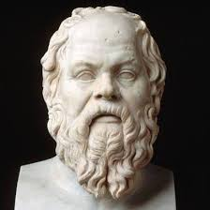
If you think education is expensive,
you should consider ignorance
Socrates

