Slide 1



1st UEMS Congress
Learning • Networking • Impacting
27-30 May 2026
UZ Leuven, Campus Gasthuisberg, Leuven (BE)

Slide 2

Plenary sessions
4 plenary sessions covering the following themes
European health: connectivity and inter-dependance of healthcare systems within Europe and between Europe and the rest of the world
AI/ Machine learning: how to educate and train medical students, trainee doctors and specialists for the new inevitable realities
European medical workforce: planning, make medicine attractive, sustain and support the workforce, respect, prepare for tough realities in the future
European health/ healthcare systems in crisis: new pandemics, naturals disasters, terror attacks, war
FORMAT
3 presenters + 3 panellists+ 1 moderator
Participant preparatory contributions
Follow-up expert interviews

Slide 3
Parallel scientific & thematic sessions
Key topics among which
AI & ethics: dilemmas of modern practice, AI, telemedicine…
UEMS and the world: global collaboration, CME/CPD beyond Europe,…
Green & sustainable practice: reducing carbon footprint, environmentally responsible healthcare
Work-life balance: promoting wellbeing, addressing burnout
Response to disasters: medical readiness and responss
Mental health in the medical profession: supporting resilience, improving workplace mental health
Training and education: ETRs, examinations & innovative approaches to medical assessment
Accreditation: innovative approach to CME, impact of life-long learning in careers
Legal issues: legal challenges affecting medical practice

Slide 4
Programme at a glance
Wednesday 27th May | Thursday 28th May | Friday 29th May | Saturday 30th May
17:00 - 18:30 • Opening Plenary session 18:30 - 20:00 • Networking reception | 9:00 - 10:00 • Plenary session 10:00 - 11:00 • Scientific & Thematic sessions Coffee break 11:30 - 13:00 • Scientific & Thematic sessions Lunch break 14:00 - 15:00 • Plenary session 15:00 - 16:00 • Scientific & Thematic sessions Coffee break 16:30 - 18:00 • Scientific & Thematic sessions | 9:00 - 10:00 • Scientific & Thematic sessions 10:00 - 11:00 • Plenary session Coffee break 11:30 - 13:00 • Scientific & Thematic sessions Lunch break 14:00 - 16:00 • Scientific & Thematic sessions Coffee break 16:30 - 18:00 • Scientific & Thematic sessions 19:00 – 22:00 • Congress Dinner | 9:00 - 11:00 • Scientific & Thematic sessions Coffee break 11:30 - 12:30 • Scientific & Thematic sessions 12:30 - 14:00 Closing Plenary session

Slide 5


Mentorship initiative
A unique opportunity to:
Connect with colleagues from across Europe.
Engage in one-to-one conversations on professional and medical matters.
Exchange insights on healthcare systems, specialist training, and career development.
Offer or receive advice, support, and guidance in a collegial and informal setting.
More information & to submit applications to become mentor or mentee or both on UEMS website

Slide 6

Call for abstracts
POSSIBLE THEMES
European health
AI/ Machine learning
European medical workforce
European health/ healthcare systems in crisis
AI & ethics
UEMS and the world
Green & sustainable practice
Work-life balance
Response to Disasters
Mental health in the medical profession
Training and education
Accreditation
Legal issues
POSSIBLE FORMATS
Oral presentation
Workshop
Symposium
Debate
Panel discussion
Submit your proposal
(in English, 250 words)
by 01/01/2026
at: uemscongress@uems.eu

Slide 7
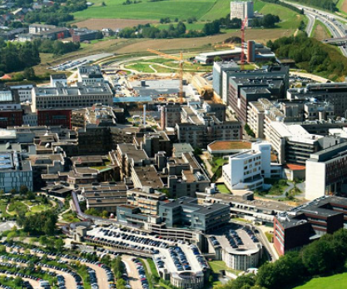
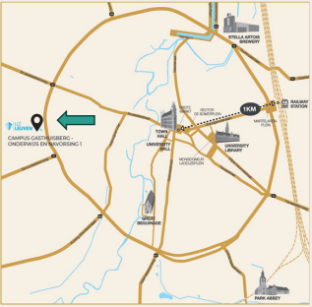

Venue: UZ Leuven, campus Gasthuisberg
15 minutes car ride from Brussels airport
15 minutes bus ride from Leuven city centre
Public transport passes for participants included in the registration
(4 days for €20 pp)

Slide 8
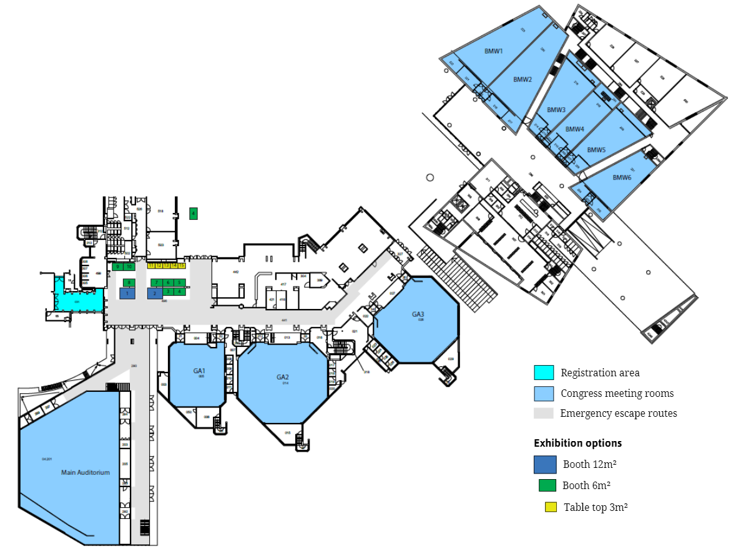
Venue detail floor plan

Slide 9
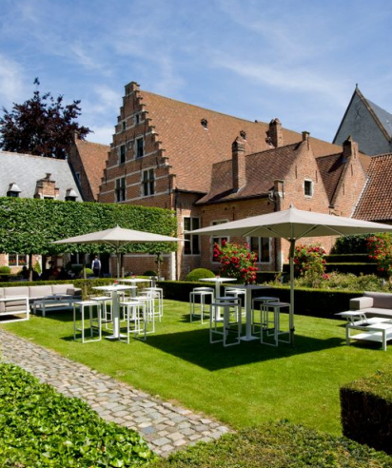
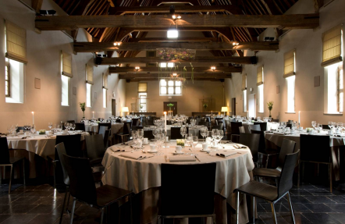
Congress dinner venue
Faculty Club Leuven
in the restored buildings of the Grand Beguinage (UNESCO World Heritage)
Located close to Leuven city centre

Slide 10
Registration fees
 | EARLY BIRD (before 01/12/2025) | REGULAR | LATE/ON SITE (after 01/05/2026)
On site attendance
Non member | 685 | 785 | 885
UEMS member | 585 | 685 | 785
Virtual attendance
Non member | 585 | 685 | 685
UEMS member | 485 | 585 | 585
1-day registration
Non member | 285 | 335 | 385
UEMS member | 235 | 285 | 335
Exhibitor (no access to sessions) | 435 | 535 | 635

Slide 11
1st UEMS Congress
Learning • Networking • Impacting
To register: uemscongress.eu

