Slide 1
The Office for EU & International Affairs
Tbilisi 18th October 2025
Grand Tbilisi Metechi Palace

Slide 2
The task force on EU & International Affairs
Suggestions proposed at the last council meeting
spreading ETRs externally => internationally represented
=> sharing information to EU parliamentarians
a dedicated page on the UEMS website
=> not yet realized
a newsletter
=> EU Insight – next issue November 2025
non-EU colleagues who passed the exams: UEMS ambassadors
=> the European Academy for Clinical Leadership

Slide 3
The task force on EU & International Affairs
Mrs. Isabelle DUMAINE
EU Policy & Public Affairs Manager
takes care of the follow-up in EU legislation
getting UEMS involved in EU projects
sends around the newsletter EU Insight

Slide 4
The task force on EU & International Affairs
Dr. Marc H.M. Hermans
ambassador for the UEMS
Contacts with the EMOs
AEMH, CEOM, CPME, FEMS, EJDs, UEMO, EAHP
on line events e.g. European Observatory
WHO MeND survey

Slide 5
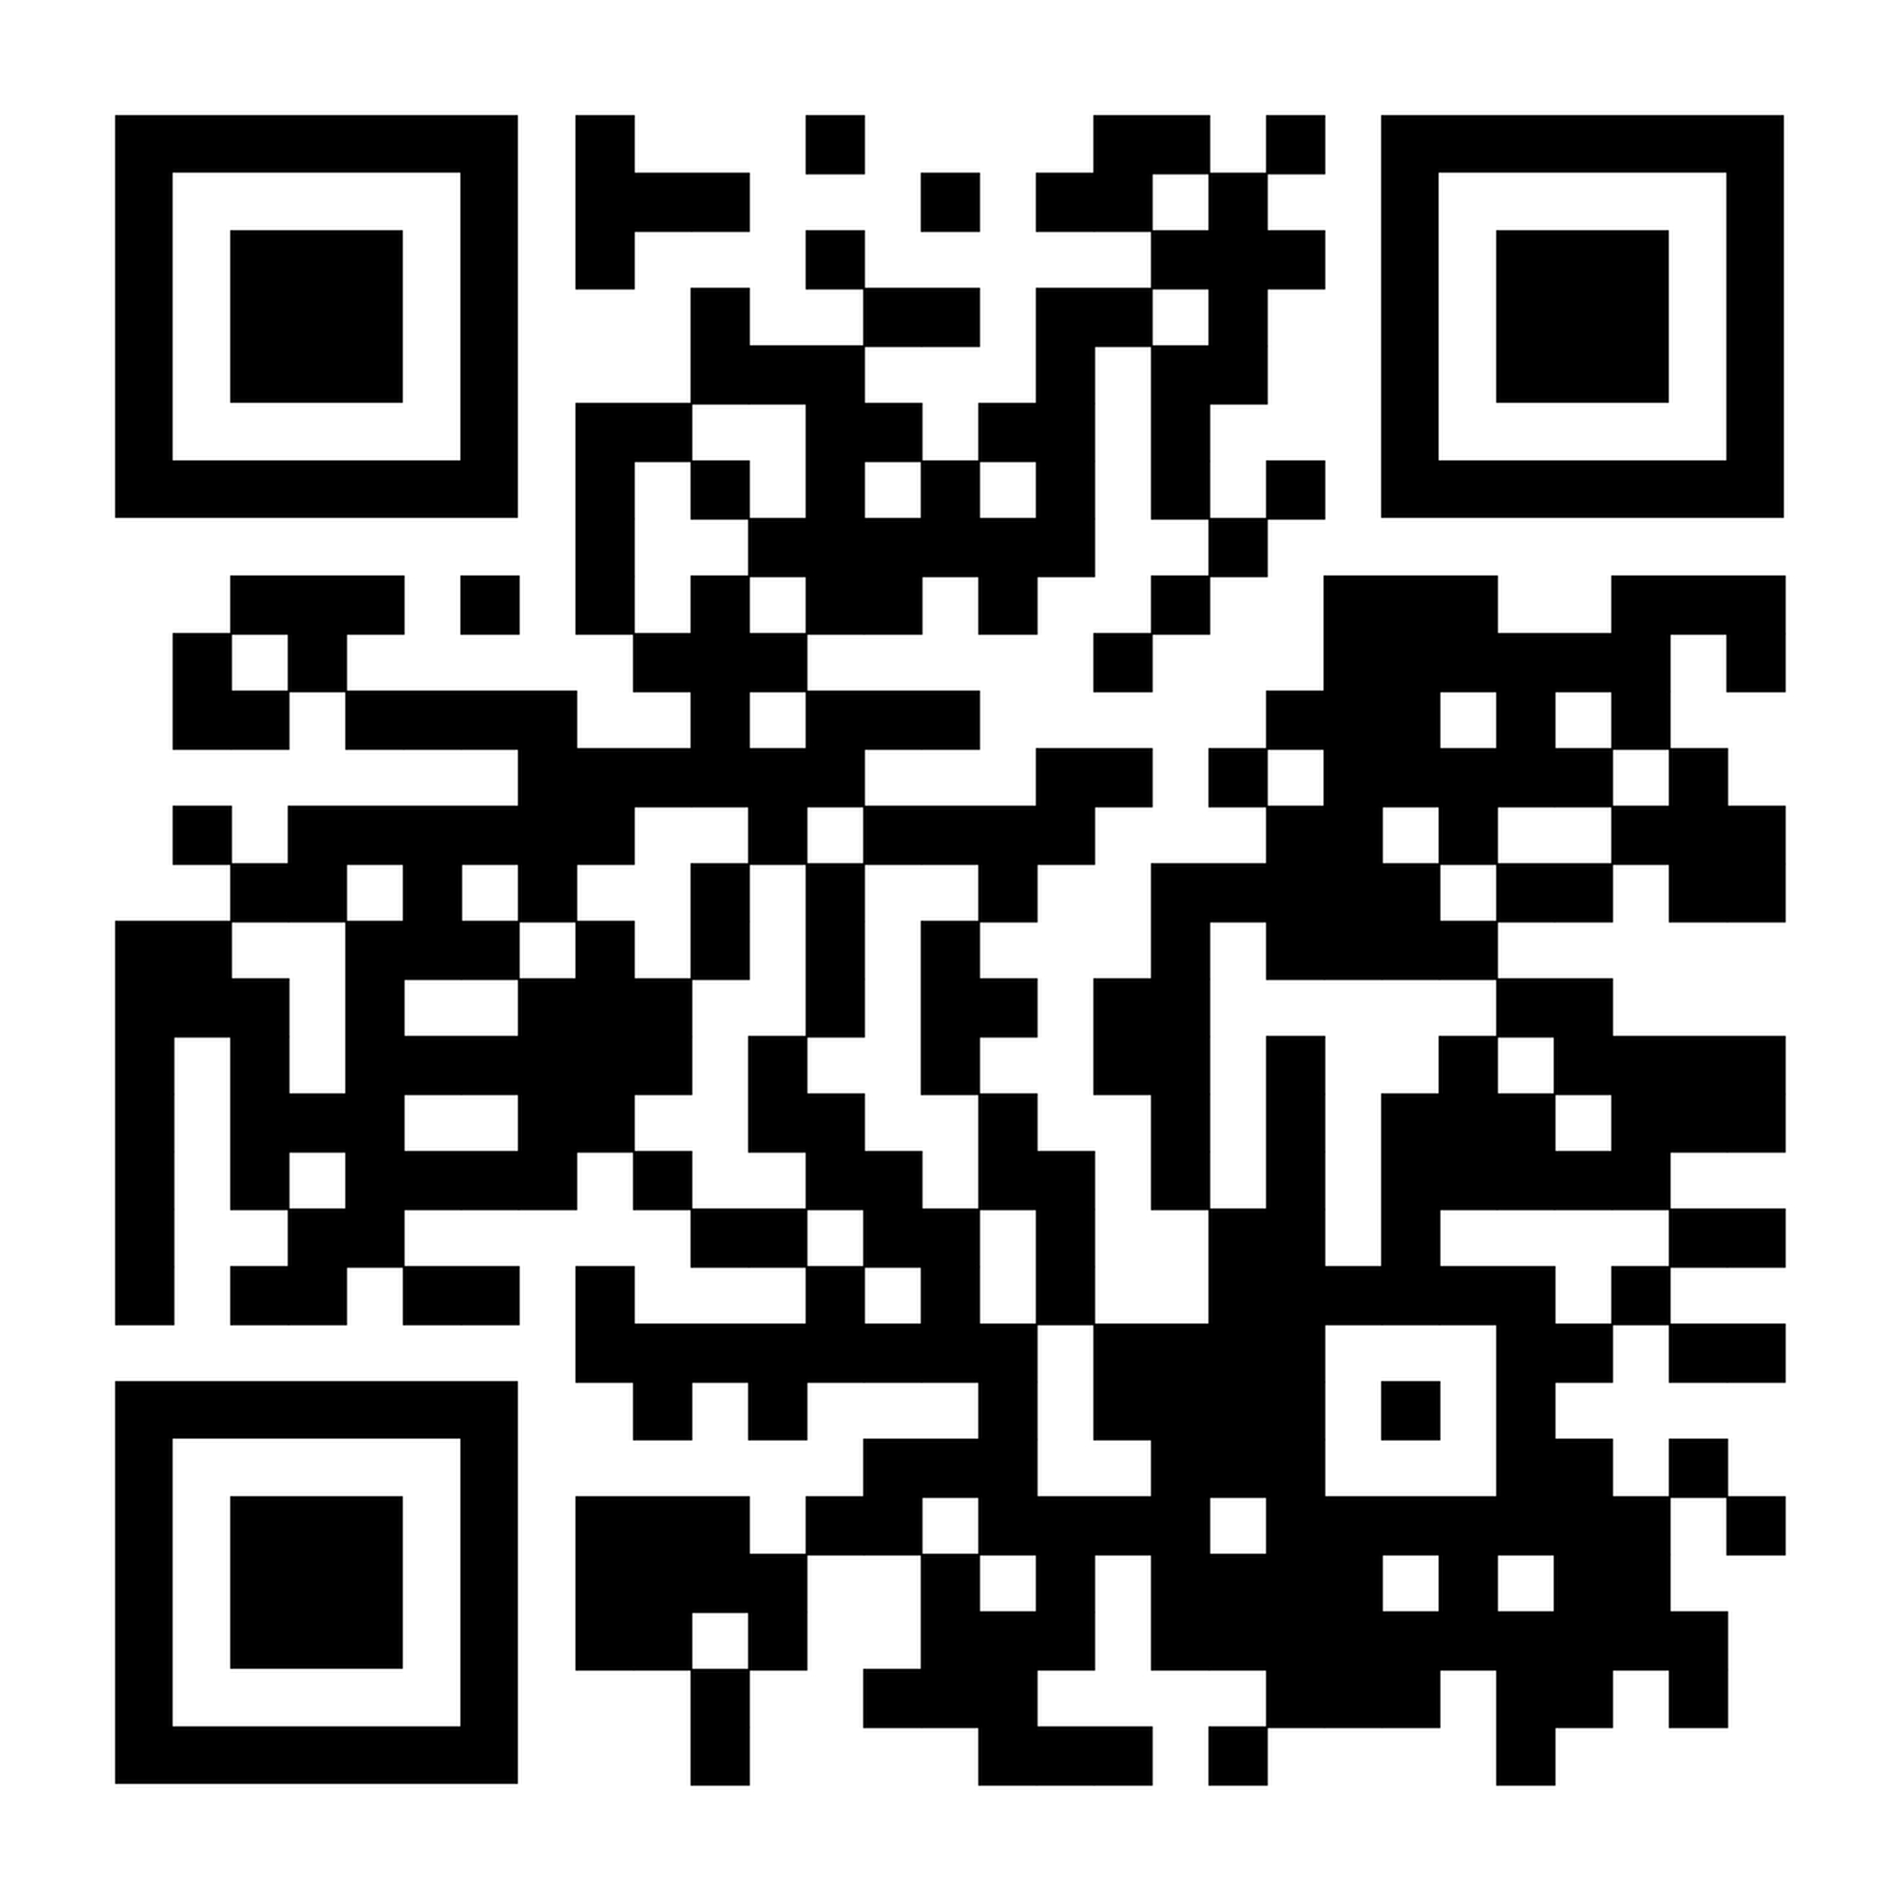
External contacts
WHO MeND survey
several EU associations of nurses and doctors
logistics: WHO Europe + finances: the EU
working during >2 years with doctors and nurses
  all EU countries plus Norway and Iceland
shocking figures on mental health
https://iris.who.int/items/7324bf3d-479f-426c-bd5d-861129616859

Slide 6
External contacts
Meetings with Latvian colleagues
Initiated by Prof. Aivars VETRA
further building on the Latvian proposal
Prof. Haralds PLAUDIS
wounded Ukrainian soldiers in Riga
waiting for surgical (re)interventions
  surgeans confronted with a lack of experience

Slide 7
External contacts
Meetings with Latvian colleagues
Initiated by Prof. Aivars VETRA
further building on the Latvian proposal
Dr. Aleksejs VISNAKOVS
a guided tour on the new Emeergency Ward
Dr. Jurgis STRAUTMANIS
  paediatric ophtalmologist and war trauma => course

Slide 8
External contacts
Barcelona - August 2025
International Conference on
Facuty Development in
the Health Professions ICFDHP
Association for
Medical Education in Europe AMEE

Slide 9
Some relevant aspects of actual UEMS activities
The geopolitical situation
A Military Medicine curriculum
in undergraduate training
An MJC on Disasters Medicine
For approval during the council meeting
How to install, streamline and coordinate
training initiatives allover European countries?

Slide 10
External contacts
Meeting with Prof. Dirk VAN RAEMDONCK
Chair of the Flemish Royal Academy for Medicine
setting up a pilot project to send trainees to Riga
  proposal spread through the Belgian VBS-GBS
financial aspects => who pays?
      could it be part of the increased defence budget?

Slide 11
EU-funded projects
KEEPCARING • HORIZON EUROPE
The KEEPCARING project is funded by the European Union’s Horizon Europe research and innovation programme under grant agreement No. 101137244.
Views and opinions expressed are however those of the author(s) only and do not necessarily reflect those of the European Union or the European Health and Digital Executive Agency (HADEA). Neither the European Union nor the granting authority can be held responsible for them.
DISCERN DSS • ERASMUS +
DISCERN-DSS: DIgitally enhanced SCenario basEd leaRNing for Digital Soft Skills, Project number: 101179391, is a project co-funded by the Erasmus+ programme of the European Union, Key Action 2 – Cooperation for innovation and the exchange of good practices – Capacity-Building projects in the field of Higher Education funded by the European Union.
Views and opinions expressed are however those of the author(s) only and do not necessarily reflect those of the European Union or European Education and Culture Executive Agency (EACEA). Neither the European Union nor the granting authority can be held responsible for them.

Slide 12





















Project overview
PROJECT GOAL
Reducing stress and preventing burnout among healthcare workers
by developing innovative, co-created solutions combining non-digital, digital, and AI-driven approaches
19 PARTNERS
TIMELINE
Ends on 31st July 2028

Slide 13



Where we stand as of now
WP2 – Identification of factors relating to resilience among healthcare professionals
Survey on stress and burnout translated in 10 languages, still on-going
1098 respondants, including 729 from surgery setting
WP3 - Solutions and interventions to reduce job stress across clinical settings
Observational study on stress using electronic tools: watch, tee-shirt with sensors, and VR goggles to help on reducing stress
WP4 – Using co-work design to reduce burnout and increase work engagement
Study on prosocial job crafting to understand how adjustments on tasks, relationships and cognition can improve nurses’ wellbeing

Slide 14
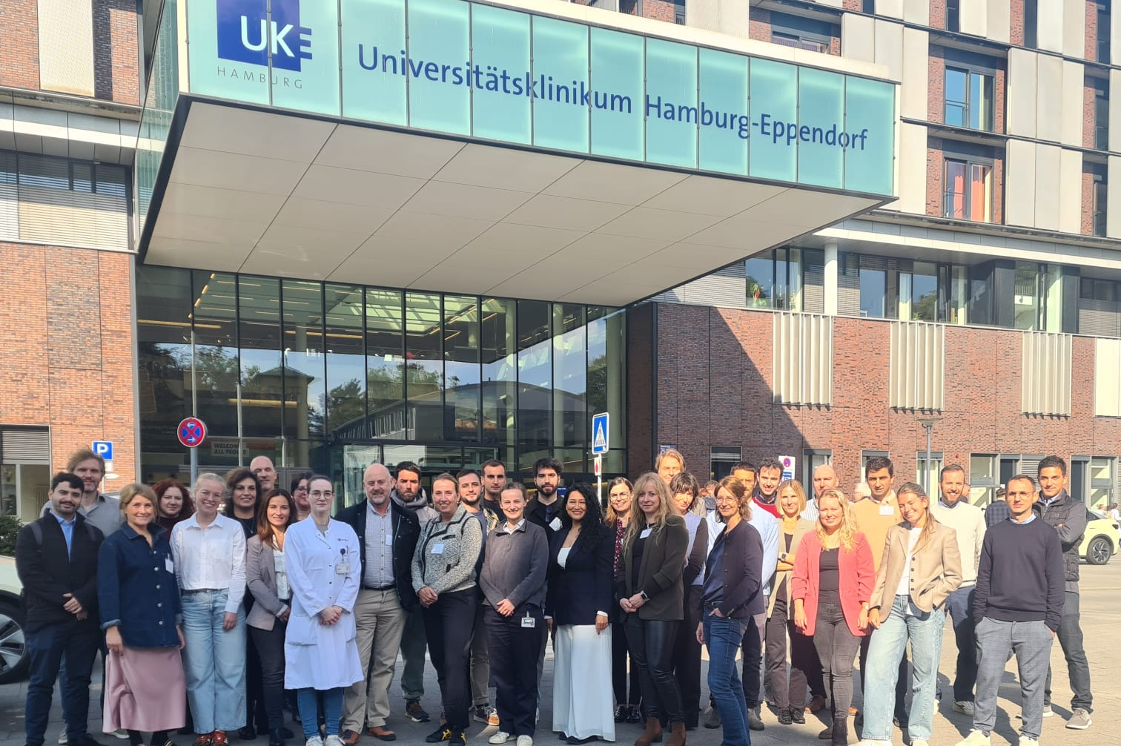
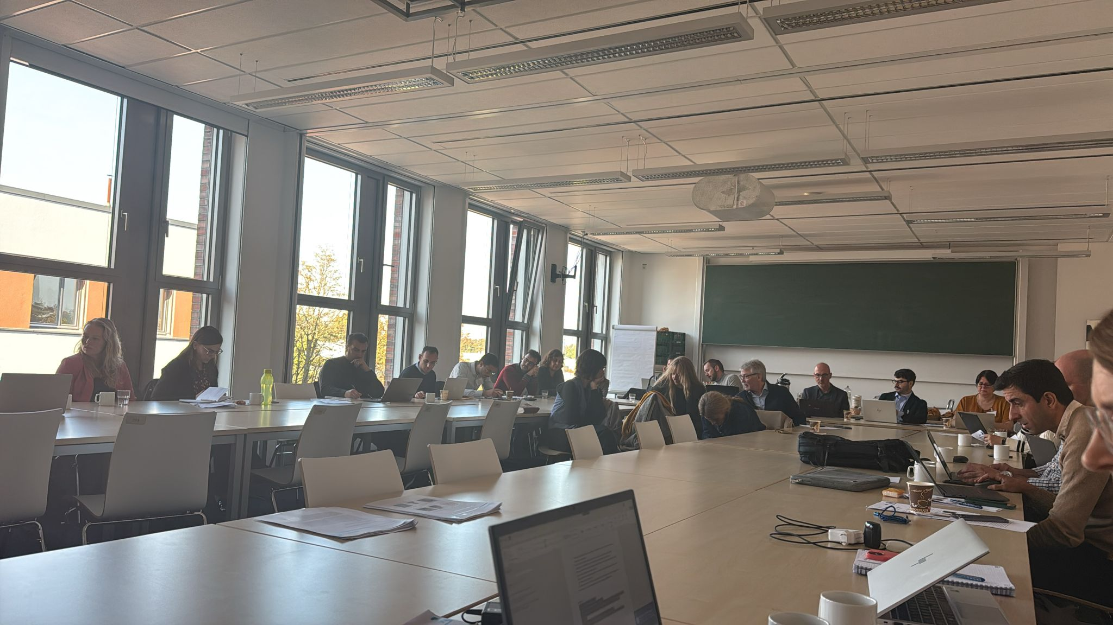
2nd & 3rd October 2025
Project’s General Assembly
Annual meeting to review the project advancements, hosted by UKE in Hamburg
UEMS represented by Mr M. Sartori

Slide 15









Project overview
PROJECT GOAL
6 PARTNERS
Developing modules of training
on telemedicine, & digital soft skills
using digital tools of teaching,
i.e. scenario-based learning
TIMELINE
Ends on 31st December 2027

Slide 16


Where we stand as of now
WP2 Needs analysis & preparatory activities
Needs assessments on digital soft skills
Curricular content for modules of training in digital soft skills
WP3 Train the trainers
International workshops
• 30th September to 3rd October 2025, in Yogyakarta (Indonesia)
• Last week January 2026, in Thessaloniki (Greece)
Local workshops
organised subsequently
within each Indonesian partner to train more faculty members to scenario-based learning

Slide 17
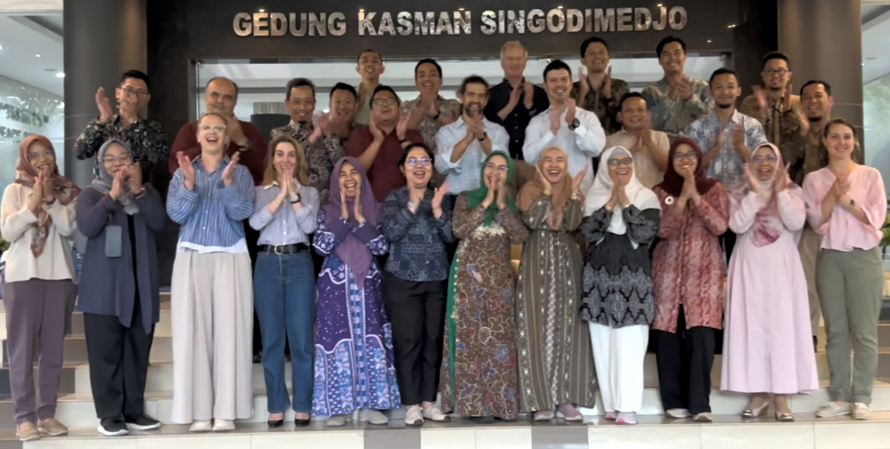
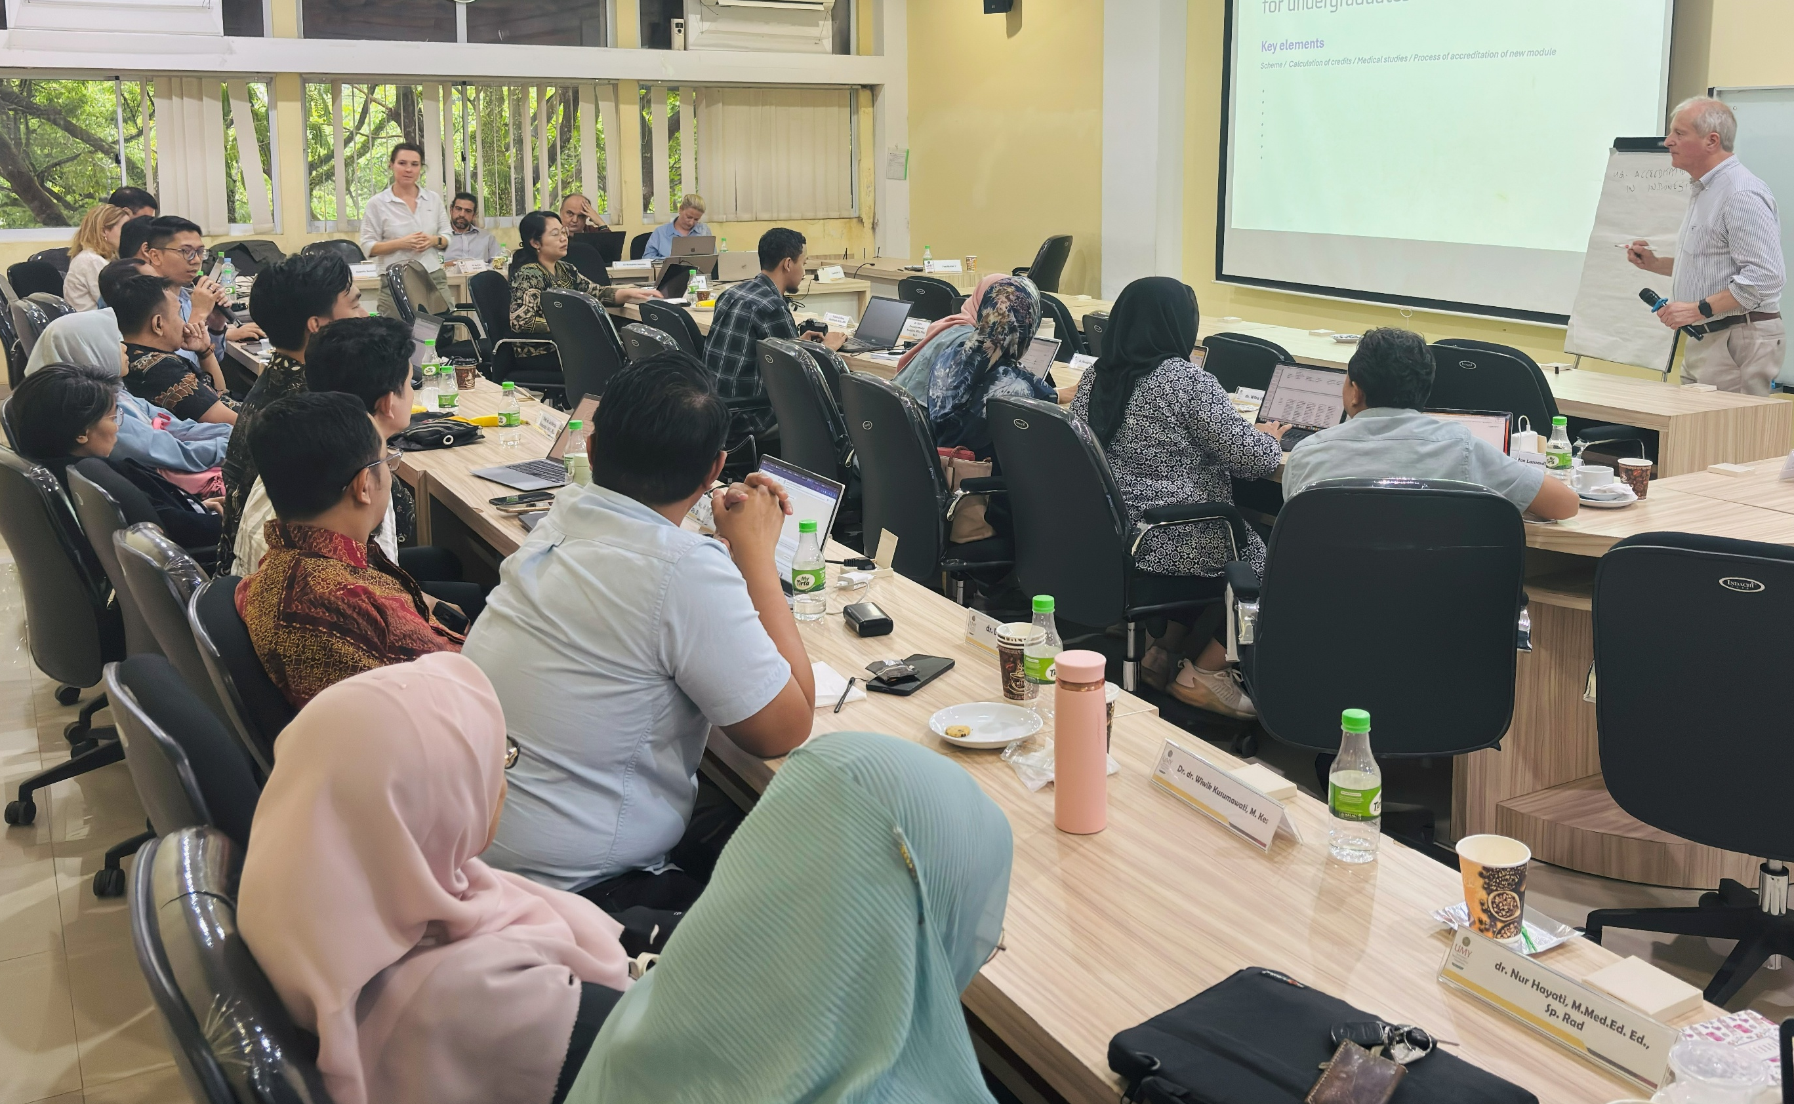
30th Sept. to 3rd Oct. 2025
Train the trainer workshop
UEMS represented by
Ms I. Dumaine and
Dr A. Brittlebank
4 days of training, hosted by Universitas Muhammadiyah Yogyakarta

Slide 18


1st UEMS Congress
Learning • Networking • Impacting
27-30 May 2026
UZ Leuven, Campus Gasthuisberg, Leuven (BE)
www.uemscongress.eu

Slide 19
1st UEMS Congress
Learning & impacting sessions, among which:
Networking & connecting opportunities
Participation of key European health stakeholders & experts
European health
AI/ Machine learning: training perspectives
European medical workforce
European health/ healthcare systems in crisis (new pandemics, naturals disasters, terror attacks, war)
Mental health in the medical profession
Green & sustainable practice
Work-life balance
Response to disasters
Oral Presentations
Workshops
Symposium
Debates
Panel Discussions
Networking Reception
Congress Dinner

Slide 20
Thanks for your attention
  Marc H.M. Hermans
  Officer for European & International Affairs
  marc.uems@telenet.be

