Slide 1

FINANCIAL REPORT
UEMS Council – 18.10.2025 – Tbilisi, Georgia

Slide 2

Profit and loss account
2024

Slide 3

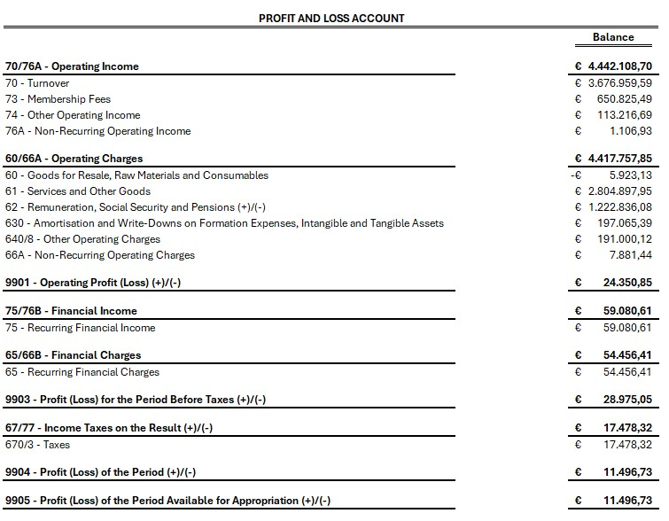
Consolidated Profit and Loss account

Slide 4
Profit and loss account
1st semester 2025

Slide 5
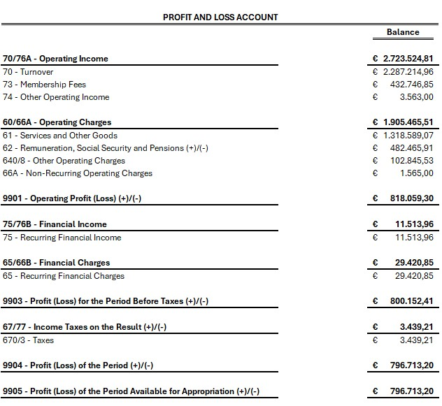
Profit and Loss account

Slide 6
Budget plan 2026

Slide 7
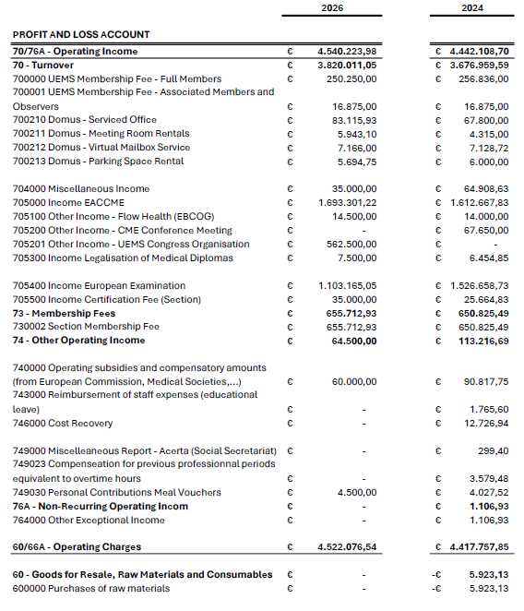
Proposal vs Consolidated results 2024!

Slide 8
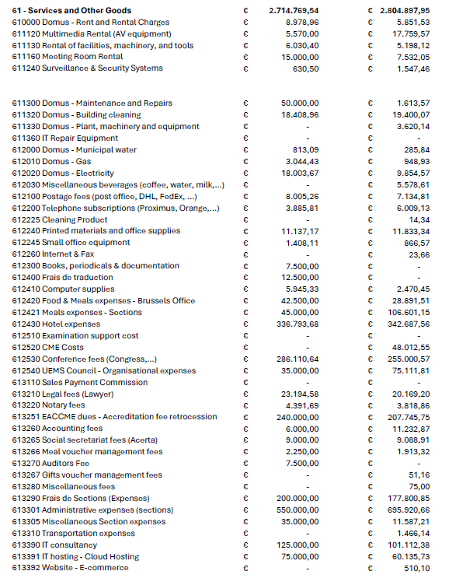
Proposal vs Consolidated results 2024!

Slide 9
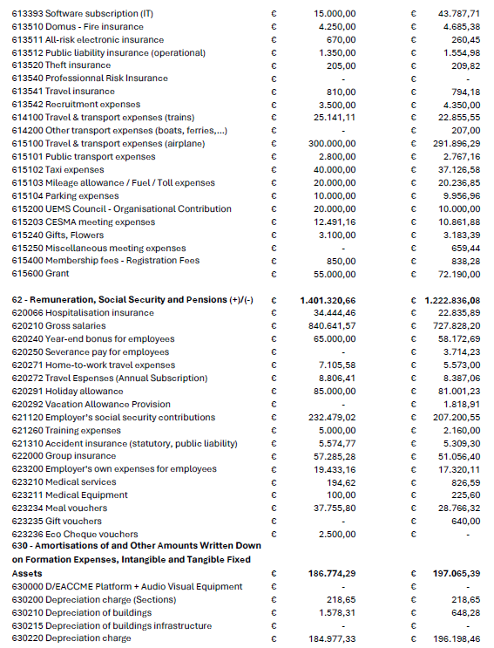
Proposal vs Consolidated results 2024!

Slide 10
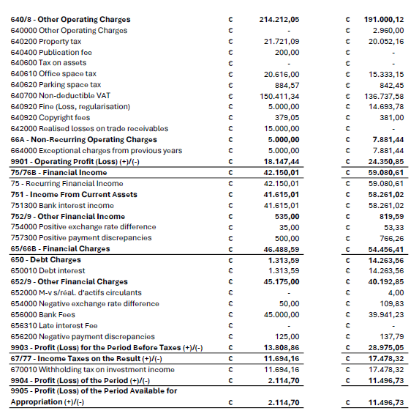
Proposal vs Consolidated results 2024!

Slide 11
UEMS COMMON INVESTMENT

Slide 12
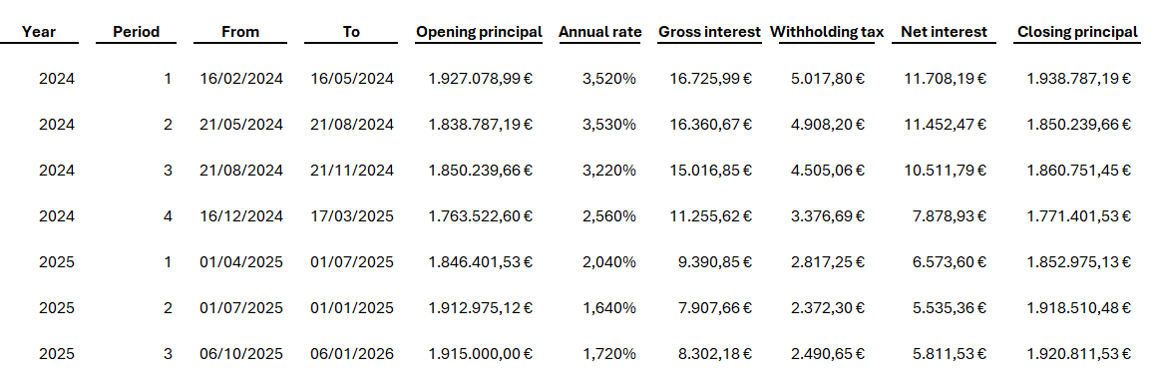
3-Month Fixed-Term Deposit

Slide 13
UEMS LOAN

Slide 14
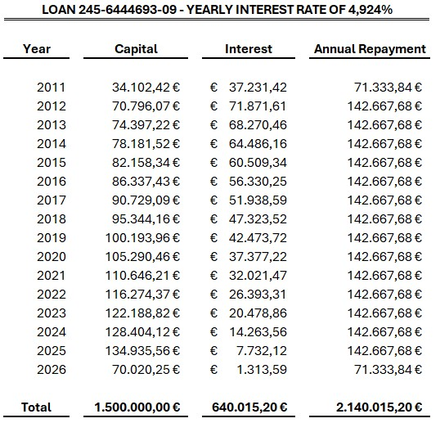
UEMS will be debt-free by mid-2026!

Slide 15
Management fee 2025

Slide 16
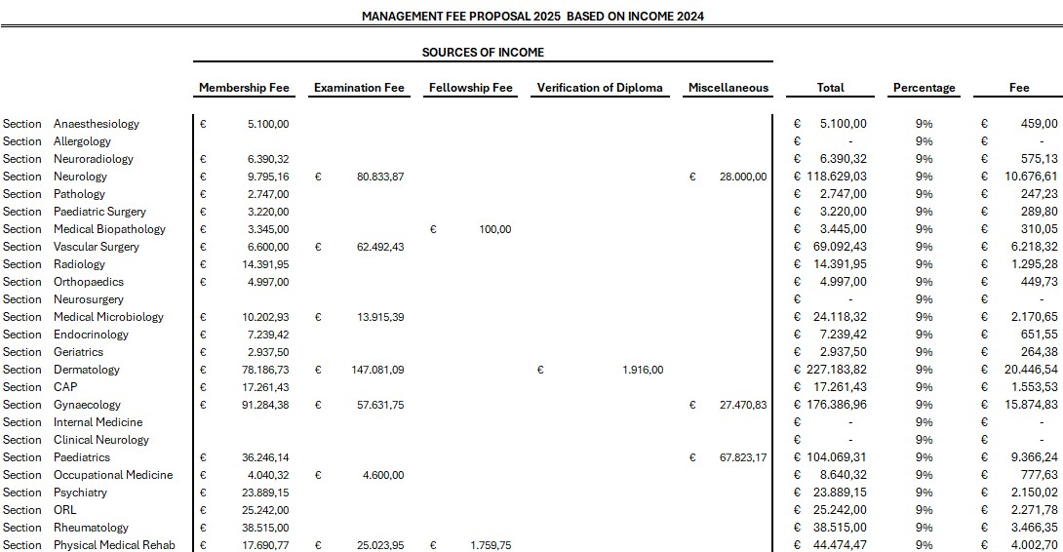
Proposal!

Slide 17
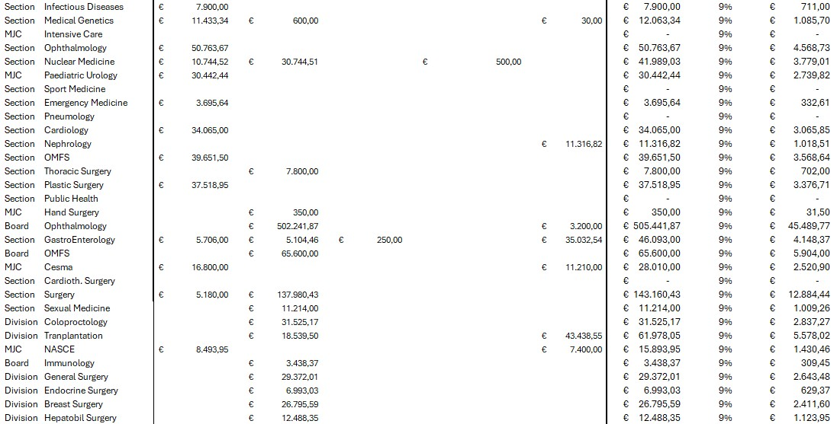
Proposal!

Slide 18
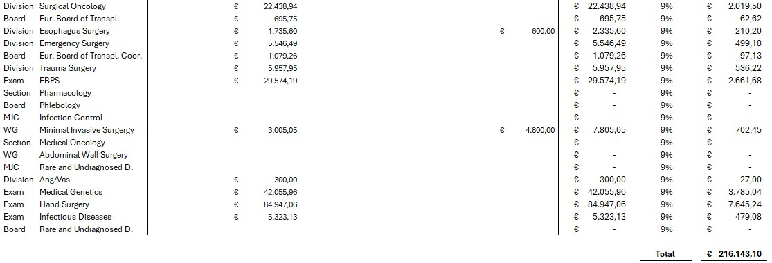
Proposal!
Subject to approval, the total amount will be transferred on 31 October 2025.

Slide 19
UEMS – EACCME Reviews

Slide 20
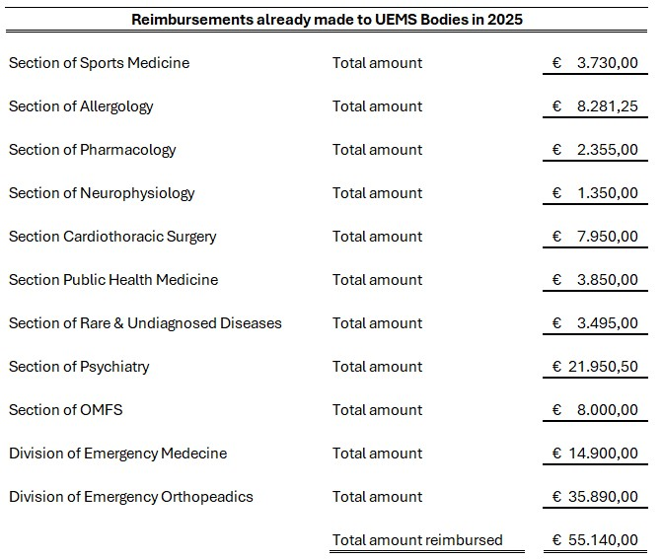
Reimbursements made in 2025!

Slide 21
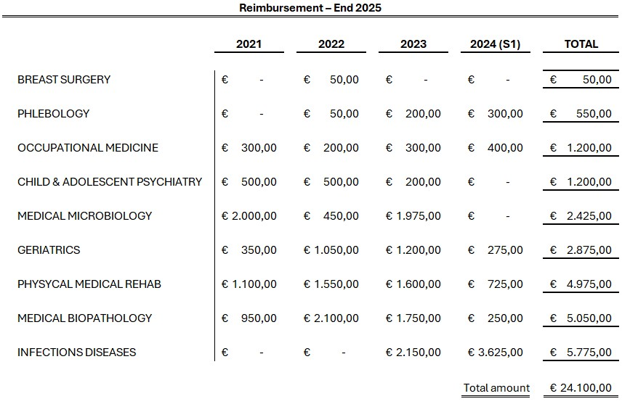
Upcoming Reimbursements in 2025

Slide 22
Strategic goals for 2026

Slide 23
UEMS: Built on Financial Strength…
  Assets directly available: 3,260,270.98 €. (as of 16/10/2025)
  Assets invested: 1,915,000.00 €.
  Remaining loan repayment: 71,333.84 € remaining on a total investment of 4,972,525.24 € (3,800,000 in capital and 1,172,525.24 in interest).
➔ In 2026 UEMS and its bodies will be free of debt and owner of the Domus Medica in the heart of Brussels.
➔ A strong asset based and disciplined investment approach ensure the UEMS remains financially resilient.

Slide 24
Together for a Better Future…
Common Investment
  Despite the drop-in interest rates, we will continue to invest in our joint investment.
  Each UEMS body is free to stop this investment or withdraw a partial amount.
  The Interest generated will be retroactively allocated to all UEMS bodies upon request.
Brussels Office Reserve
  The Brussels Office will continue to set aside €100,000 annually to reimburse the 6-Year Bond by mid-2028.
Loan Repayment
  Brussels Office loan nearly settled means higher capacity to repay EACCME dues. First reimbursements made in 2025, continuing in 2026; timing subject to operating needs and commitments.

Slide 25
Together for a Better Future…
Financial Report
  A financial report will be sent twice a year to all UEMS bodies as of 2026.
  All UEMS bodies should send their 2026 budget plan to the Brussels Office.
Examination activities
  As discussed, and approved last year, all UEMS bodies with examination activity must have a dedicated bank account for this.
Other objectives
  The Brussels Office will study the possibly of moving the accounts to an online banking institution in order to reduce the costs.
  The Brussels Office will also propose some possibilities for green investments (iShares MSCI World SRI UCITS ETF, Invesco Global Water ETF, iShares Global Clean Energy UCITS ETF,…).

Slide 26
Questions

