Slide 1

Implementation of Rare and Undiagnosed Diseases in All ETR’s
Serdar Ceylaner, MD
Prof. of Genetics
President of MJC- Rare and Undiagnosed Diseases

Slide 2
Classical information
8-10% of population has a rare disease
Misdiagnosis or missing the diagnosis causes;
  Unsuccessful therapies
  Complications
  Recurrence in the family
  Misleading informations

Slide 3
There are three main subgroups
Rare and ultrarare disorders
Combination of more than one disorders (Mixture of symptomes) of different phenothype due to modifiers
Novel disorders

Slide 4
How we can diagnose a rare disease or a novel disorder?
Checking the etiology in all cases
  Genetic
  Infections
  Trauma
  Environmental factors
  Immunology (especialy autoimmune disorders)
  Modifiers + combinations of these five titles
  BOTH COMMON AND RARE ETIOLOGIES MUST BE CHECKED
  PERSONALIZED MEDICINE

Slide 5
GENOMIC TECHNOLOGIES can diagnose
  Genetic
  Infections
  Trauma
  Environmental factors
  Immunology (especialy autoimmune disorders)
  Modifiers + combinations of these five titles

Slide 6
Overlaps
Some genetic disorders cause infection susceptibility (Common or specific microorganisms)
Genetic may increase trauma damage (Bleeding tendency, thrombosis tendency, bone fragility, adrenal insufficincy….)
Pharmacogenetics changes the effect of environmental toxins …..
WHY…….

Slide 7
Cancers and Rare Cancers
24 % of all cancers are rare cancers (ESCO)
The only way of diagnosis is genomic testing of cancer tissue + histopathology
Not only cancer but also germline testing helps us to detect
  Familial cancers (some have specific approachs and all have increased risk in family members)
  Other additional genetic disorders
  Pharmacogenetics

Slide 8
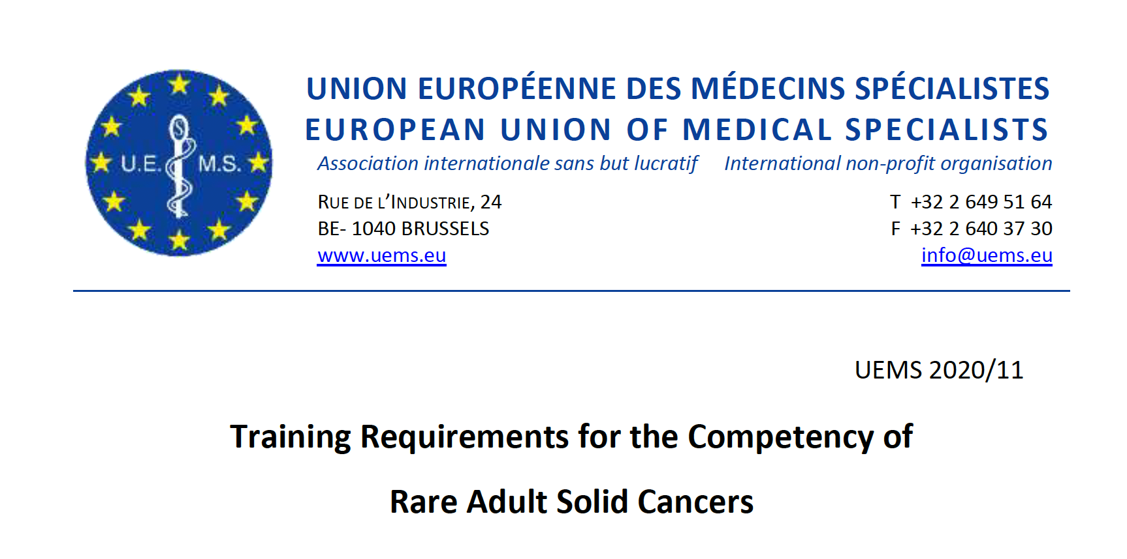

Slide 9
Genomics is not coming, it came
Genomic screening of the populations and genomic integration to medicine
  Reduces the total costs
  Increases the life quality
  Prepregnancy screening decreases the affected persons with severe disorders.
  AI technology reduces the analysis cost

Slide 10
Sample case
Anaphylaxis/ angioneurotic edema/ stroke/ asthma/ allergy
64 year-old male
Asthma and inflammatory bowel syndrome since age 15
Resistance to inhaled steroids in asthma treatment
Hypertension that began at age 50
Angioedema that began with hypertension treatment
Post-traumatic stroke
Adverse effects from medications

Slide 11
Sample case
Anaphylaxis/ angioneurotic edema/ stroke/ asthma/ allergy
Asthma and inflammatory bowel syndrome since age 15
CHI3L1 geni; NM_001276.4 c.-131C>G - Homozygote
Resistance to inhaled steroids in asthma treatment
ADRB2 geni; NM_000024.6 c.46G>A p.(Gly16Arg) - Homozygote
Hypertension that began at age 50
Angioedema that began with hypertension treatment
F12 geni; NM_000505.4 c.-4T>C- rs1801020 Homozygote
ACE geni; NM_000789.4 c.793C>T p.(Arg265Ter) - Heterozygote
Post-traumatic stroke
Factor V Leiden Homozygous/ MTHFR 677C>T Homozygote
Adverse effects of medications
CYP2D6 gene deletion

Slide 12
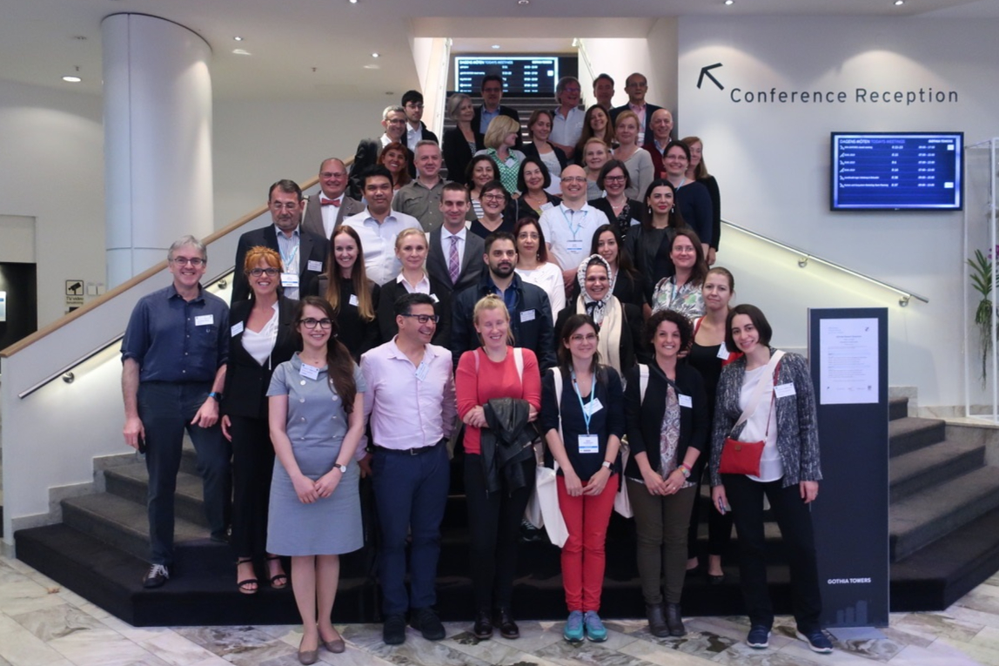
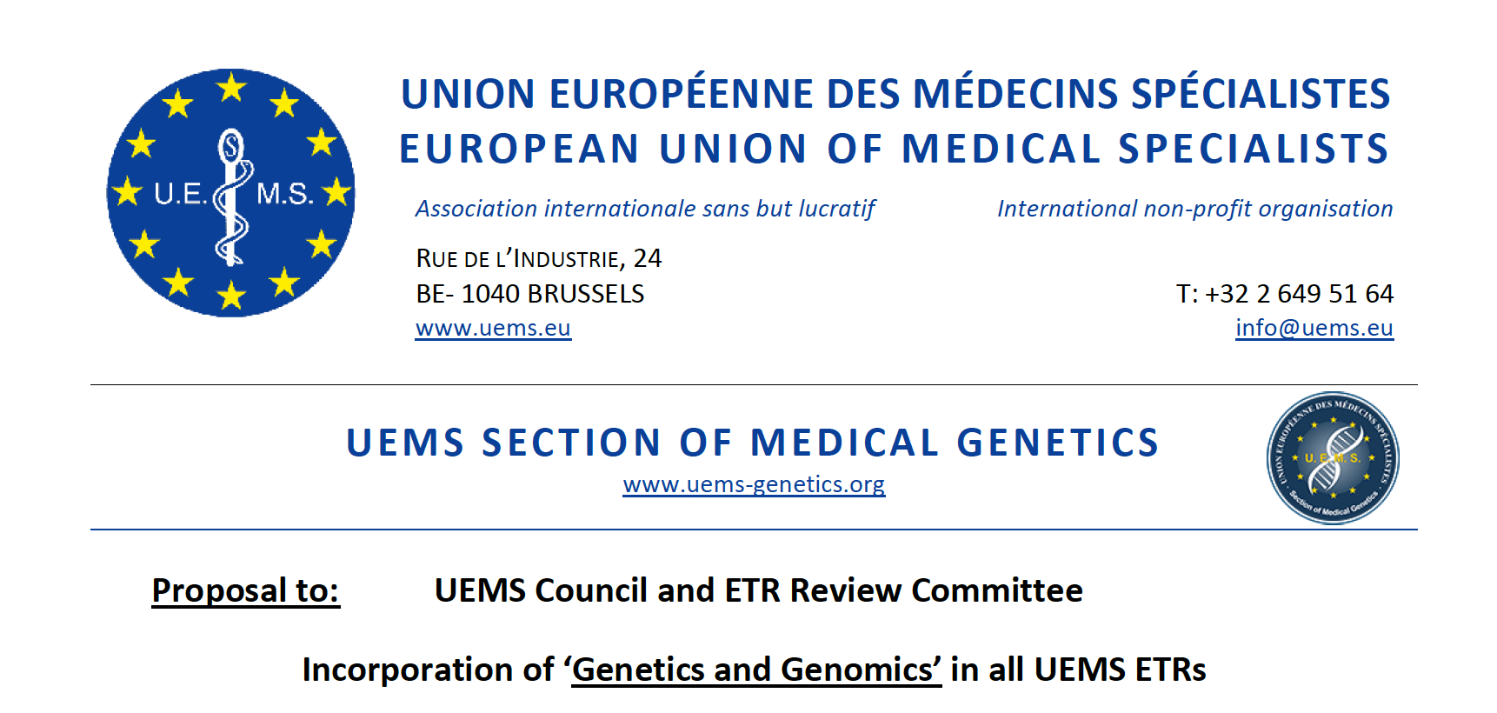
UEMS Section of Medical Genetics
This was the first step

Slide 13
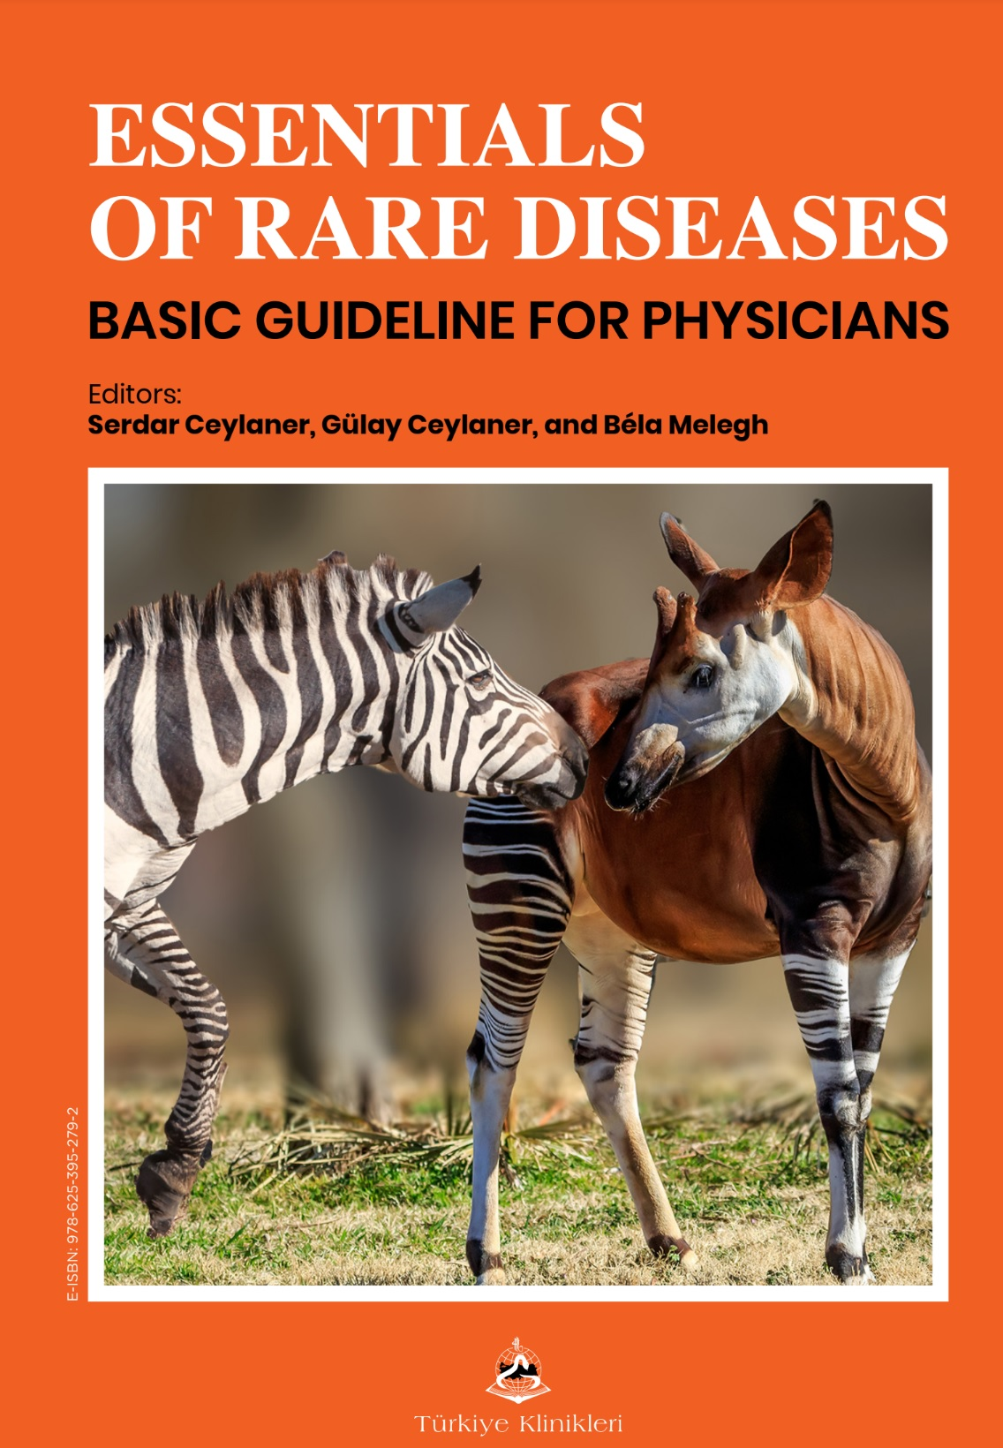
Second step
https://books.turkiyeklinikleri.com/books/essentials-of-rare-diseases/
Free book for rare disease algorithms
Nearly 20% of rare diseases have non genetic etiologies end modifiers
Rare disease competency exam and certification

Slide 14

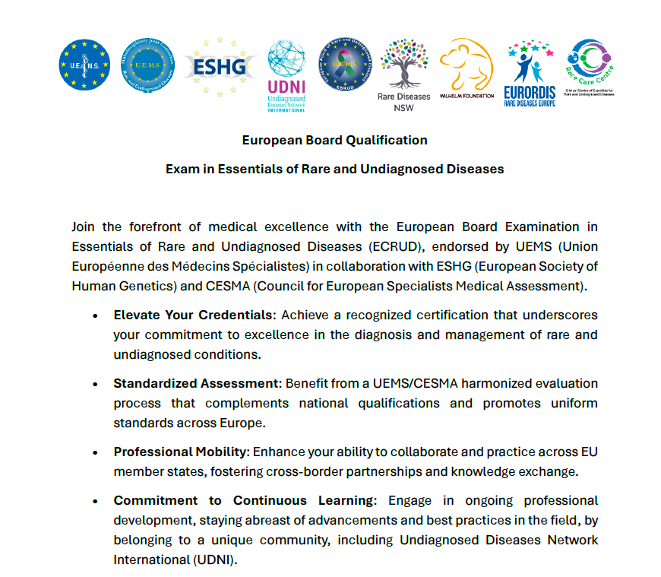
5 etiyolojiyi unutma
VERA İntergen
info@veraintergen.com
Tel: 0216 888 76 80 WhatsApp: 0542 659 85 70

Slide 15
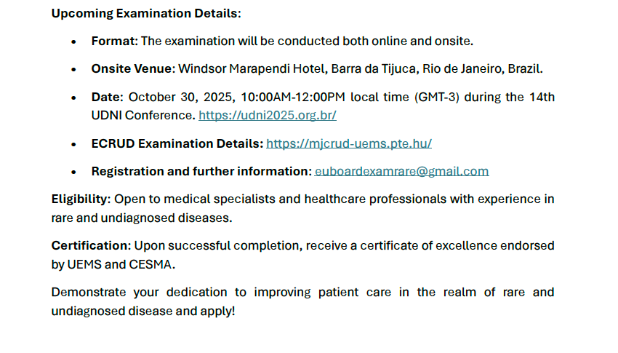
VERA İntergen
info@veraintergen.com
Tel: 0216 888 76 80 WhatsApp: 0542 659 85 70

Slide 16
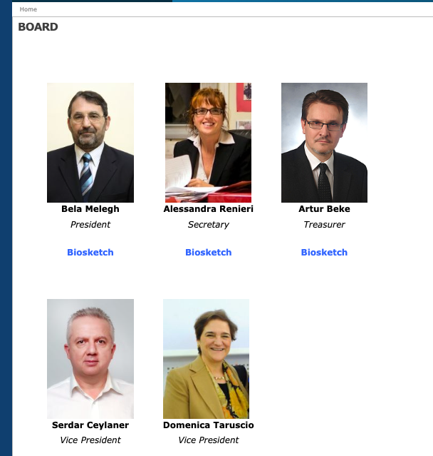
Now
Dr. Serdar Ceylaner President- MJC-RUD
Dr. Béla Melegh
President- Head of Exam Committee EBRUD
Dr. Tinatin Tkemaladze
Secretary, Enlarged Exam Steering Committee (EESC)
Dr. Hadzsiev Kinga
Vice President
Dr. Artur Beke
Treasurer
Dr. Katalin Sumegi
Exam organizing committee

Slide 17


Slide 18
Third step
Implementation of genomic + non-genomic rare diseases in to cirruculums.
Changing the habbits of all medical specialities
Reevaluation of guidelines
Preparing education books and videos together.
Essentials of rare diseases in orthopedics
Essentials of rare diseases in obstetrics…….

Slide 19
Cross-Specialty Etiological Training Curriculum for Rare Diseases
(Online multidiciplinary education)
Introduction to Rare Diseases & Diagnostic Challenges
General Workflow for Undiagnosed Cases
Genetic Etiologies — Core Concepts for All Specialties
Genetic Etiologies — Rare Variant Analysis & Genomic Investigation
Infectious Etiologies in Rare Disease
Trauma-Related Etiologies and Physical Injury Triggers
Environmental and Toxicological Etiologies
Immunological and Autoimmune Causes
Multifactorial and Combination Etiologies
Critical Care Module — Investigation and Evaluation of Genetic and Non-Genetic Rare Diseases in the ICU
Next-Generation Technologies and AI in Rare Disease Diagnosis

Slide 20
Working groups
Internal working group including 5 persons in every speciality
1-2 persons from every individual speciality as representers of internall working groups
Common education
Preparing online videos
Preparing online free of charge books- booklets
Summer courses
Speciality specific education
Detection of speciality specific ecutation programs

Slide 21
Plan
Kick of meeting (online)
Mounthy meetings at least 7-8 times a year.
E-mail groups
Online document management
Editorial support of a professional company
Time table:
1 year for the first videos
2 years for the books
First summer course will be in 2026 (Hybrit)
Yearly checking the documents

Slide 22

Prof. Dr. Serdar Ceylaner
@mail: serdarceylaner@intergen.com.tr
+90 533 214 5337 (Call and Whatsapp)
I can send;
Draft- Online Education Modules
Draft-Common Core Curriculum
Free book- Essentials of Rare Diseases
Please send;
The names and e-mails of volunters for books and videos
Your recommentations
Any kind of additional supports
Download the documents

