Slide 1

Clinical Pharmacology to Non-Clinical Pharmacologists in Europe
Romaldas Mačiulaitis, M.D., Pharm.D.
President, UEMS Section of Pharmacology
Professor of Clinical Pharmacology and Clinical Pharmacy, Lithuanian University of Health Science (LUHS), Kaunas, LITHUANIA
Medical clinical pharmacologist, LUHS Kaunas Clinics
Nephrologist, Nephrology Clinic of LUHS Kaunas Clinics
Regulatory advisor to National Competent Authorities for marketing authorization and reimbursement
Prof. Dr. Romaldas Mačiulaitis President of UEMS Section of Pharmacology | Clinical Pharmacology to Non-Clinical Pharmacologists UEMS Advisory Board Meeting, 17th October 2025 | Page 1

Slide 2
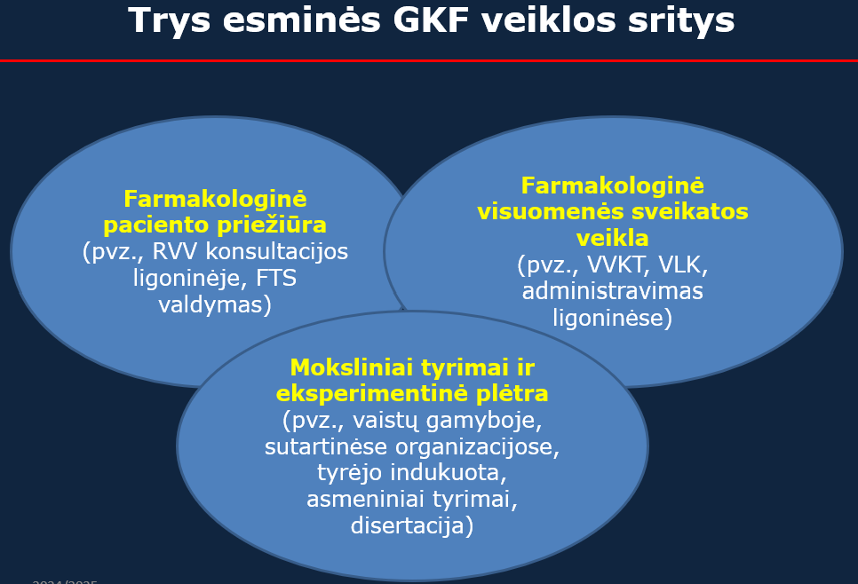
Main provisions
Clinical pharmacology as medical specialty
Medical clinical pharmacologist
Medical clinical pharmacologist
Clinical pharmacology (CP) – a branch of biomedical science that encompasses the discovery and development of medicines, the use of medicines as therapeutic agents, and all aspects of the effects of medicines on humans.
Medical clinical pharmacologist (MD/CP) - a medical doctor who has acquired the professional qualification of a medical clinical pharmacologist in accordance with the procedure established by legal acts.
The practice of a medical clinical pharmacologist - the personal healthcare / patient care provided by a medical clinical pharmacologist in accordance with the acquired professional qualifications and established competences, regulated by legal acts.
Rational use of medicines (RUM) – the use of medicines when the patient is given the individual doses of medicines most appropriate for their clinical condition at the right time, during the optimal treatment period, and the costs of treatment are minimal for both the patient and society.
Pharmacotherapeutic problem (PTP) – any issue related to medicine therapy that negatively impacts a patient's health or treatment outcomes. These problems can range from medication errors and adverse drug reactions to ineffective treatment or patient non-adherence.
Three activity areas
Pharmacological patient care
Pharmacological public health care
Research and Development, especially translational
Prof. Dr. Romaldas Mačiulaitis President of UEMS Section of Pharmacology | Clinical Pharmacology to Non-Clinical Pharmacologists UEMS Advisory Board Meeting, 17th October 2025 | Page 2

Slide 3
European Environment of Clinical Pharmacology as Medical Specialty
Overlapping competences
Clinical pharmacy
Other medical specialties
Clinical pharmacology
Pharmacy
Regulatory and reimbursement
Basic pharmacology
Pharmaceutical physician
Prof. Dr. Romaldas Mačiulaitis President of UEMS Section of Pharmacology | Clinical Pharmacology to Non-Clinical Pharmacologists UEMS Advisory Board Meeting, 17th October 2025 | Page 3

Slide 4
European Environment of Clinical Pharmacology as Medical Specialty
Variability of national competences
Lithuania - 2025
Clinical pharmacy
Other medical specialties
Clinical pharmacology
Pharmacy
Regulatory and reimbursement
Basic pharmacology
Pharmaceutical physician
These are 3 main
areas related to TDM
Prof. Dr. Romaldas Mačiulaitis President of UEMS Section of Pharmacology | Clinical Pharmacology to Non-Clinical Pharmacologists UEMS Advisory Board Meeting, 17th October 2025 | Page 4

Slide 5
European Environment of Clinical Pharmacology as Medical Specialty
Top 7 PTP tasks defining presence and clinical relevance
Interpretation of drug inefficiency
Extrapolation of indication, dosage
Interpretation of diverging DDIs
Interpretation of pharmacokinetic/TDM analysis
Interpretation of provisions in SmPC
Differential diagnosis and management of ADR
The experimental Rx
As regards Lithuania (2015)
Clinical pharmacy
Other medical specialties
Clinical pharmacy
Clinical pharmacology
Pharmacy
Pharmacy
Regulatory and reimbursement
Regulatory and reimbursement
Basic pharmacology
Basic pharmacology
Pharmaceutical physician
Pharmaceutical physician
Areas of overlapping competences coping with issues of clinical relevance (for RUM)
Prof. Dr. Romaldas Mačiulaitis President of UEMS Section of Pharmacology | Clinical Pharmacology to Non-Clinical Pharmacologists UEMS Advisory Board Meeting, 17th October 2025 | Page 5

Slide 6
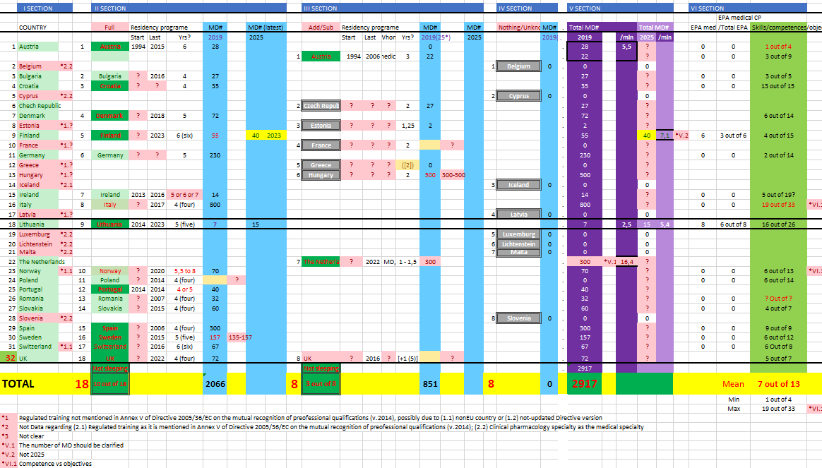
Clinical pharmacology NTRs (2025-07-01)
Prof. Dr. Romaldas Mačiulaitis President of UEMS Section of Pharmacology | Clinical Pharmacology to Non-Clinical Pharmacologists UEMS Advisory Board Meeting, 17th October 2025 | Page 6

Slide 7
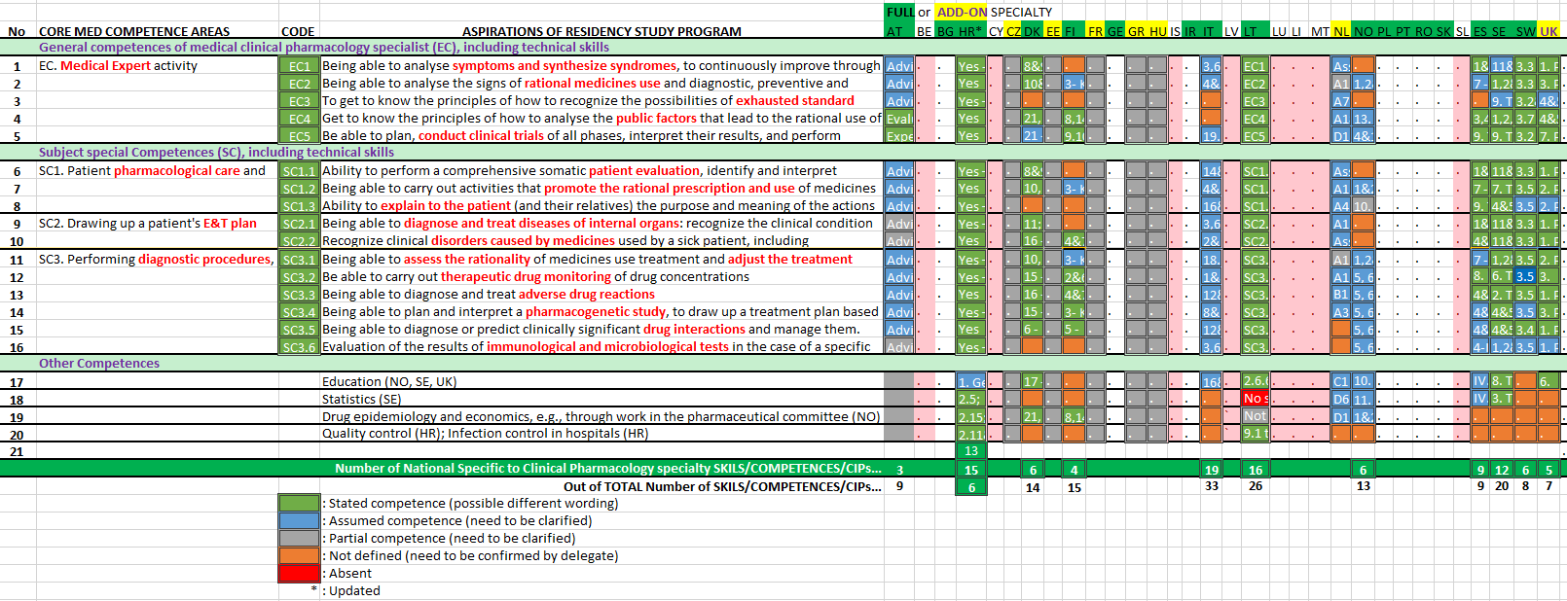
ETR
Competence-based education
Prof. Dr. Romaldas Mačiulaitis President of UEMS Section of Pharmacology | Clinical Pharmacology to Non-Clinical Pharmacologists UEMS Advisory Board Meeting, 17th October 2025 | Page 7

Slide 8
Proposed Composite list of 15 UEMS Competences for residency study program
Draft 1, 2025-06-09 (1/2)
General medical competences of Clinical pharmacology specialist - common primary competences as MEDICAL EXPERT (MEC), COMMUNICATOR (COM), SCHOLAR (SCO), and PROFESSIONAL (PRF)
MEC1. Being able to analyze symptoms and synthesize syndromes for the clinical assessment and treatment in at least one therapy area
MEC2. Being able to evaluate the signs of rational use of medicines (effective, safe and pharmacoeconomic) at the individual patient level
MEC3. Being able to recognize exhausted standard internal medicine treatment of diseases and reasonably to suggest to participate in ongoing (inter-) national clinical trials
MEC4. Being able to know the principles to analyze the effects of medicines and public factors that lead to the rational use of medicines on population level - evaluation criteria for authorization, use, reimbursement and marketing rights
PRF1. Be able to plan, conduct clinical trials of all phases, interpret their results, and perform benefit and risk assessment of medicinal products
SCO1. Being able to deliver objective, producer independent effective education in clinical pharmacology, therapeutics and prescribing to promote safe and effective use of medicines across the whole workforce
COM1. Being able to explain to the patient and their relatives the purpose and meaning of the actions performed with them, to explain the findings and further actions to the patient, to gain trust and informed consent
Prof. Dr. Romaldas Mačiulaitis President of UEMS Section of Pharmacology | Clinical Pharmacology to Non-Clinical Pharmacologists UEMS Advisory Board Meeting, 17th October 2025 | Page 8

Slide 9
Proposed Composite list of 15 UEMS Competences for residency study program
Draft 1, 2025-06-09 (2/2)
Subject special Competences (SSC)
8. SSC1. Being able to demonstrate the ability to provide pharmacological care through comprehensive patient evaluation and monitoring, addressing pharmacotherapeutic issues related to the inefficacy or safety concerns of pharmacological therapy
9. SSC2. Being able to carry out activities that promote the rational prescription and use of medicines, addressing pharmacotherapeutic problem of inefficacy or safety concerns and managing patients with complex prescribing needs, including multimorbidity, polypharmacy, adherence issues, and medication intolerance, including adverse drug reactions and interactions
10. SSC3. Being able to draw-up patients examination plan for differential diagnosis and treatment plan in case of pharmacotherapeutic problem of non-efficacy or non-safety due to medicine related disorders
11. SSC4. Be able to assess the rationality of individual patient drug treatment
12. SSC5. Be able to carry out therapeutic monitoring of drug concentrations of individual patient
13. SSC6. Be able to diagnose and treat ADRs of individual patient
14. SSC7. Be able to plan and interpret a pharmacogenetic investigation of individual patient
15. SSC8. Be able to diagnose or predict clinically significant drug interactions of individual patient
Prof. Dr. Romaldas Mačiulaitis President of UEMS Section of Pharmacology | Clinical Pharmacology to Non-Clinical Pharmacologists UEMS Advisory Board Meeting, 17th October 2025 | Page 9

Slide 10
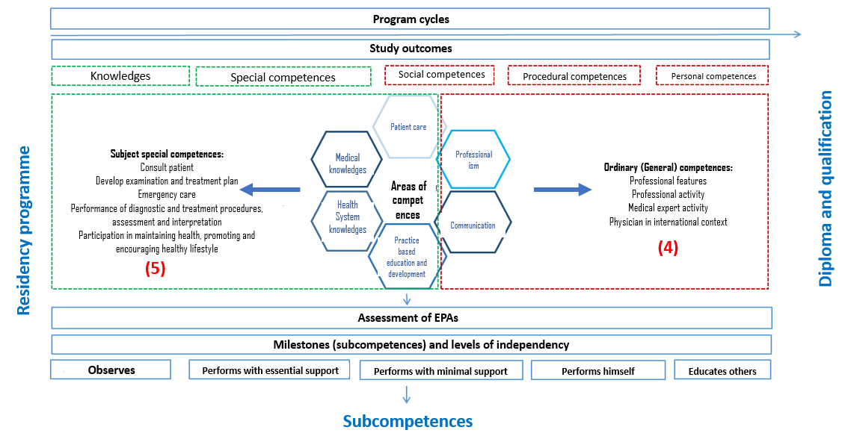
Prof. Dr. Romaldas Mačiulaitis President of UEMS Section of Pharmacology | Clinical Pharmacology to Non-Clinical Pharmacologists UEMS Advisory Board Meeting, 17th October 2025 | Page 10

Slide 11
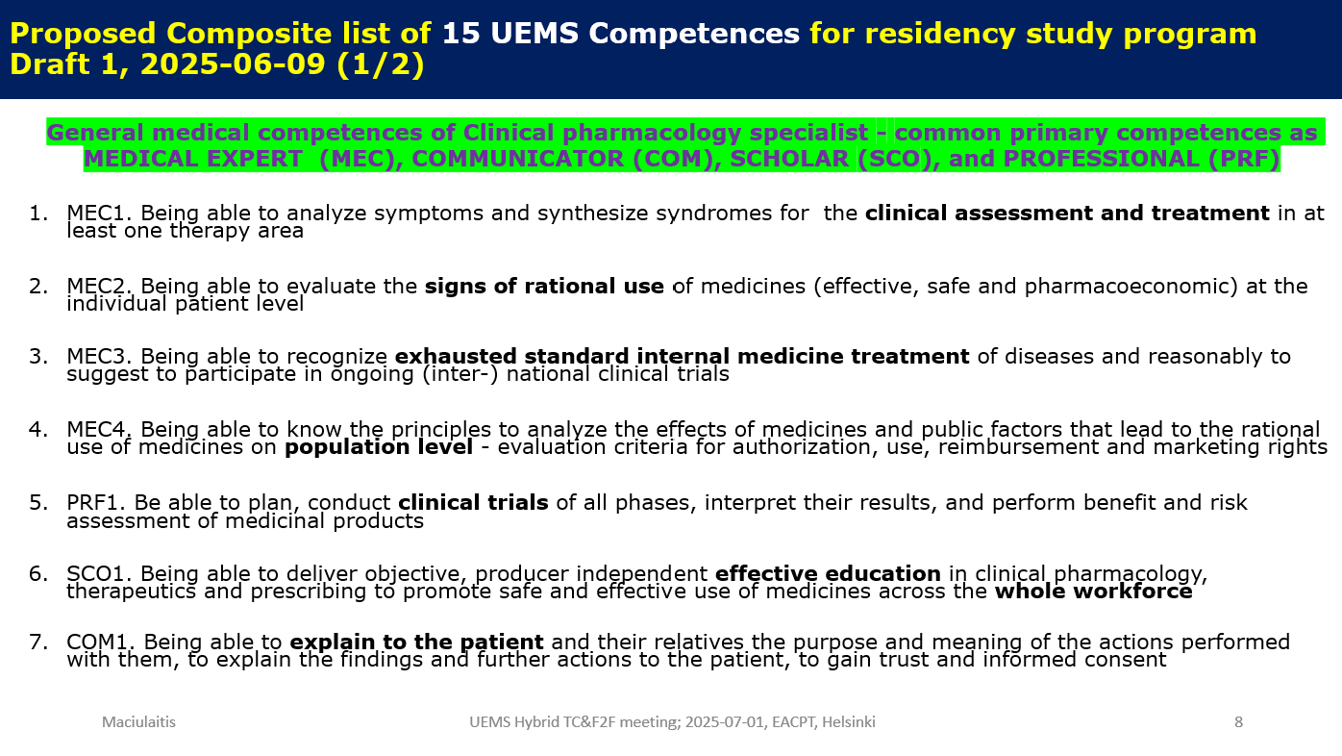
“Competences of clinical pharmacology to non-clinical pharmacologists”
Certain level of several Ordinary (General) competences (e.g., initial diagnosis & therapy) will need to be promoted and incorporated into all other relevant medical specialties, primarily to therapeutic ones (e.g., neurology, geriatrics, nephrology, internal medicine) + provisions of seeking further support from medical clinical pharmacologist (timely consultation and/or referral)
Prof. Dr. Romaldas Mačiulaitis President of UEMS Section of Pharmacology | Clinical Pharmacology to Non-Clinical Pharmacologists UEMS Advisory Board Meeting, 17th October 2025 | Page 11

Slide 12
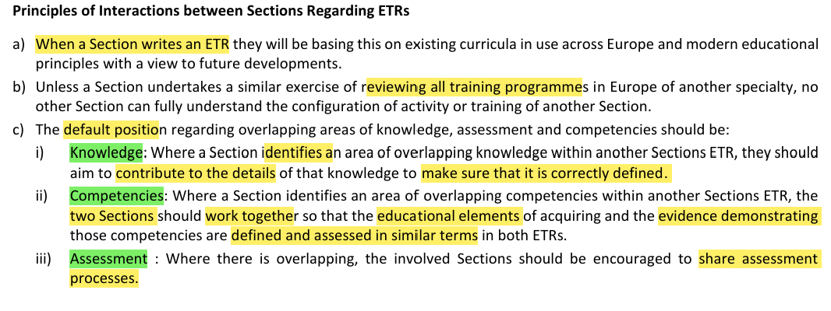
ETR
Managing overlapping Competency and Knowledge (UEMS)
Prof. Dr. Romaldas Mačiulaitis President of UEMS Section of Pharmacology | Clinical Pharmacology to Non-Clinical Pharmacologists UEMS Advisory Board Meeting, 17th October 2025 | Page 12
Notes:
1/ UEMS European Training Requirements Committee Terms of Reference, Version 3, April 2021
2/ Jason R. Frank, Linda S. Snell, Olle Ten Cate et all: Competency-based medical education: theory to practice, Medical Teacher, 32:8, 638-645, DOI: 10.3109/0142159X.2010.501190
3/ Andrew K. Hall, Daniel J. Schumacher, Brent Thoma et all (2021) Outcomes of competency-based medical education: A taxonomy for shared language, Medical Teacher, 43:7, 788-793, DOI: 10.1080/0142159X.2021.1925643

Slide 13
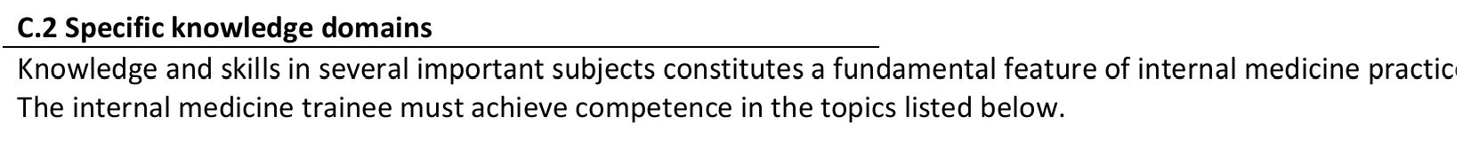
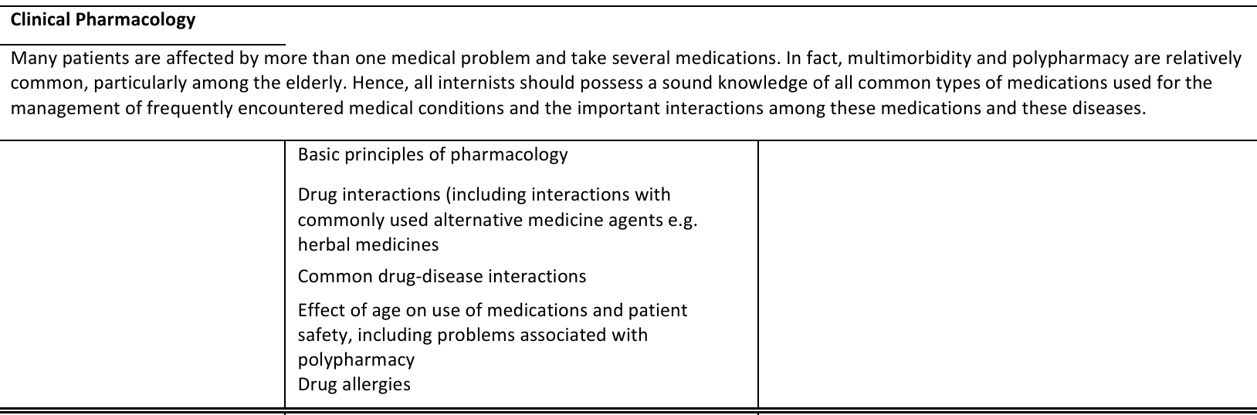
ETR
Internal medicine (2016) – partially overlapping areas
Prof. Dr. Romaldas Mačiulaitis President of UEMS Section of Pharmacology | Clinical Pharmacology to Non-Clinical Pharmacologists UEMS Advisory Board Meeting, 17th October 2025 | Page 13

Slide 14
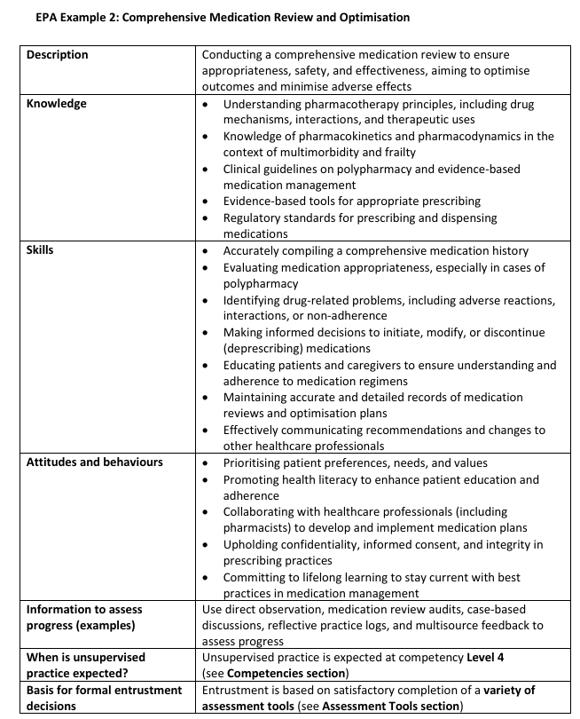
ETR
Geriatric medicine (2025, revised, draft)
Proposal of Section Pharmacology to incorporate the wording on 'Competences of clinical pharmacology for non-clinical pharmacologists' has been submitted for the Geriatric Section
Certain level of several Ordinary (General) competences (e.g., initial diagnosis & therapy) will need to be promoted and incorporated into all other relevant medical specialties, primarily to therapeutic ones (e.g., neurology, geriatrics, nephrology, internal medicine) + provisions of seeking further support from medical clinical pharmacologist (timely consultation and/or referral)
Prof. Dr. Romaldas Mačiulaitis President of UEMS Section of Pharmacology | Clinical Pharmacology to Non-Clinical Pharmacologists UEMS Advisory Board Meeting, 17th October 2025 | Page 14

Slide 15
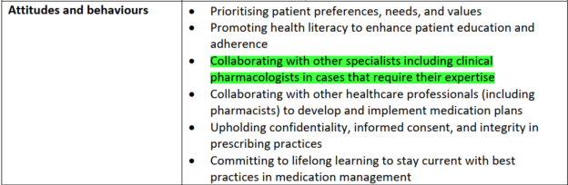
ETR
Geriatric medicine (2025, revised, draft)
We truly appreciate the efforts to integrate the new wording regarding 'Competences of clinical pharmacology for non-clinical pharmacologists' into the EPA by the Geriatric Section
Proposal of Section Pharmacology to incorporate the wording on 'Competences of clinical pharmacology for non-clinical pharmacologists' has been submitted for the Geriatric Section
Certain level of several Ordinary (General) competences (e.g., initial diagnosis & therapy) will need to be promoted and incorporated into all other relevant medical specialties, primarily to therapeutic ones (e.g., neurology, geriatrics, nephrology, internal medicine) + provisions of seeking further support from medical clinical pharmacologist (timely consultation and/or referral)
Prof. Dr. Romaldas Mačiulaitis President of UEMS Section of Pharmacology | Clinical Pharmacology to Non-Clinical Pharmacologists UEMS Advisory Board Meeting, 17th October 2025 | Page 15

Slide 16
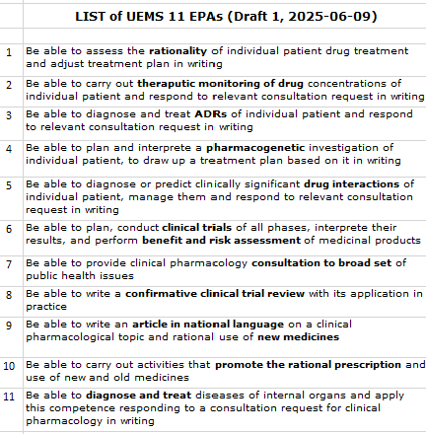
Current Agenda Topics
#1: Agreement within UEMS Section of Pharmacology on
  Ordinary (General) Competences (e.g., initial diagnosis & therapy)
  Subject special Competences and EPAs
  European Training Requirements (ETR)
#2: Feedback/endorsement from the Therapeutic specialties sections on
  The need to integrate into Specialties ETRs the provisions regarding
    General Competences of clinical pharmacology for non-clinical pharmacologists' into the CBME/EPAs of therapeutic sections
    Seeking further support from medical clinical pharmacologist (timely consultation and/or referral) in cases that require their expertise
#3: Search for national contributors for Delphi Study (Topic #2):
Contact:
  Prof. Dr. Romaldas Mačiulaitis
  President of UEMS Section of Pharmacology
  Lithuanian University of Health Sciences
  Mickevičiaus g. 9, Kaunas; LT-44307; LITHUANIA
  Phone +370-699-43734
  Email: Romaldas.Maciulaitis@lsmu.lt
Prof. Dr. Romaldas Mačiulaitis President of UEMS Section of Pharmacology | Clinical Pharmacology to Non-Clinical Pharmacologists UEMS Advisory Board Meeting, 17th October 2025 | Page 16

