Slide 1
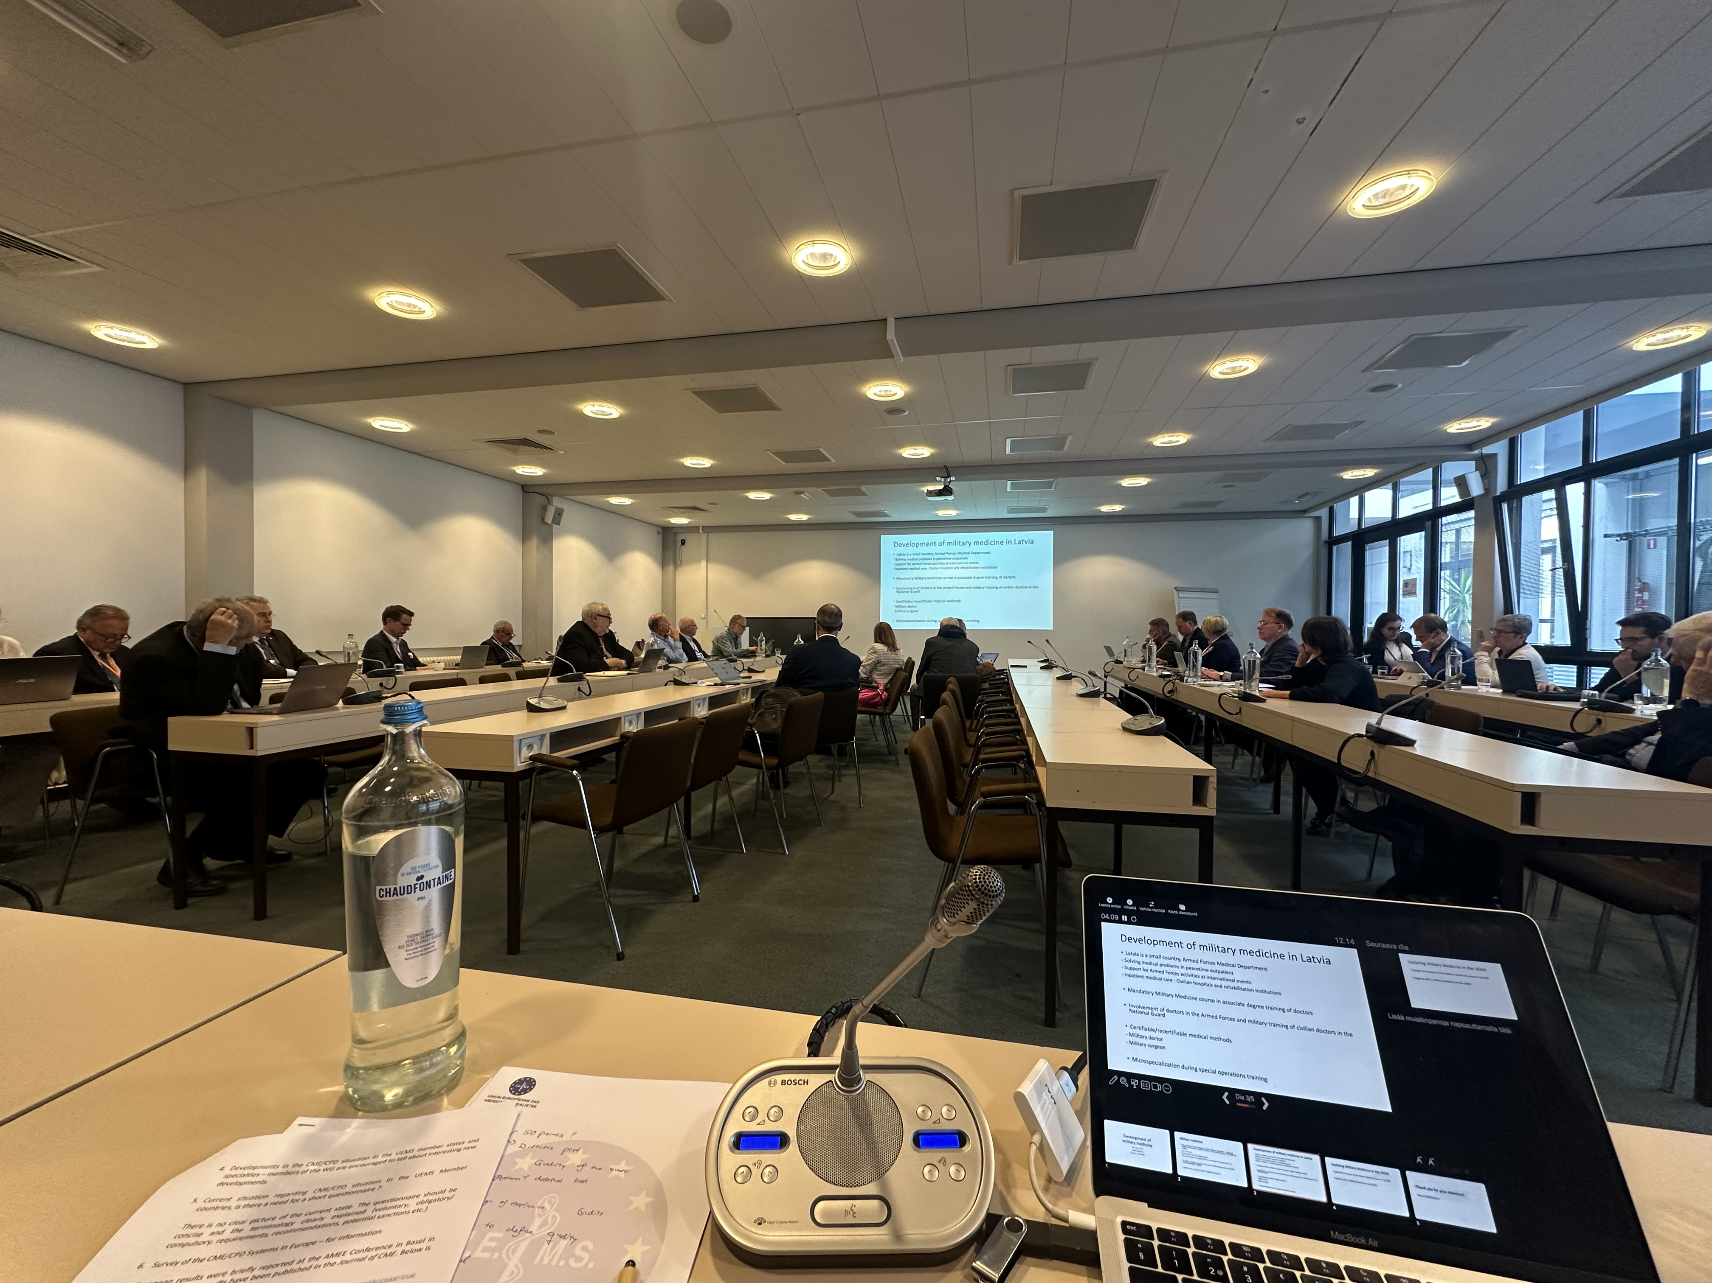
UEMS
Working Group of
CME/CPD
April 25, 2025
Brussels
Dr. Hannu Halila
Chairman of the WG
UEMS Past President, Honorary Member
Gynecology, Finland

Slide 2
CME / CPD Working Group meeting
Meeting well attended by 36 colleagues representing widely the European countries and various specialities, lively and constructive discussion
Main item on the agenda was the discussion about the UEMS Draft Charter of CPD

Slide 3
Background
UEMS Standing CPD (Continuing Professional Development) policy is very old, Basel Declaration from 2001
Much has happened since then in the field of CME/CPD within UEMS and Europe
UEMS CME/CPD Working Group has discussed the need for a new policy and nominated a smaller Task Force to construct a draft
The Draft was dealth at the Working Group meeting on April 25
It was also be briefly introduced at the Advisory Committee meeting on April 25

Slide 4
UEMS CME/CPD Task Force
Hannu Halila Finland
Aivars Vetra Latvia
Emelie Hultberg Sweden
Jozef Glasa Slovakia
Milena Staneva Bulgaria
Marc Soethout The Netherlands
Fridbjorn Sigurdsson Iceland
Monika Brodmann-Mäder Switzerland
Foued Bouzaouache Tunisia

Slide 5
Process of revision of the Draft
Working group meeting on October 18, 2024 had a long and fruitful discussion about the Draft
The Task Force revised the Draft based on the discussion and decided to make the part ”CME, CPD and modern adult learning” an Annex to the document
UEMS Enlarged Executive Committee gave its important comments to the Draft at its live meeting on January 10, 2025 especially about the more ”political statements” and decided that the document would be titled ”UEMS CPD Charter”

Slide 6
Discussions about main political statements in the Draft
CPD must have a specific budget in the health care system
  Special attention paid also to private practice/self-employed doctors
  Stressing also the protected time for CPD
When does CPD start?
  After becoming a physician
    (but the concept of life-long learning already at the beginning of medical school)

Slide 7
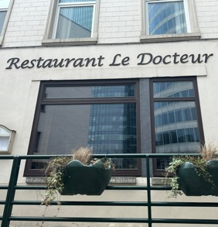
Discussions about main political statements in the Draft
CPD content suggested as a part of the discussion between the doctor and colleagues (or superior/mentor/peers)
(Discussion about the terminology,
differences in various health care systems)

Slide 8
Usefulness of recertification/other compulsory systems / Title to be changed into more positive approach
  UEMS supports motivation systems and procedures for doctors to facilitate their participation in CPD activities. UEMS does not support current recertification/revalidation systems but supports methods that can improve quality of care and quality of medical specialist practice.
Or
  UEMS endorses systems and procedures for doctors to facilitate their participation in CPD activities and supports methods that can improve quality of care and quality of medical specialist practice.
  The Working Group largely preferred this latter version, giving a positive view

Slide 9
Further steps
Based on the discussions at the Advisory Committee and CME/CPD Working Group meetings on April 25 the Draft Charter will be revised
The final proposed version for the UEMS Council meeting in October 2025 will be formulated by the UEMS Enlarged Executive Committee
The plan is that the UEMS CPD Charter could be adopted by UEMS Council in October 2025

Slide 10
Other items at the WG meeting
Developments in the CME/CPD situation in the UEMS members and specialities
Need for an updated questionnaire of the CME-CPD systems in the UEMS members (special need to make the terminology clear)
Survey of the CME/CPD systems in Europe - for information
  Recent publication in the Journal of CME (open access)
  Lawrence Sherman, Hannu Halila, Kathy Chappell: An Overview of Continuing Medical Education/Continuing Professional
  Development Systems in Europe: A Mixed Methods Assessment

Slide 11
Other items at the WG meeting
Need for training and transformation of the civilian medical profession to work in war and disaster situations ?
MJC within UEMS?
Discussion about the scope expanded from not only military medicine to disasters etc.

Slide 12
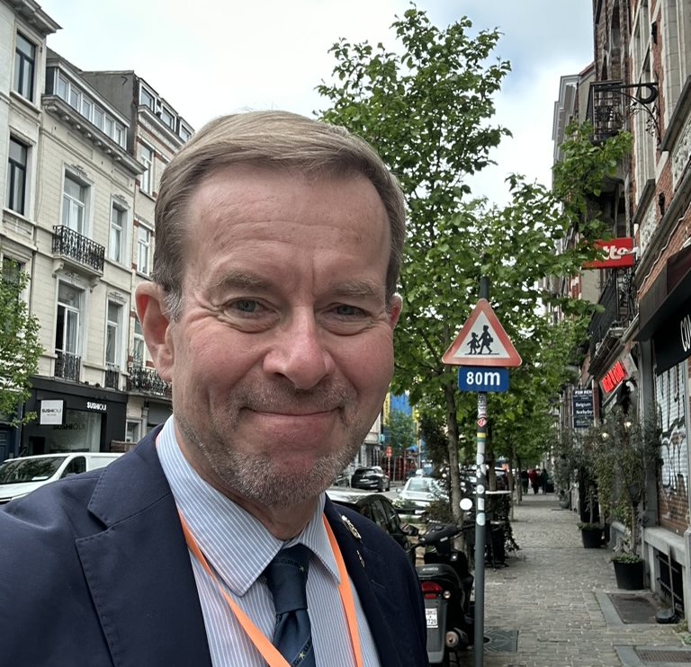
Next meeting of the WG, October 17, 2025
Thank you ! Kiitos !

