Slide 1
Artificial Intelligence and PRM
POSITION STATEMENT by UEMS PRM SECTION AND BOARD
Presenter: Aydan Oral
President, European Board of PRM

Slide 2
Potential benefits of AI in Medical Rehabilitation
Personalized Treatment Plans
AI can analyse vast amounts of patient data to create tailored rehabilitation programs, optimising individual patients' outcomes. AI-driven personalised care can improve functional outcomes
Early Diagnosis and Prognosis
AI algorithms can identify subtle patterns in patient data, potentially leading to earlier and more accurate diagnoses and prognoses.
Robotics and Assistive Technologies
AI-powered robotic systems can assist in physical therapy, providing consistent and precise movements for patients.
Notes:
Our General assembly in Zagreb was a great success with the gathering of many participants. We would like to thank our colleagues in Croatia for their kind hospitality.

Slide 3
Potential benefits of AI in Medical Rehabilitation
Remote Monitoring
AI can enable more effective remote patient monitoring, allowing timely interventions and reducing hospital readmissions. Tele-rehabilitation systems enhanced with AI have shown promise in maintaining continuity of care and improving patient engagement.
Decision Support
AI systems, such as those using Contextual Model-based Reinforcement Learning, personalise treatment plans by adjusting timing, dosage, and intensity to maximise long-term outcomes for certain health conditions. These systems collaborate with clinicians to customise plans based on clinical judgment and patient preferences.
Transformative Impact of AI
The integration of AI in medical rehabilitation programs is shown to enhance patient care significantly. AI technologies are not just supplementary tools; they represent a transformative approach that can lead to better outcomes for patients undergoing rehabilitation
Patient education, research literature analysis, and personalised treatment planning.
Notes:
Our General assembly in Zagreb was a great success with the gathering of many participants. We would like to thank our colleagues in Croatia for their kind hospitality.

Slide 4
Recommendations
Education and Training: PRM professionals should receive ongoing education and training in AI technologies and their applications in rehabilitation medicine.
Interdisciplinary Collaboration: Encourage collaboration between PRM professionals, AI researchers, ethicists, and policymakers to ensure responsible development and implementation of AI in rehabilitation.
Research and Development: Support further research into AI applications in PRM, focusing on clinical validation and real-world effectiveness.
Notes:
Our General assembly in Zagreb was a great success with the gathering of many participants. We would like to thank our colleagues in Croatia for their kind hospitality.

Slide 5
Recommendations
Ethical Guidelines: Develop and regularly update ethical guidelines for using AI in PRM, building on existing frameworks such as the WHO guidance and the EU Ethics Guidelines for Trustworthy AI.
Patient Involvement: We need to foster transparency and trust, aligning with principles of patient-centred care. This will ultimately lead to more effective and accepted AI applications in rehabilitation and other healthcare settings.
Regulatory Framework: Work with policymakers to develop appropriate regulatory frameworks that balance innovation, patient safety, and ethical considerations. The proposed EU AI Act provides a starting point for such regulations.
Notes:
Our General assembly in Zagreb was a great success with the gathering of many participants. We would like to thank our colleagues in Croatia for their kind hospitality.

Slide 6
Risks and Limitations of AI in Physical and Rehabilitation Medicine
While Artificial Intelligence (AI) offers significant potential benefits in Physical and Rehabilitation Medicine (PRM), it is crucial to acknowledge and address the associated risks and limitations:
Overreliance on AI Systems:
Risk of diminishing clinical reasoning skills among practitioners
Potential for overlooking nuanced patient factors not captured by AI models
The danger of automation bias, where clinicians may excessively trust AI recommendations
Data Quality and Bias:
AI models are only as good as the data they're trained on
Risk of perpetuating or amplifying existing biases in healthcare data
Potential for reduced efficacy in underrepresented patient populations
Lack of Interpretability:
Many AI models and profound learning systems operate as "black boxes."
Difficulty in explaining AI-driven decisions to patients and regulatory bodies
Challenges in identifying and correcting errors in AI reasoning
Privacy and Security Concerns:
Increased risk of data breaches due to the large amounts of sensitive patient data required
Potential for unauthorised access or misuse of personal health information
Challenges in ensuring GDPR compliance and other data protection regulations
Integration and Interoperability Issues:
Difficulties in integrating AI systems with existing healthcare IT infrastructure
Potential for errors or data loss during information transfer between systems
Need for standardisation of data formats and AI algorithms across different platforms
Limited Generalizability:
AI models developed in one clinical setting may not perform well in others
Challenges in adapting AI systems to diverse patient populations and healthcare contexts
Notes:
Our General assembly in Zagreb was a great success with the gathering of many participants. We would like to thank our colleagues in Croatia for their kind hospitality.

Slide 7
7. Ethical Dilemmas:
Questions of accountability when AI systems contribute to clinical decisions
Potential for AI to exacerbate healthcare disparities if not carefully implemented
Ethical concerns surrounding patient autonomy and informed consent with AI-driven care
8. Regulatory and Legal Uncertainties:
The evolving regulatory landscape for AI in healthcare in the light of the EU document
Unclear liability frameworks for errors or adverse events involving AI systems
Challenges in certifying and auditing AI systems for clinical use
9. Resource Intensiveness:
High costs associated with developing, implementing, and maintaining AI systems
Need for specialised personnel to manage and interpret AI in clinical settings
Potential for increasing healthcare costs, at least in the short term
10. Resistance to Change:
Potential reluctance among healthcare professionals to adopt AI technologies
Patient scepticism or discomfort with AI involvement in their care
Organisational challenges in managing the cultural shift required for AI integration
11. Limitations in Complex Decision-Making:
AI may struggle with cases requiring complex, multifaceted decision-making typical in PRM
Difficulty in capturing the holistic, patient-centred approach central to rehabilitation medicine
12. Continuous Learning and Updating:
Need for ongoing monitoring and updating of AI systems to maintain performance
Challenges in ensuring AI systems adapt to changing clinical practices and new evidence
Notes:
Our General assembly in Zagreb was a great success with the gathering of many participants. We would like to thank our colleagues in Croatia for their kind hospitality.

Slide 8
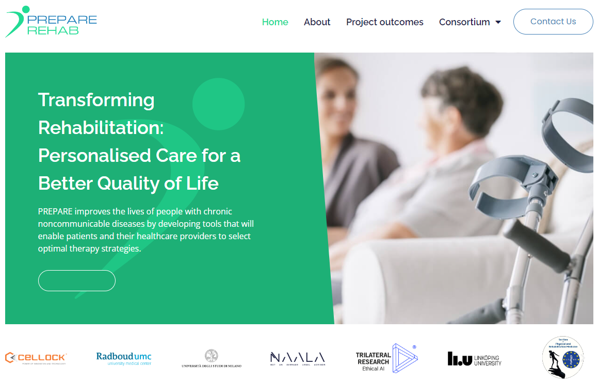
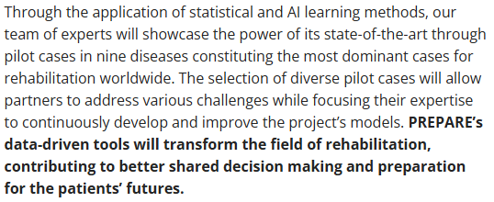
https://prepare-rehab.eu/
“PREPARE - Personalized Rehabilitation via Novel Patient Stratification Strategies”. Project has been funded as of December 9, 2022.

Slide 9
Thank you for your attention aydanoral@yahoo.com ayoral@istanbul.edu.tr aydan.oral@ebprm.eu

