Slide 1
My experience as first time appraiser
Ileana Ghiordanescu, MD, PhD
Chair of the EAACI-UEMS Knowledge Examination

Slide 2
Conflict of interests declaration
Chair of the European Academy of Allergy and Clinical Immunology (EAACI)-UEMS Knowledge Examination Committee

Slide 3
Exam key steps observed
Exam Committee meeting–in-person participation.
Online Exam–online participation.

Slide 4
Process of Inviting Observers for the Exam
Invitation Sent: 8 August 2024
Exam Committee meeting: 17 October 2024 during the Society Congress
Accommodation, travel expenses and subsistence were covered by the inviting party
Online Exam:
Call for observers sent: 24 October 2024
Exam date: 19 November 2024

Slide 5
Exam Committee Meeting – 17 October during the Society Congress – Logistics
In-person attendance included two evaluators.
The hotel and congress venue were easy to locate and comfortable.
Internal navigation within the congress center was more challenging due to multiple buildings and simultaneous events.
Observers completed desk registration and received badges upon arrival.
Two meeting rooms were reserved for the Exam committee meeting.
In the first phase, participants—including the Exam Chair, Examination Officer, Secretary General, and 5 senior question reviewers—were split into two groups, each in a separate room with one evaluator.
In the second phase, the groups merged into a single session for continued discussions.

Slide 6
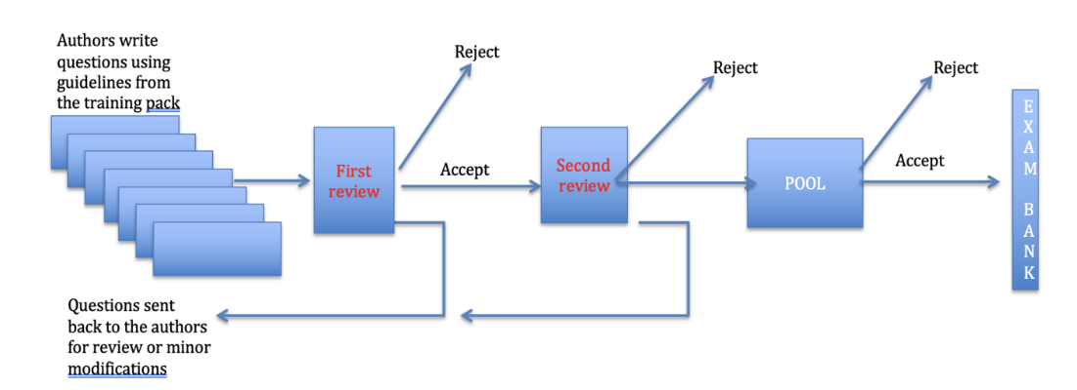
Exam Committee Meeting – 17 October during the Society Congress - Observations
Question generation follows a structured workflow within the CIYM platform, involving question submissions by authors, and multiple rounds of review.
Meeting exclusively focused on the final reviewing of newly written questions.
Observed question revisal process—thorough and collaborative effort, ensuring that all questions are aligned with the curriculum and meet high standards of clarity, accuracy, and fairness.

Slide 7
Exam Committee Meeting – 17 October during the Society Congress – Issues identified and on-site recommendations
Issues identified
Content Issues—use of absolute terms, negative wording, areas addressed too broad, minor terminology issues
Structural and Formatting Issues —progressive item order, no area tagged, clinical data representation (tables with values)
Safety concerns—the instructions booklet along with the actual questions to be revised, were sent to the observers
On-site Recommendations
More Detailed Guidelines for writing questions
Expand Use of Tables and Visuals
Avoid sending any sensitive information outside the reviewer team

Slide 8
Online Exam - Issues identified
Pre-Exam:
Difficulties with Login as observer
Laptop Resource Testing Issues
Latency Issues with Guardian Browser
During the Exam:
Proctoring process lasted for about 15 minutes
Interactions with two proctors
First, accessed system settings like the "Game Mode" without providing any explanation
Second, was speaking in a difficult to understand English, his voice could be heard but there was no visual interaction
Upon finishing the exam early, there was no comment or acknowledgement from the proctors
Snipping Tool Access–possible
Chrome browser–opened by the proctors on my laptop

Slide 9
Exam Results Analysis – Identified issues
Exam guidelines mention that the Exam organisers decide upon the pass mark, which can vary from year to year.
No scientific method seems to be communicated for this important task.

Slide 10
Reflections on Participating as an Evaluator
Serving as an evaluator for a European Specialty Examination—while also Chairing our own Exam Committee—offered a valuable comparative perspective on exam preparation, organization, and analysis.
This experience helped to highlight differences and potential areas for improvement within our own examination process.
Drafting a preliminary report for both the Exam Committee meeting and online Exam was not as challenging as expected as there was constructive collaboration and exchange of ideas with fellow exam appraisers at all steps.
The experience allowed me to apply many of the principles discussed during the May 2024 CESMA workshop dedicated to exam appraisal procedure.

Slide 11
Thank you!

