Slide 1
Treasurer’s report Cork, 3rd May 2025
Gian Battista Parigi
UEMS-CESMA
Council for European Specialist Medical Assessment

Slide 2
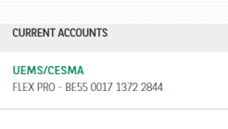
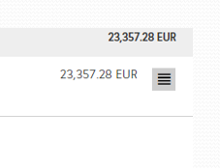
Account 29-4-2025

Slide 3
Expected fees - 2025
43 sections
33 authorised payment = 9.900
9 upon invoice = (2.700)
1 withdrew (Urology)
3 MJC authorised payment = 900
18 Scientific Societies = (5.400)

Slide 4
Membership payments

Slide 5
Membership payments

Slide 6
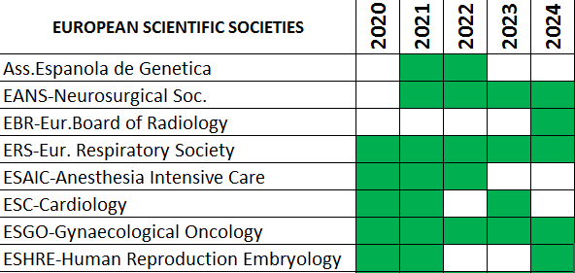
Membership payments European/National Scientific Societies

Slide 7
Breakdown income = +28.242,80

Slide 8
Breakdown Expenses = -20.351,72

Slide 9
UEMS expenses = 8.068,66

Slide 10
Income/expenses trend 2017-2024

Slide 11
General yearly balance
2017 2018 2019 2020 2021 2022 2023 2024

Slide 12
Thanks to all of you

