Slide 1
SBA Question Writing Overview
CESMA May 2025
Keith Farrington, Education Dept RCPI

Slide 2
Creation of a high-quality exam
Identification of topics & numbers
Question writing
Question review and approval
Review of exam data and results generation
Used in exam and feedback

Slide 3
What we need
Exam
Good quality discriminating questions
Appropriate quantity
Specific category quantity

Slide 4
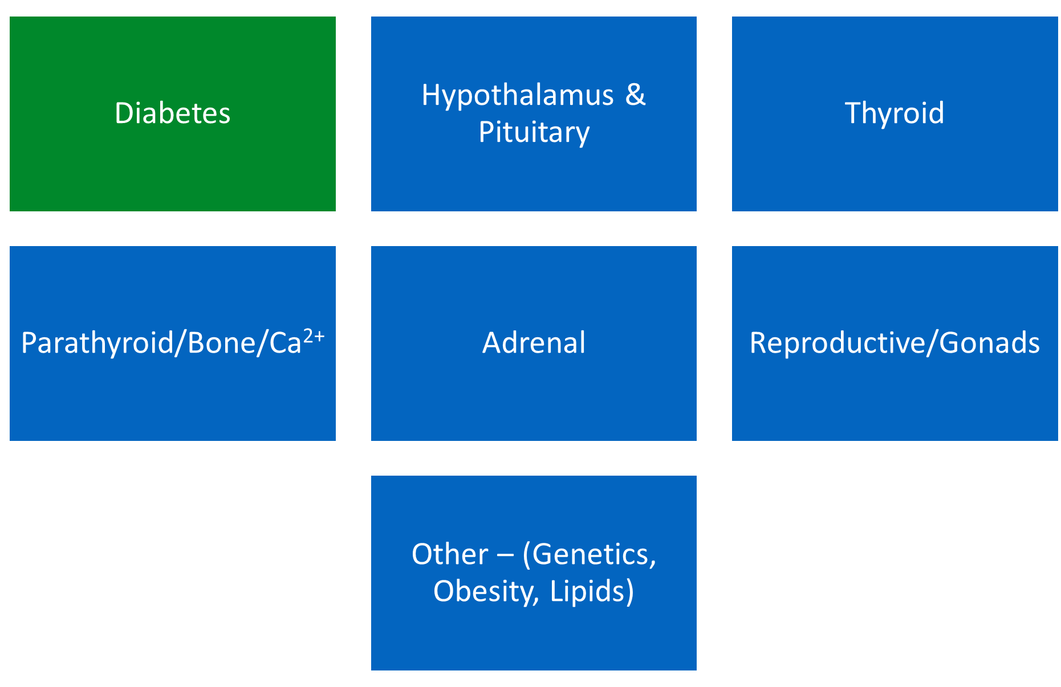
High level blueprint

Slide 5
Detailed blueprint

Slide 6
What is a Single Best Answer
Presentation
History
Examination
Investigations
Clinical Scenario Presented
Lead in question
Five options presented – only one is correct
Option A
Option B – Best Option
Option C
Option D
Option E

Slide 7
The scenario
Should contain all important information relevant to the answer
Should be realistic
Should help the candidate eliminate distracter options or give enough information to confirm the best answer

Slide 8
Discrimination

Slide 9
Discrimination

Slide 10
Discrimination

Slide 11
The lead in question
Present a complete problem
Be clear
No scope for opinion, phrase question in the positive

Slide 12

The lead in question - Examples
e.g., What is the most appropriate next step in the management of this patient?
e.g., What is the most likely diagnosis?
e.g., What is the most appropriate test to request?
e.g. What is the most appropriate additional hormonal therapy?

Slide 13
Question Options
All questions must have 5 options
Only one option can be clearly correct
No subsuming options
All options should be in line with each other in topic and length
Avoid repeating words from the stem in the options
Answers within up-to-date guidelines

Slide 14
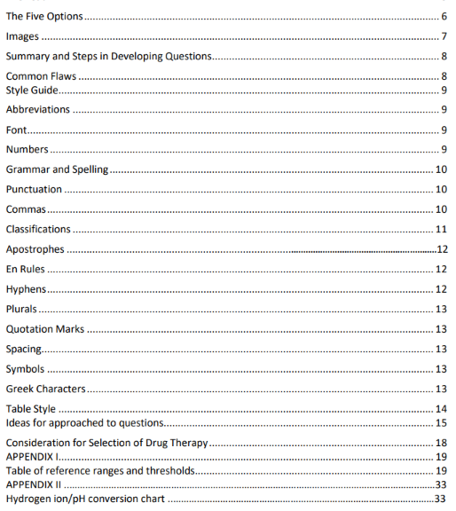
Styleguide
Units
Normal ranges
Tenses
Special characters
Flow of the item
Table style

Slide 15
What makes a question difficult?
Secondary Factors
Topic
Stem Length
Primary Factors
Level of Expertise
Distractors

Slide 16
What is the capital city of Kyrgyzstan?
Options
A. Rome
B. Madrid
C. Paris
D. Something else
E. Berlin

Slide 17
What is the capital city of Kyrgyzstan?
Options
A. Almaty
B. Ashgabat
C. Bishkek
Dushanbe
E. Samarkand

Slide 18

Medical Education Spectrum
Intern
SHO
SpR
Fellow
Consultant
1-2 years of Specialty Training
Basic Knowledge
History/Phys Exam
Lab & Dx
Guidelines
3-4 years
Specific rotations completed
Have undergone WBA
5 years
Completed penultimate year
Research knowledge
Deep specialty knowledge

Slide 19
Rationale
Guidelines
Evidence Based Practice
Current Practice
Research
Journal Articles
Trends
Established Knowledge
Textbooks
Biochemistry
Genetics

Slide 20
What we know after the exam
Cohort(s) strength
Question Difficulty
Reliability
Question Discrimination

Slide 21

Examples of Questions not accepted
Negative Questions
Lists of percentages or numbers (e.g. risk)
Questions unrelated to the stem (for SBA)
Too easy

Slide 22
Negative Questions
Which is not a cause of the condition…
What is not the most appropriate treatment…
Certainly, no double negatives!
What should not be done in order to not….

Slide 23
List of percentages or numbers
What percentage of patients experience insomnia as a complications of treatment with the drug absurdium?
2%
1%
0.5%
0.25%
0.1%

Slide 24
Questions unrelated to the stem or no stem!
What is the best treatment for bleeding caused by the condition X in a 55 year old man with type 2 diabetes?
Drug 1
Drug 2
Drug 1 with phototherapy
Phototherapy
Surgery

Slide 25
Questions that are too easy
More appropriate for medical school
Too routine
Simple Dx
Testing only knowledge not application of knowledge

Slide 26

The Review Process
Group of three (quorum)
Decide if within scope
Approve, rewrite, reject
Edit if appropriate, qc check

Slide 27
The Review Process
<5 min per item
≠Perfect
Appropriate Distractors
Doesn’t have to be unanimous

Slide 28
Recap
High Quality Exam
Constructing SBA
Difficulty & Distractors
Questions Not Accepted
Review Process

