Slide 1



All you wanted to know, but didn’t dare to ask, about MCQ examinations
Danny G.P. Mathysen (MSc, PhD)

Slide 2
Personal experience with MCQ examinations
PhD research (2010 – 2013)
Consultant (psychometric analysis)
  European Board of Ophthalmology (2006 – 2017)
  AlephQ (2015)
  European Respiratory Society (2014 – 2015)
  CYIM (2018 – 2020)
  European Society of Cardiology (since 2019)
  European Board of Endocrinology (since 2023)
European Union of Medical Specialists (UEMS)
Council for European Specialist Medical Assessments (CESMA) (co-opted Executive member since 2016)

Slide 3
Advantages of MCQ examinations
Easy to correct
Easy to provide multiple versions of a single examination
Easy to process for statistical (psychometric) analysis
(although psychometric analysis is considered easy
when interpretation is concerned, reality proves it to be
more difficult than anticipated)
Objective judgment of candidates
Broad mapping possible with ETR, curriculum, syllabus
Implementation possible for formative assessments
Implementation possible for summative assessments

Slide 4
Disadvantages of MCQ examinations
Only lower levels of Bloom’s taxonomy can be evaluated
(recalling, understanding, application)
  suboptimal psychometric parameters
  need to invest time to develop!
Reflex for MCQ authors to complicate MCQs
  negative impact on psychometric parameters
Attention needs to be paid not to give away a clue to the answer key
Possibility for candidates to guess the correct answer

Slide 5
❶ Help ... how do I write high quality MCQs, and how can I measure the quality of MCQs?

Slide 6
A. How to write a high quality MCQ?
Single best answer (SBA) format is widely used
  True/false questions seem to oversimplify things
  UAntwerpen advise in preparation regarding MAQ
Lay-out requirements
  3 separate paragraphs (2 without scenario) are recommended
  Easier to understand for candidates
  Less time need for candidates to read the question
Clinical scenario / Introduction = 1st paragraph
  max 200 words / 6 lines / 5 sentences
  age and gender of the patient
  race and occupation (if applicable)
  clinical context (GP practice, emergency department, etc.)
  Patient’s complaints
  Relevant medical and family history
  Relevant use of medication

Slide 7
A. How to write a high quality MCQ?
Clinical investigation with relevant results = 2nd paragraph
(only in case of clinical scenario MCQ)
  max 200 words
  images and/or short video fragments only if useful and if high quality
  no more than 6 different items
Actual question = 3rd paragraph (2nd without clinical scenario)
  question followed by a question mark (?)
Single best answer format (SBA)
  one most correct answer
  several plausible distractors
Time needed for candidates
  90 seconds in case of SBA with clinical scenario
  60 seconds in case of SBA without clinical scenario

Slide 8
A. How to write a high quality MCQ?
Clearly mention to the candidates that whatever is not specifically mentioned within the test item, has to be considered as normal
Keep the question as short and as simple as possible
All options should be of same length and level of detail
Options in alphabetical or random order
Limited possibilities (max. 20%) for “fatal” (-1) or 2nd best (+1/3) answer options (same category for MAQ)
Pay attention to the grammatical link between the actual question in the stem (3rd paragraph) and the different options
Make sure that the answer to a test item cannot be deducted from elements mentioned in other test items

Slide 9
A. How to write a high quality MCQ?
What to avoid preferentially?
  First name of the patient (not always relevant, sometimes indicative)
  Jargon
  Abbreviations
  Eponyms
  Negatively formulated test items (limited number is accepted)
  Misleading statements
  Options as “all of the above” or “none of the above”
  Absolute wording such as “always” or “never”

Slide 10
A. How to write a high quality MCQ?
Tips and tricks
  Dedicated time needed to write high quality MCQs
  (60 minutes for a question with clinical scenario or 30 minutes
  for a question without clinical scenario) → to make sure that mathematical validity corresponds optimally with clinical validity
  (content validity)
  Describe who is the author of the MCQ (including contact details)
  Describe mapping with ETR, syllabus and curriculum
  Describe sources that have been consulted during the writing process
  Define the expectancy level of the question (basic knowledge, applying knowledge, etc.) → without defined expectancy level it is impossible to properly analyse the psychometric parameters
  Be prepared that the quality monitoring process may significantly change the lay-out and/or content of MCQs
  (principle of at least 4 eyes!)

Slide 11
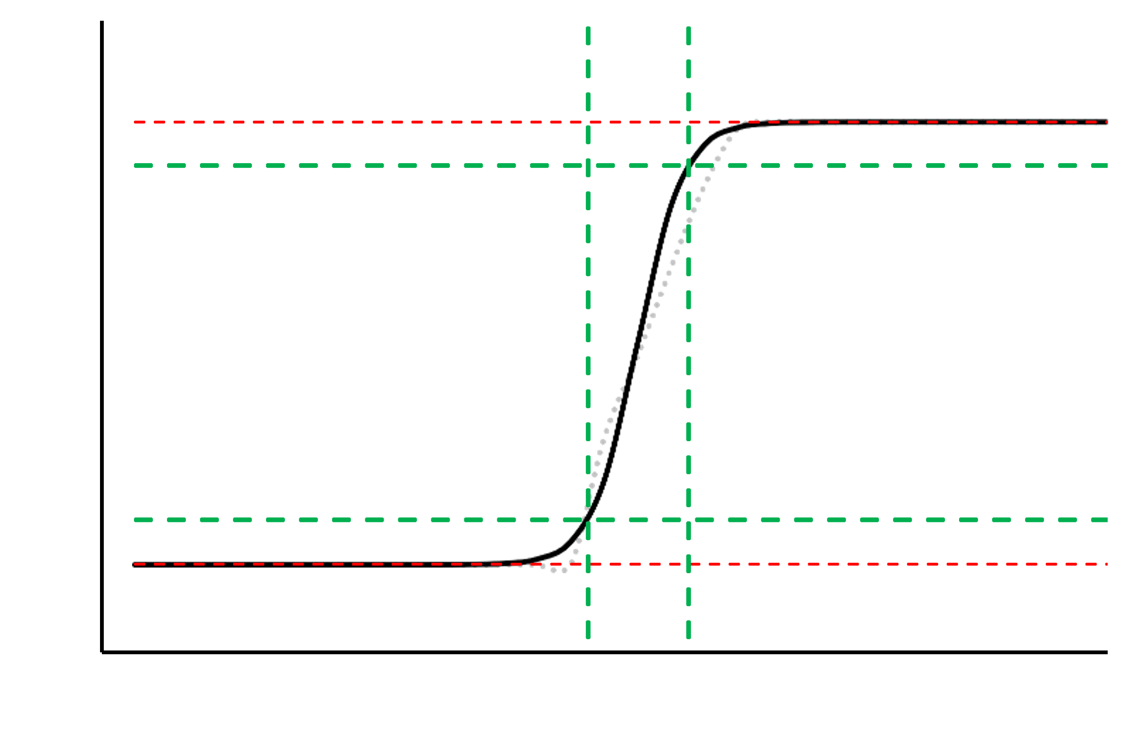
B. How to measure the quality of MCQs?
Psychometric analysis parameters of test items
  P-value (preferably between 0.10 and 0.90)
  Rit-value (preferably above 0.15) and relative Rit-value (parameter developed by D. Mathysen)
  Discriminative power (preferably above 0.15)
  Item Response Theory (IRT) for large candidate populations (N ≳ 500)
as narrow as possible
Probability of correct answer
as high as possible
Ability level of the candidates

Slide 12
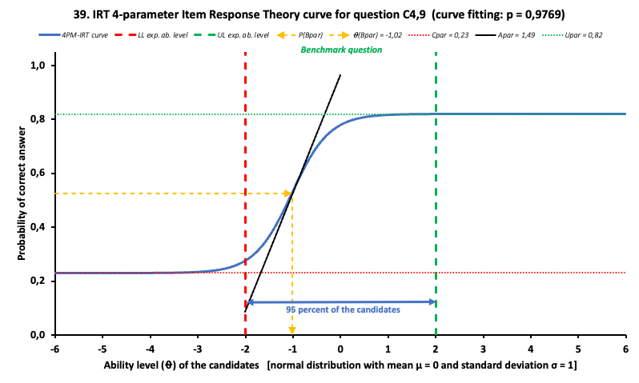

Slide 13
Example of dashboard on item performance

Slide 14
How to measure the quality of MCQs?
Elimination of test items: caveats
  Psychometric parameters are only valid for the set of test items
  and the specific candidate population: same test item in another
  examination with other candidates will have different outcomes
  A good examination is NOT a combination of test items with
  optimal psychometric parameters
  Some test items are expected to be answered correctly by
  virtually all (none) of the candidates: very bad psychometric
  parameters will be the result
  Development of knowledge is not a linear process: a weaker
  candidate may be more performant on a single part of the syllabus
  or curriculum compared to an overall stronger candidate
  Elimination of test items will impact on the blueprint of the examination
  If a distractor is selected more often than the answer key,
  please check whether the answer key was assigned properly
  (and recalculate the total examination scores if necessary)

Slide 15
How to measure the quality of MCQs?
Elimination of test items: how to avoid?
  Pay enough attention and enough time on the process of
  question writing
  Implement review panels to improve the quality of test items
  prior to the use in an examination
  Implement review panels to imrpove the quality of test items
  after having been used in an examination, taking into consideration
  the psychometric parameters of the test item (in case reuse of
  the test item as benchmarking test item is considered)
  Calculate the psychometric parameters as part of a quality
  monitoring of the examination
  If the quality monitoring of the test items has been conducted
  properly before using these test items in an examination,
  examiners can be confident as what minimal level can be
  expected from the candidates: don’t fall into the boobytrap
  of lowering the standard because of poor candidate performance...

Slide 16
How to measure the quality of MCQs?
Elimination of test items: it is acceptable to keep
test items with expected poor psychometric parameters!
  Some test items are expected to be answered (in)correctly by
  virtuall all (none) of the candidates!
  Some test items will test pure recall of knowledge, without
  further reasoning
  Negatively formulated test items can be used (provided the
  negation is clearly indicated with bold and/or underlined font
  type, and/or capital letters) to detect the really excellent
  candidates
  Some distractors may be considered as dangerous options,
  and the selection of such distractors is a potential indicator for
  red flag candidates

Slide 17
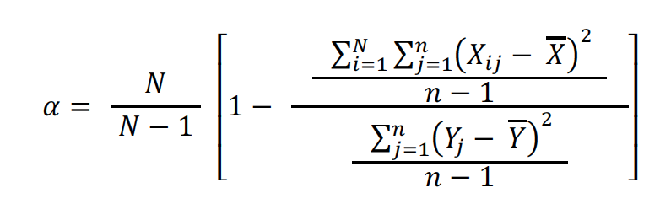
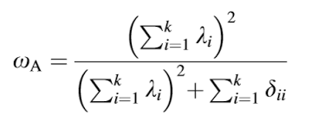
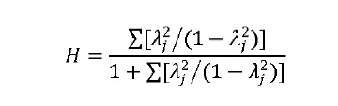
How to measure the quality of MCQs?
Internal consistency of MCQ examination
  Coefficient H (upper limit)
  McDonald’s Omega (most reliable estimation)
  Cronbach’s alpha (lower limit)
Confidence interval of total examination score and SEM

Slide 18
Recent research on effectiveness of MAQs vs SBAs

Slide 19
❷ Help ... how many MCQs should there be on my examination?

Slide 20

A. Exam blueprint: dimension n° of MCQs

Slide 21
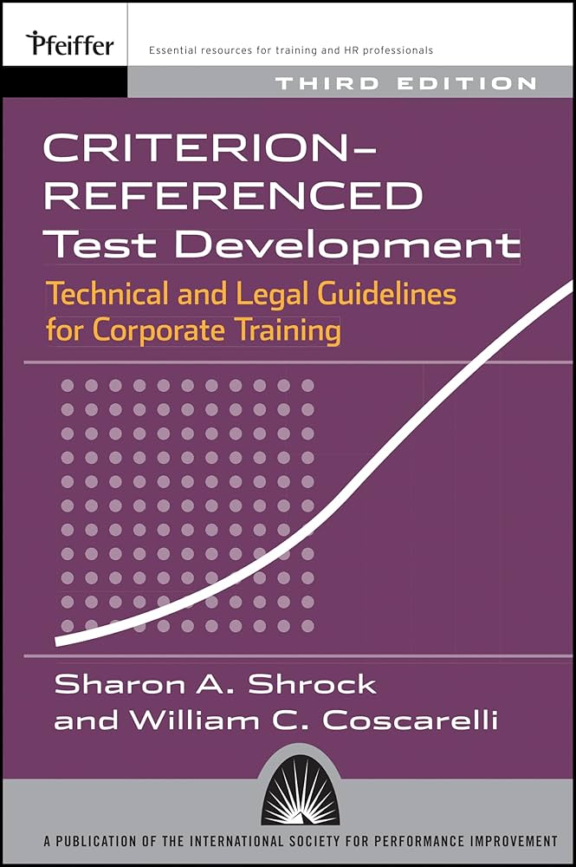

Slide 22
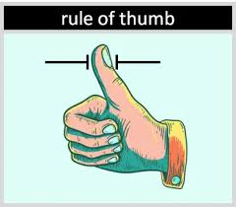
Learning objective | Size of content domain | Relationship between content domains? | Estimation of number of test items (MCQs) per learning objective
Critical learning objective | Large content domain | Not related | 10 – 20
 |  | Related | 10
 | Small content domain | Not related | 5 – 10
 |  | Related | 5
Not critical learning objective | Large content domain | Not related | 6
 |  | Related | 4
 | Small content domain | Not related | 2
 |  | Related | 1

Slide 23
B. Exam blueprint: dimension education level

Slide 24
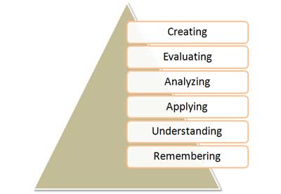
Bloom’s taxonomy of learning domains (1956) has evolved towards KSA categories: Knowledge (cognitive), Skills (psychomotor), Attitudes (affective)
more difficult to capture in MCQ*
less dificult to
capture in MCQ*
* It is important to realise that MCQs are not fit for all purposes and that multiple examination formats may be needed
MCQs are predominantly used to assess the three lower levels of Bloom’s taxonomy

Slide 25

Learning objective Content domain | Recall of facts (= remembering) | Understanding facts (= understanding) | Application knowledge (= application) | Total number of test items
Content domain I | n = 3 | n = 5 | n = 2 | n = 10
Content domain II learning objective x | n = 4 | n = 6 | n = 0 | n = 10
Content domain II learning objective y | n = 1 | n = 5 | n = 4 | n = 10
Content domain II learning objective z | n = 3 | n = 1 | n = 1 | n = 5
Content domain III (related to IV) | n = 3 | n = 6 | n = 6 | n = 15
Content domain IV (related to III) | n = 2 | n = 2 | n = 6 | n = 10
Total | n = 16 | n = 25 | n = 19 | n = 60

Slide 26

C. Exam blueprint: consistent difficulty level

Slide 27
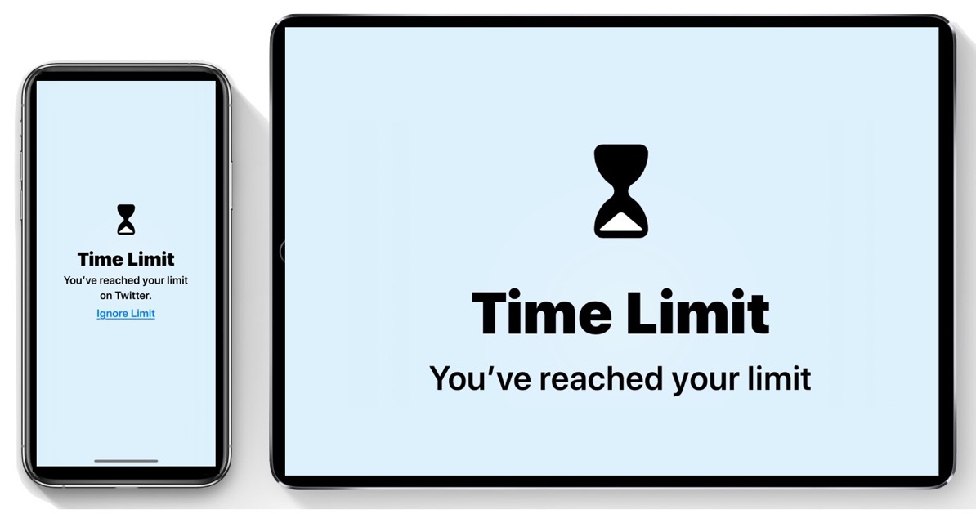
D. Exam blueprint: time constraints

Slide 28
D. Exam blueprint: time constraints
Clinical investigation with relevant results = 2nd paragraph
  max 200 words
  images and/or short video fragments only if useful and if high quality
  no more than 6 different items
Actual question = 3rd paragraph
  question followed by a question mark (?)
Single best answer format (SBA)
  one most correct answer
  several plausible distractors
Time needed for candidates (total exam max. 2,5 hours)
  90 seconds in case of SBA with clinical scenario
  60 seconds in case of SBA without clinical scenario
  time indications are applicable for all candidates
  (including dyslectic candidates or candidates with other facilities)

Slide 29
❸ Help ... I don’t have enough time to develop my examination, can AI come to the rescue?

Slide 30
Time needed to write a high quality MCQ?
Clinical investigation with relevant results = 2nd paragraph
  max 200 words
  images and/or short video fragments only if useful and if high quality
  no more than 6 different items
Actual question = 3rd paragraph
  question followed by a question mark (?)
Single best answer format (SBA)
  one most correct answer
  several plausible distractors
Time needed for candidates / examiners
  90 seconds in case of SBA with clinical scenario (60 minutes)
  60 seconds in case of SBA without clinical scenario (30 minutes)

Slide 31
Experiences of using AI to develop MCQs
Reduction of time needed to develop MCQs
  Inspiration for new content topics of MCQs
  Less time needed to enhance generated MCQs
  No need to start from scratch
  Significant reduction in time needed to prepare an examination
Don’t trust blindly on the quality of the generated MCQs
Hallucinations may occur (see examples):
https://chat.openai.com/share/4d94c7ac-d154-44d2-a73f-038ce5d58beb
https://chat.openai.com/share/fa5fce94-21f3-4b4b-a135-793e25e4cc38
Beware of data leakage in open AI systems
Evaluation necessary for closed AI systems
(e.g. Blackboard)
Hyperlink for selfstudy on Blackboard AIDA module:
https://lms.uantwerpen.be/ultra/courses/_99214_1/outline

Slide 32
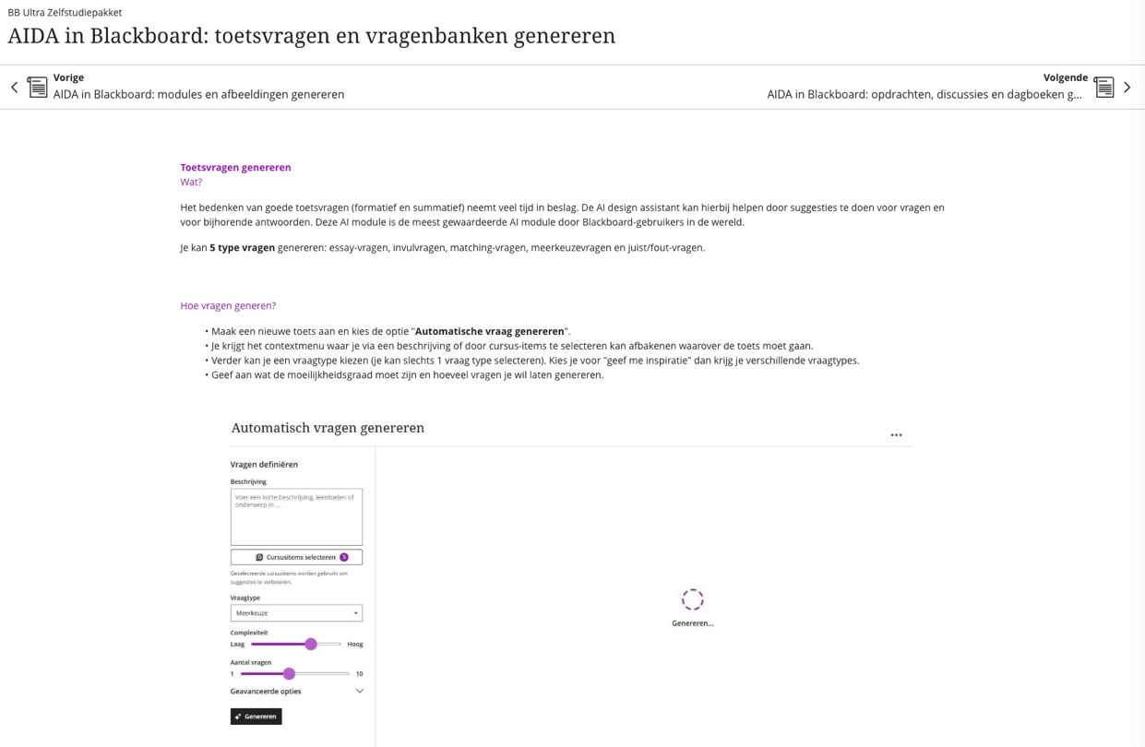

Slide 33
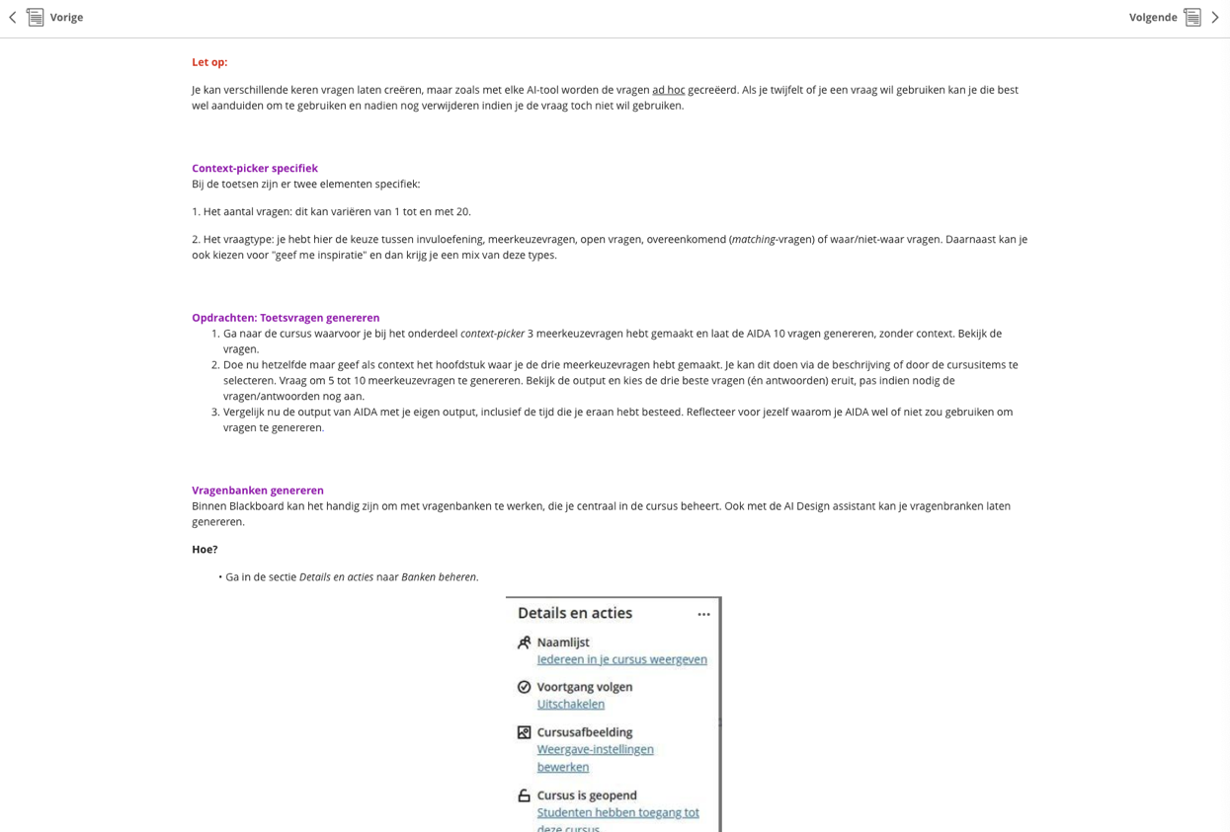

Slide 34
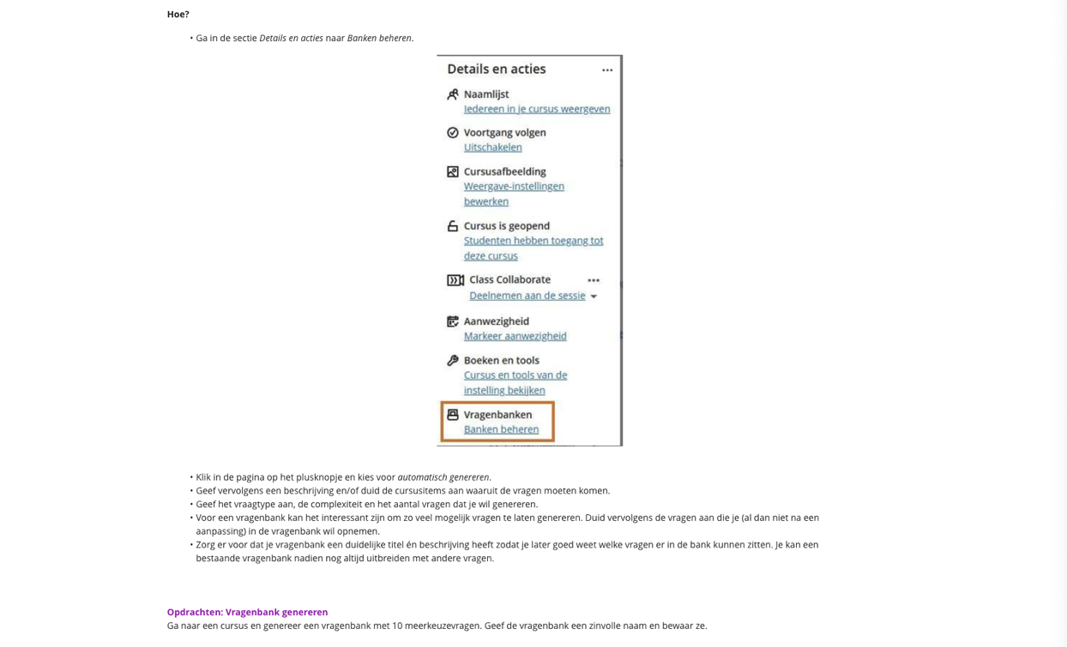

Slide 35


Slide 36
❹ Help ... AI scores are higher than my candidate scores: how to set the pass mark?

Slide 37
ChatGPT could be able to pass the USMLE examination (February 2023)

Slide 38
Also observed at the University of Antwerp...
(February 2024)

Slide 39

Study presented on USMLE (July 18th, 2024)

Slide 40

Pass mark setting: risk of raising the standards
→ better to avoid using AI during examination

Slide 41
Standard setting methods
Universities typically deduct pass marks from total
examination scores
  Dangerous in case no solid quality monitoring is implemented!
  Risk of passing candidates one year who would have failed in
  another year...
  Avoid discussions on pass/fail due to rounding effects
There is a clear indication to use scientific methods
for pass mark setting (Angoff, Cohen, Hofstee, etc.)
No golden standard for pass mark setting is available!
Adopt a realistic pass mark for your examination!

Slide 42
Faleminderit shumë (Albanian) Shterakravetsun (Armenian) Eskerrik asko (Basque)
Mnogo blagodarya (Bulgarian) Dzãkujã (Cassubian) Moltes gràcies (Catalan) Merastawhy (Cornish)
À ringraziavvi (Corsican) Hvala lijepa (Croatian) Dĕkuji (Czech) Mange tak (Danish) Dank u wel (Dutch)
Thank you (English) Ic sæcge eow Þancas (English, old) Dankon al vi (Esperanto) Aitäh (Estonian)
Paljon kiitoksia (Finnish) Merci beaucoup (French) Tanke wol (Frisian) Graciis (Friulian) Grazas (Galician) Mèrczi (Gallo) Merci (Gascon) Besten dank (German) Merci villmahl (German: Zurich Switzerland) Ευχαριστώ (Greek) Toda raba (Hebrew) Nagyon köszönöm (Hungarian) Takk fyrir (Icelandic)
Gratias (Interlingua) Qujanaq (Inuttut) Go raibh mile maith agaibh (Irish Gaelic) Gratias tibi ago (Latin)
Liels paldies (Latvian) Mouchou gratzia (Lingua Franca) Labai achiu (Lithuanian) Merci (Luxembourgish) Grazzi hafna (Maltese) Gura mie mooar ayd (Manx) Merçì (Monegasque) Gràzzie (Napulitano) Dziękuję (Polish) Obrigado (Portuguese) Mercé plan (Provencal) Nais tuke (Romani: gypsy)
Oven saste (Romani) Mulţumesc (Romanian) Grazia fitgun (Romantsch) Спасибо (Russian)
Giitus eanat (Saami Lappish) Moran taing (Scottish Gaelic) Grazzii (Sicilian) Dakujem vám (Slovak)
Hvala lepa (Slovenian) Dz’akujo so (Sorbian) Muchas gracias (Spanish) Dankeschee (Swabian)
Tackar så mycket (Swedish) Çok tesekkür ederim (Turkish) Moltes gracies (Valencian)
Merci (Walloon) Diolch yn fawr iawn (Welsh) A dank aych (Yiddish)

