Slide 1
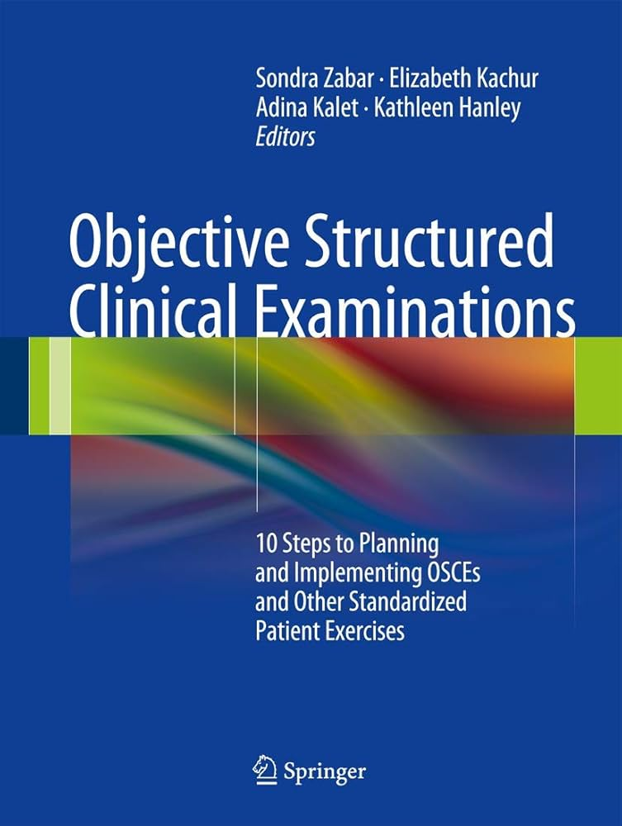
Oral examinations
Dr Morné Wolmarans
Norfolk & Norwich University Hospital
United Kingdom

Slide 2
Why do Oral / OSCE evaluations?

Slide 4
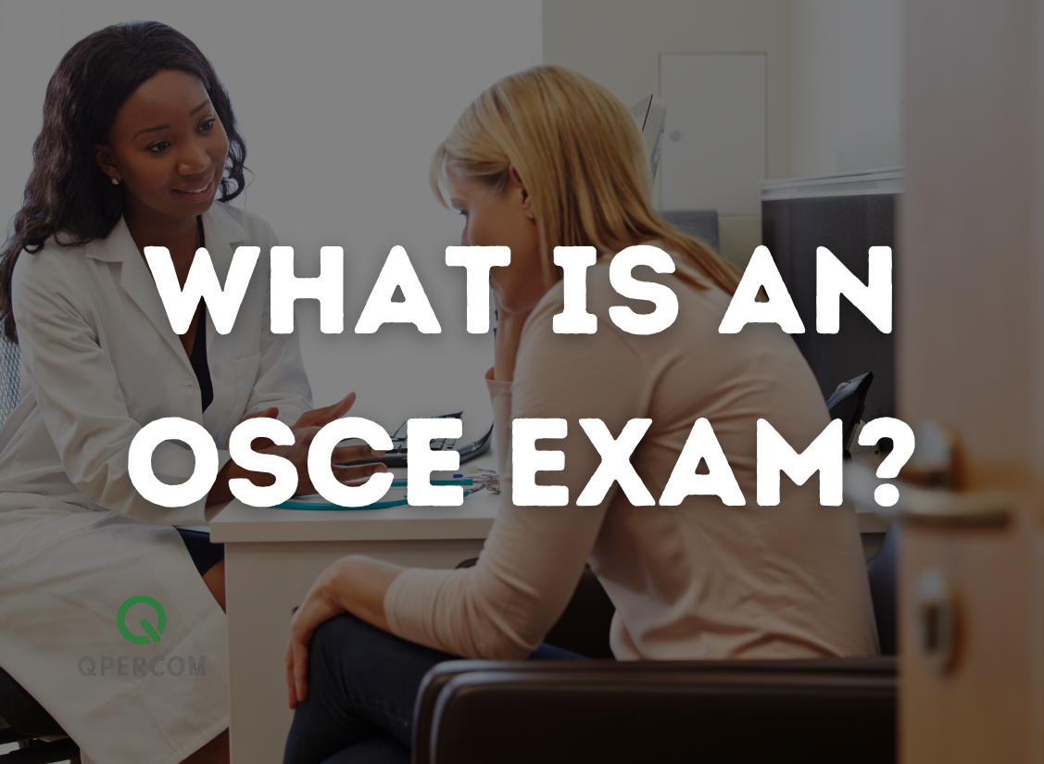
Objective
Structured
Clinical
Examination

Slide 5
OSCE
Defining skill that would be evaluated
Checklists for Examiners
Clinical Skill

Slide 6
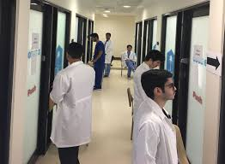

Slide 7
OSCE
Theoretical knowledge
Clinical skills
Communication skills
Patient Interaction
Attitude
Professional Behaviors

Slide 8
Rotation

Slide 9
Viva exams:

Slide 10
How to set up Oral examinations: Online

Slide 13
How to set up Oral examinations: In person:
2 or more examiners
Objective and standardized questions
Appropriate venue
Hawk’s and Dove’s

Slide 14
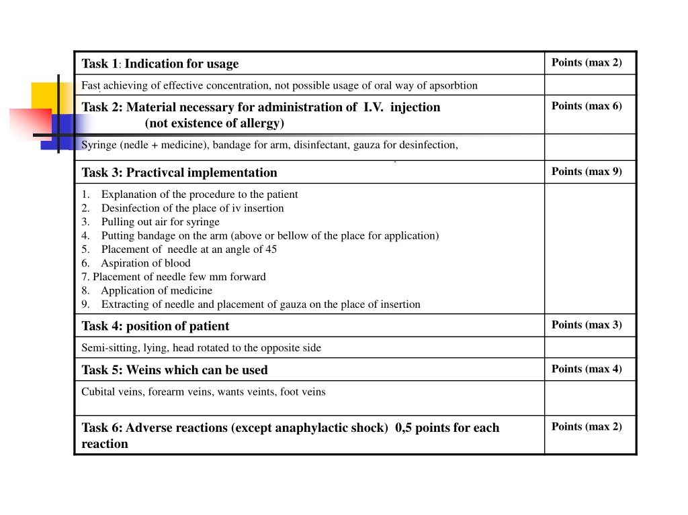
Assessment: Scoring:

Slide 15
RATING: 2 point vs 4/ 5 point scales

Slide 17
Borderline group method

Slide 18
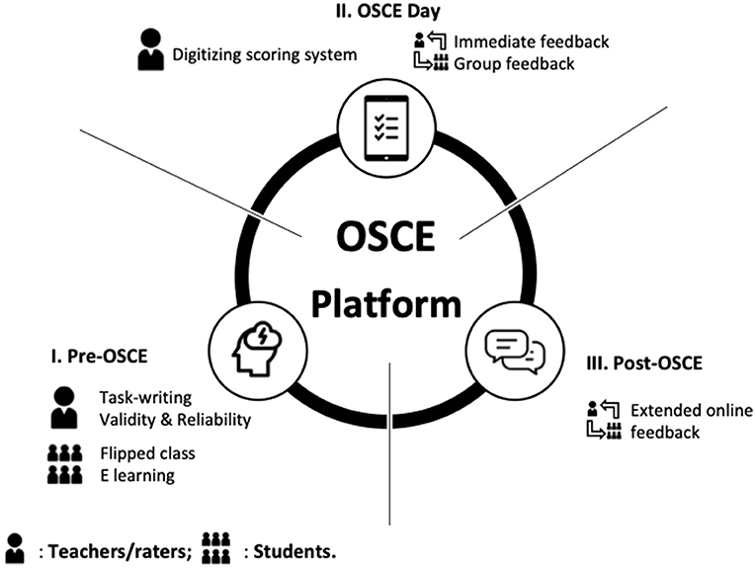
Digital marking systems

Slide 19
Costs / Logistics: Pro’s
Standardised conditions
Same Tasks for all students
Precise checklists
Use of Simulation centre / Mannikin / real patients

Slide 20
Costs / Logistics: Con’s
Requires lots of human resource
Requires appropriate exam space / conditions
Financial costs
Limited capacity
Asking the same question???

