Slide 1
UEMS Rheumatology EULAR to create the European Certificate of Rheumatology ………
Kaushik Chaudhuri
Head, Department of Rheumatology
University Hospital Coventry, UK
President UEMS Rheumatology Section & Board
Member of Council & Education Committee EULAR

Slide 2
Journey starts 2022 Feb – annual meeting of the section
UEMS rheumatology would work towards an examination
single best answer - MCQ examination
Preferably with the specialist society - European Alliance of Associations in Rheumatology
( EULAR)
Update the 2014 ETR
The idea of an MCQ exam – on the cards from 2019
met with mixed response – many did not feel it was necessary within the UEMS rheumatology community

Slide 3
Training of specialists (Rheumatologists) at the national level……..
The concept of “harmonisation”
Legal licence to practice
National training programme
But other pan-national organisations involved as well………..
Harmonisation of training
Consider a common set of standards for training
Consider a common examination
Common training may enable more rheumatologists to be trained
Notes:
Aran boards…

Slide 4
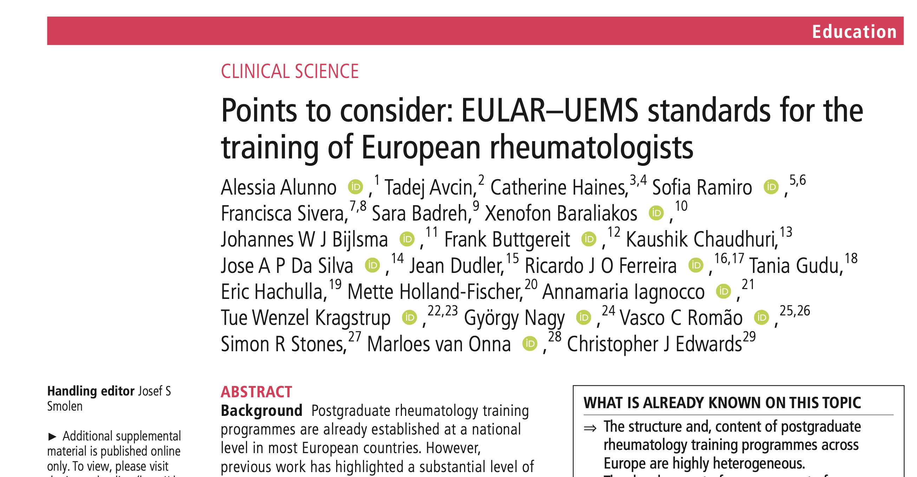
Agree standards for training
Alunno A et al. Points to consider: EULAR-UEMS standards for the training of European rheumatologists. Ann Rheum Dis. 2023 Aug;82(8):1107-1113.
Notes:
Why do this? How to cover in the congress?

Slide 5
The MCQ exam – is one element of the overall landscape of harmonised training

Slide 6
EULAR and UEMS
Key areas
Closer working
Standards/ETR project
Examination MCQ : single best answer out of 5
proctored online
90 questions in 120 min
Blueprint
Question writing guidance – manual , workshops
Submissions plus 2 X 2 day workshops
UNION EUROPÉENNE DES MÉDECINS SPÉCIALISTESEUROPEAN UNION OF MEDICAL SPECIALISTS

Slide 7
MCQ – European Certificate of Rheumatology What are the options on the table ? UEMS – EULAR collaboration
EULAR had an exam – which by their own admission was poorly subscribed and would not meet CESMA approval
So Options were
Adopt an existing examination : we undertook discussions with representatives of the Federation of the Royal College of Physicians
Commission a third party – vendor – and ‘buy off the shelf’
Develop a new examination from scratch – following CESMA guidance and principles

Slide 8
The nuts and bolts of creating an examination from scratch
It is complex and labour intensive -
“know- how” in –house
Important to have a “provider”
Requirement from team developing the exam :
a level of competence and sense of joint purpose
enthusiasm and time commitment
goodwill + mutual trust and
a strict time- line of delivery
underlying logistic support
core group – equal representations from both organisations
lots (& lots !) of time – for meetings , question writing … and more meetings

Slide 9
Taskforce
Aurelie Najm – France/ United Kingdom
Benoit Le Goff - France
Caroline van Durme - Netherlands
Chamaida Plasencia - Spain
David Kane - Ireland
Dimitrios Vassilopoulos - Greece
Frank Buttgereit - Germany
Isabel Castrejon - Spain
Laura Muntean - Romania
Marloes van Onna - Netherlands
Marta Mosca - Italy
Martin Aringer - Germany
Mette Holland-Fischer - Denmark
Miroslav Mayer - Croatia
Nikolay Stoilov - Bulgaria
Peter Balint - Hungary
Silvia Piantoni - Italy
Tadej Avcin - Slovenia
Tue Kragstrup - Denmark
Valgerdur Sigurdardottir - Sweden

Slide 10
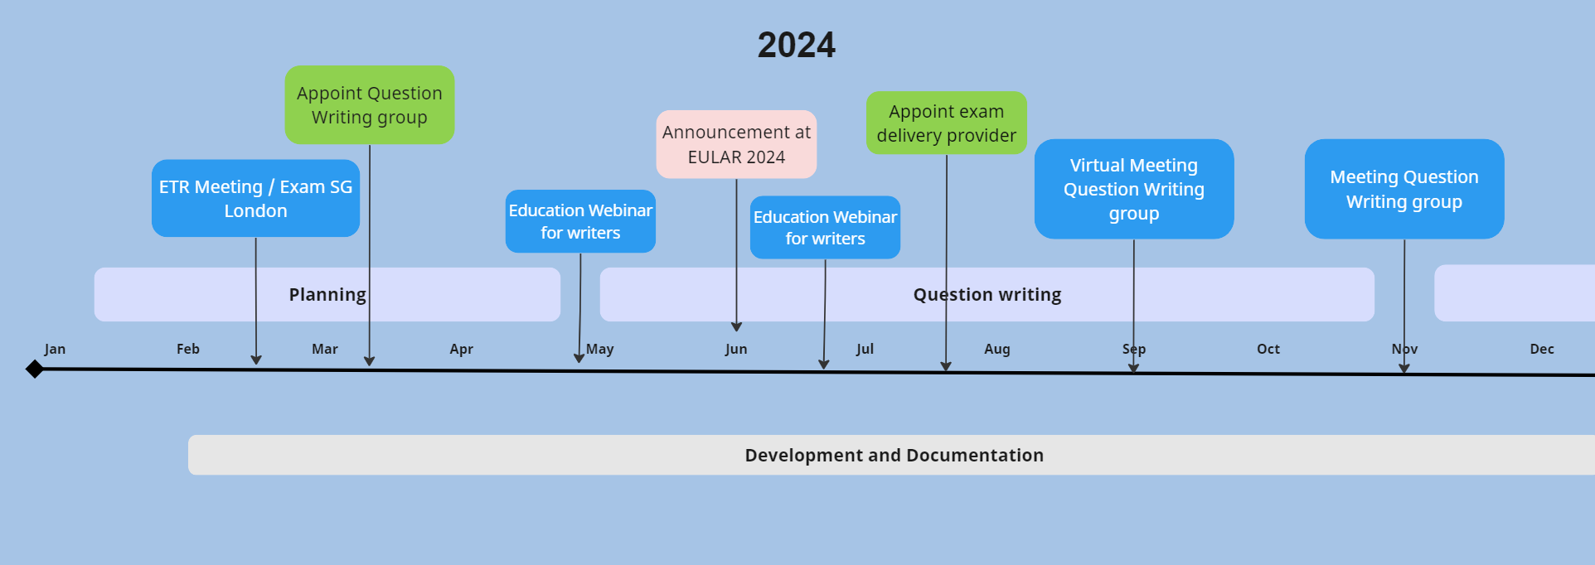
Time line 2024

Slide 11
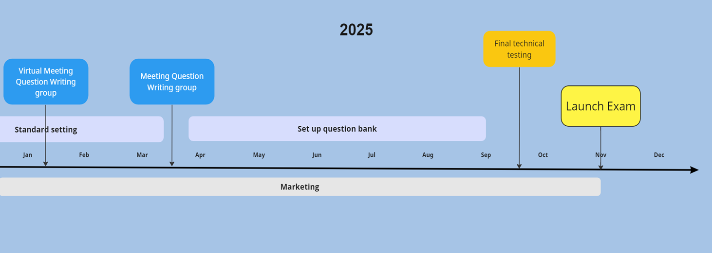
Time line 2025

Slide 12
Current status : where are we in May 2025
On Line sessions
Question writers
Reviewers
Work in small groups to produce 2nd reading of MCQs
Work at Live F2F meeting to produce 3rd draft of MCQs
By core steering group
160 questions 2nd reading ( need another 20)
Final selection
Standard setting

Slide 13
Past 2 years
Progress has been good – some bumps along the way
EULAR bank- rolling the project and basically in charge
but UEMS has a voice and representation – without which CESMA approval may be at stake
A core steering group & question writing group from both organisations created
Launch for late 2025 – we are on schedule
MOU between EULAR and UEMS next on the agenda - pending – (?!)
It is an asymmetric relationship with the specialist society
On the whole
we are hoping to have a viable examination by end of next year
– initially it will be loss making – being absorbed by EULAR –
break even projected 3 – 5 years ;
apply for CESMA approval -3 years
Creating an exam from scratch is a huge undertaking – in terms of time /effort and resources
Sustaining it long term is going to be the challenge

Slide 14
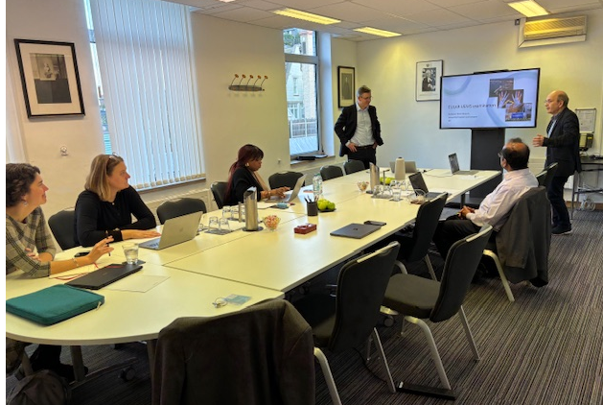
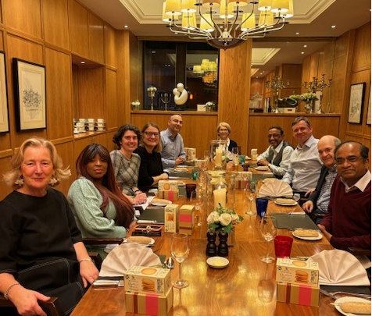
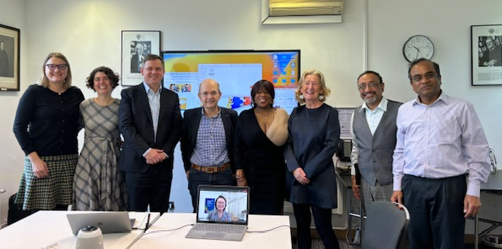
Vignettes of our cooperation

Slide 15
Thank you
Thanks to Prof Chris Edwards; immediate past chair EULAR Education committee and co lead of the project and all my colleagues from both organisations

