Slide 1
Update on the Thematic Federation in Legal and Forensic Medicine
Dr John Firth FRCPath ME
Head of UK Delegation to UEMS Council
UEMS Pathology Board Treasurer
RCPath Representative to UEMS Pathology Board
Autopsy Pathologist and Medical Examiner
UEMS Council Meeting 26th April 2025

Slide 2
Preamble - UEMS Activities
The UEMS represents medical specialists in Europe operating through its legal bodies headed by a Council and Executive and supported by internal bodies that do not constitute separate legal entities:
Specialist Sections,
Divisions,
Boards,
Multidisciplinary Joint Committees (MJCs)
and Thematic Federations. (TFs)
UEMS Council Meeting 26th April 2025

Slide 3
Article II. Members (Articles IV and V of the Statutes) II Delegates to UEMS Bodies A. Appointment and mandate
Preamble
The status of specialist doctor is required in order for any doctor to validly sit on the bodies of UEMS (See Article I of the Statutes).
NMAs (National Medical Associations) shall ensure that specialist doctors with a working knowledge of the English language are chosen.
Nomination of all delegates UEMS bodies has to be confirmed by their respective NMA.
Membership of all UEMS bodies requires the NMAs membership fees are up to date.
UEMS Council Meeting 26th April 2025

Slide 4
Preamble- Thematic Federations
UEMS Thematic Federations are platforms for co-operation between Specialist Sections to address multidisciplinary issues.
Federations must follow the same UEMS rules of procedure as though they were a Section and refer all decisions to the Council.
The daily management will be entrusted either to one of the Sections or to representatives of several Sections working in a collegiate way.
A Federation must be open to members of any Section wishing to participate, provided the Section in question is obviously linked to the Federation.
UEMS Council Meeting 26th April 2025

Slide 5
HISTORY OF THE TF in LEGAL AND FORENSIC MEDICINE
14th September 2011 the Executive Board of the European Council of Legal Medicine (ECLM) a non UEMS Body, submitted the proposal to the UEMS for a Thematic Federation of Legal and Forensic Medicine on behalf of the ECLM , following approval of the Document by the delegates of the Member States of the ECLM.
At the meeting of the UEMS in Brussels on Friday, 19th April 2013 the UEMS Thematic Federation on Legal and Forensic Medicine was formally brought into being.
In 2013 the executive of the TF in LFM was elected :
President Professor Duarte Nuno Vieira
Secretary Professor Santo Davide Ferrara
Treasurer Professor Denis Cusack
UEMS Council Meeting 26th April 2025

Slide 6
Thematic Federations
Members of TF :-
may be proposed by relevant European and national associations and must be nominated by UEMS Member.
There is no limit to the number of nominated by one UEMS Member.
According to the UEMS Statutes Rules of procedure and explanatory notes Thematic Federations exist for 3 years to a maximum of 6 years
UEMS Council Meeting 26th April 2025

Slide 7
Competences of the Thematic Federation
Forensic Physicians (also called forensic medical examiners/police surgeons)
Pathologists performing Medico-Legal Autopsies in various nations
Forensic Pathologist
Forensic Toxicologist and Clinical Toxicologist
Forensic Psychiatrists
Medical Examiner of cause of death (or equivalent)
Physicians involved in Medico-Legal work including medico legal expert witnesses
UEMS Council Meeting 26th April 2025

Slide 8
UEMS Sections to form the rejuvenated TF in Legal and Forensic Medicine
UEMS Body Main relevant activity
Pathology Medical Legal Autopsies. Forensic Pathology
Psychiatry Forensic Psychiatry
Pharmacology Forensic Toxicology Clinical Toxicology
Emergency Medicine Forensic Emergency Medicine
Paediatrics Sudden Child Death
Laboratory Medicine Toxicology
Genetics Genetics and Autopsy practice
MJC in Sexual Medicine
Non UEMS Participants
European Council of Legal and Forensic Medicine
UEMS Council Meeting 26th April 2025

Slide 9
Areas of possible activity of the TF in Legal and Forensic Medicine
Recognition of the discipline at the European Level (Annex V)
Harmonisation of practices and quality assurance in the specialty at a European level.
Developing UEMS European Training Requirements for the subspecialties of this Thematic Federation in cooperation with or lead by UEMS Sections.
Developing Professional Development Modules
Accreditation of training centres.
26th April 2025

Slide 10
Next steps
Kick off meeting took place 20th March 2025 Achieved
Seek approval from UEMS Executive/Council for the TF in L&FM to be restablished with a new 6 year term. Spring Council 2025
First meeting (online) of the TF organized by UEMS Central with election of the Bureau and agreeing the financial basis for the TF Summer 2025
UEMS Council Meeting 26th April 2025

Slide 11
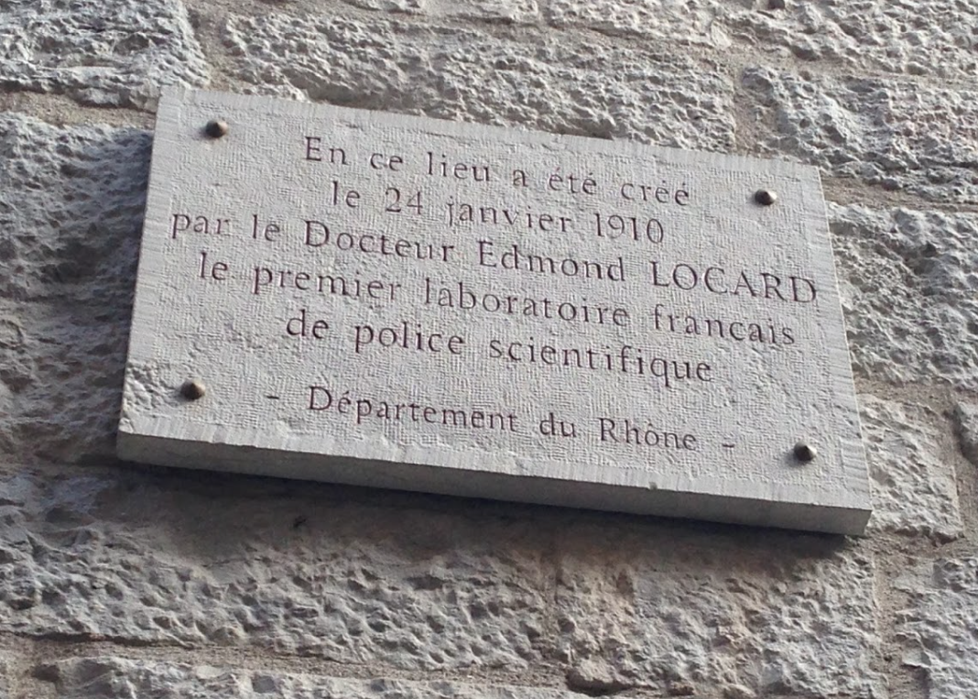
Thank you.
Dr John Firth FRCPath ME
JohnBFirth@gmail.com
UEMS Council Meeting 26th April 2025

