Slide 1
Strengthening Transitional Care in Europe: UEMS Adolescent Medicine and Health MJC
Adolescent Medicine and Health Multidisciplinary Joint Committee (MJC)
Assoc. Prof. Lina Zabuliene, President (Lithuania)
Dr. Anna Gutniak, Vice-president (Sweden)
Dr. Bernadra Vogrin, Vice-president (Slovenia)
UEMS Council meeting 26 APR 2025

Slide 2
"Transition felt like floating alone in open water." Female, 18-years-od
Adolescents and young adults transitioning from pediatric to adult services have varying experience, competence and knowledge in handling their condition and health-care interactions
Forsberg J, et al. Acta Paediatr. 2024;113(7):1612-1620
Sweeden, 2024
Notes:
Forsberg J, Lööf G, Burström Å. Young adults' perception of transition from paediatric to adult care. Acta Paediatr. 2024 Jul;113(7):1612-1620. doi: 10.1111/apa.17231. Epub 2024 Apr 3. PMID: 38568009.

Slide 3
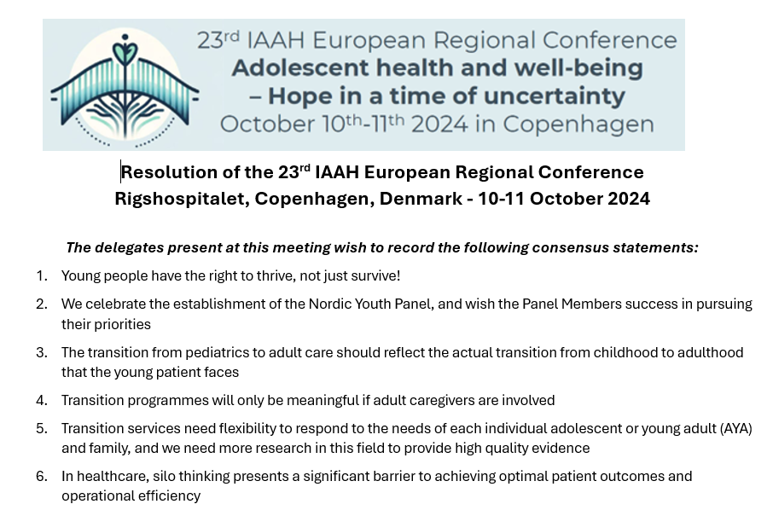
The voice of young people (The Nordic Youth Panel)
Nordic Youth Panel comprises 15 young individuals aged 17–24 from Denmark, Norway, Sweden, and Finland, representing hospital-based youth panels, health research advisory groups, or other youth organizations advocating for the rights of young people with chronic illnesses and disabilities.
https://dsum.dk/the-nordic-youth-panel/

Slide 4
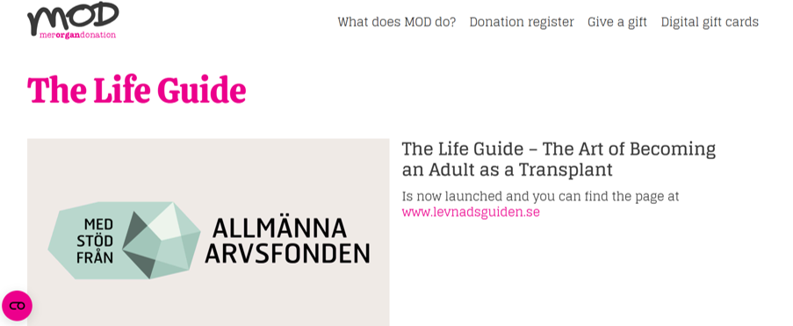
Top priorities of young peple with chronic conditions The Nordic Youth Panel
Transitional care
Silo thinking in the Health Care System
“I think it would work better in adult care if they tried to get to know me better.” Female, 17-year-old
Psychosocial and existential aspects of living with an illness

Slide 5
Why transitional care matters
Over 15-20% of the EU population is aged 10–24 (112-149 mln)
AYAs are not “big children” nor “small adults”
Challenges
Increasing number of survivors with chronic conditions
Transition phase is often fragmented → leads to poor outcomes
Risk of poor follow-up, missed diagnoses, and mental health decline
Adult specialists are central to improving post-transition outcomes, but may feel a lack of structured tools.
Opportunity
equipping adult providers across specialties
Cyprus, 2019
Beaufils C, et al. Arch Pediatr. 2019;26(4):205-213; Mazur A et al. Acta Paediatr. 2017;106(8):1354-1357.
Notes:
Beaufils C, Jacquin P, Dumas A, Limbourg A, Romier M, Larbre JP, Mellerio H, Belot A. Patients' association programs for adolescents and young adults: The JAP study. Arch Pediatr. 2019 May;26(4):205-213. doi: 10.1016/j.arcped.2019.03.006. Epub 2019 Apr 11. PMID: 30982562. https://pubmed.ncbi.nlm.nih.gov/30982562/
Mazur A, Dembinski L, Schrier L, Hadjipanayis A, Michaud PA. European Academy of Paediatric consensus statement on successful transition from paediatric to adult care for adolescents with chronic conditions. Acta Paediatr. 2017 Aug;106(8):1354-1357. doi: 10.1111/apa.13901. Epub 2017 May 25. PMID: 28471516. https://pubmed.ncbi.nlm.nih.gov/28471516/

Slide 6
What's normal?
Unique Developmental Needs
Child's body Adult body
What's the difference between a 20-year-old and an older adult?
Exploration Aversion to risk
What's a 15-year-old like?
Time Thoughts Logic
Need for adult support in daily life
Friendships Social arenas
Romantic and sexual interest and ability
Images of Ellar Coltrane from the American epic coming-of-age drama "Boyhood" (by R.Linklater 2014)

Slide 7
Navigating transition – professional coaching
 | Early adolescense 10-13 yrs | Middle adolescense 14-16 yrs | Late adolescense / young adult 17-24 yrs
Body
Cognition Thoughts Identity
Social arena Autonomy
Sexuality
Parents' responsibility
Patient's responsibility
IMAI One-day Orientation on Adolescents Living with HIV, WHO, 2010. Youth-friendly care – what is it? Swedish paediatric societz, 2021. Programme Guidance for the Second Decade, UNICEF, 2018

Slide 8
Introducing an idea of transition care EPAs
Make appropriate assessment
Follow legal aspects, assess autonomous capacity
Address psychosocial & developmental needs
Promote health equity and special needs groups (migrants, minorities, disasters' victims)
Coordinate transition in practice
Contribute to health literacy improvement
Use appropriate digital tools

Slide 9
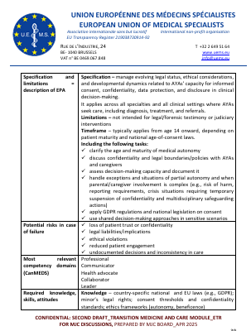
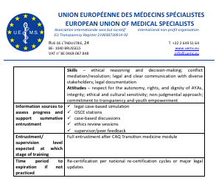
EPA 2 – e. g. Follow legal aspects, assess autonomous capacity
Content
Specification and limitations = description of EPA
Potential risks in case of failure
Most relevant competency domains (CanMEDS)
Required knowledge, skills, attitudes
Information sources to assess progress and support summative entrustment
Entrustment/ supervision level expected at which stage of training
Time period to expiration if not practiced

Slide 10
Why these EPAs matter – relevant and flexible
Designed for Adult Specialists Across Disciplines
These EPAs address critical, often overlooked competencies post-transfer.
Applicable across specialties where chronic or complex care intersects with development
EPAs are written in universal language, not specialty-specific – ensuring broad adaptability.
Specialty | Case Examples
Endocrinology | Diabetes, PCOS, growth disorders, CAH
Psychiatry | Transition from CAMHS to adult mental health
Rheumatology | Juvenile idiopathic arthritis to adult care
Gynecology | Menstrual disorders, contraception counseling
Oncology | Survivorship care for adolescent cancer patients
General Internal Medicine | Managing chronic comorbidities in AYAs
Pain Medicine / Rehab | Neurodiverse youth with chronic pain
Primary Care / Family Med | First point of contact post-transition

Slide 11
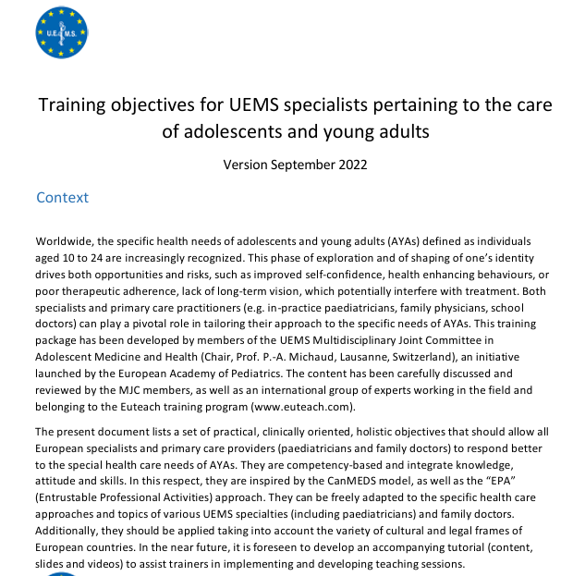
We are grateful for
Appendixes in
Psychiatry
Child and Adolescent Psychiatry
Emergency Medicine
Paediatric Haematology/Oncology
Madeira, 2021

Slide 12
Implementing an ETR on transition care competency for adult specialists could enable efficient and youth-friendly health care
with or without proximity to the pediatric clinic
with or without a set transitioning structure at the specific clinic
when the patient relapses after transitional age
when onset is in late adolescence or young adulthood
Lithuanian field, 2024

Slide 13
”Adult health-care is completely different. They have other routines, do tests differently, and leave much more responsibility to me. It's good, but it's not always easy”
Male, 18-year-old transplant patient:
The Life Guide – The Art of Becoming an Adult as a Transplant, Sweden
”The shift to adult care didn't go very well. Apparently, they lost me in the system, and when I wanted to make an appointment, they said it wasn't probable I'd have a hearing disability because of my age.”
Female, 19-year-old patient with congenital hearing disability:
A study of children and young people's experiences of the transition from pediatric to adult hearing care in Sweden, by Forsberg J and Wahlström JE
Madeira, 2021
UEMS Adolescent Medicine and Health MJC

