Slide 1
AEMH updates 2025
João de Deus
AEMH President

Slide 2
European Academy of Clinical Leadership
- from an idea to a joint project -

Slide 3
EACL
Naples 2016: Decision to
Focus on Clinical Leadership
Founding of the Working Group on Clinical Leadership
Template UEMS Bodies/ETRs
Continuing Conferences on CL
The Origin of the Board & Academy of Clinical Leadership

Slide 4
European Clinical Leadership Academy European Training Requirements
Training requirements for senior doctors with clinical leadership experience (fellowship)
Training requirements for junior doctors (in coming)
Training requirements for trainees (in coming)

Slide 5
Governance
The Clinical Leadership Academy is governed by AEMH in close collaboration with UEMS.
The Academy is managed in collaboration with other EMOs (FEMS, EJD, CEOM) and universities from different European countries.
The management of the CL Academy is done by the CL Academy Board.

Slide 6
European Academy of Clinical Leadership – project development
EACL launching event in cooperation with UEMS (17 September 2021)
Recording available on the EACL youtube channel

Slide 7
European Academy of Clinical Leadership – first candidate assessment session -
12 May 2022 – Frauenkirchen (Austria)
9 candidates
2 juries

Slide 8
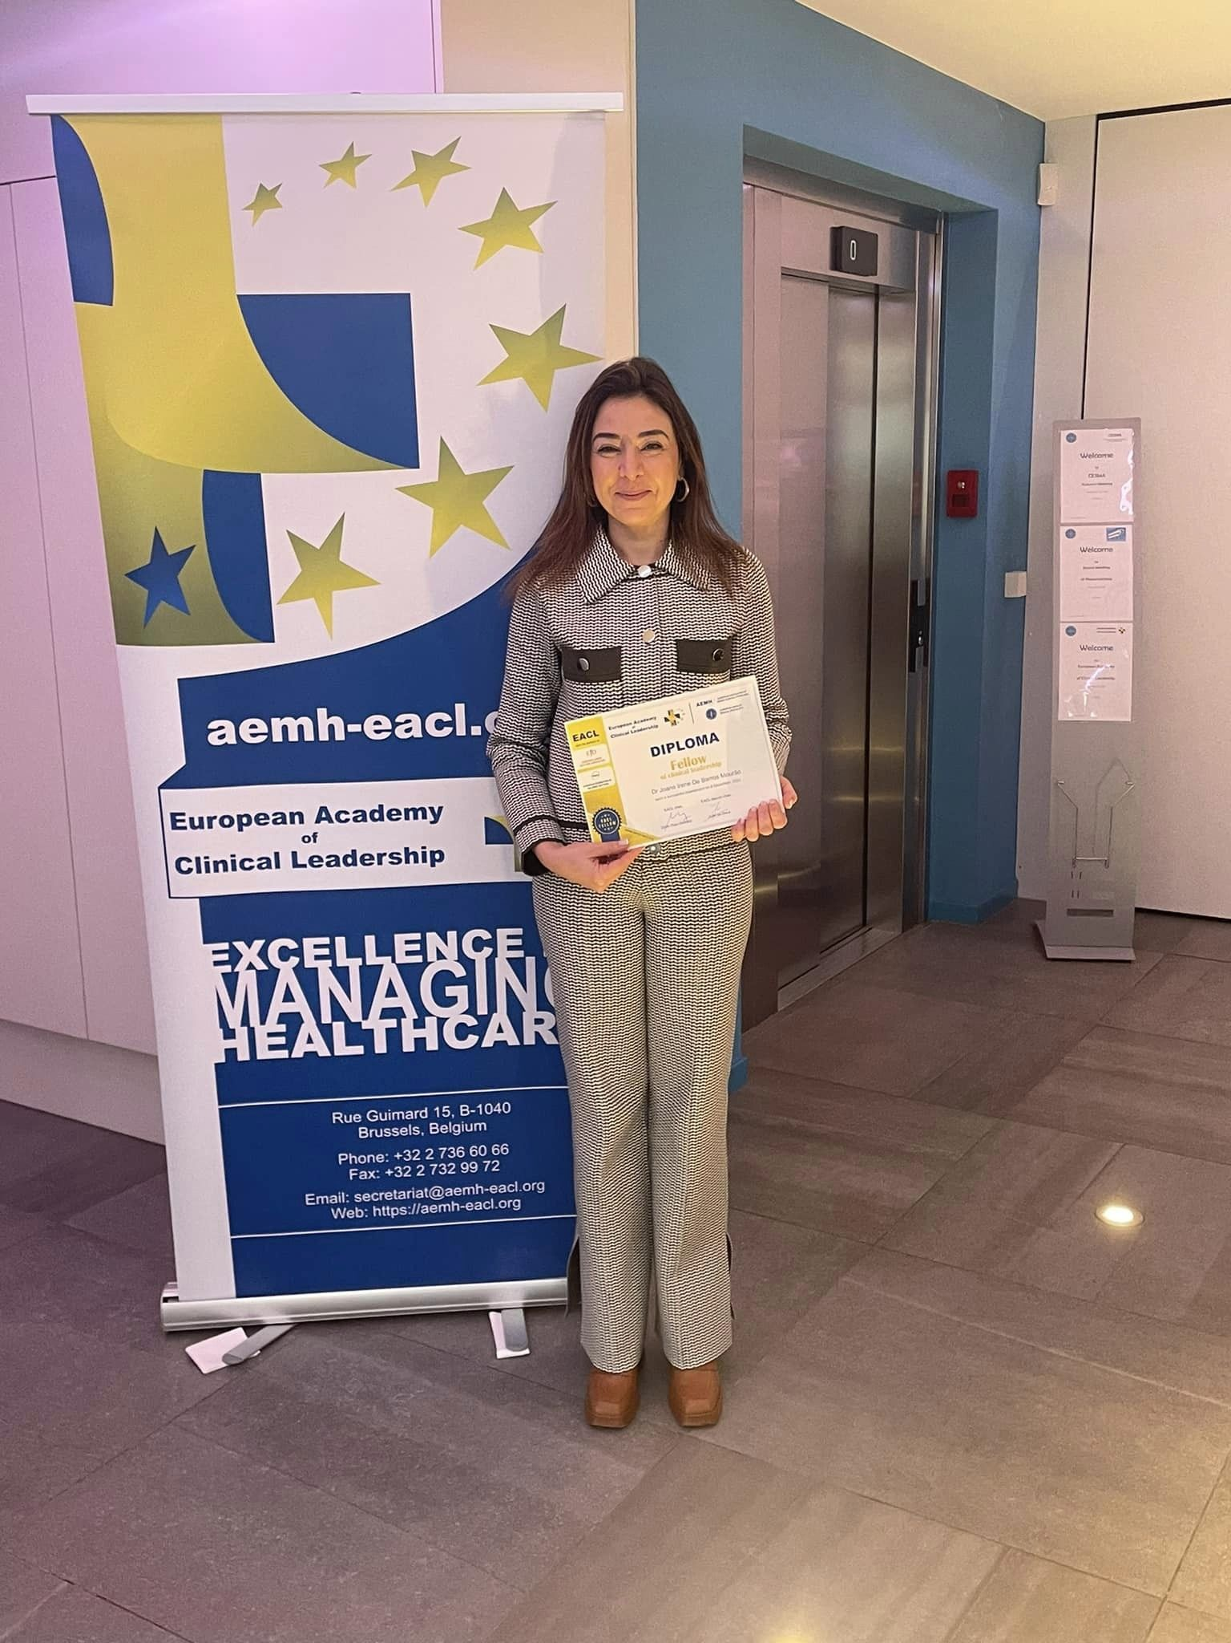
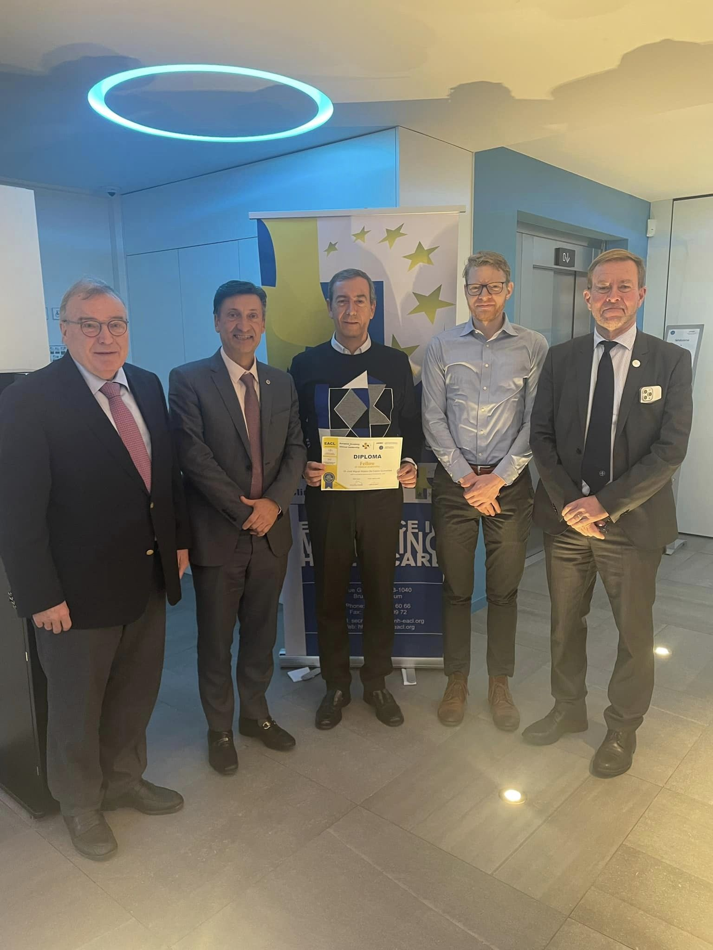
European Academy of Clinical Leadership – second candidate assessment session -
8-9 December 2022 – Brussels (Belgium)
- 30 candidates
2 juries
2 days of examinations

Slide 9
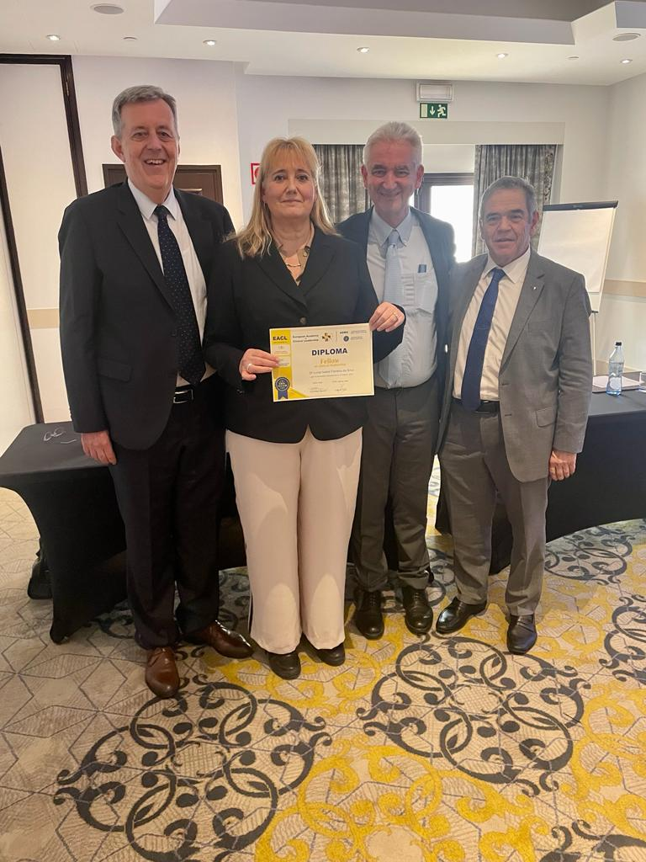
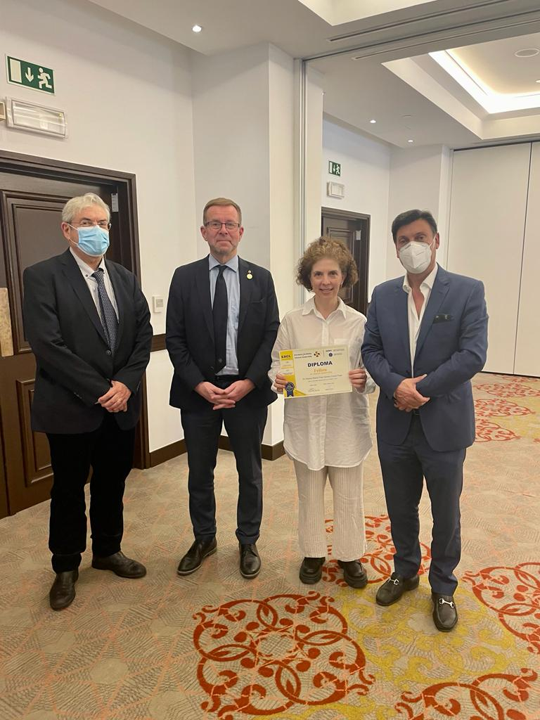
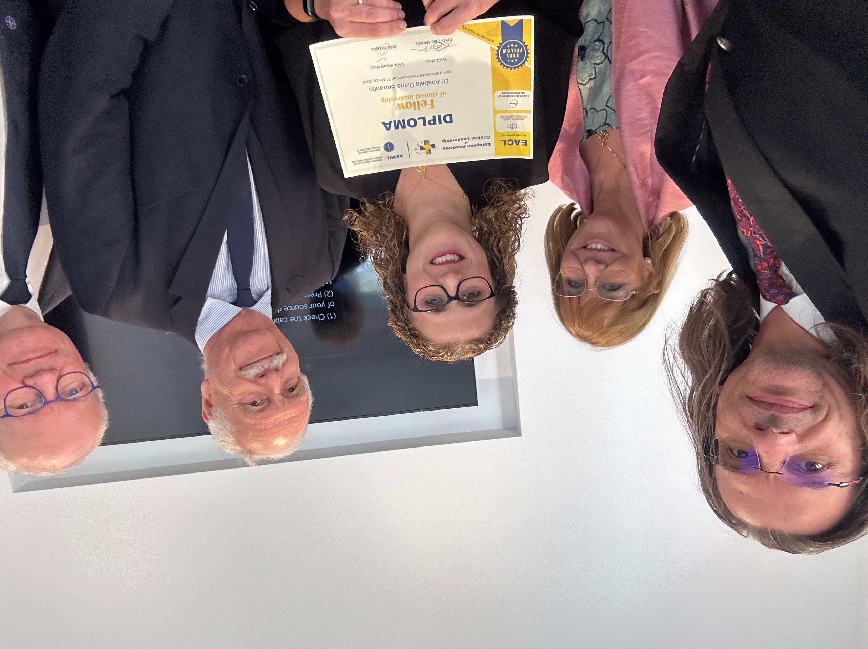
European Academy of Clinical Leadership – third candidate assessment session -
31 March 2023 – Algarve, Portugal
- 19 candidates
- 3 juries

Slide 10
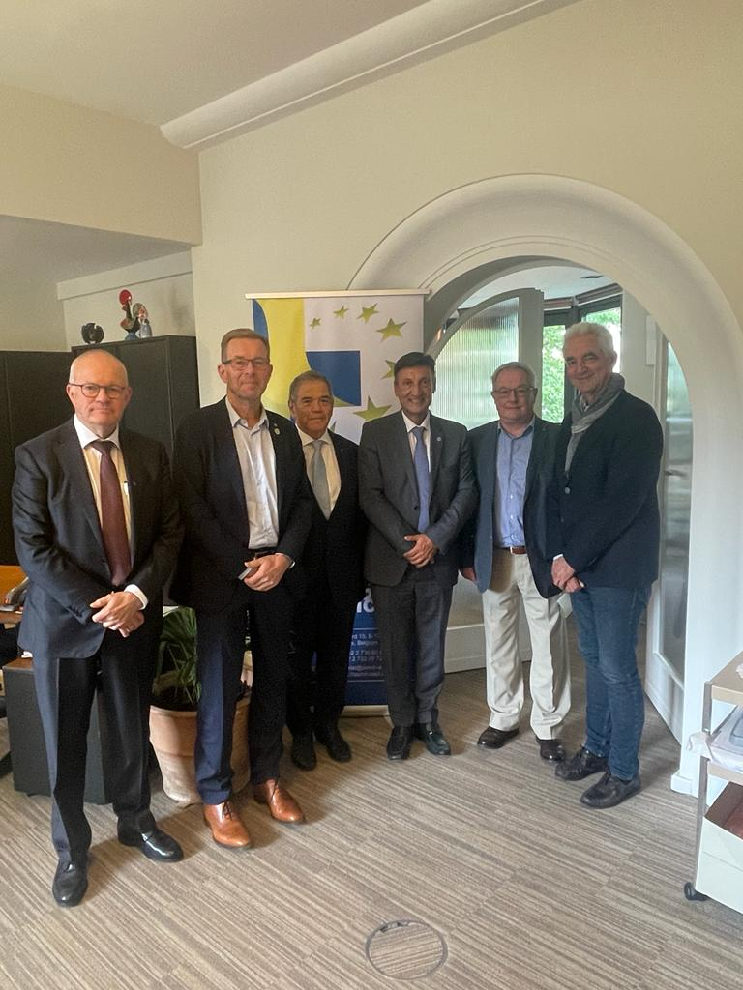
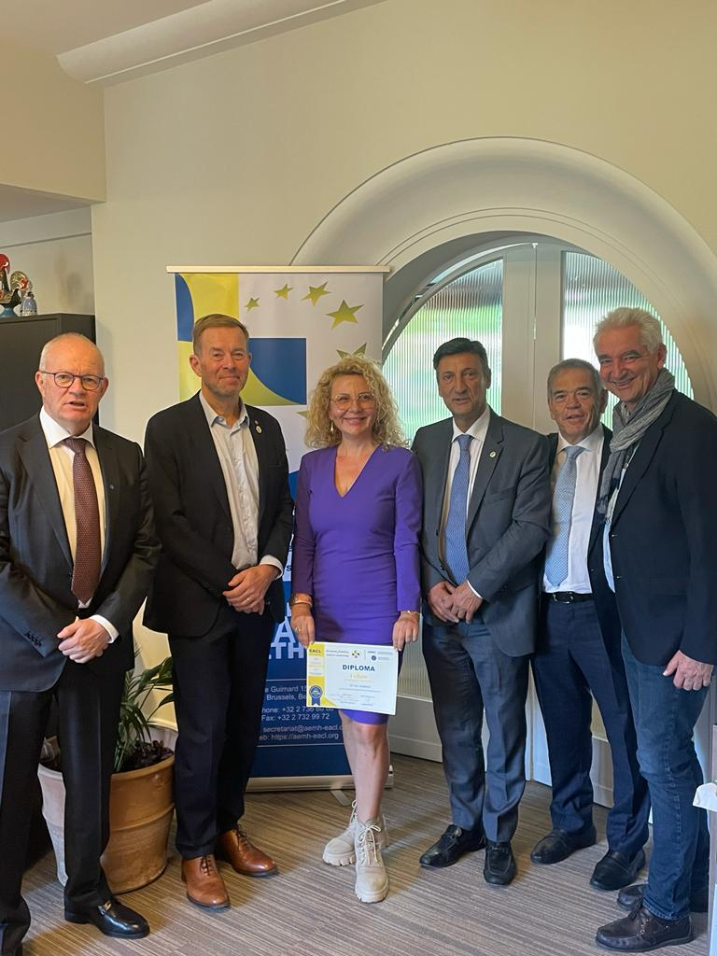
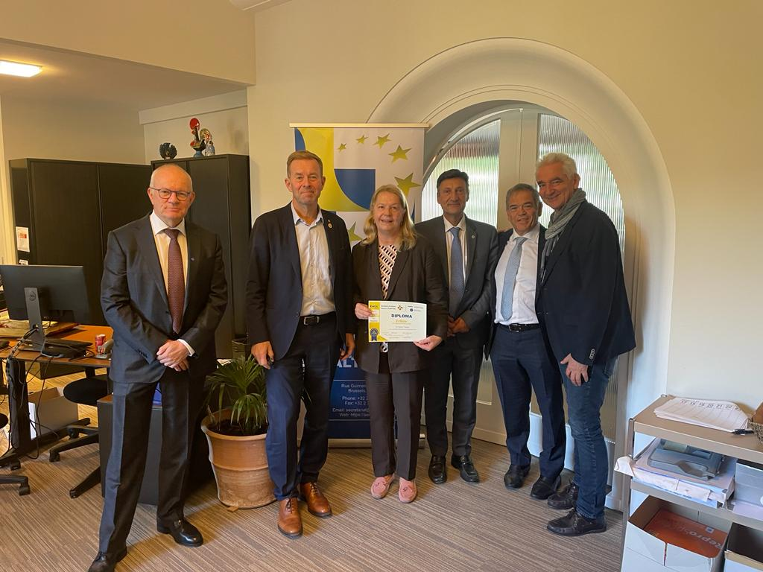
European Academy of Clinical Leadership – fourth candidate assessment session -
22 September 2023 – Brussels, Belgium
- 4 candidates
- 1 jury

Slide 11
European Academy of Clinical Leadership – fifth candidate assessment session -
7 March 2024 – Brussels, Belgium
- 4 candidates
- 1 jury

Slide 13
CV Evaluation : leadership skills
Experience, capacity and ability to manage teams;
Experience, capacity and ability to manage services;
Experience, capacity and ability to manage organisations

Slide 14
European Academy of Clinical Leadership
Almost 100 fellows from 11 countries:
EACL fellows:
https://aemh-eacl.org/eacl-fellows/

Slide 15
European Academy of Clinical Leadership – future assessment sessions -
More information and application documents to be found on the EACL website:
https://aemh-eacl.org/
or contact
secretariat@aemh-eacl.org

Slide 16
AEMH-FEMS Joint GA, 10-11 May, Berlin, Germany
New AEMH board elected for the period 2025-2027:
João de Deus (president) - Portugal
Sergio Bovenga (1st vice-president) - Italy
Konstantinos Koumakis (2nd vice-president) - Greece
Clarisse Joaquim (3rd vice-president) - France
Pierre Maldague (treasurer) – Belgium
Erich-Theo Merholz (past president) - Germany

Slide 17
AEMH GA 2025 – Rome, Italy hosted by FNOMCeo
Preceded by a conference on - Artificial Intelligence, Augmented Reality, Metaverse: Impact on Medicine and the Medical Profession
Proposal to have 2 GAs a year as the other EMOs
2 working groups on:
Strategic management of hospital crises (chaired by Dr Clarisse Joachim)
Quality of life of hospital doctors (chaired by Dr Pierre Maldague)

Slide 18
Thank you for your attention!

