Slide 1
Update on the current situation in Ukraine
ANDRIY BAZYLEVYCH
Member of the Board
of the Ukrainian Medical Association
Brussels - 26 April 2025

Slide 2
Ukrainian Medical Association (UMA)
1910 - 1939 – Ukrainian Medical Association in Lviv (West Ukraine in Austro-Hungarian Empire)
1917 - 1921 – Ukrainian Union of Physicians (Kyiv)
1990 – Ukrainian Medical Association
Vse-Ukrainske Likarske Tovarystvo
in Ukrainian language
– renewed the activity

Slide 3
Our Mission in Wartime

Slide 4
War and Helth sysmem

Slide 5
Rehabilitation Center “SUPERHUMAS”
>200

Slide 6
Frame 14_28.03.jpg

Slide 7
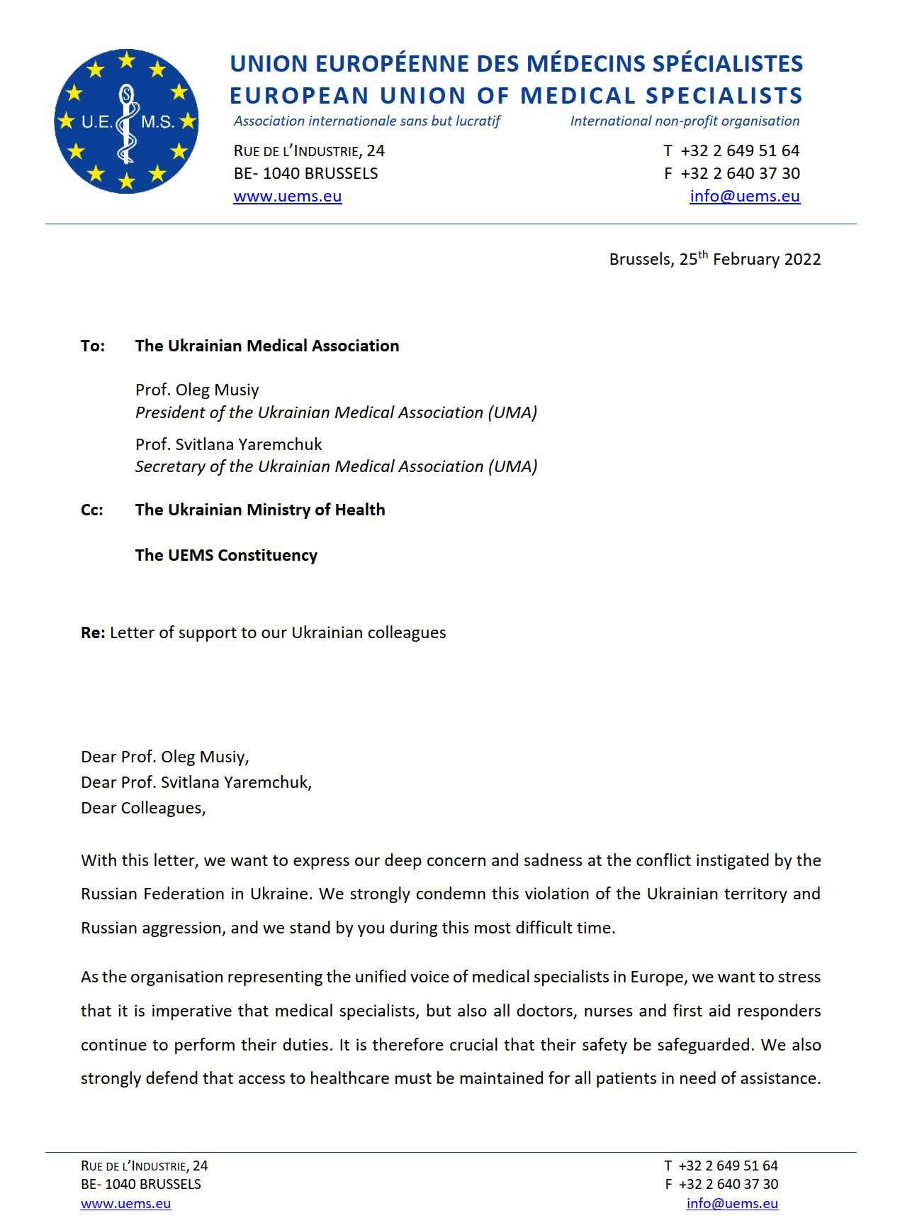

Slide 8
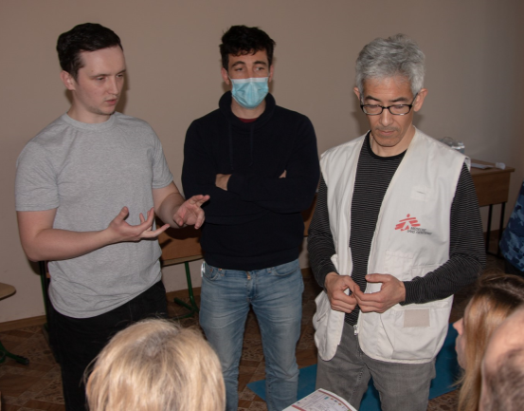
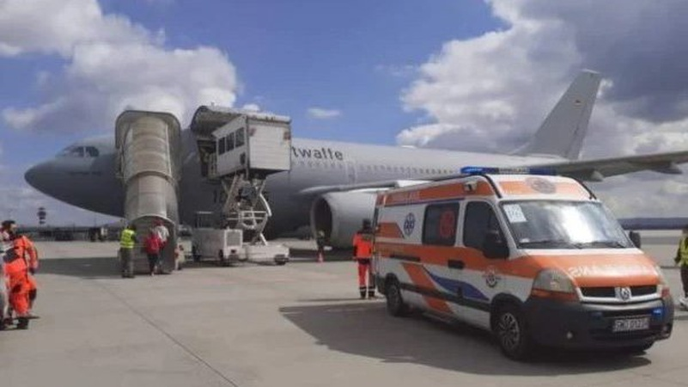
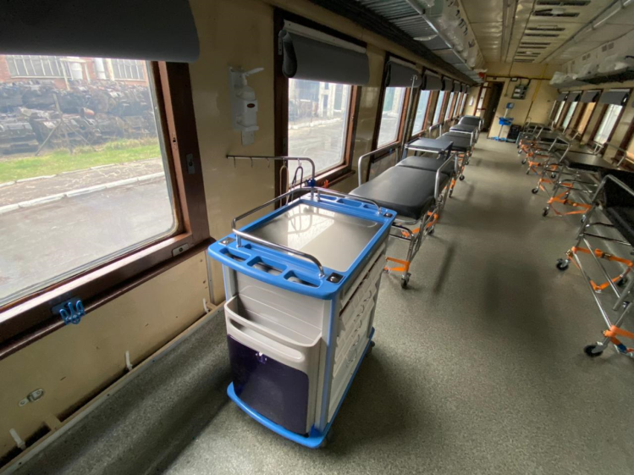
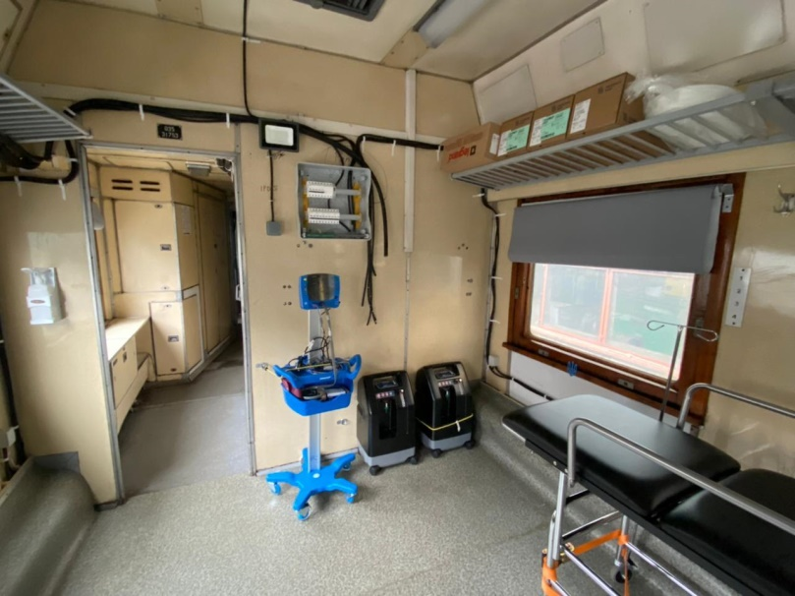

Slide 9
New medical Center “UNBROUKEN”

Slide 10
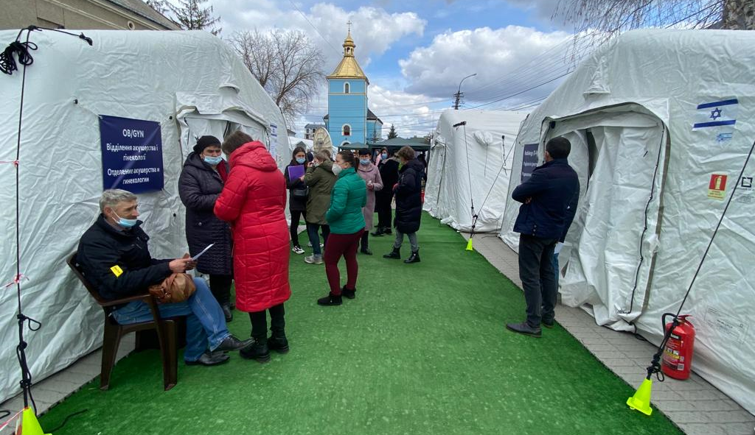
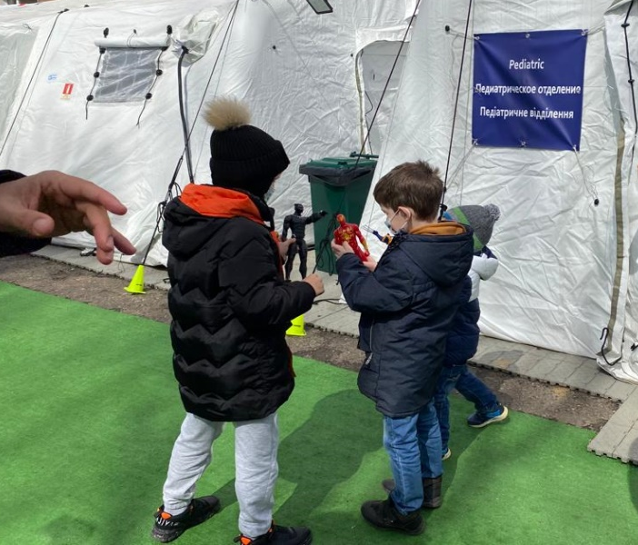
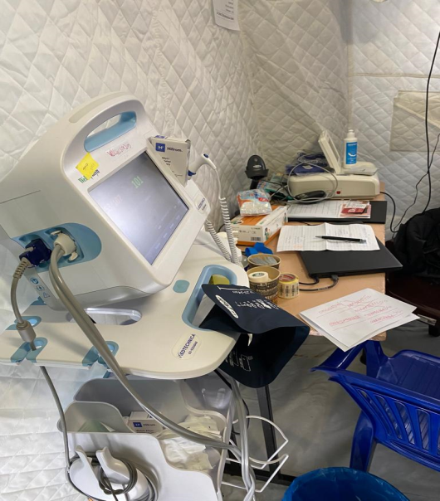
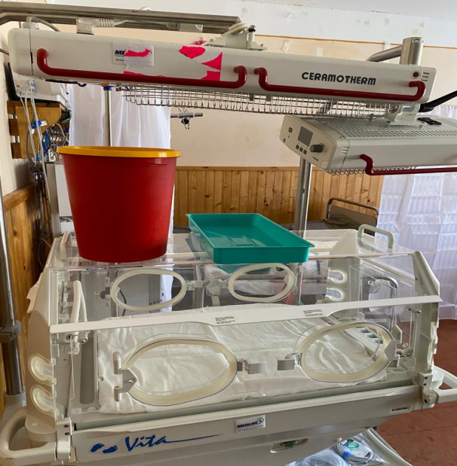
Israeli field hospital

Slide 11
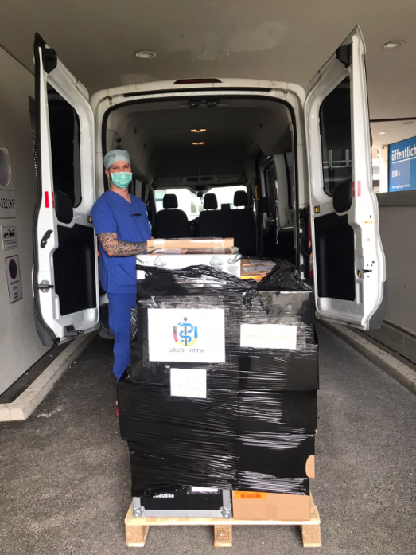
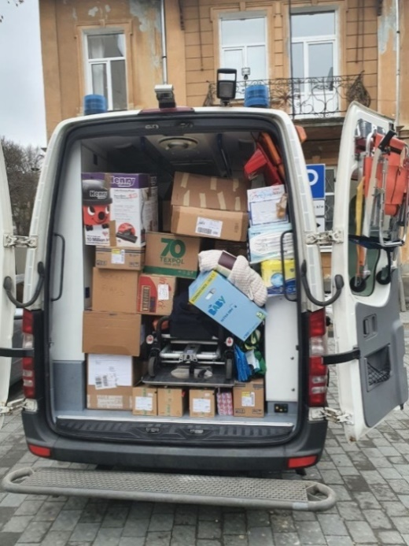
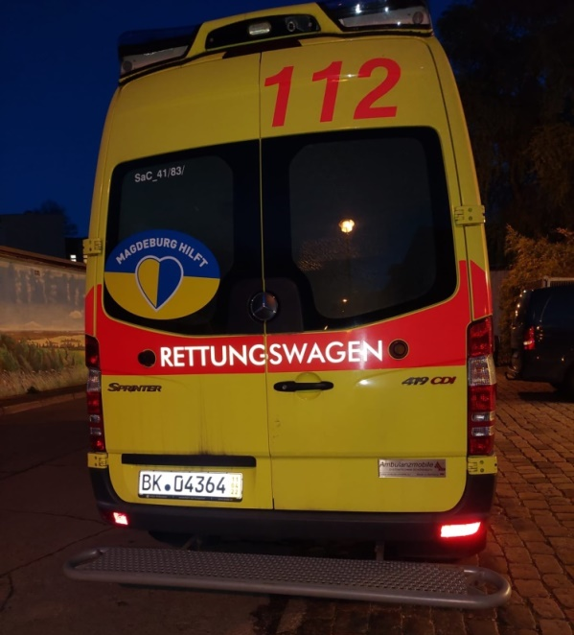
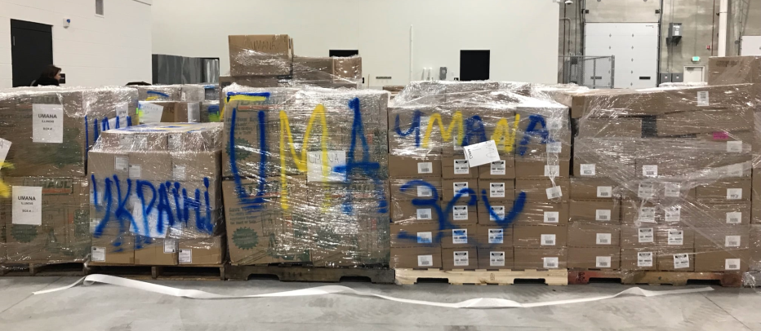
From around World

Slide 12
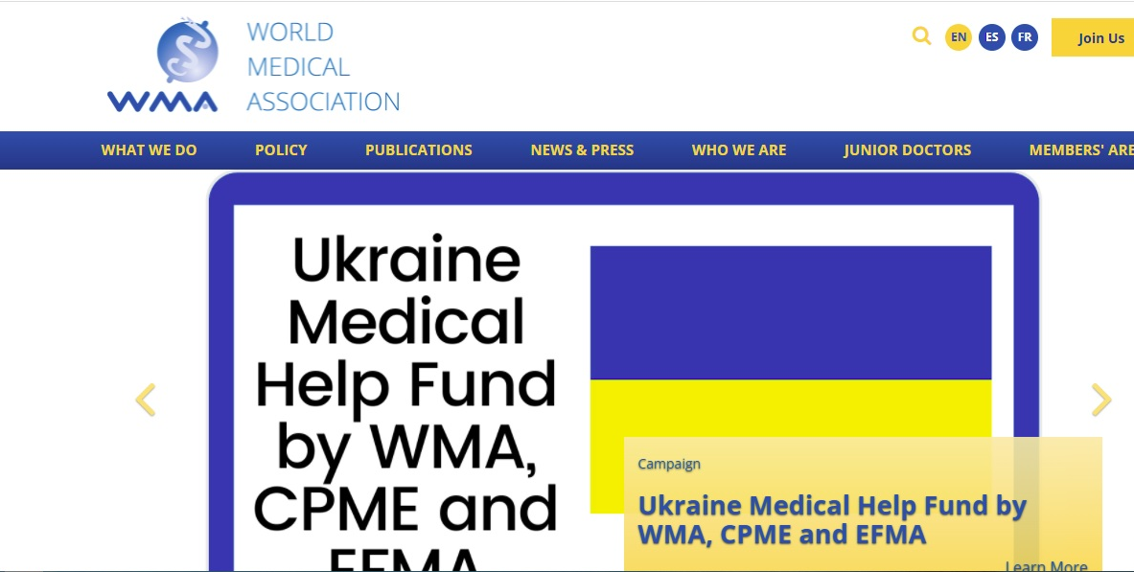
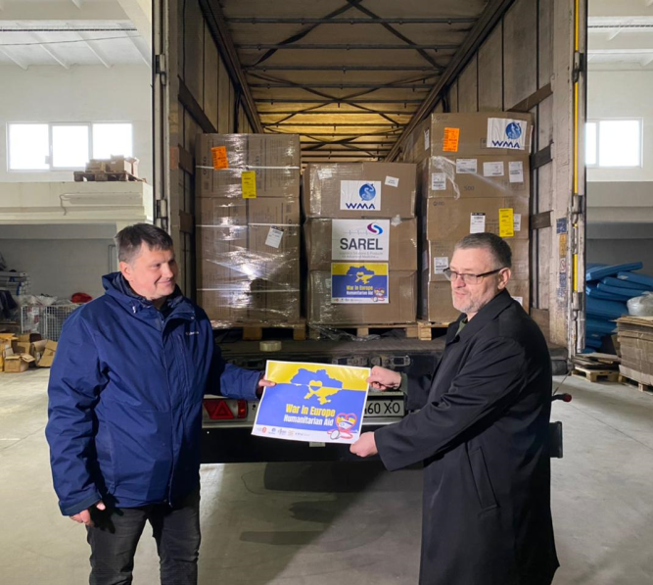
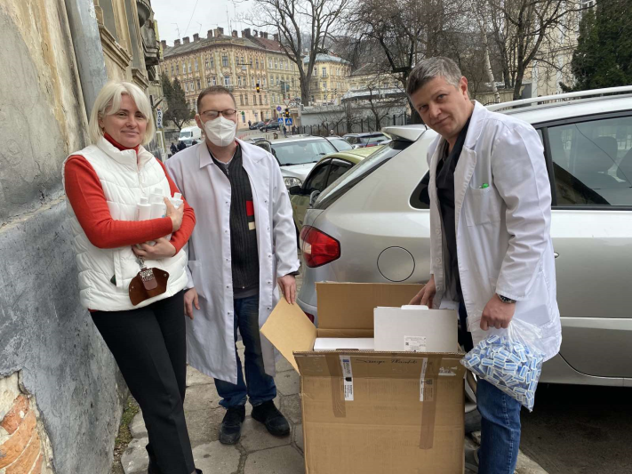

Slide 13
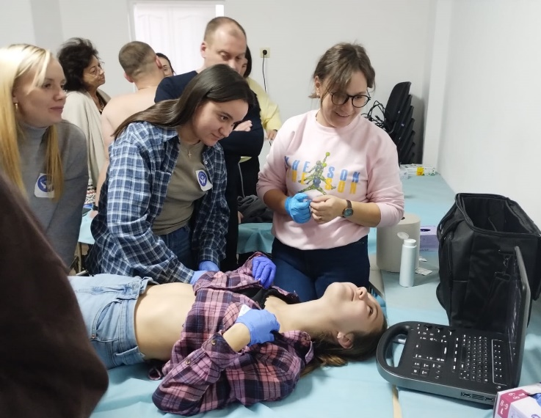
Trainings

Slide 14
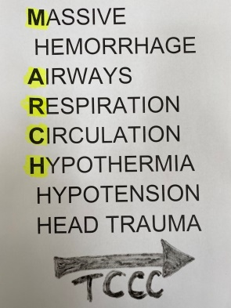
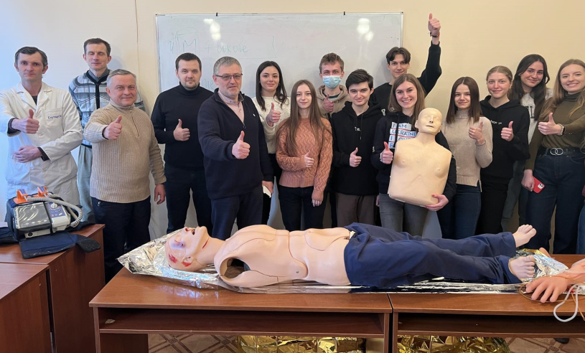
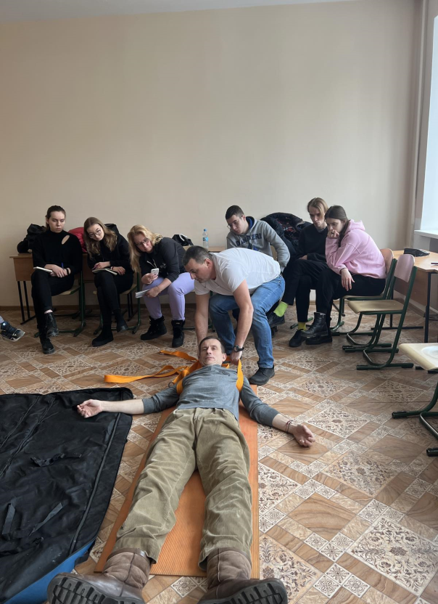
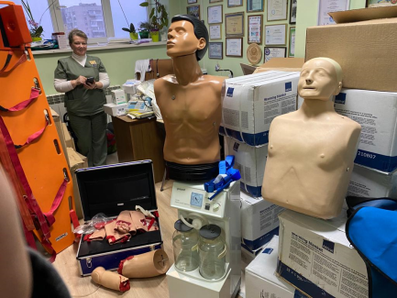
ТССС «Tactical Combat Casualty Care»

Slide 15
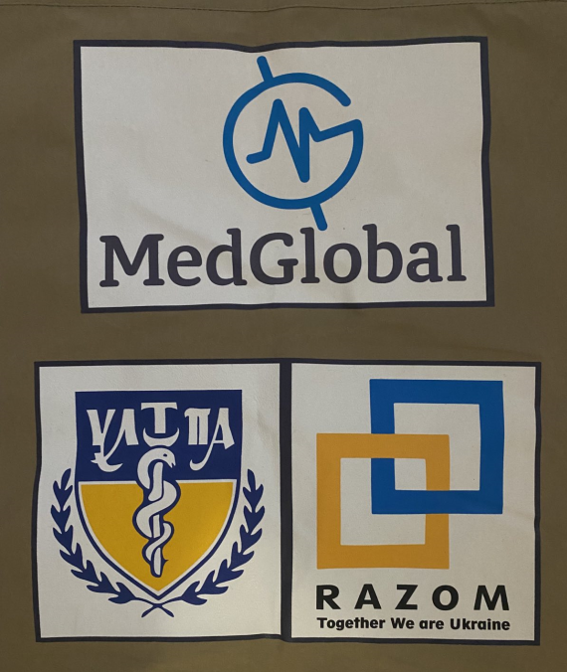
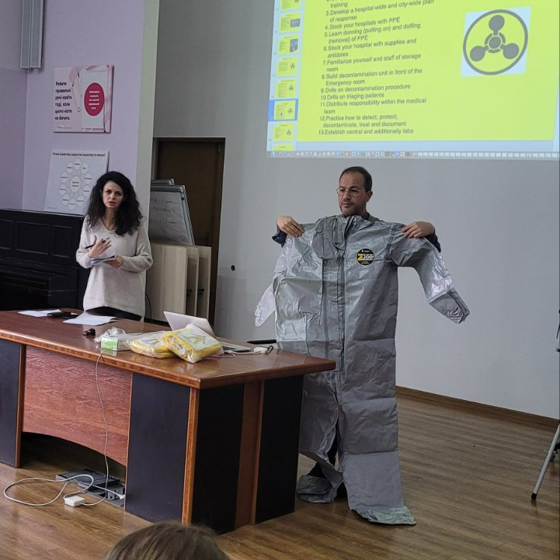
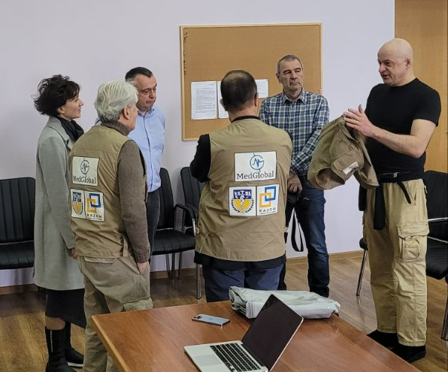
MedGlobal and UMA North America (USA)

Slide 17
Postgraduate medical education in Ukraine
After receiving a diploma, young doctors validate and expand their practical skills during their internship, which typically lasts 2 to 3 years, depending on the specialty. These programs combine theoretical education with practical (hands-on) training in hospitals and clinics.
Following their internship, some doctors may choose to pursue fellowships for further specialization in specific fields, which can last 1 to 3 years.
Postgraduate medical education is primarily offered by medical universities and specialized training institutions across Ukraine.

Slide 18
Continuing medical education (CMA) in Ukraine
Doctors of all specialties, after completing their internship, undergo annual advanced training and are required to earn 50 points of continuous professional development.
Higher educational institutions, hospitals, medical public organizations, etc., hold various events to support this professional development of doctors (including, conferences, master classes, online courses, workshops, seminars, professional schools, etc.).
Following each CME event, doctors must take a test by the end of the day and, upon successful completion, they receive a certificate awarding 5 to 20 points.

Slide 19
Future collaboration
1. Establishing formal partnerships with European medical associations, clinics and educational institutions.
2. Organizing exchange programs for Ukrainian teachers and interns. This will enable them to gain practical experience in European institutions and their professional skills.
3. Developing joint educational programs that align with European standards. This may include collaborative courses, trainings, and seminars.
4. Encouraging Ukrainian educators and students to actively participate in international conferences and symposiums held in Europe.
5. Securing the opportunities for funding and grants to support exchange programs and collaborative research. This can help cover travel and training costs.

Slide 20
Thank you for your support …

