Slide 1
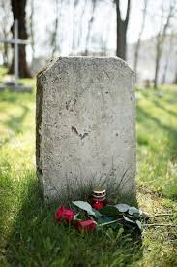
After a sad NEWS, often
ehealth
Group

Slide 2
Comes a good one!
IA Group

Slide 3
What a Subject !
What is AI?
For Patients?
For every Speciality?
For Doctors?
Legal Aspects
For Trainees?
For Hospital direction
For research

Slide 4
Next Step
A survey sent to every section
Common topics
Specific ones
Guides for :
Trainees, ETR
Patients
CME/CPD Programs
Literature monitoring
etc.

Slide 5
JOIN the TEAM!
NB focus on young doctors
Contact me : gperrard@yahoo.com

