Slide 1
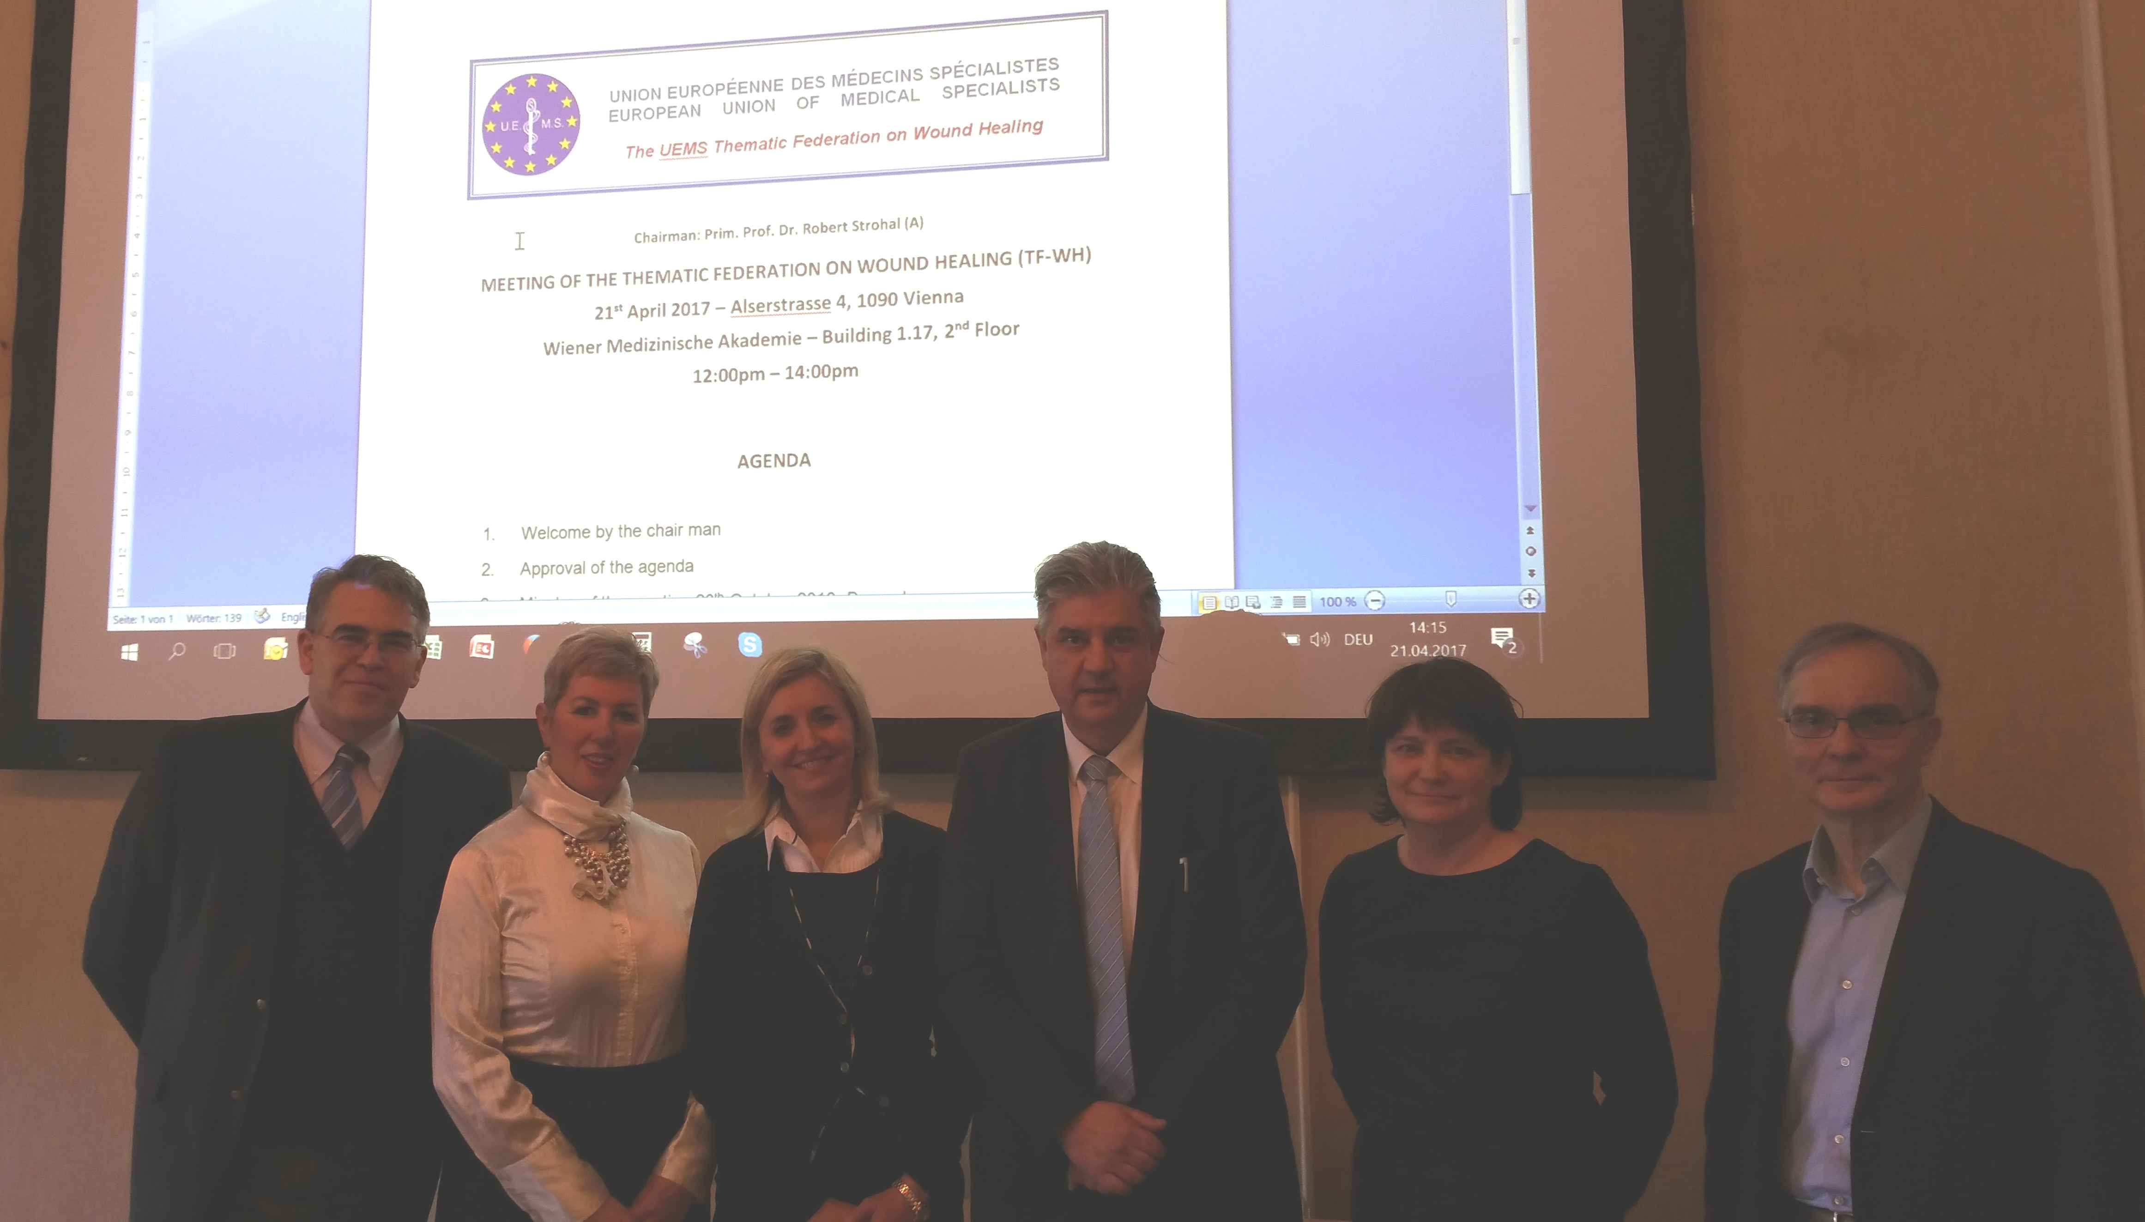
European Training Requirements (ETR) for Wound Healing UEMS advisory board April 2025
George-Sorin Tiplica – UEMS MJC Wound Healing

Slide 2
Wound Healing—A Multidisciplinary Field
Chronic and acute wounds: a challenge across specialties
Not a standalone specialty, but a competence for many disciplines
Interdisciplinary and interprofessional collaboration is essential
Aim
Align wound healing training with modern educational standards
Address Europe’s growing burden of chronic wounds (prevalence: 2% of EU population)

Slide 3
Historical Evolution
2015: UEMS Thematic Federation Wound Healing
President: Prof. Robert Strohal (Austria)
WH - curriculum framework
2018: UEMS Multidisciplinary Joint Committee Wound Healing
First UEMS-recognized ETR in Wound Healing
2024 - 2025: Wound Healing ETR** developed on the principles of Competence Based Medical Education

Slide 4
Rationale for Revision
Variability in national training standards
70% gap between best/worst-performing EU states
Rising diabetic foot ulcer incidence
+18% since 2020
Advances in bioengineerred tissues and AI-driven diagnostics
Need for clear competencies and modern assessment

Slide 5
Main Innovations in the 2025 ETR
Introduction of Entrustable Professional Activities (EPAs)
Alignment with CANMEDS roles for physician competencies (Medical Expert, Communicator, Collaborator, Leader, Health Advocate, Scholar, Professional)
Integration of Bloom’s taxonomy for learning objectives

Slide 6
Bloom's Taxonomy
developed by Benjamin Bloom in 1956
is a framework used in education to classify learning objectives into a 6 levels hierarchy:
Remembering: Recalling facts and basic concepts.
Understanding: Explaining ideas or concepts.
Applying: Using information in new situations.
Analyzing: Breaking information into parts to explore understandings and relationships.
Evaluating: Justifying a decision or course of action.
Creating: Producing new or original work
this taxonomy helps educators design curriculum and assessments that promote higher-order thinking skills.

Slide 7
Establishment and Contributors
UEMS Wound Healing MJC: responsible for the ETR
Working group 1st edition: experts from Austria (Robert Strohal), Lithuania (Daiva Jasaitiene), Romania (Sorin Tiplica)
Working group 2nd edition: experts from Finland (Kirsi Isoherranen, Jaakko Viljamaa), Switzerland (Jan Plock, Anna Wang), Romania (Sorin Tiplica)
Multidisciplinary analysis: dermato-venereology, plastic surgery, internal medicine, angiology, endocrinology, vascular surgery, pathology, phlebology and UEMS ETR Review Committee – Prof. Nada Cikes
Collaboration with WH international organizations: EWMA and EAFWH
Review and Comments: Prof. Arthur Felice, Thorsten Schumann, Jurate Macijauskiene, Stephen Zammit, Sarah Verheyen, Edgar Peters, Henry de Vries

Slide 8
Structure of the ETR Document
<follows the UEMS ETR frame>
Preamble and aims
Training requirements for
Trainees
Trainers
Institutions
Assessment, governance, and quality management
Annexes: Logbook, EPAs

Slide 9
European Context
Wound healing managed differently across Europe
Dermato-venereology, plastic surgery, surgery, diabetology, geriatrics, vascular surgery, endocrinology, angiology, infectious disease, physical and rehabilitation medicine, oncology, neurology, genetics and more are involved in the management of wounds
National associations and international ones (as EWMA/EAFWH) play key roles in this field

Slide 10
Training requirements for trainees
Developed as Competence Based Medical Training
Competence = knowledge + skills + professionalism
Focus on outcomes, not time spent

Slide 11
Theoretical Knowledge—Key Domains
The trainee will be able to:
OUTLINE the physiology and stages of wound healing
EXPLAIN the factors that are of importance in relation to wound healing
DESCRIBE the stages of wound healing
UNDERSTAND and APPLY the clinical classifications used in wound care

Slide 12
DIAGNOSTICS — Key Domains
The trainee will be able to:
SUMMARIZE which pieces of anamnestic information and clinical findings are relevant and ADAPT this knowledge to interviewing and examining the patient
ASSESS the patient's quality of life
OUTLINE screening for malnutrition, ASSESS the nutritional status of the patient
ASSESS the pain associated with a wound
IDENTIFY the typical and atypical chronic wounds and ASSESS its risk factors
CHOOSE the appropriate laboratory and imaging studies required in the diagnostic and treatment

Slide 13
Treatment — Key Domains
The trainee will be able to:
UNDERSTAND that treatment must be based on diagnosis, is evidence-based and patient-centred
PLAN the treatment
CARRY OUT local treatment
MANAGE pain
ASSESS the treatment options realistically and DETERMINE the appropriate treatment limitations
SUMARIZE the principles of palliative wound care

Slide 14
consultationS — Key Domains
The trainee will be able to:
IDENTIFY the situations in which multidisciplinary or multiprofessional assessment of the patient is warranted
UNDERSTAND the importance of precise communication in consultations and UTILIZE this knowledge in requesting and acknowledging a consultation
UNDERSTAND the importance of continuity of care and how care chains work, and IDENTIFY and SOLVE problems related to care chains

Slide 15
Multiprofessionality and care processes — Key Domains
The trainee will be able to:
UTILIZE their knowledge as a representative of their speciality in a multiprofessional wound care team and in different tasks that are related to the development of wound care
MAKE USE of the specific expertise and skills of different professional groups
UNDERSTAND how the costs of care are incurred and APPLY this knowledge in their work in order to provide cost-effective care for the patient
IMPROVE the quality of care and DEVELOP care practices and processes

Slide 16
EDUCATION — Key Domains
The trainee will be able to:
MAKE USE of their knowledge as an educator of wound care within one’s speciality and its training program as well as for physicians from other specialities
MAKE USE of their knowledge to teach the theory and basic practical skills of wound care to other professional groups involved in patient care

Slide 17
Organization and curriculum of Training
Unit | Theoretical | Practical
A: Theoretical | 10 | 15
B: Diagnostics | 18 | 30
C: Treatment | 18 | 30
D: Consultations | 8 | 15
E: Multiprofessionality | 5 | 10
F: Education | 5 | 10
Congress / Symposia | 16 | -
Clinical Cases | - | 20
Total | 80 | 100

Slide 18
Organization of Training—Practical Work
Minimum 3 months in a wound healing unit (100 hours)
Logbook documentation of practical steps and supervisor sign-off

Slide 19
Entrustable Professional Activities (EPAs)—Overview
22 EPAs: 13 foundation, 9 advanced
Each EPA:
Description
CanMEDS domains
Required knowledge/skills/attitudes
Information sources to assess progress and support summative entrustment
Entrustment / supervision level expected:
Level 4: Distant supervision
Level 5: Supervising others (expected at program completion)

Slide 20
EPA Examples—Foundation
Interview and examine a patient with a wound
Diagnose wounds, assess arterial circulation, foot biomechanics, diabetes, infection
Manage a patient with a pressure ulcer

Slide 21
EPA Examples—Advanced
Manage wounds due to edema, arterial/venous ulcers, diabetic foot ulcers
Manage a patient with atypical wounds
Teach wound care to other professional groups in wound care

Slide 22
Assessment and Evaluation—Overview
Continuous support and feedback by a group of interdisciplinary trainers.
The whole theoretical and practical training program for a trainee is personally headed by a director of program.
LOGOOK and PORTFOLIO of each trainee will include clinical cases, EPAs achieved, publications, and courses – CME
Regular review and sign-off
Periodic progress assessment balanced between formative and summative assessment
Different types of examinations: DOPS – direct observation of procedural skills, MiniCex – mini clinical examination, OSCE – Objective Structured Clinical Examinations…

Slide 23
End of Training and Examination
The candidate should be ELIGIBLE demonstrating: qualification, training, logbook, CME, recommendations
European Board for Wound Healing Examination
Formative Assessment (made by the Examination Committee on the basis of the CV, Logbook and Credit points presented by the candidate as a proof of experience and expertise).
Summative Assessment on the basis of an “Exit Examination”:
-Part 1 (Theoretical) mainly assessing knowledge: 100 Multiple Choice Questions.
-Part 2 (Practical) mainly assessing clinical reasoning, decision-making, risk assessment, clinical skills and technical skills consisting on the management of the wound of one patient.

Slide 24
Governance and Quality Management
The governance of a Training program is the responsibility of the Program Director and the institution(s) in which the training program is being delivered.
A trainer will be responsible to the Program Director for delivering the required training in the area of practice.
A Program Director is required to take responsibility for Program organisation, implementation, trainee selection and subsequent monitoring and oversight.
The Training will be documented in the LOGBOOK.

Slide 25
TRAINING REQUIREMENTS FOR TRAINERS
1. Process for recognition as trainer
a. Requested qualification and experience: nationally registered as specialist with knowledge and skills in Wound Healing; strongly recommended to gain UEMS recognition
b. Core competencies for trainers
Familiar with all aspects of the overall Wound Healing curriculum
Experienced in teaching and in supporting learners
Skilled in identifying the learning needs of their trainees
Trained in the principles and practice of medical education
2. Quality management for trainers: national medical specialty boards

Slide 26
Training Institution Requirements
Adequate patient volume and case diversity
Multidisciplinary staff and facilities
Regular interdisciplinary meetings
Accreditation by national boards and UEMS
Internal quality boards and external audits

Slide 27
ConclusionS
The new ETR sets a unified, competency-based standard for wound healing training in Europe
Ready for implementation and further feedback

