Slide 1
NEW ESGO CURRICULUM:
Training Requirements
for the subspecialty of
Gynaecological Oncology
UEMS advisory board
April 25th 2025
Presentor: René Verheijen,
co-chair ESGO
Training & Education Committee
ESGO Training & Education Committee

Slide 2

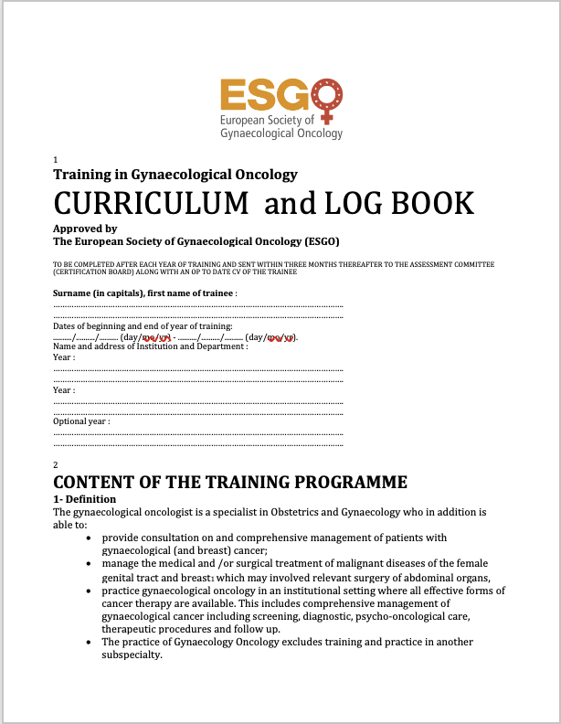
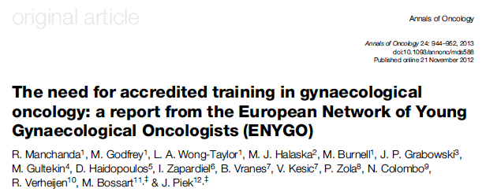
1st ESGO Curriculum
    2010 1st ESGO Curriculum: authority based guide + on-paper logbook
Need:
most european countries do NOT have a
training programme for gynaecological oncology

Slide 3
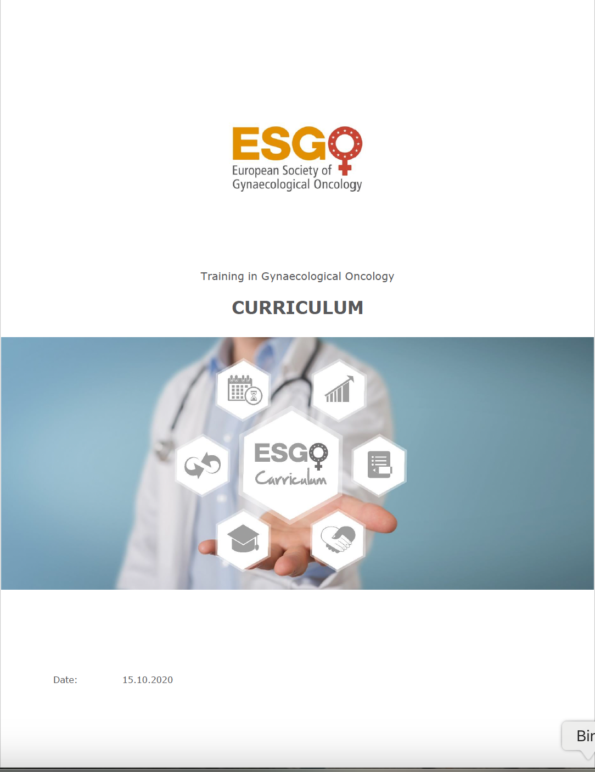
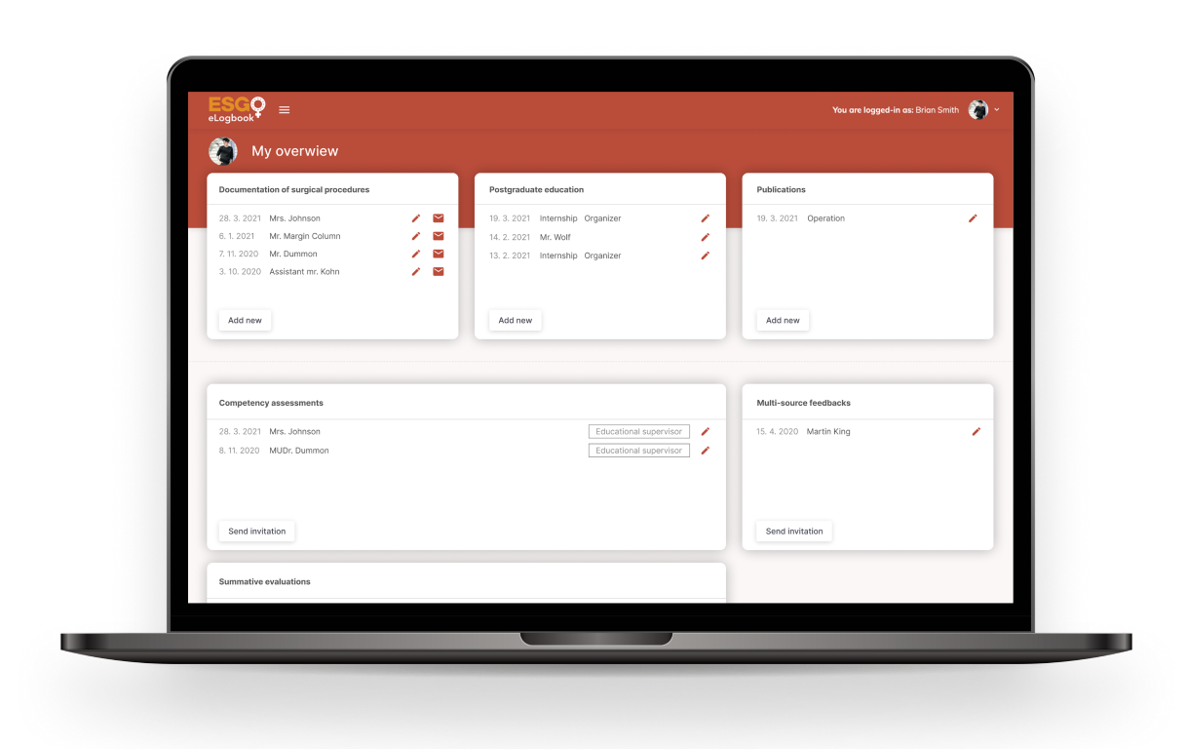
2nd version
    2010 ESGO Curriculum: authority based guide + on-paper logbook
  2020 1st revision: consensus based detailed framework + on-line eLogbook
DELPHI method defined: - modular
            competence based (ACGME)
            assessment tools and criteria (OSATS etc)
Structured, systematic & detailed learning targets
Continuation of the EBCOG PACT programme
eLogbook
(in-house)

Slide 4

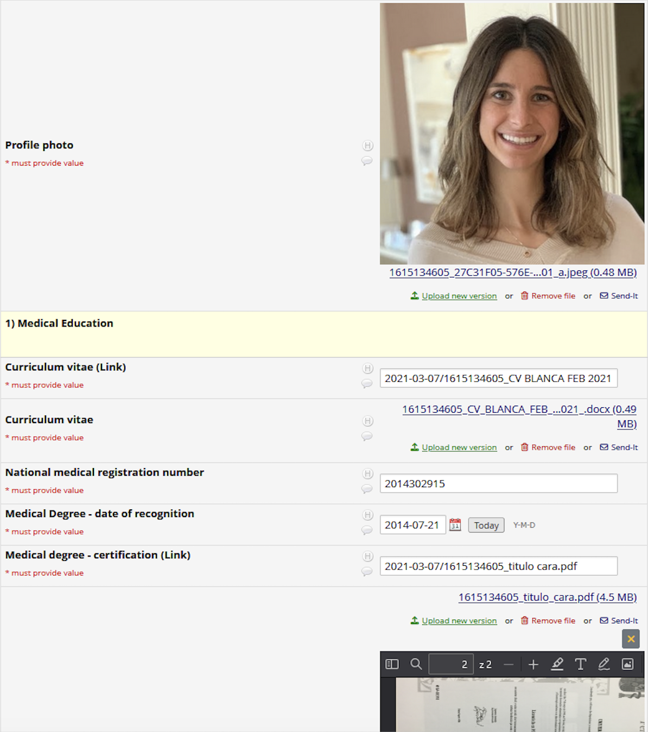
3rd version
    2010 ESGO Curriculum: authority based guide + on-paper logbook
  2020 1st revision: consensus based detailed framework + on-line eLogbook
2025 2nd update: addition of special interest module + ETR format
Keeping the consensus principles
Diploma for (fully trained) gynaecological oncologist +
Certificate for special interest training (ultra sound)
Change of on-line platform for logbook
(REDCap®)

Slide 5

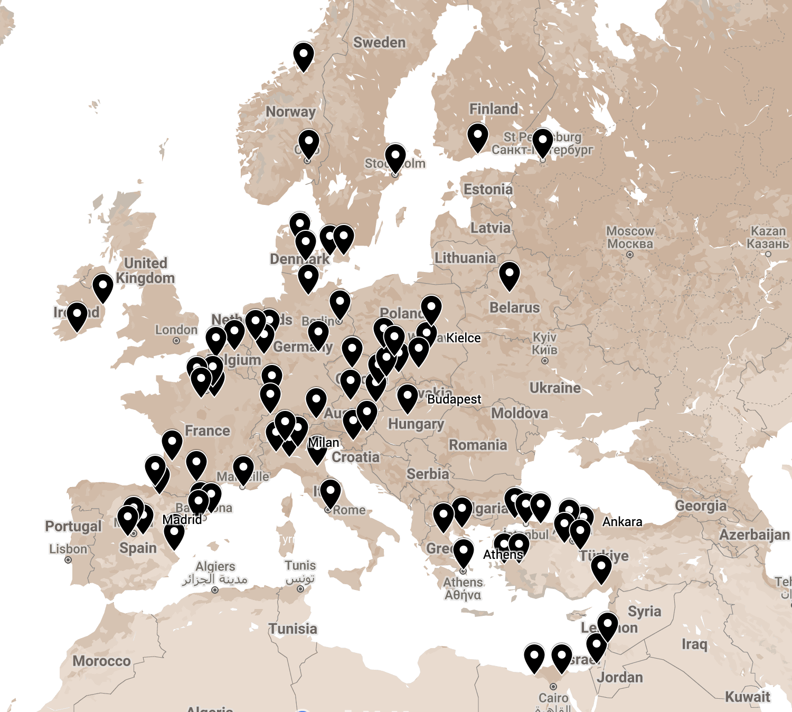
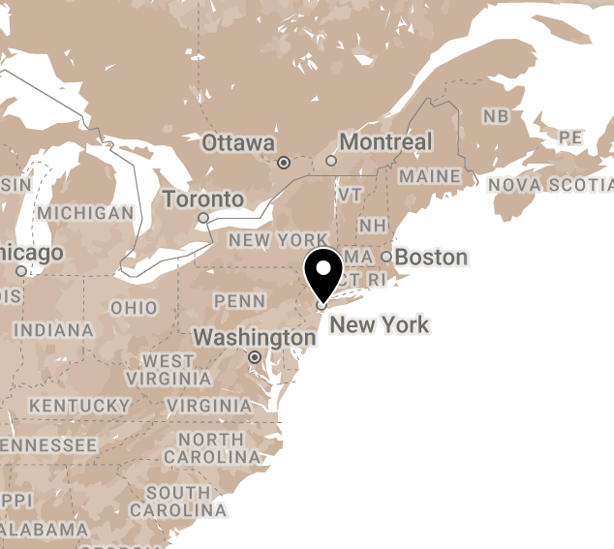
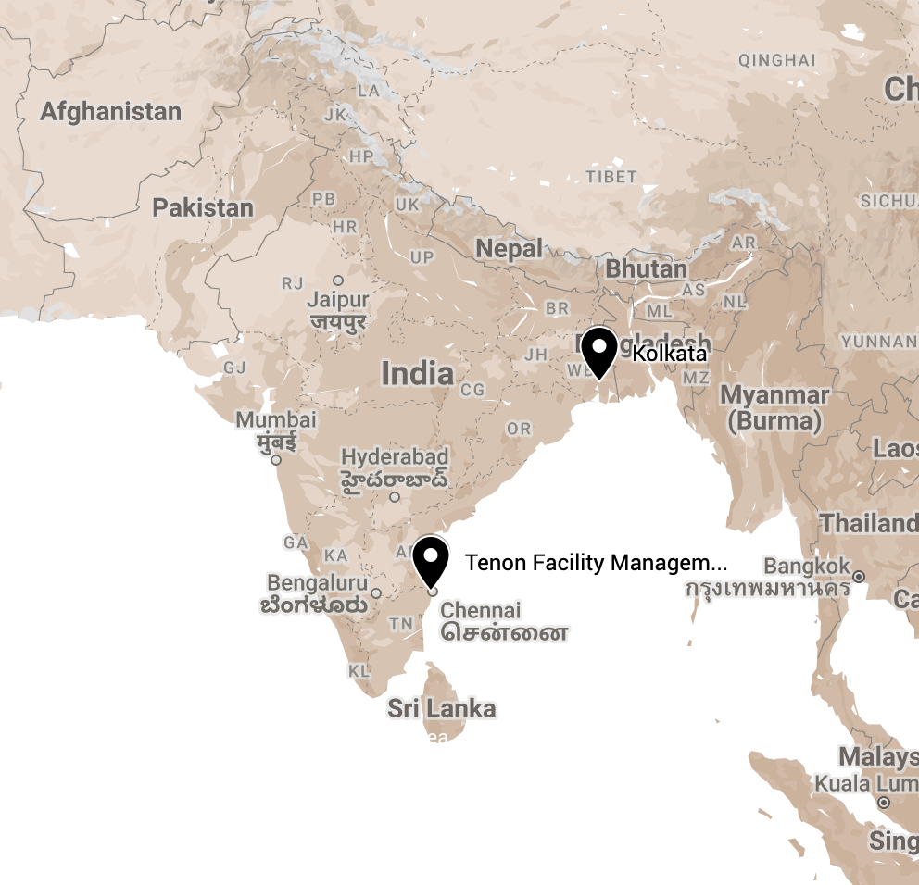
ESGO Accreditation in Training & Certification
80 centres accredited for Training in 24 countries
FELLOWS Current: 117 Certified (since 2020): 41
Notes:
Last update 15.1.2024
Newly accredited - Memorial Sloan Kettering Cancer Centre, NYC, USA - accredited in training in 2023

Slide 6


Slide 7
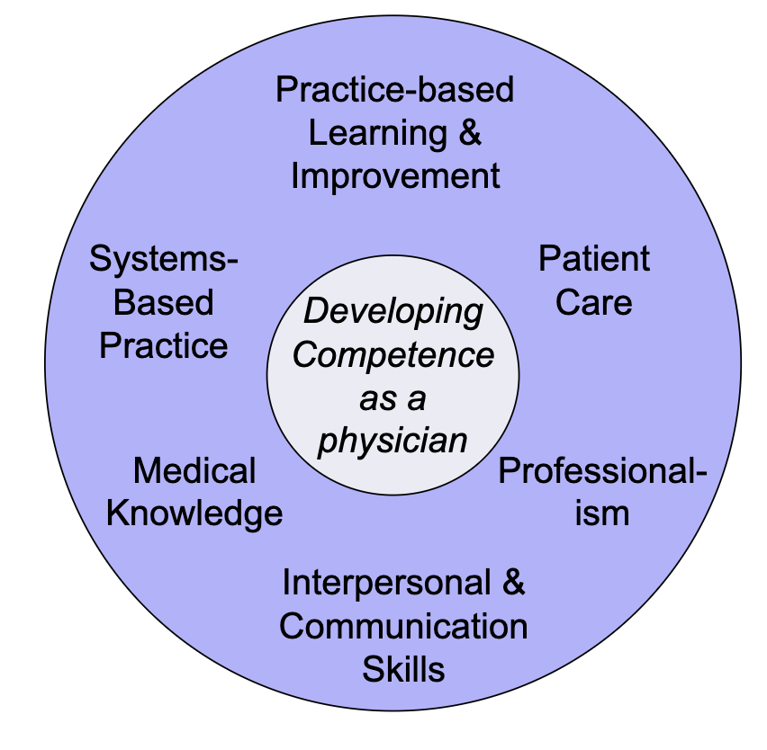
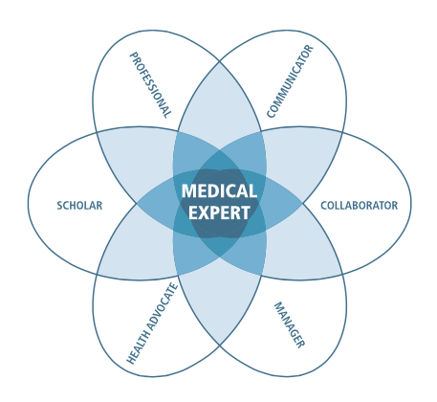
Why still ACGME competence framework ?
AGCME competency framework:
1st ACGME by ESGO consensus, no new consensus rounds
2nd both frameworks similar
3rd change to CanMEDS = reformatting on-line logbooks
4th change to CanMEDS = rephrasing just finished Curriculum
(UEMS requirement for CanMEDS not yet published!)
5th ........ we are preparing for a SHIFT:
from competence based training,
to outcome based training ..........
CanMEDS competency framework:

Slide 8
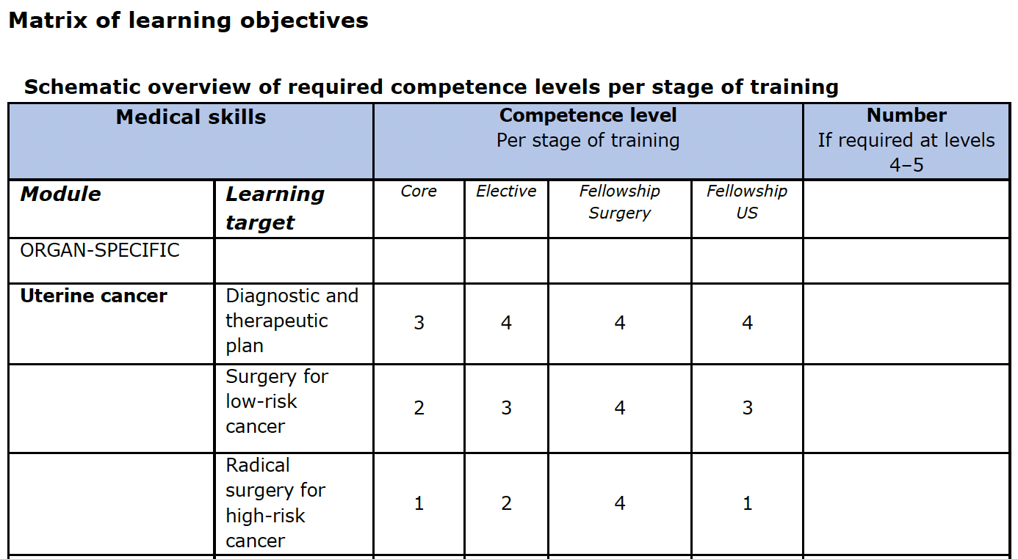
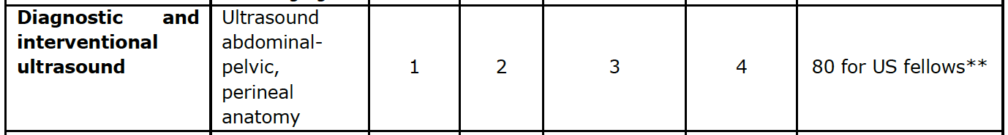
special interest module
      Introduction modular certificate:
    ‘diagnostic and interventional ultrasound’
etc. ...
etc. ...

Slide 9
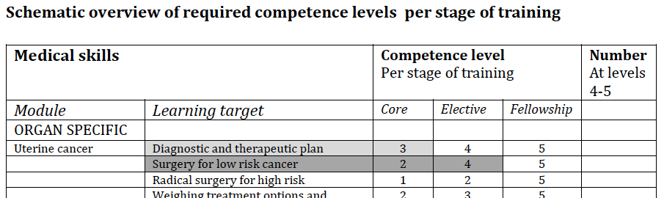
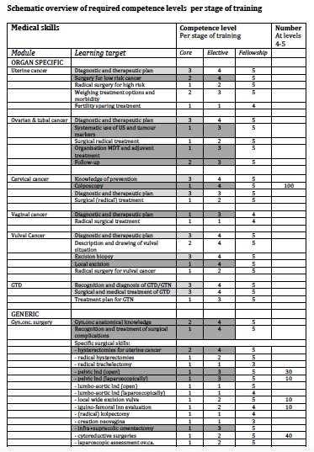
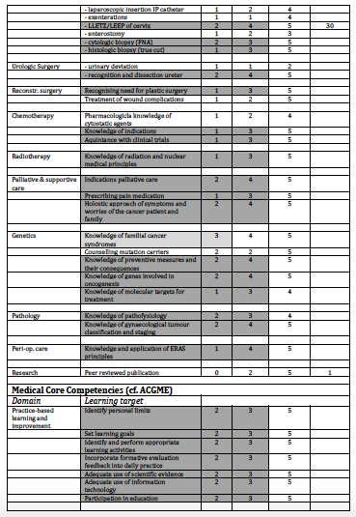
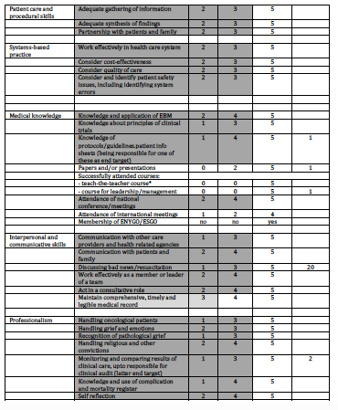
2020 REVISED Curriculum:
PORTFOLIO:
Formative assessments: repeatedly (competence, skills)
Summative assessments: regularly (proficiency)
Documentation (procedures, courses, publications etc)
COMPLEX, BUT DIGITALISED !

