Slide 1
New UEMS ETR Terms of Reference, Template and Timeline Documents
Report of the ETR Review Committee
Working Group
Presentation of new ETRs
Nada Čikeš and Ute Moog
UEMS Advisory Board meeting and Council meeting
Brussels April , 2025

Slide 2
Tasks of ETR RC from UEMS announced at the Council meetings in April and October 2024
To strengthen the plans of ETR RC working group(s) ✔︎
Revise – modernise the ETR Template structure ✔︎
to support writing and proposing new ETRs
in accordance with CBME
To revise the ETR Review and Approval Process Timeline ✔︎
Revise the Terms of Reference for ETR RC → roles/responsibilities of the ETR RC ✔︎
To invite /communicate with UEMS Sections and Boards in writing/revising ETRs ✔︎
To support the collaboration of UEMS Sections with European scientific societies (ESS) and national societies when writing and proposing new ETRs (✔︎)
Create atmosphere based on principles of transforming education to strengthen health system – we are trying

Slide 3
Work of the ETR template and Timeline Working group - report
All information @ uems.eu/european-training-requirements
Documents
UEMS ETR template incl. preamble (UEMS 2022/30)
Practical approach in managing overlapping competency & knowledge in ETRs
ETR RC Terms of reference (v3, 2021)
ETR Timeline (2021)
CBME terms and definitions_240924
Members:
Ute Moog, leader
Nada Cikes
Arthur Felice
Paolo Ricci
Pedro Lara Jimenez
Sarah Verhayen
Leila Niemi – Murola
All documents reviewed ✔︎
Leading question when revising ETR documents
How can we better support UEMS bodies writing/revising ETRs?
Notes:
Leading question:
How can we better support UEMS bodies writing/revising ETRs?
What have you been missing when writing/revising your ETR?

Slide 4
UEMS ETR Review Committee (RC) - Terms of Reference
Most important changes
Composition: ≥ 8 members: UEMS Vice President, 6 medical specialists preferably from different groupings, administrator from Brussels team;
RC elects one of the members to be the chair
Duties: each ETR reviewed by ≥ 2 RC members, 2 mandatory RC meetings according to timeline
Communication between UEMS Enlarged Executive and RC better structured
Clarified how to proceed in case of unsettled issues raised during the review or between several UEMS bodies involved in an ETR

Slide 5
Framework and Challenges I
Study on the ETR Implementation in the UEMS countries
Survey sent to the National medical associations (NMAs) (2022 and 2023)
Data analysis
1st UEMS Conference on Medical Specialists’ Training in Europe: ETRs guiding towards a new era (Brussels 20 April 2023)
Panel discussions on Competency Based Medical Education
Lancet Commission document: Health professionals for a new century: transforming education to strengthen health systems in an interdependent world- https://www.thelancet.com/article/S0140-6736(10)61854-5/fulltext
WFME Global Standards for Quality Improvement: Postgraduate Medical Education, 2023
WHO Global strategy on human resources for health: workforce 2030, WHO 2016
Policy options …. cooperation on health workforce education,….. education policies….
Global milestones (by 2020): All countries have established accreditation of health training institutions.
ACGME Common Program Requirements (Residency), 2023 etc…….

Slide 6
Framework and Challenges II
Implementation of Competency-Based Medical Education
“…..As a new paradigm, CBME will result in a dramatic shift in the way physicians are trained
We must ensure……… that medical education and postgraduate training systems continue to meet the needs of our Patients…²
Methods of assessments
EPA – Entrustable Professional Activities
²http//canmeds.royalcollege.ca/

Slide 7
ETR Template Structure – procedure
Review of preamble → unchanged
Review of Template structure → expansion while maintaining 3-part structure: Requirements for trainees Requirements for trainers Requirements for training institutions
Review, completion and reinsertion of definitions
Link to Competency-Based Medical Education (CBME) to integrate CanMEDS-competencies to include Entrustable Professional Activities (EPAs)
Extension of explanations, in particular in trainers‘ and training centres‘ parts
→ Goal: Clinical Learning Environment

Slide 8
ETR Review and Approval Process Timeline
...
Whole review process, i.e. latest date submission draft ETR to UEMS Council 4 months
1st obligatory meeting ETR Review Committee (RC) in the month following submission of ETRs

Slide 9
ETR Review and Approval Process Timeline
...
2nd obligatory meeting ETR RC in the month following submission of amended ETRs
* not in scheme, but has to follow: decision by UEMS EE on presentation at Council meeting

Slide 10
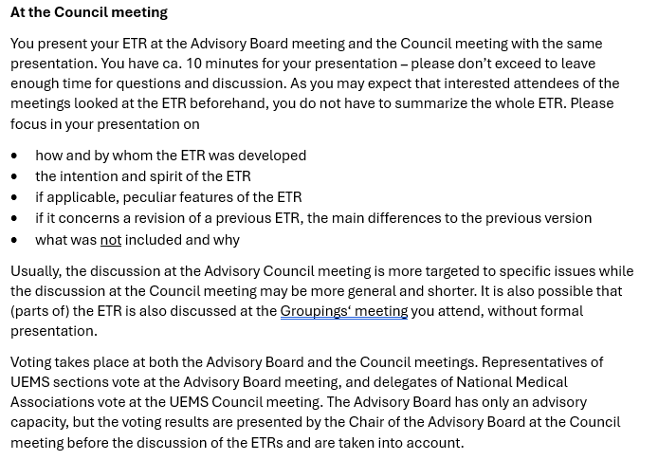
ETR Timeline - Explanatory Notes for Authors
.....

Slide 11
Managing Overlapping Competencies and Knowledge within ETRs
Most important changes
Difference between curriculum and syllabus
Principles of interaction between UEMS Sections: team spirit in true inter-professional collaboration should be the basis and overcome psychological, cultural and social barriers
Clue is dialogue and professional behaviour
Assessment of overlapping areas of knowledge and competencies: may differ between the Sections involved and are thus the responsibility of each Section
Notes:
next to editing

Slide 12
Future steps towards UEMS S&Bs and UEMS Members (NMAs)
To intensify the collaboration of UEMS Sections with European scientific societies (ESS) and national societies.
successful collaboration has successful ETR implementation in UEMS countries !!
UEMS Sections should invite ESS to collaborate in preparing new ETRs
UEMS member should be aware of UEMS dedication for ETR implementation in member countries
To reassure UEMS member have two national representatives to all UEMS sections, one of them with academic engagement
To establish Committee of all national delegates to UEMS bodies to connect with the stakeholders involved in the process of implementing the ETRs in their country
to support the broad national discussion on the future of specialty training with all stakeholders
5 countries with effective experience in CBME - could be role models for others

Slide 13
Review of ETR Template and Timeline
Still to do
Add links (Appendices) to general UEMS documents, e.g. documents written by TF Green and Sustainable Medical Practice or TF Equality, Diversity and Inclusivity, to ETR Template
Update of website @ uems.eu/european-training-requirements

Slide 14
ETR documents proposed for the UEMS Council meeting, April 2025
By January 23rd 2025 proposed were ETRs:
Professional Development Module for Anaesthesiology in Geriatric Patients
ETR for Child and Adolescent Psychiatry
ETR for Subspecialty of Gynaecological Oncology
ETR for the Specialty of Laboratory Medicine
ETR for Training in Paediatric Haematology and Oncology
ETR for the Specialty of Urology
ETR for Wound Healing
Review process ended 23rd of February followed by authors’ responses and corrections of the proposed texts

