Slide 1
The Office for EU & International Affairs
Brussels 26th April 2025
House of the International Associations

Slide 2
The task force on EU & International Affairs
a word of thanks to its members
Prof. Umut Akyol Prof. Hannu Halila
Dr. Andrew Brittlebank Dr. Marc Hermans
Prof. Nada Cikes Prof. Romuald Krajewski
Ms Isabelle Dumaine Dr. Naishadh Patil
suggestions
spreading ETRs externally => internationally represented
a dedicated page on the UEMS website
a newsletter
non-EU colleagues who passed the exams: UEMS ambassadors?

Slide 3
The task force on EU & International Affairs
EMOs’ meetings participated in or attended
EJD’s meeting in Prague (CZ)
CPME’s meeting in Amsterdam (NL)
EBCOG’s meeting in Leuven (B)
EACCME meeting in Brussels
Eur. Ass. of Hospital Pharmacists in Copenhagen (DK)
UEMO co-hosted meeting in the EU parliament

Slide 4
The task force on EU & International Affairs
activities participated in or attended
WHO Europe’s survey on mental health
addressing doctors and nurses in the EU
developing the questionnaire (EMOs, nurses’ associations)
invitations sent to NMAs & Sections
disappointing level of response ☹
a live contact in Copenhagen: apologies Tomas Zapata

Slide 5
The task force on EU & International Affairs
Stakeholders’ activities participated in or attended
Mental Health Europe in Brussels
International Longevity Association
European Observatory on Health Systems and Policies
many online webinars (available on Youtube© aterwards)
planned: deploying further contacts with WHO Europe
participating in AMEE 2025

Slide 6
Connections with the European Commission
Directive 2005/36EC • Recognition of Professional Qualifications
Directorate-General for Employment, Social Affairs and Inclusion
(DG EMPL)
Unit B.5
Professional qualifications & skills for competitiveness

Slide 7
DISCERN DSS
Development of training modules on digital soft skills for Indonesian medical universities

Slide 8
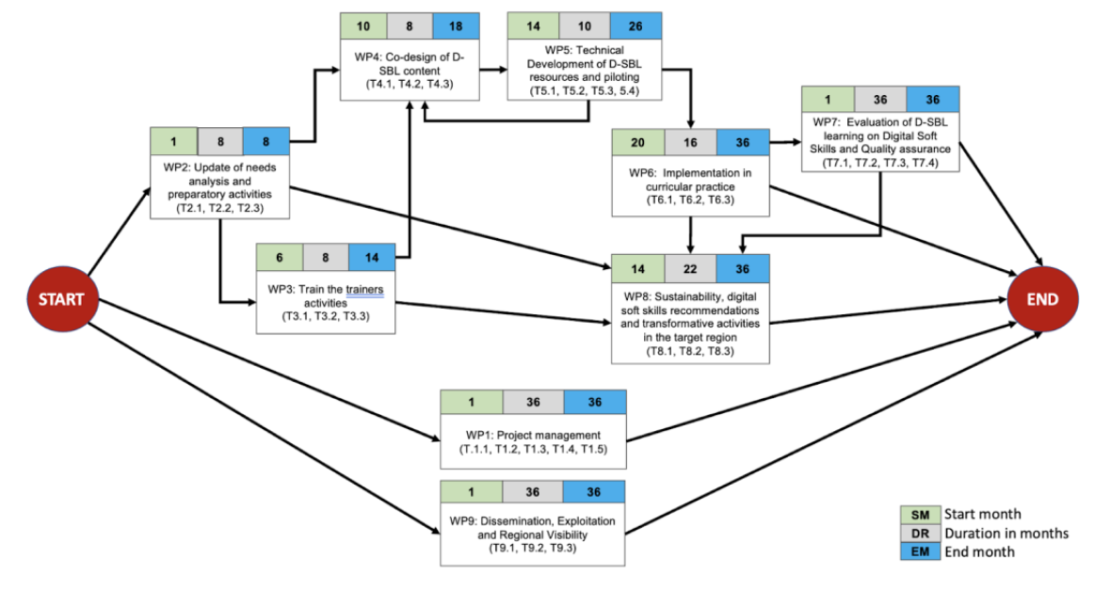
DISCERN DSS (Erasmus + Lump sum)
6 partners:
3 European (only UEMS as European organisation)
3 Indonesian (medical universities)
Jan. 2025
Dec. 2027
Grant = € 725,678
UEMS share = € 85,699
i.e. 11,8%

Slide 9
UEMS Activities in DISCERN DSS
Participates in all Work Package (WP)
Leader on 2 Tasks
Quality reviewer on 7 Deliverables
WP6 T6.2 Accreditation of the developed modules
WP8 T8.1 Development of Best practices
UEMS Office for Coordination in all WP
& Execution of WP1 & WP9
100% on UEMS Office for WP1 & WP9
Support for execution from experts in UEMS
WP2 / WP3 / WP4 / WP5 / WP6 / WP7 / WP8

Slide 10
Keepcaring
Development of tools & resources to support mental wellbeing of doctors and nurses in hospitals (surgery)

Slide 11
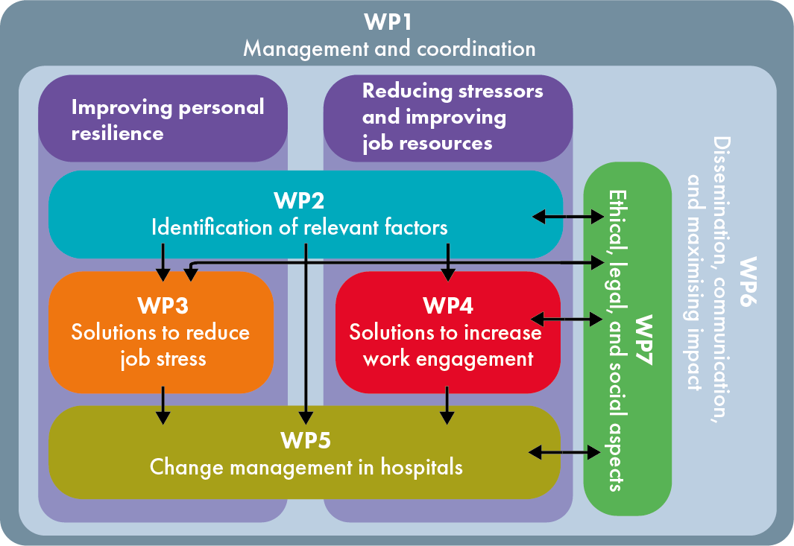
KeepCaring (Horizon Europe, Budget grant)
Work Packages
July 2024 – June 2028
Coordinator: University of Amsterdam
20 partners, incl. 3 European organisations
Grant = € 5,687,784
UEMS share = € 47,575
i.e. 0,8%

Slide 12
UEMS Activities in KeepCaring
UEMS Office for coordination
Office and Experts for execution
UEMS Office for coordination & execution

Slide 13
Training on budget for EU-funded projects
Practical outcomes for project coordination, and for finance management

Slide 14
Management of current EU projects
2 different programmes
Horizon Europe Erasmus +
Adapt reporting & finance approach in each consortium
2 different grants
Estimated budget
Lump sum

Slide 15
The task force on EU & International Affairs
the Office as a politically oriented initiative
developing contacts with the EU parliament
addressing and meeting MEPs
providing documents
how can UEMS support you?
the actual geopolitical situation
sharing relevant philosophical-political insights

Slide 16
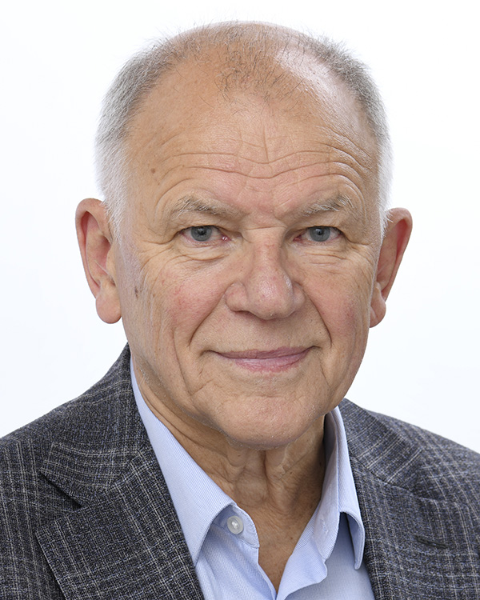
The task force on EU & International Affairs
the Office as a politically oriented initiative
developing contacts with the EU parliament
addressing and meeting MEPs
up until now
Dr. Vitenis ANDRIUKAITIS (LT)
stresses first aid education
disaster preparedness
supports a MEPs/EMOs platform?

Slide 17
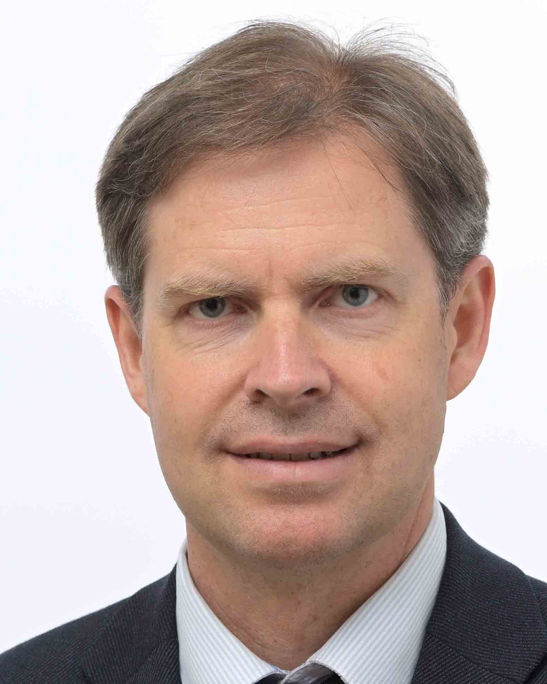
The task force on EU & International Affairs
the Office as a politically oriented initiative
developing contacts with the EU parliament
addressing and meeting MEPs
up until now
Mr. Ondřej DOSTÁL (CZ)
stresses first aid education
seems to support the platform

Slide 18
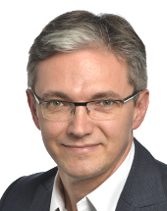
The task force on EU & International Affairs
the Office as a politically oriented initiative
developing contacts with the EU parliament
addressing and meeting MEPs
next Monday
Mr. Adam JARUBAS (PL)
Committee on Public Health

Slide 19
The task force on EU & International Affairs
the Office as a politically oriented initiative
interesting litterature
Michael SANDEL political philosopher
Timothy SNIDER historian
Kishore MAHBUBANI former UN ambassador for Singapore
Ray DALIO hedge fund administrator

Slide 20
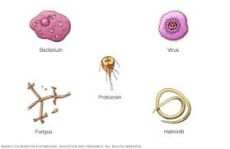
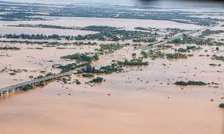
The task force on EU & International Affairs
the Office as a future oriented initiative
the four elements according to Empedocles & Aristotle
joined by
fire
water

Slide 21
The task force on EU & International Affairs
the Office as a future oriented initiative
disaster preparedness
promotion of resilience
by first aid courses for all citizens
safey measures, e.g. for IT infrastructure & software
regular training sessions
war preparedness for public services & Health Work Force

Slide 22
The task force on EU & International Affairs
the Office as a politically oriented initiative
medical litterature on disaster medicine
training courses & simulation sessions
e.g. Dr. Aivars VETRA’s proposal from Lithuanian NMA
but: too little experience in the EU
political will lacking: do not cause panick
Ukrainian colleagues can lear us a lot

Slide 23
The task force on EU & International Affairs
the Office as a politically oriented initiative
should UEMS engage in more concrete ways of support ???
Prof. Robert VAN VOREN (NL)
Federation Global Initiative on Psychiatry (FGIP)
www.fgip-global.org
supports wounded Ukrainian soldiers in LT
Mr. Luc ROMBOUT
international support coordinator for Rotary Europe

Slide 24
Thanks for your attention
Marc H.M. Hermans
Officer for European & Int’l Affairs
marc.uems@telenet.be

