Slide 1

Financial Report
UEMS Council – 25.04.2025 – MAI, Brussels

Slide 2

Profit and Loss account

Slide 3
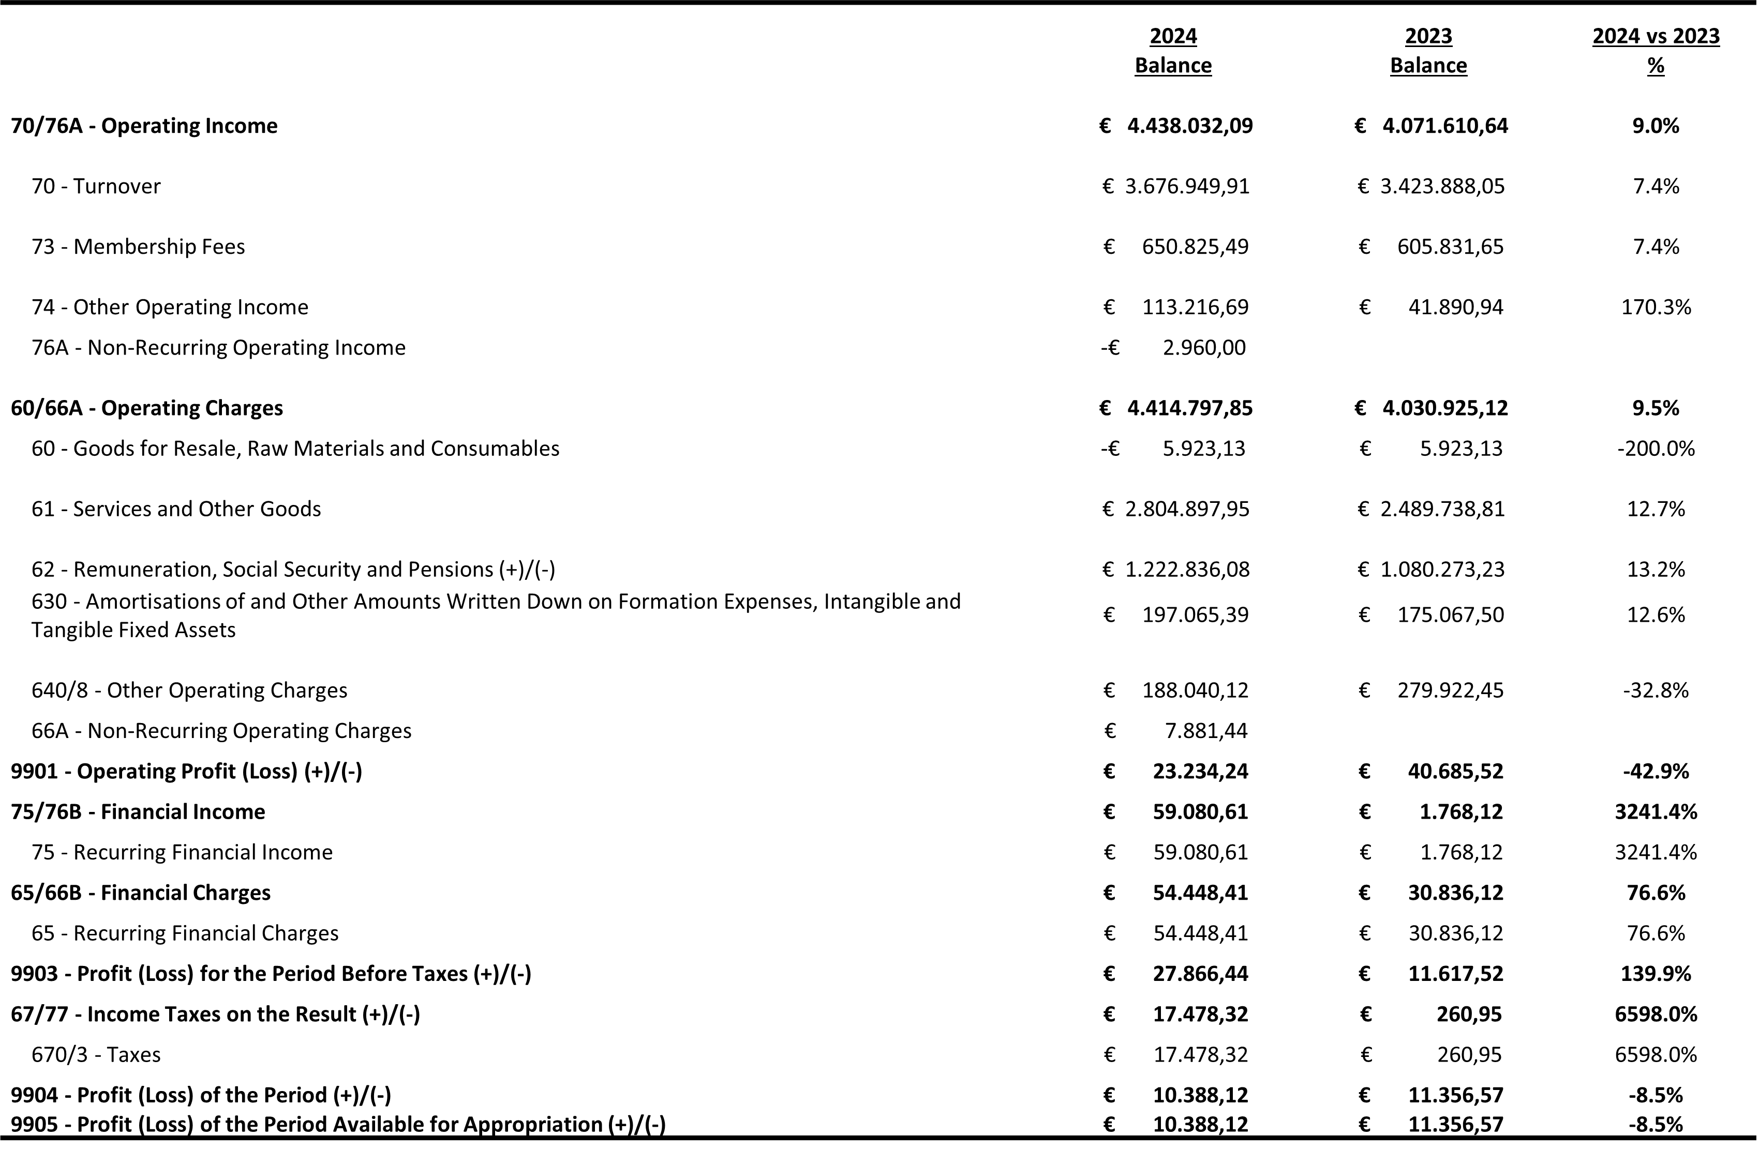
Figures for 2024 compared to 2023

Slide 4
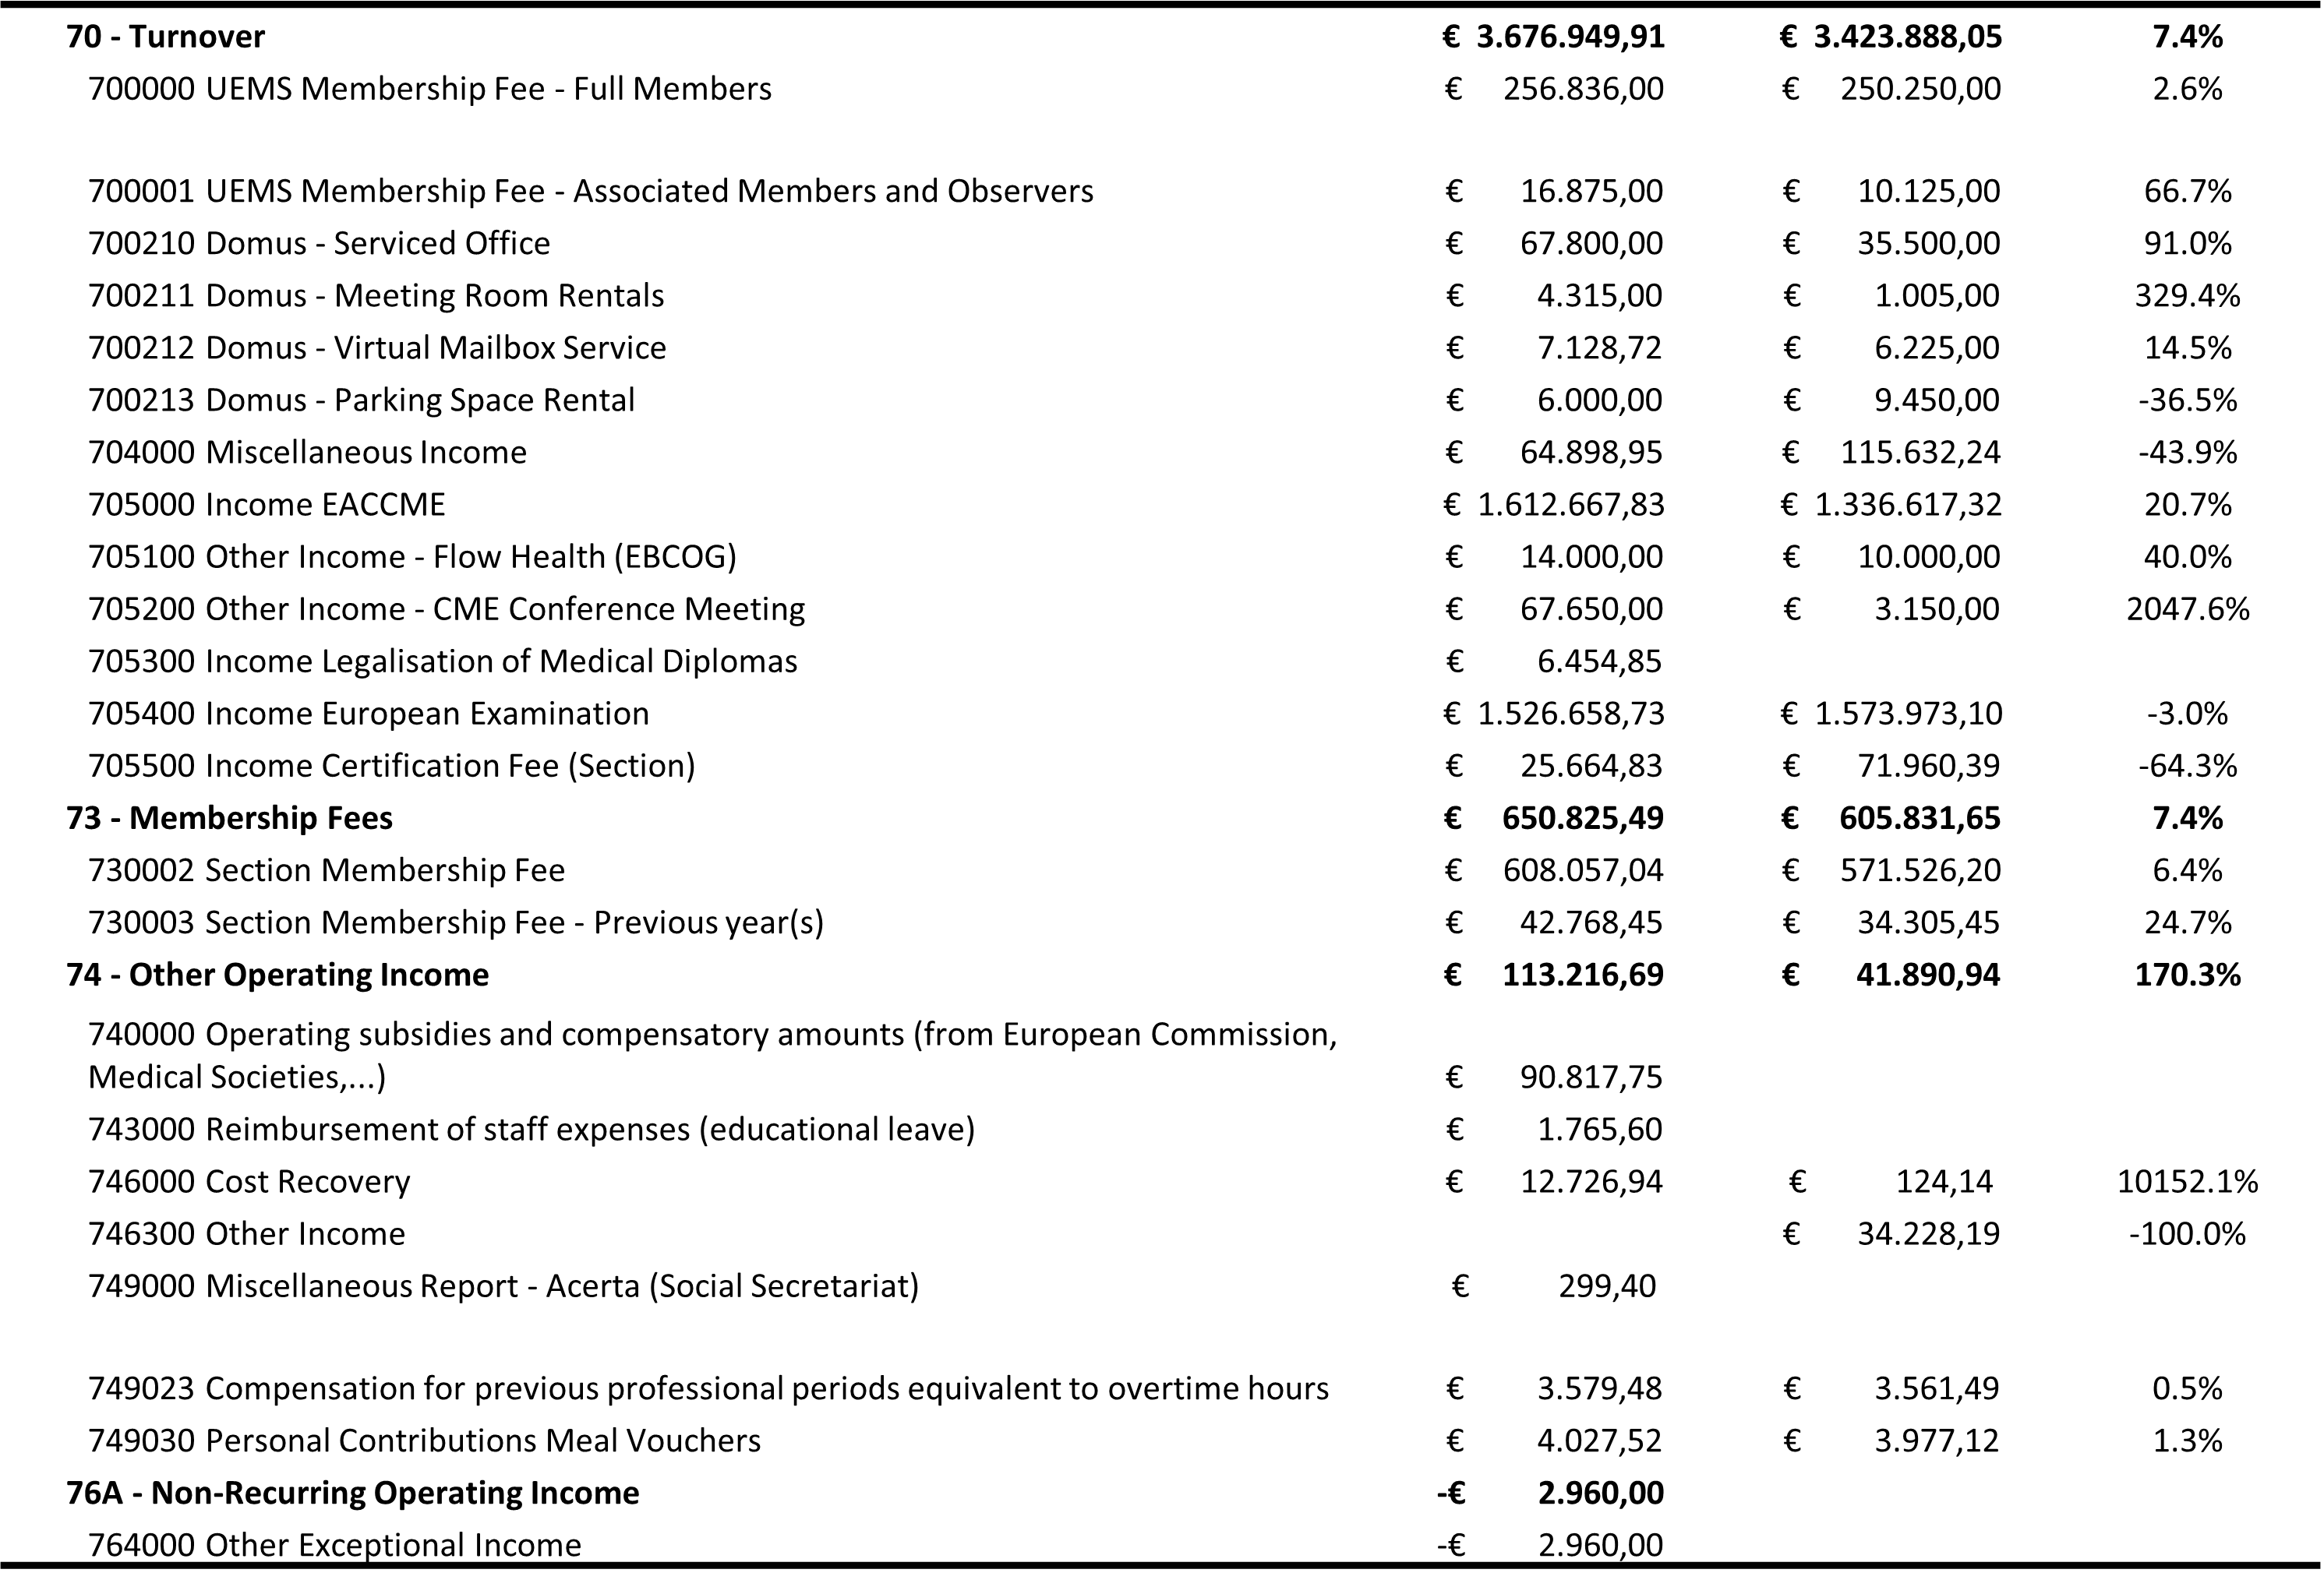
Operating Income

Slide 5
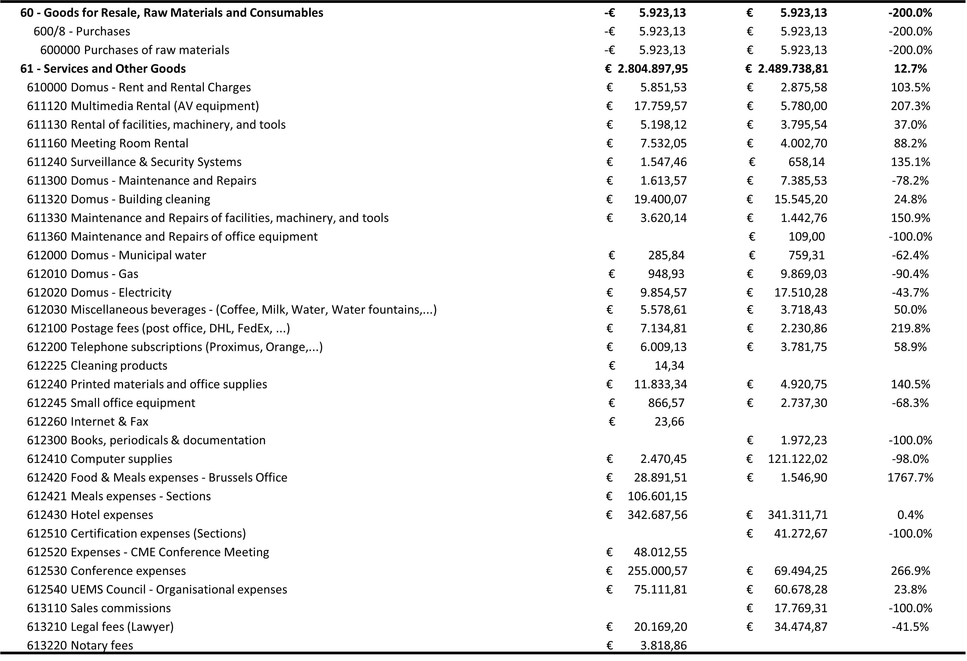
Operating Charges (1)

Slide 6
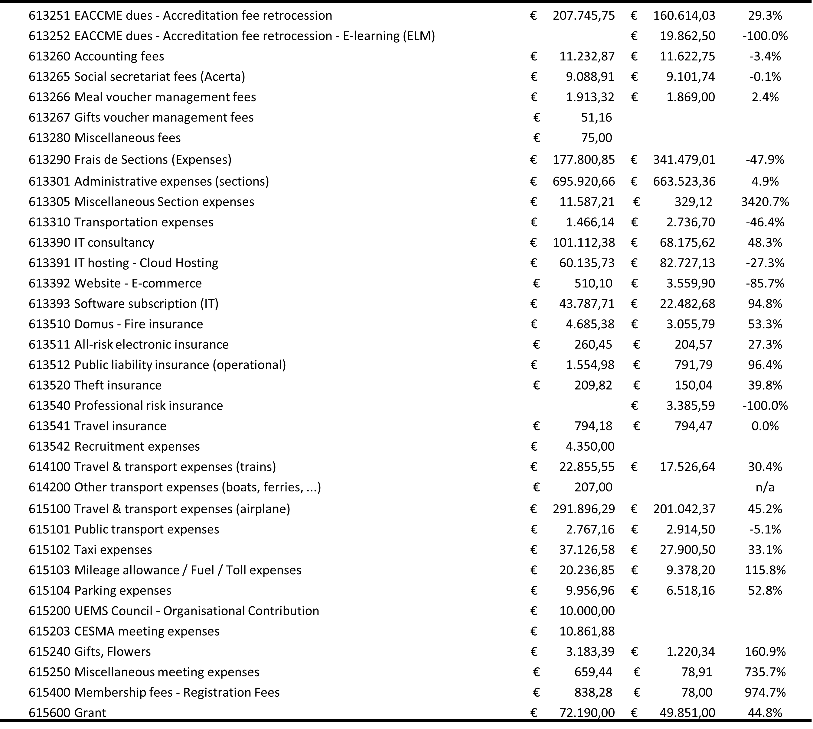
Operating Charges (2)

Slide 7
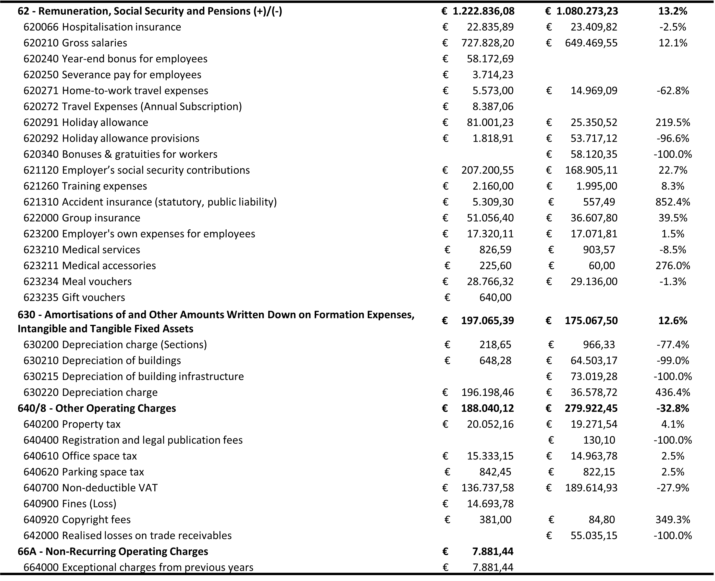
Operating and Other Charges

Slide 8
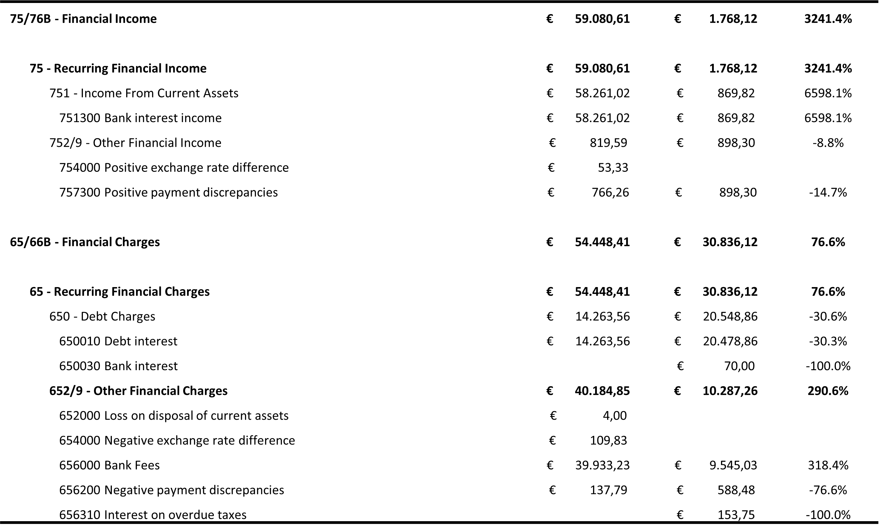
Financial Income and Charges

Slide 9
Balance Sheet

Slide 10
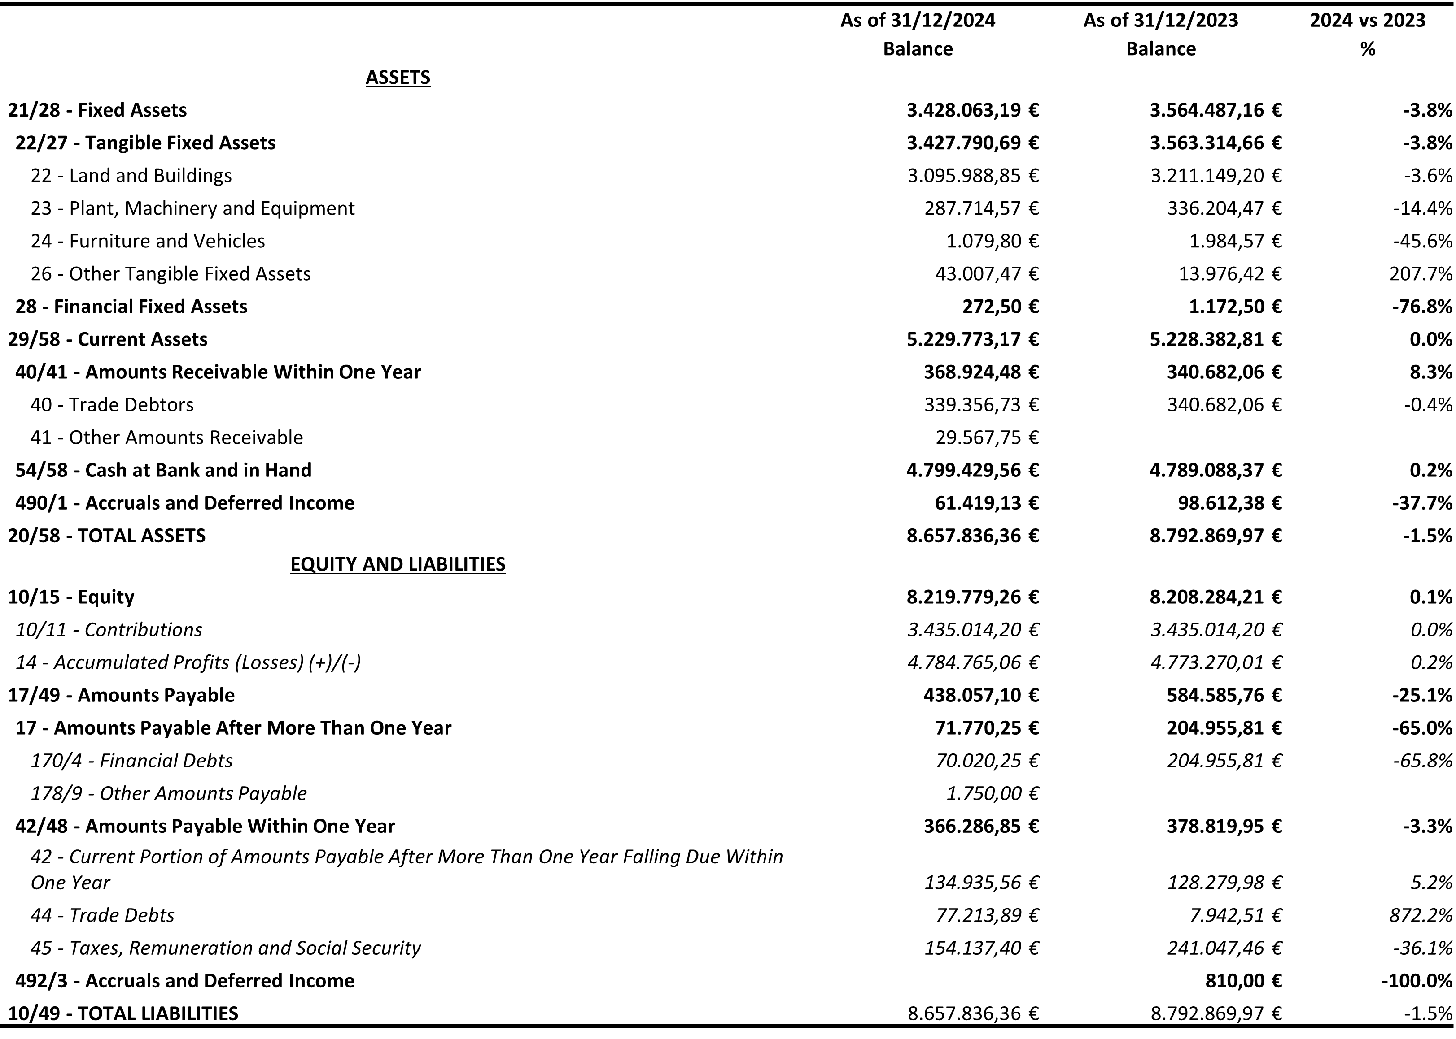
Figures for 2024 compared to 2023

Slide 11
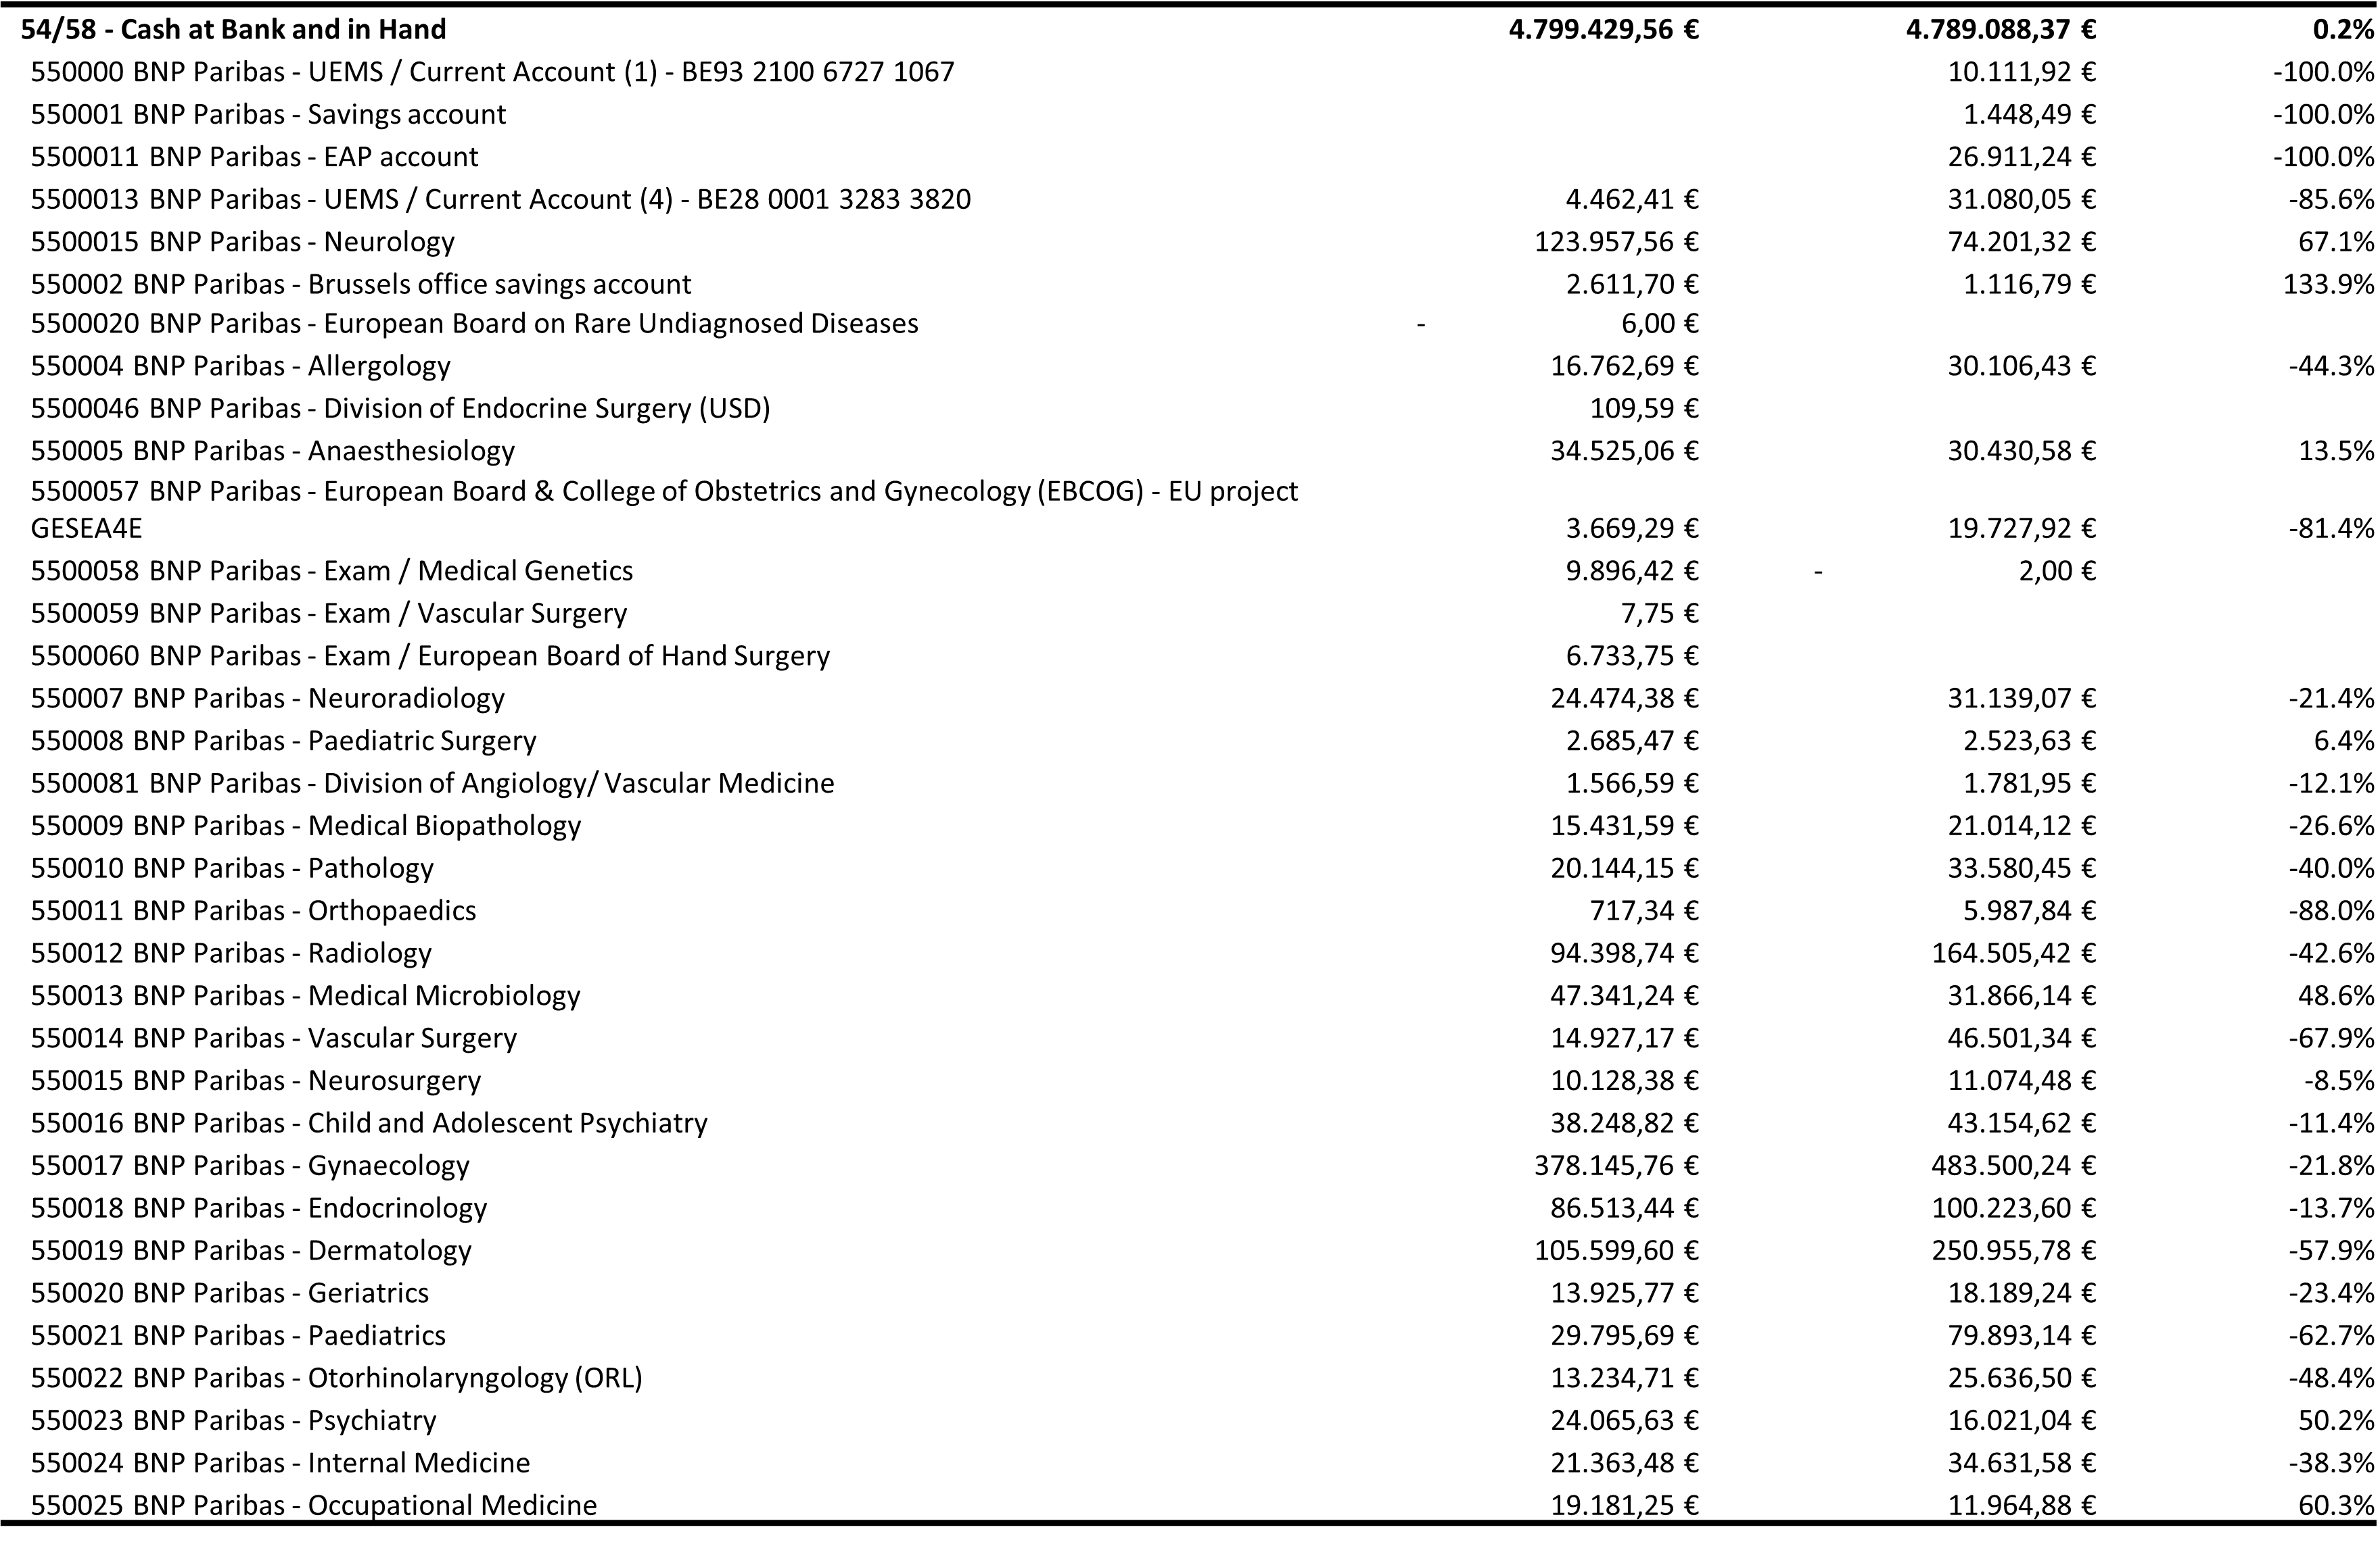
Assets (1)

Slide 12
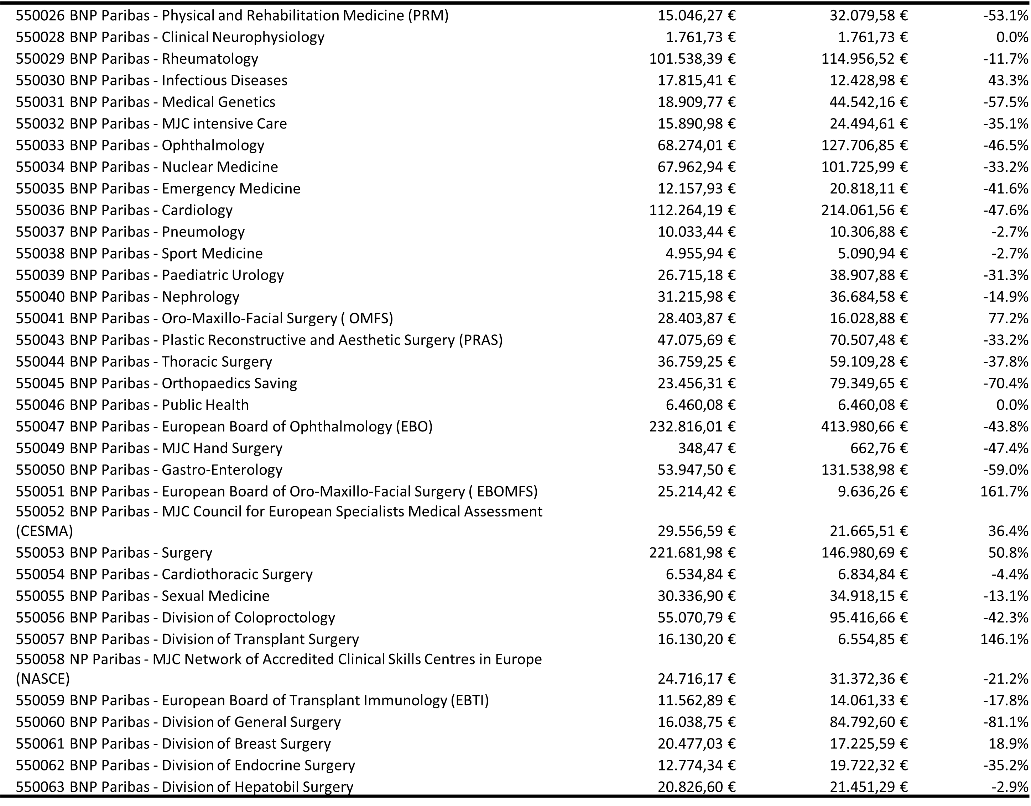
Assets (2)

Slide 13
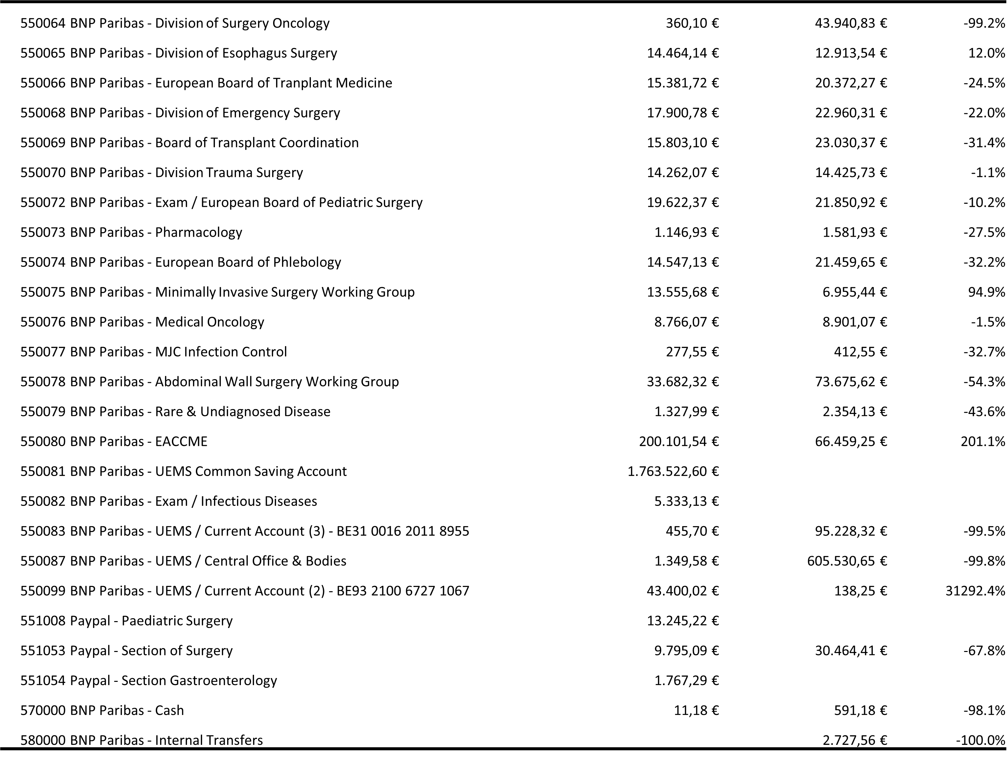
Assets (3)

Slide 14
Profit and Loss - Q1 2025

Slide 15
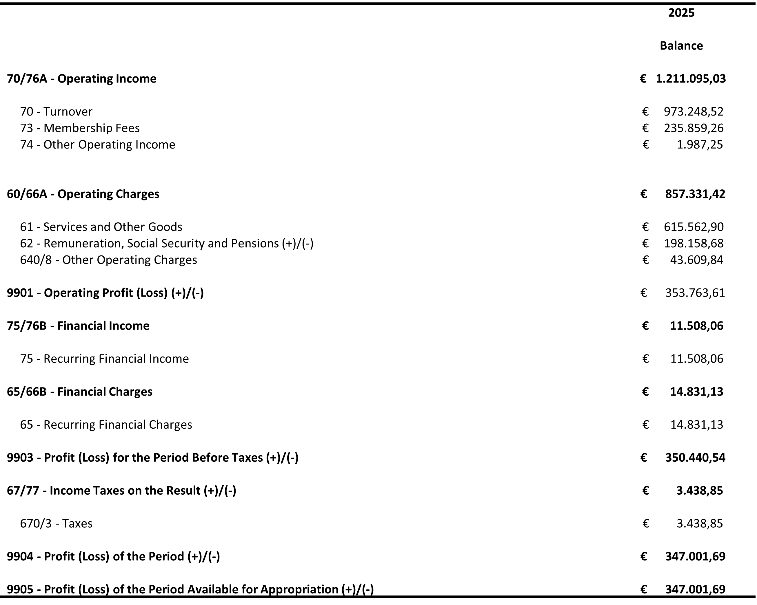
Figures for Q1 2025

Slide 16
UEMS Loan

Slide 17
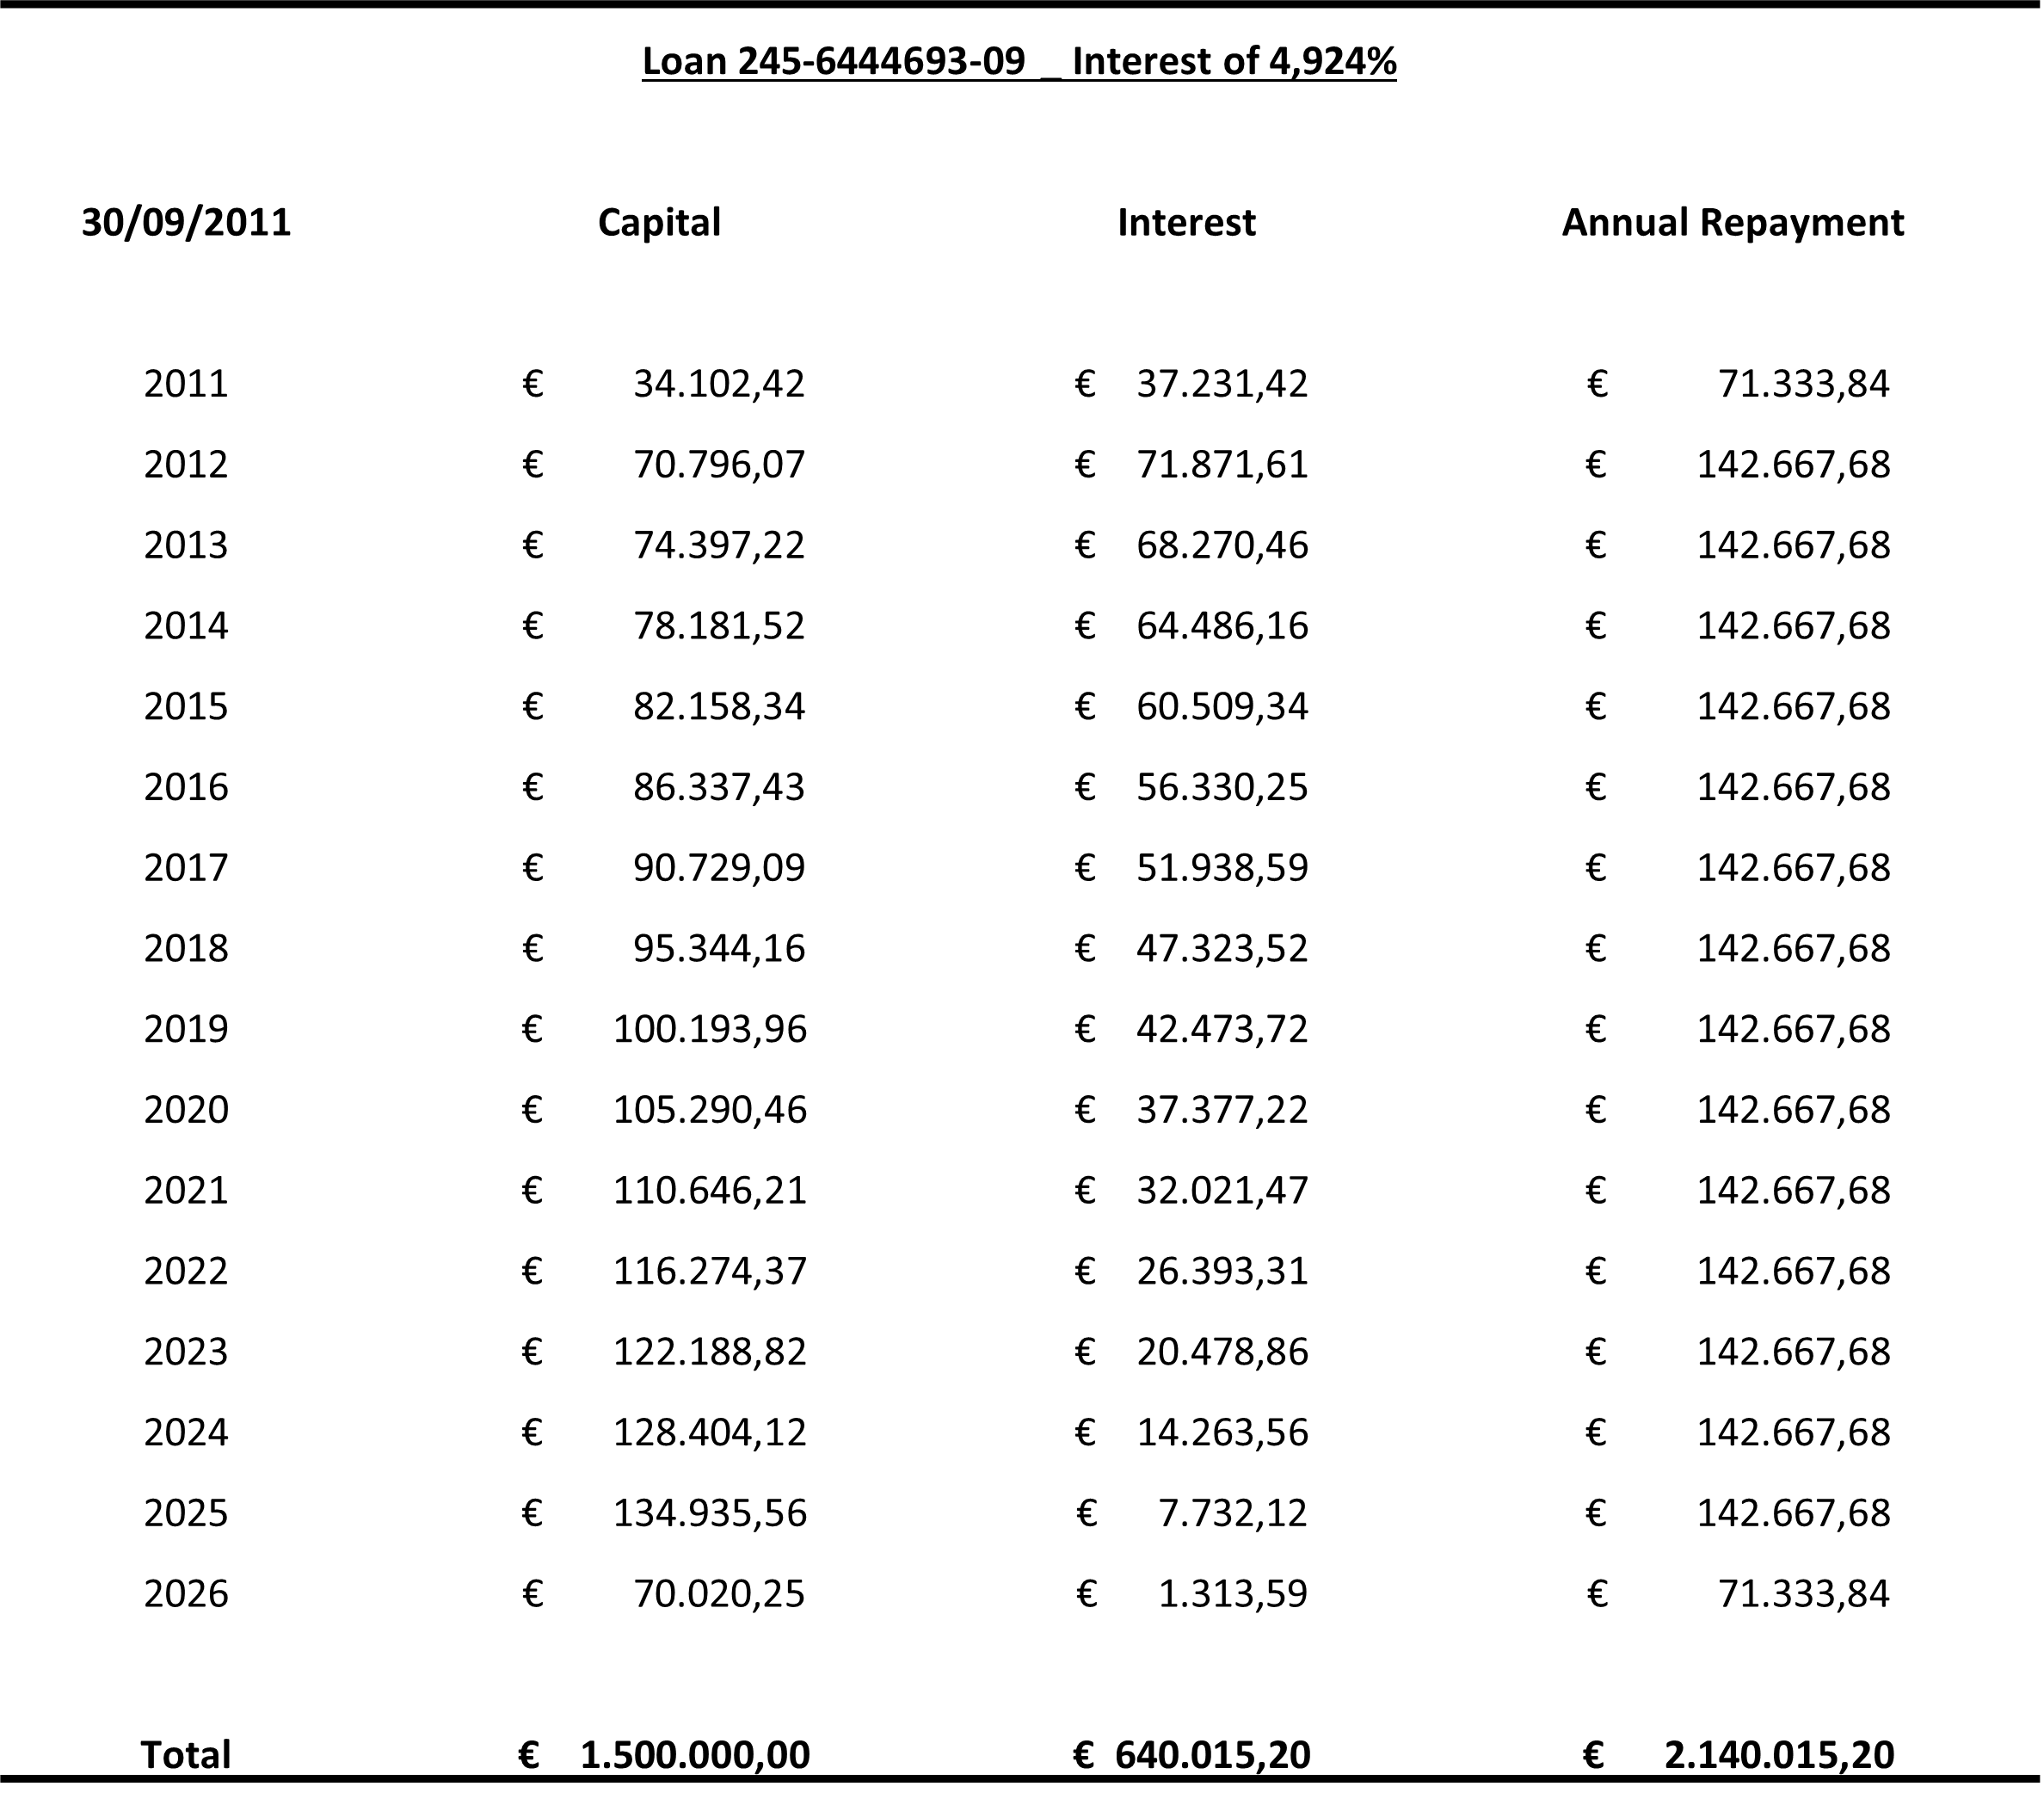
As of April 2025, only 5 quarters remain before UEMS is debt-free!

Slide 18
UEMS Common Investment

Slide 19
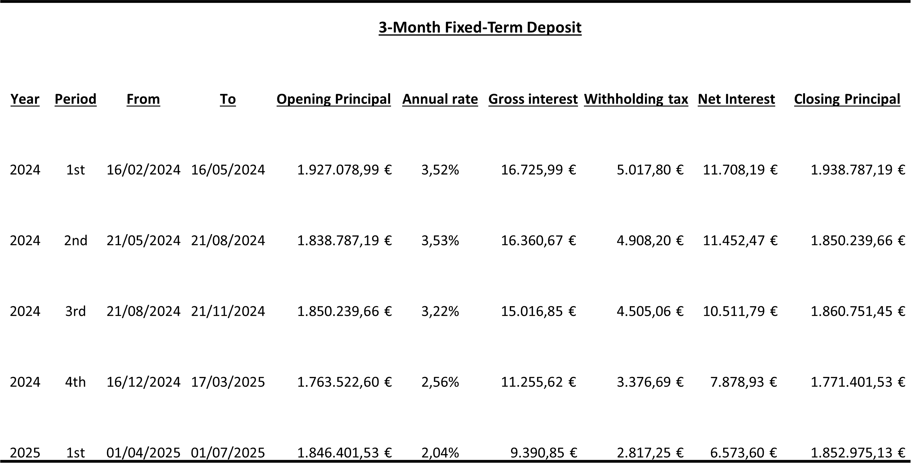
Our cash is working instead of sitting idle resulting in a 48.124,98 € bonus !

Slide 20
2024 – Key numbers

Slide 21
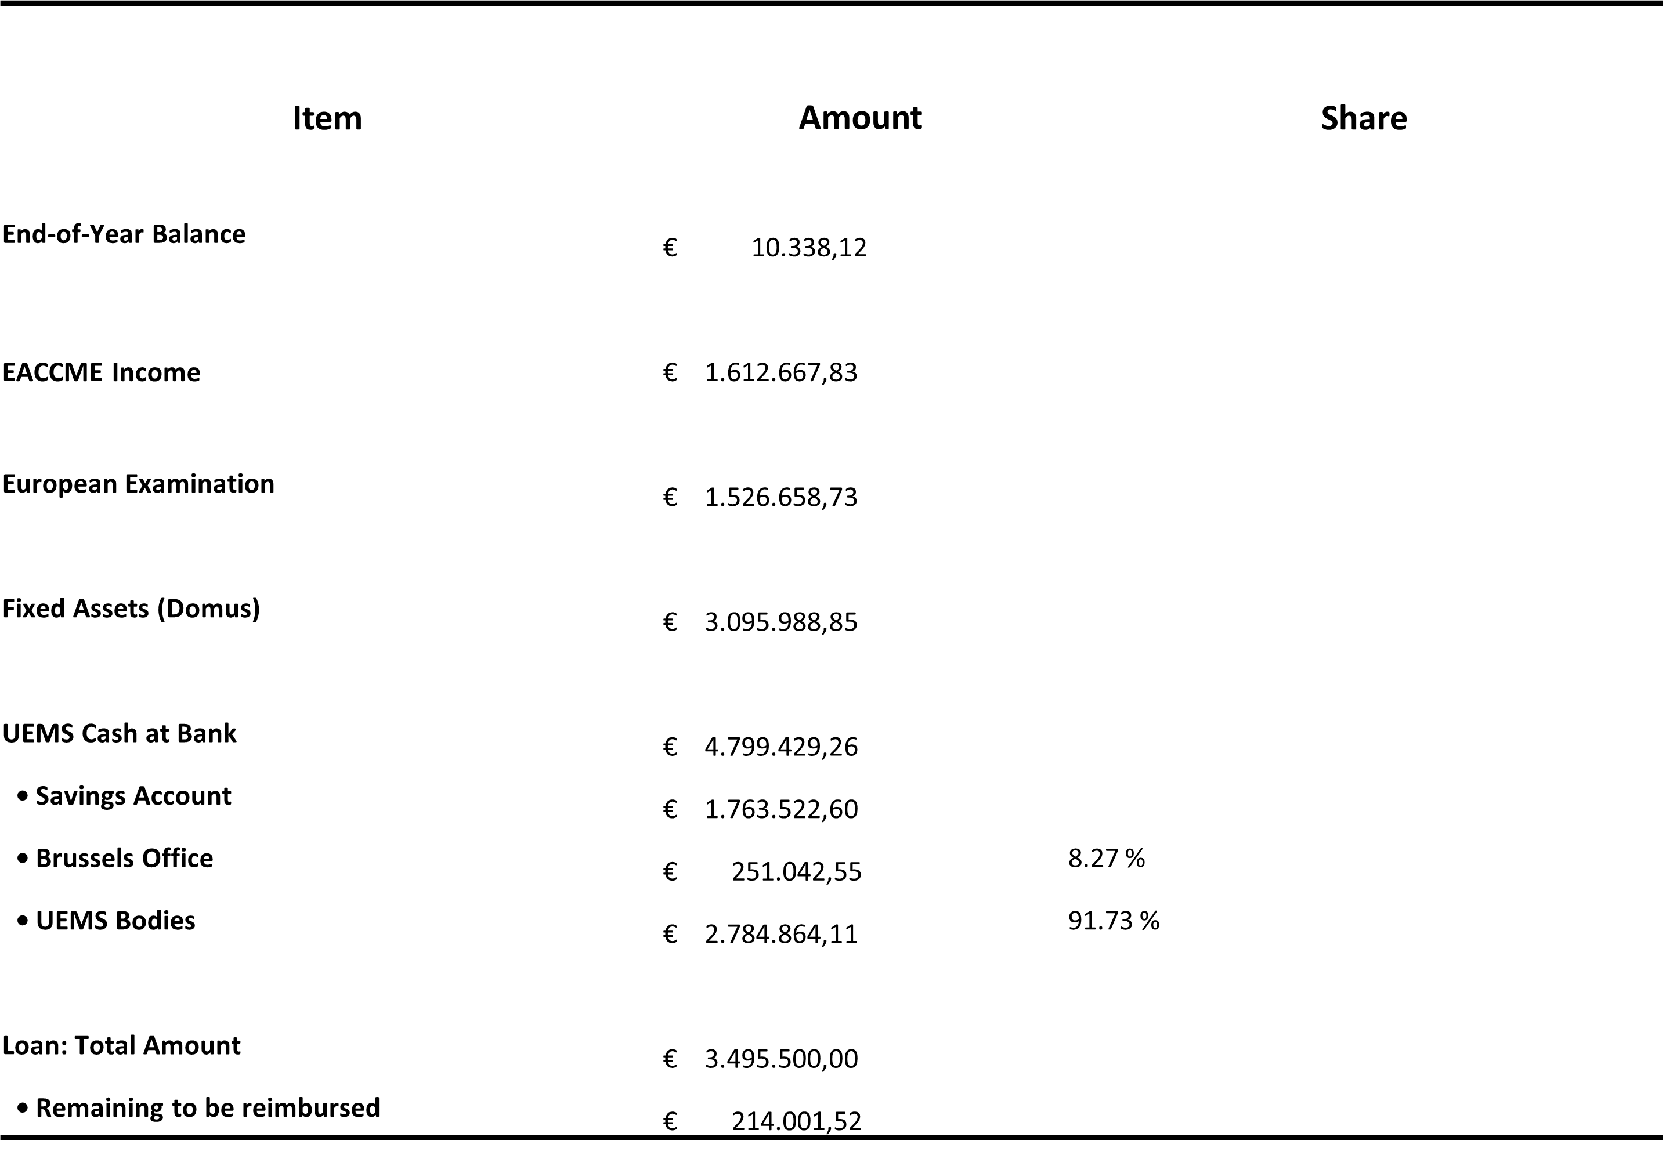
Key numbers to remember for 2024!

Slide 22
Financial Goals for 2025

Slide 23
Where there’s a will, there’s a way.
Common Investment
  Despite the drop-in interest rates, we will continue to invest in our joint investment.
  Each UEMS body is free to stop this investment or withdraw a partial amount.
  The Interest generated will be retroactively allocated to all UEMS bodies upon request.
Brussels Office Reserve
  The Brussels Office will continue to set aside €100,000 annually to reimburse the 6-Year Bond by mid-2028.
Environmental Investment
  The Brussels Office will explore the possibility of investing in environmentally friendly projects to generate interest, as requested by several UEMS bodies.
Loan Repayment
  As the last loan will be paid off soon, the Brussels Office will be in a better position to repay the EACCME dues to the Section.
  A repayment plan will be sent to the Treasurers in the coming months.

Slide 24
Questions and Answers

