Slide 1

Secretary General
Report
UEMS Council meeting
Brussels, April 26, 2025

Slide 2

Summary
EACCME
European Training Requirements
1st UEMS Congress
Domus Medica Europaea
UEMS Office in Brussels

Slide 3
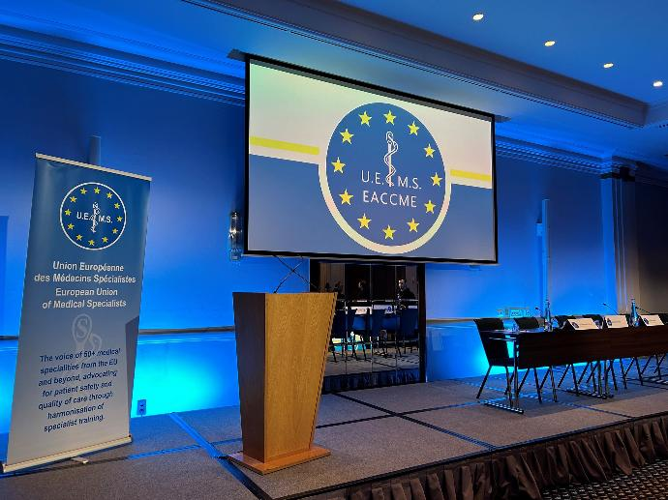
EACCME

Slide 4
EACCME – Strategic Developments and Agreements
New agreement signed with UEMO, allowing accreditation of CME/CPD events in General Practice / Family Medicine.
Extension of EACCME scope to include Dentistry.
Strengthened cooperation with European Society of Cardiology, SEAFORMEC, PhMA and ACCME (USA).
Ongoing dialogue to expand cooperation with other healthcare professions to foster interprofessional CME/CPD.

Slide 5
EACCME – 2024 Data & Trends
📈 General Growth
  2,735 applications processed in 2024 (+10.6% vs 2023).
  Reflects the consolidation of EACCME 3.0 and increasing institutional
  maturity of providers.

Slide 6
EACCME – 2024 Data & Trends
🧑‍🏫 Live Educational Events (LEE)
  2,244 applications in 2024 (vs 2,080 in 2023) — 2nd highest annual total ever.
  Monthly peaks: July (301), December (203), March (214), April (177).
  Confirms the enduring importance of in-person and hybrid learning formats.
📊 10-Year Growth Trend
  Nearly +50% increase since 2010 (from 1,524 to 2,244).

Slide 7
EACCME – 2024 Data & Trends
DIGITAL & BLENDED LEARNING FORMATS
💻 e-Learning Modules
  240 accredited in 2024 (down from 293 in 2023).
  Still above pre-pandemic levels.
  Reflects a post-pandemic rebalancing and the impact of stricter pedagogical criteria under EACCME 3.0.
📺 Webinar Packages
  52 applications – highest ever (vs 35 in 2023, 24 in 2022).
  Growing interest in structured thematic series.

Slide 8
EACCME – 2024 Data & Trends
DIGITAL & BLENDED LEARNING FORMATS
💻 📘 Scientific/Educational Material
  9 applications, stable compared to 2023.
  Supports critical appraisal and content validation processes.
🔀 Blended Learning
  21 applications in 2024 (vs 14 in 2023).
  Increasingly valued for pedagogical flexibility, especially in procedural and interdisciplinary fields.

Slide 9
International Cooperation – SEAFORMEC & PhMA Agreements (2024)
🇪🇸 SEAFORMEC Agreement (Spain)
  464 events accredited, over 4× the volume in 2019.
  273 LEE, confirming sustained post-pandemic growth.
  173 e-Learning Modules, slightly below 2023 but still high.
  18 Blended Learning applications (+50% vs 2022).
➡ Reflects strong engagement by Spanish providers and deeper integration of international CME standards.

Slide 10
International Cooperation – SEAFORMEC & PhMA Agreements (2024)
🇬🇷 PhMA Agreement (Greece)
  176 events accredited under the national collaboration framework.
  Integration of EACCME into Greek CME system shows growing alignment with European standards.
  PhMA decision to mandate EACCME accreditation for all CME events in Greece expected to boost future volumes.
➡ Reinforces EACCME as the reference framework for independent CME-CPD in Europe.

Slide 11
EACCME 3.0 – Operational Consolidation in 2024
⚙️ Internal Streamlining
  Optimised workflows and improved coordination across review and appeals.
  Updated guidance materials for providers to ensure clarity and consistency.
💬 Provider Communication
  Enhanced transparency and responsiveness to inquiries.
  Increased clarity in submission requirements and evaluation outcomes.

Slide 12
EACCME 3.0 – Operational Consolidation in 2024
⚙️ Systemic Improvements
  Aligned assessment criteria and reinforced consistency across reviewers.
  Strengthened internal mechanisms to support the growing volume and scope of applications.

Slide 13
EACCME 3.0 – Operational Consolidation in 2024
⚙️ Revised Fees Schedule
  Implemented on 1 January 2024, reflecting inflation and updated timelines.
  Contributed to improved applicant planning and more predictable review cycles.
🔐 “Trusted Provider” Status (Upcoming)
  Framework developed for providers with a strong compliance record.
  Will introduce simplified procedures while upholding rigorous quality standards.

Slide 14

European Training Requirements

Slide 15
European Training Requirements (ETRs)
✅ Framework consolidated with active support from the ETR Review Committee
  📄 5 ETRs adopted by the UEMS Council:
    Emergency Medicine
    Ophthalmology
    Orthopaedics & Traumatology
    Plastic, Reconstructive & Aesthetic Surgery
    Rare Neurological Diseases

Slide 16
European Training Requirements (ETRs)
🗳️ Documents submitted for approval:
    Professional Development Module in Anaesthesiology for Geriatric Patients
    Child & Adolescent Psychiatry
    Gynaecological Oncology
    Lab Medicine / Biopathology
    Paediatric Haematology & Oncology
    Urology • Wound Healing
🧭 New guidance: “ETR Terms of Reference & Timeline”
    Stronger focus on CBME and Entrustable Professional Activities (EPAs)
    Promotes transparency and harmonisation across specialties

Slide 17

1st UEMS Congress

Slide 18
1st UEMS Congress – Leuven, 2026
    📅 4-day event with keynotes, panels, workshops & thematic tracks
    27-30 May 2026
    🌐 Strategic platform for dialogue & visibility across UEMS and external partners
    🎯 Topics to include:
    Future of healthcare systems in Europe
    Specialist careers: training, equity & sustainability
    Achievements & aspirations in medical practice
    🧩 Showcases UEMS Sections, Bodies & partner organisations
    🛠️ Led by UEMS President with structured governance & full support from the UEMS Office

Slide 19

Finances

Slide 20
Financial Overview – 2024
📊 Stable financial management aligned with strategic goals
🧾 Full integration of Odoo across Finance & EACCME for improved tracking
💼 All obligations with external partners met: loans, contracts & commitments
💹 Joint investment strategy positively impacted results
🧮 UEMS registered a positive operational result, despite rising expenditures

Slide 21
Internal Audit & Recommendations
📅 Annual audit held at Domus Medica Europaea (19 March 2025)
✅ Auditors commended payment documentation & finance department performance
🤝 Suggested:
  Expansion of training & financial reporting within UEMS Bodies
  Continued treasurers’ coordination meetings
  Commissioning of an external audit now feasible via Odoo platform
📉 Noted: Disparities in UEMS Bodies’ reserves – recommend further reflection on balanced risk management considering potential fiscal exposure

Slide 22
Revenues & Membership Contributions
💰 EACCME revenue increased: €1.337M (2023) → €1.613M (2024)
  Growth reflects success of EACCME 3.0 and increased accreditation
🇺🇦 Proposal to waive Ukraine’s 2025 fee reaffirmed
🧾 UEMS manages 25,000–30,000 transactions across 80+ accounts
📍 2025 Budget & accounts to be presented by Dr Othmar Haas.

Slide 23
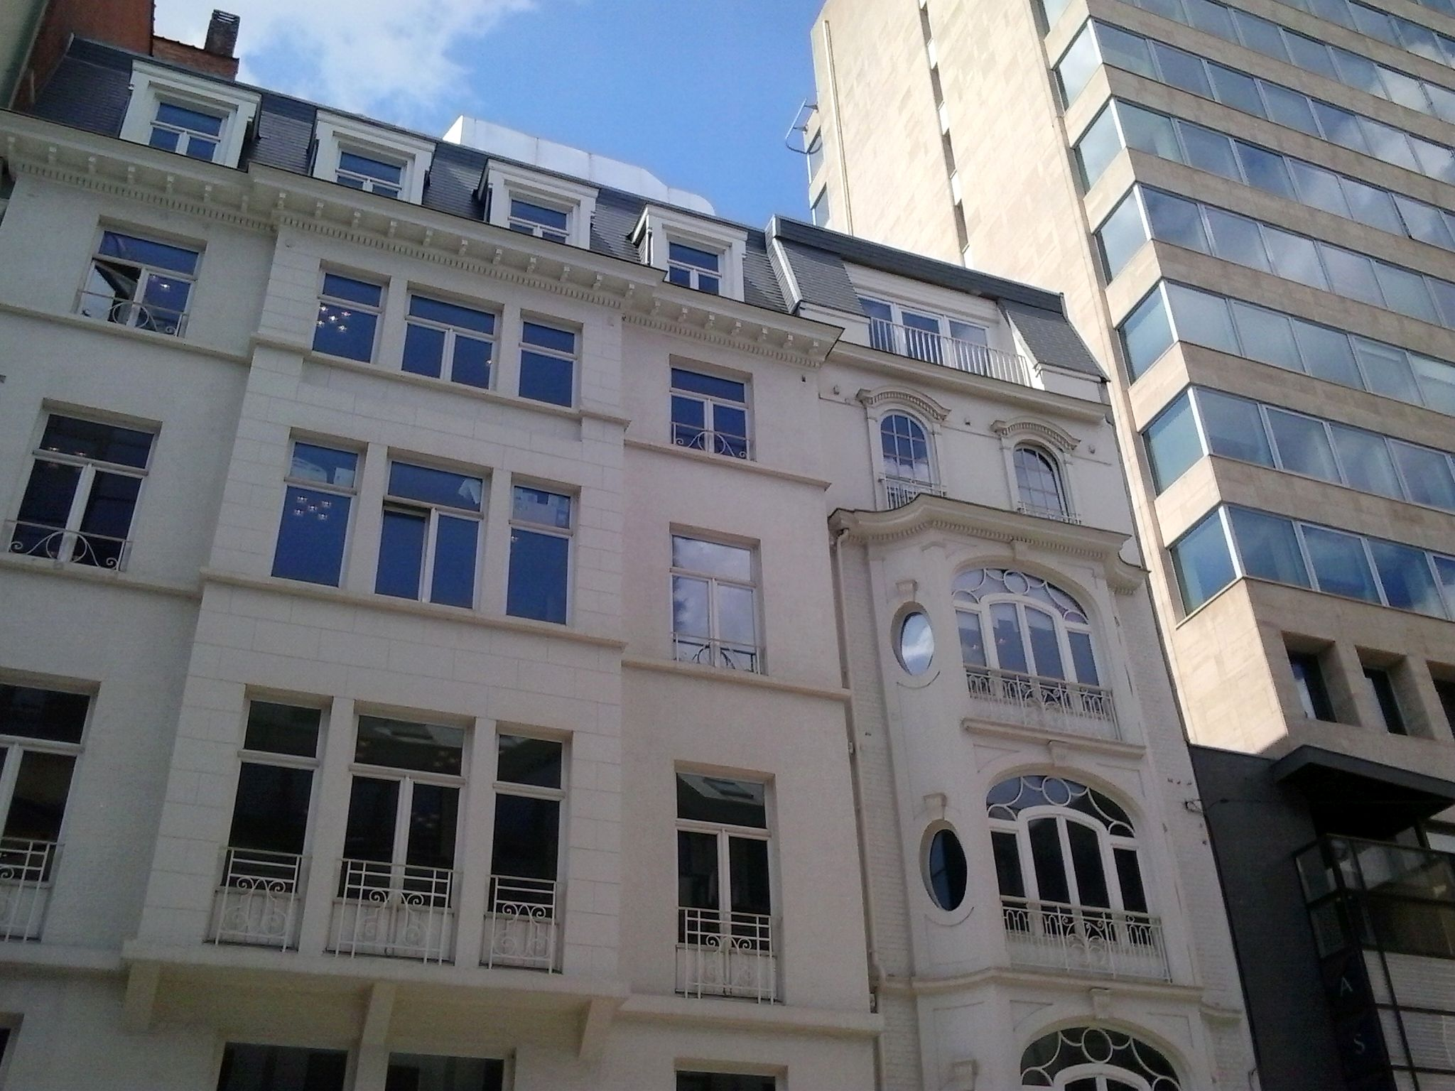
Domus Medica Europaea

Slide 24
Domus Medica Europaea

Slide 25
Domus Medica Europaea – 2024 Highlights
🧩 Strategic hub for UEMS and European medical organisations
🆕 New tenant: Cancer Patient Europe (CPE) joined in 2024
📈 Rental income up 43% – €103,561.15 for the year
🖥️ Smart camera system installed in main room → improved hybrid meetings
🏢 Full occupancy & growing demand for well-positioned office space

Slide 26
Operations & Strategic Value of the DME
🗓️ High utilisation of meeting rooms and parking facilities
🚗 3 parking spots rented externally; 6 for UEMS staff; 3 for visitors
🤝 Used by UEMS Bodies and external organisations alike
🌐 Supports visibility, networking and institutional influence in Brussels
💶 Income-generating asset contributing to UEMS sustainability strategy

Slide 27
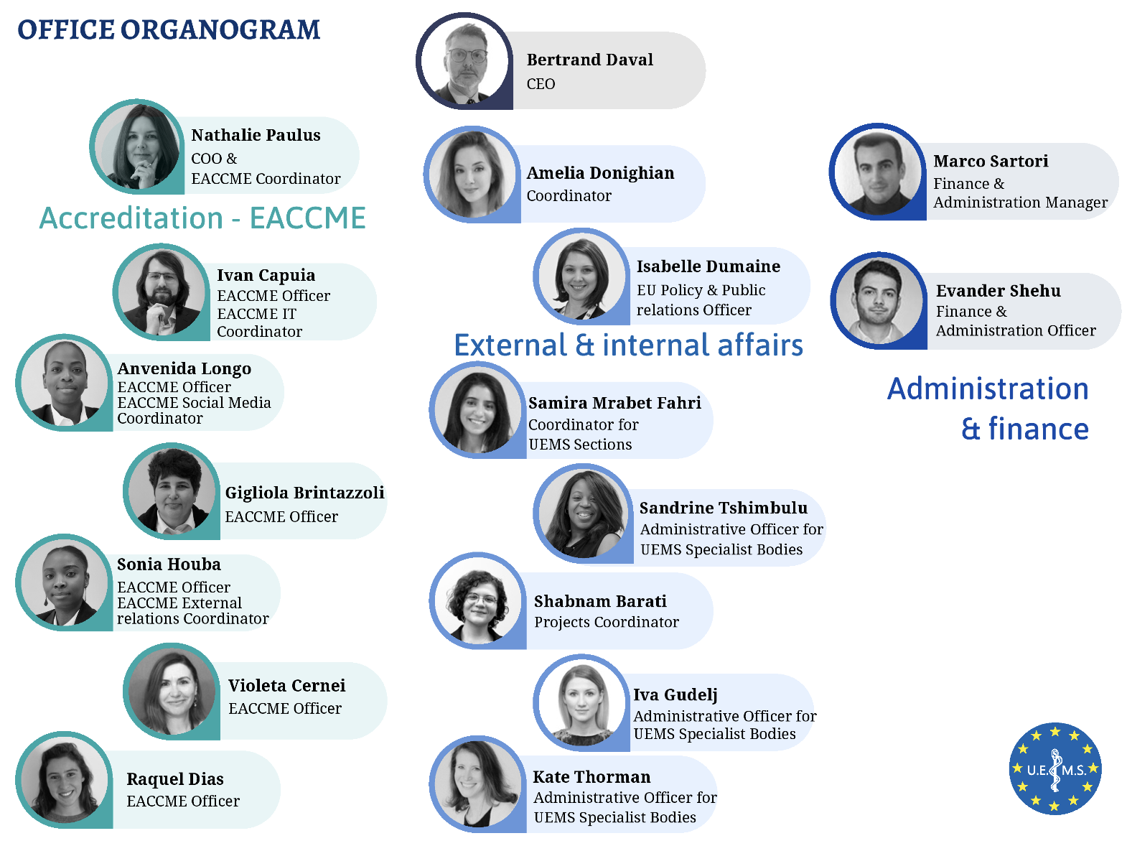
UEMS Office in Brussels

Slide 28
UEMS Office

Slide 29
UEMS Brussels Office – 2024 Overview
The UEMS Office staff reached 17 full-time and 2 part-time positions, corresponding to a Full-Time Equivalent (FTE) of 18.6, up from 15.3 in 2023.
The Accreditation Department remained the largest unit, with 6 full-time and 2 part-time staff (FTE 7.6).
The Administration and Finance team remained stable, comprising 2 full-time positions (FTE 2.0).
Administrative support to UEMS Bodies was strengthened with 3 internal staff members and 2 external collaborators (FTE 5.0).
The Coordination of Internal and External Affairs, including project management, was ensured by 3 full-time staff members (FTE 3.0).

Slide 30
UEMS Office – Changes in Staff Composition
Several long-serving colleagues left the organisation:
  Ms Deborah D’Agnese
  Mr Juan José Arraez Galinanes
  Ms Maud Carr
  Ms Aela Tréguier
  Ms Patricia Demeulemeester, who retired after nearly 12 years of dedicated service
  Ms Zahra Barati, whose contract concluded in October 2024

Slide 31
UEMS Office – Changes in Staff Composition
To meet growing operational demands, especially in the EACCME and UEMS Bodies departments, the following colleagues joined the team:
  Ms Raquel Vigário Dias
  Ms Violetta Cernei
  Ms Iva Gudelj
  Ms Kate Thorman
  Ms Sophie Gidikas (starting January 2025)
  Ms Alexandra Olteanu was recruited to support the Section of Surgery, working in coordination with Ms Samira Mrabet Farih.
  Ms Xénia Melo Acarin rejoined the team in early 2024 and is currently focused on managing SEAFORMEC applications.

Slide 32
Core Functions & Strategic Role
Throughout the year, the UEMS Office continued to provide crucial support in:
  The preparation and follow-up of Council, Board, and Advisory Board meetings
  The coordination of internal elections and ETR submission processes
  Institutional communication, including the UEMS website and internal newsletters
  Operational assistance to UEMS Bodies
A key milestone was the completion of the Odoo system rollout across the Finance and EACCME departments.
The Office remains the institutional and operational backbone of the UEMS, ensuring both continuity and agility in a growing and increasingly complex environment.

Slide 33
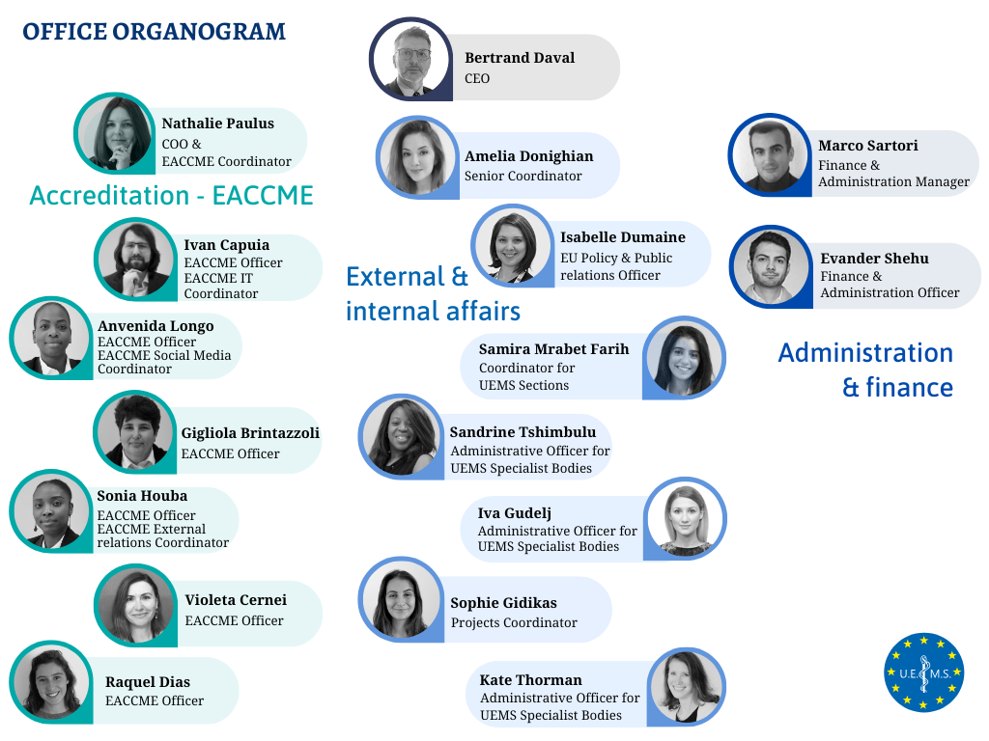
UEMS Office

Slide 34
Secretary General Report
THANK YOU!

