Slide 1
Proposed marking of MCQ’s & SBA’s
Weighting of Marking
Dr Morné Wolmarans
. Norfolk & Norwich University Hospital , Norwich, U. K.

Slide 2
Traditional Marking Schemes
Dichotomous models
One Correct Answer
3-4 Incorrect Distractors
Each incorrect answer has same score
Score is correct answers minus incorrect answers
May encourage guessing : A,B,C,D: 25% chance

Slide 3
Traditional Marking Schemes
Dichotomous models
Students think it’s easier.
Less fair because of each wrong answer is not the same difficulty.
? Introduce negative marking for incorrect guess
Neutral for “ I don’t know”

Slide 4
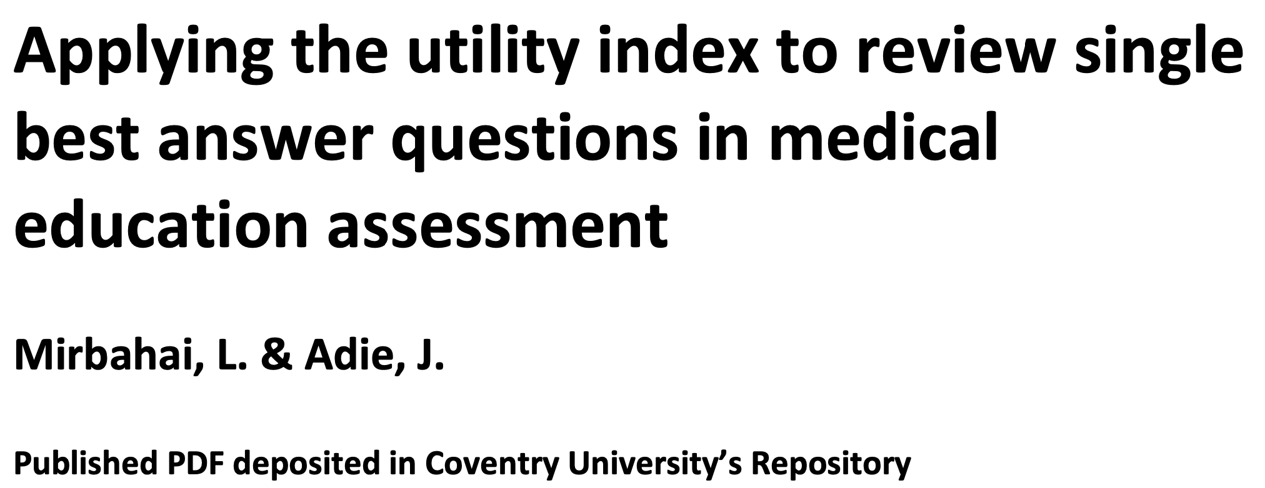
Good MCQ & SBA’s questions
Requirements
Dilligent construction
Clear / precision
Lingual simplicity
Clear pass/ fail standards

Slide 5
Defining Expertise
Excellence achieved with relative ease
Sees overall picture and alternative approaches
Authoritative knowledge of discipline
Recognises patterns
Able to take responsibility for going beyond existing standards
New movement patterns to deal with unique problems
Expert
Deep understanding of discipline and area of practice
Able to take full responsibility for own work
Routinely achieves acceptable standards
Sees the full picture
Modifys movement patterns to address difficulties
Proficient
Good working & background knowledge
Able to address most tasks using own judgement
Sees tasks at least partly in terms of longer goals
Quick, accurate, coordinated performance
Competent
Sees actions as a series of steps
Uncomplicated tasks completed at an acceptable level Working knowledge of key aspects of practice
Able to achieve some steps using own judgement Supervision needed for overall task
Skills habitual
Advanced beginner
Tends to see actions in isolation
Needs close supervision
Textbook knowledge
Skills more trial and error
Novice
Courtesy Prof. Graeme McLeod

Slide 6
Traditional Marking Schemes
Classic Test Theory models
One point for each correct answer
Result is the sum/ mean of points

Slide 7
Weighted Marking Schemes
Reward candidates that answer more demanding Q’s
Polyweighting
Assess depth of understanding
Analytical reasoning
More points for difficult questions

Slide 8
Weighted Marking Schemes
Importance / Difficulty / Complexity
Importance is related to how essential the subject within the curriculum : core area of training
Difficulty is related to amount of effort required
Complexity related to background knowledge required and thinking expected

Slide 9
Weighted Marking Schemes
How to weight an answer
Experts weighting
Faster / self-consistent ( multiple opinions)
Empirical weighting
mathematical method of average success or difficulty level
More objective

Slide 10
Weighted Marking Schemes
How to weight an answer

Slide 11
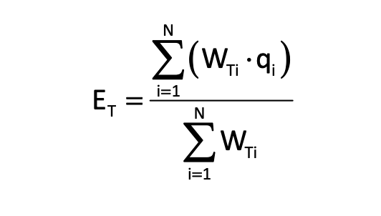
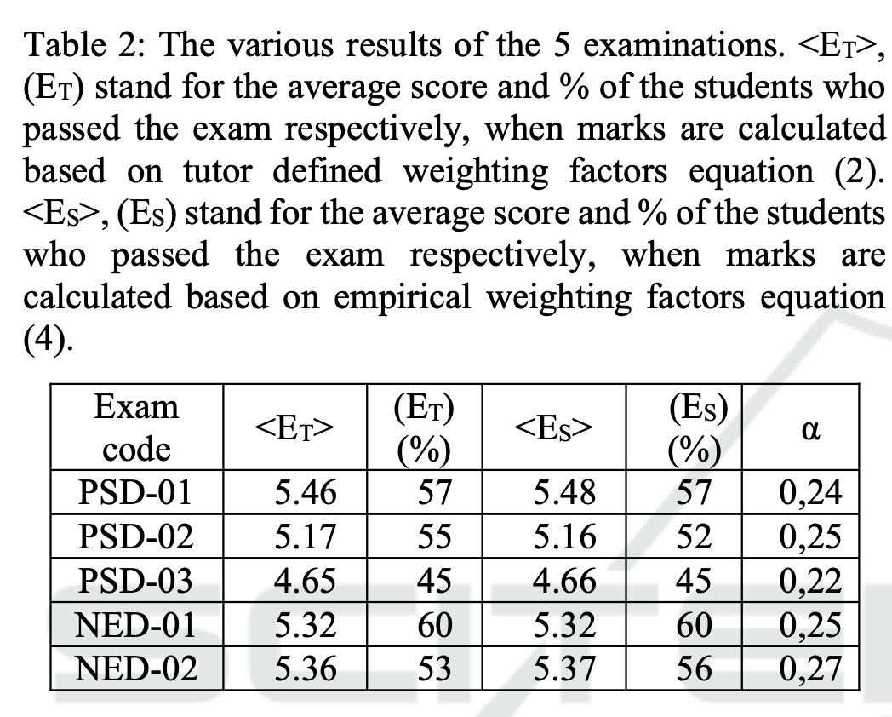
Weighted Marking Schemes
Expert weighting

Slide 12
Weighted Marking Schemes
Expert weighting
Question 1: 60% get correct. P 1 = 0.4
Question 2: 90% get correct. P 2 = 0.1
1 is 4 X more difficult than 2.
Weighting that influences final result is determined by the students that took exam. Then becomes more empirical

Slide 13
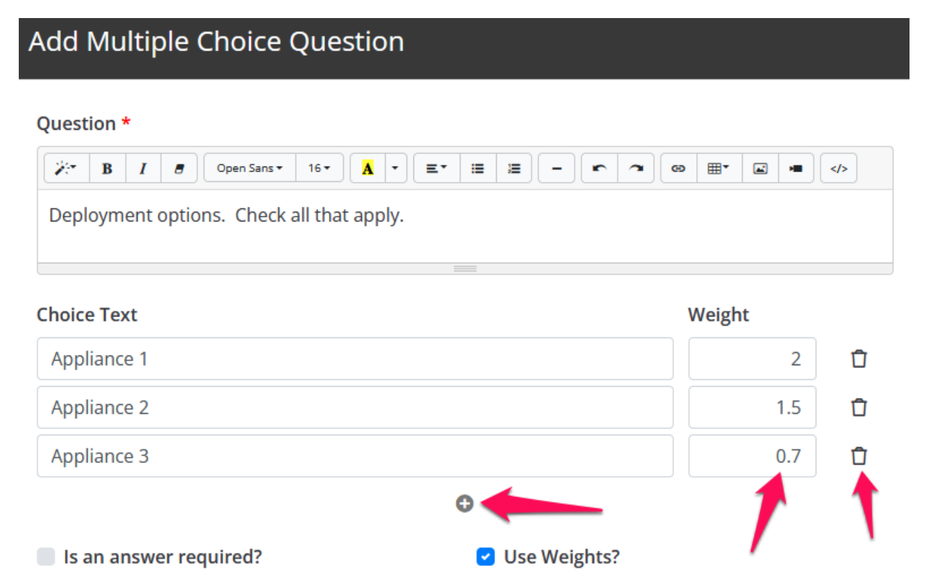
Weighted Marking Schemes
Expert weighting

Slide 14
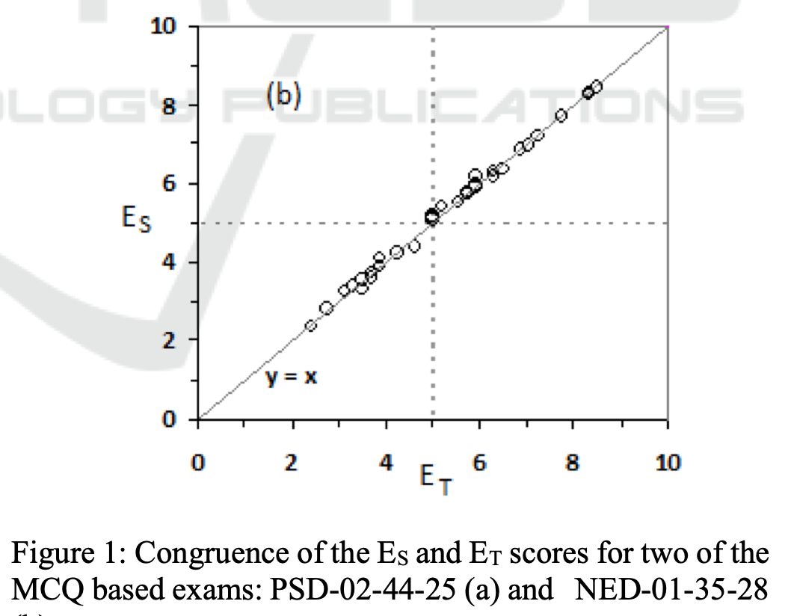
Weighted Marking Schemes
Expert weighting

Slide 15
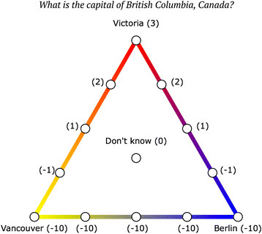
Weighted Marking Schemes
Confidence weighted MCQ

Slide 16
Weighted Marking Schemes
SBA weighting
Ranking answers:
Provide explanations for ranking
Interaction with examiners for ranking

Slide 17
Weighted Marking Schemes
SBA weighting
Best answer: + 3
Next best answer: + 2
Acceptable answer: + 1
Unlikely answer : 0
Dangerous/ completely wrong: - 1

Slide 18
Traditional Marking Schemes

