Slide 1
UEMS CESMA Picking an Exam that Suits you
Maeve Durkan, Vice Chair UEMS CESMA
President UEMS Board & section of Endocrinology
UEMS Board of Endocrinology Experiences

Slide 2
What exam ? Why ?
MCQ
Essay
Open Book
Oral exam
OSCE*

Slide 3
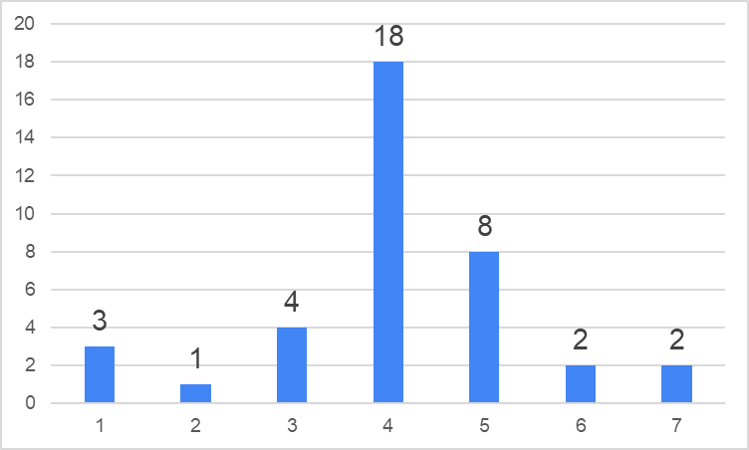
How do you foresee the future setting of European Examinations ?
AVERAGE = 4,07 n = 38
Fully online Part hybrid fully on site

Slide 4
Is your European Examination organised into One/ two parts: Part 1, more theoretical (e.g. MCQ) and Part 2, more clinical (e.g. OSCE) ?
NO = 14 One part only
YES = 20 Two parts
Oral examination only = 2
No exams organized yet = 3

Slide 5
If your examination is organised in two parts, how do you envisage the organisation of part 1 (theoretical) ?
AVERAGE = 2,35 n = 20
Fully online Part hybrid fully on site

Slide 6
If your examination is organised in two parts, how do you envisage the organisation of part 2 (practical) ?
AVERAGE = 5,35 n = 20
Fully online Part hybrid fully on site

Slide 7
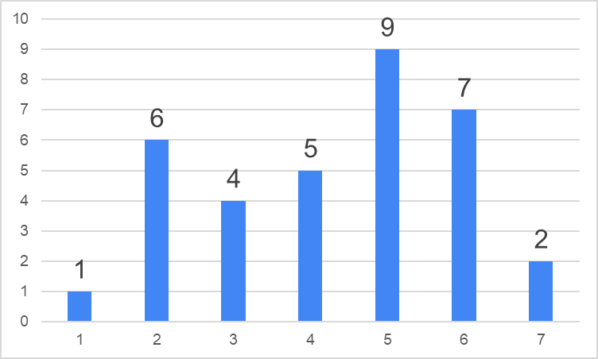
How relevant will the impact of budgetary considerations be on these choices ?
AVERAGE = 4,29 n = 34
Totally
irrelevant
Heavily
impacting

Slide 8
Best of 5 MCQ exam ( Part 1 )
Exam of knowledge only
Not always * an examination of competency
Aligned with curriculum ETR – weighted questions / core questions / ‘rare Qs
Alignment with training program infers competency
Options ( as with all ) as European exam and as National exit exam

Slide 9
Partnerships with SCIENTIFIC Societies and other groups / Providers
Intellectual property rights
Sharing of costs
Sharing of ‘profit’
Sharing of control ( Board make up )
Managing the pan - European exam* and inter country differences *( benchmarks )

Slide 10
Pilot Program Concluded – Endocrinology Experience Seeking a ‘ new’ partner
ESE
MOA
Legal framework
50 / 50 costs and income

Slide 11
Logistics & challenges of delivering an MCQ exam in 18/12
Q bank 200 for single exam – need for 220* ( standard setting )
Need for 300 questions and to regularly add and update Q
Q writing group ..getting Q writers / Q writing workshops
Costs and logistics of bi yearly meetings*
Incentivization
Standard setting and setting pass marks

Slide 12
What next ‘after the marriage’? No honeymoon Logistics & challenges of delivering an MCQ exam in 18/12
Currently
Experienced Q writers 14
Planned 2 weekends for Q writing
Plan 2 weekends / year ( ? Align with ECE or stand alone)
Costs 15 000 / weekend
Incentives : CPD points / ECE attendance support

Slide 13
What next ‘after the marriage’? No honeymoon The logistics and challenges of delivering an exam for 2023
Currently Expanding Q writers etc.
Q writing Workshops .UEMS assembly pilot
Each delegate invited to nominate 2 delegates* from National society
Each Society encouraged to create a Q writing group and contribute questions
Pan European alliance

Slide 14
Next STEP
Meeting and interviewing Providers (5)
But know what you want
Know the questions to ask
Know your costs and cost structure

