Slide 1
Selecting an Exam provider
Albert J Mifsud
CESMA meeting
Rome
5th / 6th May 2023

Slide 2
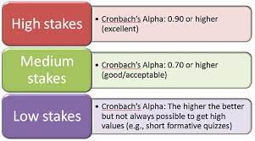
Early exams

Slide 3
Generic needs of exam
Reliable
Robust
Standardised
Support EU professional mobility directive
In time, provide alternative → replacement to national certification excaminations

Slide 4
Exams vary
No one size fits all
One paper or more?
Written; vivas; OSCEs; etc.
Decide what you want

Slide 5
Needs
What is essential?
What is desirable?
What is your budget?

Slide 6
Considerations
What is your support structure?
Do you have an administrator / office?

Slide 7
Checklist of stages / functions
General administration: support examination governance and operations
Run examination applications
Manage all communications with candidates
Provide the examination database
Deliver the examination
Undertake psychometric assessment, etc.
Provide educationalist advice / consultancy

Slide 8
Administration
Communicate with all exam committee members, and all examiners
Minute meetings
Take responsibility for all operations relating to exam
Ensure that all reporting obligations met
Support budgeting and expenditure
Ensure appeals process followed precisely

Slide 9
Applications
Determine what is needed
Website design
Advertising
Opening and receiving applications
Who vets applications and how arranged
Payment
If payment separate, co-ordination of accepted list with payment list

Slide 10
Candidate communications
General queries
Pre-exam communications
Post-exam communication

Slide 11
Examinations database
NB: Exam database may be distinct from exam delivery platform
What functionality required?
MCQs / OSCEs / viva voce frameworks
Ease of importation of Qs; images
Think about your question-writing journey: Each question will move through several stages. What records needed?
Security; levels of access

Slide 12
Examinations delivery
Part of, or distinct from, question database?
Is delivery being subcontracted?
Delivery mechanism – flexibility for future
Suited to multi-part exam?
Can accept marking at OSCEs, Viva voce, etc. with contemp notes facility

Slide 13
Examination psychometrics
These are essential!
Are they part of the exam delivery database / software?
What parameters are calculated?
Does system allow passmark determination? with repeated iterations?

Slide 14
Consultancy
Expertise in educational psychology and psychometrics is important
Will this be sourced separately or is it part of the the specification?

Slide 15
Example Tender Document
The following slides are screenshots of a particular tender document that I had developed in 2019 for a particular Section’s Exam.
If I were to re-issue this document, I would make significant changes to it, in particular relating to question development process.
Please DO NOT consider this to be a document to be emulated.

Slide 16
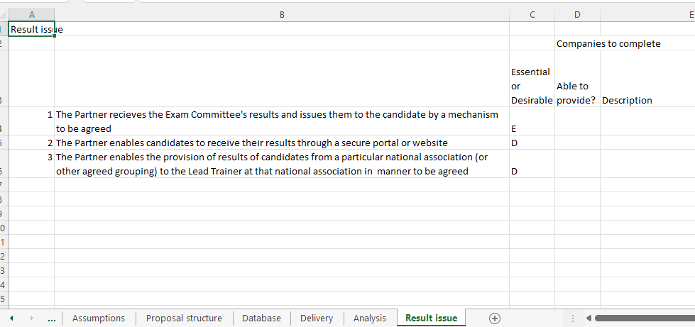
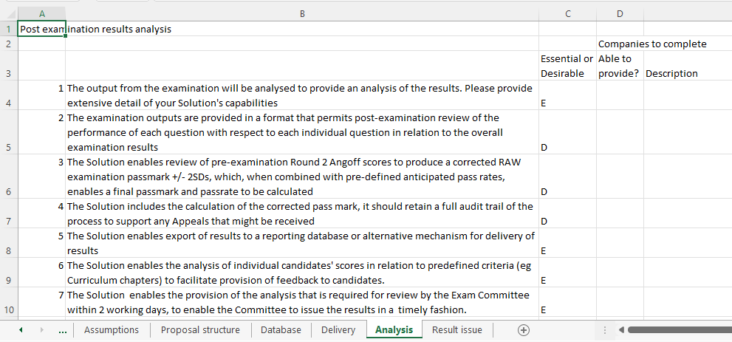
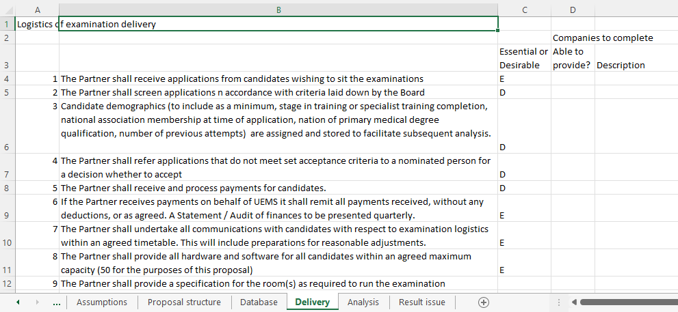
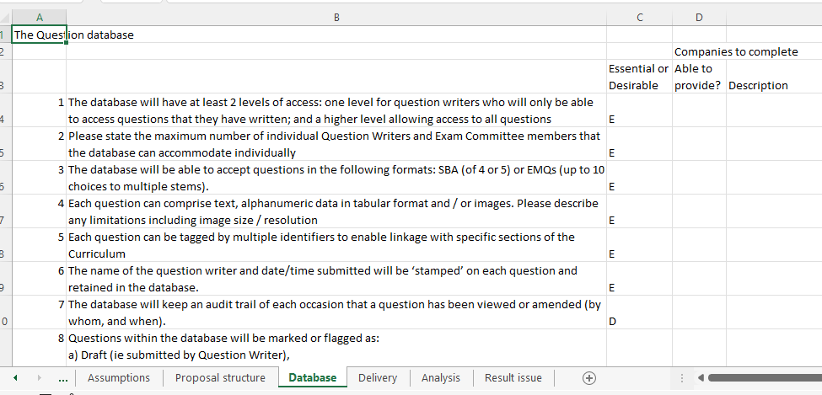
Tender document
Result issue
Analysis
Delivery
Database

Slide 17
Background
Background
The Medical Microbiology Section of UEMS wishes to launch an examination in medical microbiology.
UEMS is inviting examination assessment suppliers to provide detailed descriptions of the product(s) that you can provide with the associated costs and how you wish to work with UEMS Medical Microbiology Section to deliver the examination. Companies are invited to complete the following questionnaire. We are proposing to run a pilot examination in April 2020.
Set up costs for this examination are being provided by ESCMID (European Society for Clinical Microbiology and Infectious Diseases) with the expectation that the examination will become self-funding within 4 years (i.e. from the April 23 Diet).
Companies are requested to describe how they would meet the requirements listed.

Slide 18
Assumptions
The exam will be electronic, delivered on desktop-top, lap-top or tablet computers.
It shall be set in English only ( in the first instance)
For the purposes of this proposal, assume that the examination shall comprise a single paper of 120 multiple choice questions (e.g. SBAs, EMQs), lasting 3 hours.
We anticipate that it will be attempted by up to 50 candidates in the first instance.
It will be delivered in one location annually at various European cities, depending on the location of the annual European scientific conference, ECCMID (European Congress of Clinical Microbiology and Infectious Diseases). The meeting is normally held in April. The location of forthcoming conferences can be checked on the ESCMID website. The April 2020 meeting will be held in Paris.
Sufficient rooms to enable the exam to be taken will be provided.
Invigilators will be provided (except as specified below).
Please assume that the examination will be held on the Friday morning, prior to commencement of ECCMID. The Exam Committee will meet at 17:00hrs on the Tuesday immediately after the close of ECCMID
The contract for the examination delivery will be with, and signed by, UEMS. Their requirements will need to be met.
The precise detail of the examination development process, to include question writing, initial and subsequent individual question review, initial and subsequent standard setting of individual questions, development of the whole examination, setting and reviewing the examination passmark, etc has not been finalised. We are likely to utilise a statistical standard setting procedure, eg Angoff
For the purposes of this invitation, the examination will be run by an Examination Committee comprising 5 senior consultant microbiologists, referred to as ‘Exam Committee’ in this document. Further consultants may be co-opted from time to time. Questions will be provided by a network of ‘Question writers’ who will submit questions remotely.
The Companies submitting descriptions of their products are referred to as 'Commercial Partners' abbreviated to 'Partners'.
The product or products that Companies propose to provide will be referred to as 'Solutions'. This includes software, any associated advice and exam delivery.
The term 'Working Day' refers to Monday to Friday 09:00 to 17:00hrs local time.
Multiple choice question (MCQ) types: Single best answer (SBA), Extended matching questions (EMQs).

Slide 19
Proposal structure
The request for proposals is divided into sections which follow sequentially
1 | Question database
2 | Examination delivery (including call for examination entry)
3 | Post examination results analysis
4 | Issue of results

Slide 20
Database (1)
 |  | Essential or Desirable
1 | The database will have at least 2 levels of access: one level for question writers who will only be able to access questions that they have written; and a higher level allowing access to all questions | E
2 | Please state the maximum number of individual Question Writers and Exam Committee members that the database can accommodate individually
3 | The database will be able to accept questions in the following formats: SBA (of 4 or 5) or EMQs (up to 10 choices to multiple stems). | E
4 | Each question can comprise text, alphanumeric data in tabular format and / or images. Please describe any limitations including image size / resolution | E
5 | Each question can be tagged by multiple identifiers to enable linkage with specific sections of the Curriculum | E
6 | The name of the question writer and date/time submitted will be ‘stamped’ on each question and retained in the database. | E
7 | The database will keep an audit trail of each occasion that a question has been viewed or amended (by whom, and when). | D
8 | Questions within the database will be marked or flagged as: a) Draft (ie submitted by Question Writer), b) Screened (ie screened for potential suitability by a Board member) with Provisional Acceptance, Returned, Rejected and c) Reviewed (ie discussed by Question Review Group). Alternative terminology is acceptable. | E
9 | The database will allow Draft questions to be returned to the author for amendment / clarification with a brief message from the screener. | D

Slide 21
Database (2)
10 | Each question will have a field where various numerical and textual information can be stored (e.g. the author's proposed estimated level of question difficulty on a predetermined scale). | D
11 | Questions can be selected for inclusion at a Question Writers Review meeting. | D
12 | The date of discussion at the Question Writers meeting can be stored | D
13 | Following Discussion at the Question Writers' review group updated ratings can be stored | D
14 | Questions selected for potential inclusion in a particlar diet of the examination can be flagged as such. | E
15 | Once candidate questions are selected to populate a particular diet of the examination, the 'draft' examination can be made available for testing by independent individual(s) as nominated by the Board | E
16 | The database must be secure at every stage of the question writing and examination development. Please describe your approach. | E
 | Database developmental possibilities
 | Rather than SBAs or EMQs, a question might have a limited number of possible options. An example of these questions are Computer Based Case Simulations CCSs). Selection of each option will lead a specific further questions. Candidates will not be able to back-track. Please state whether you are prepared to explore this type of question sequence. | D

Slide 22
Delivery (1)
 |  | Essential or Desirable
1 | The Partner shall receive applications from candidates wishing to sit the examinations | E
2 | The Partner shall screen applications n accordance with criteria laid down by the Board | D
3 | Candidate demographics (to include as a minimum, stage in training or specialist training completion, national association membership at time of application, nation of primary medical degree qualification, number of previous attempts) are assigned and stored to facilitate subsequent analysis. | D
4 | The Partner shall refer applications that do not meet set acceptance criteria to a nominated person for a decision whether to accept | D
5 | The Partner shall receive and process payments for candidates. | D
6 | If the Partner receives payments on behalf of UEMS it shall remit all payments received, without any deductions, or as agreed. A Statement / Audit of finances to be presented quarterly. | E
7 | The Partner shall undertake all communications with candidates with respect to examination logistics within an agreed timetable. This will include preparations for reasonable adjustments. | E
8 | The Partner shall provide all hardware and software for all candidates within an agreed maximum capacity (50 for the purposes of this proposal) | E
9 | The Partner shall provide a specification for the room(s) as required to run the examination

Slide 23
Delivery (2)
10 | The Partner shall take responsibility to ensure that the room(s) provided meet the Partner's requirements to run the examination effectively | E
11 | The Partner shall deliver the examination on site. This will include candidate identification and registration. | E
12 | The Partner shall make arrangements to make appropriate reasonable adjustments for candidates who require this, as agreed with the Exam Committee in advance | E
13 | The Partner shall provide the Exam Committee with the results of the examination within 2 working days in an agreed format. Please describe this format, bearing in mind your response to requirements laid down in the next section of this bid | E
14 | The Partner will have a Business Continuity Plan for all reasonably-foreseeable eventualities | E
15 | All personal identifiable information is treated in accordance with GDPR requirements as applicable. The Partner takes responsibility to determine such requirements | E
 | Database developmental possibilities
 | The candidate database should facilitate subsequent linkage with or population with additional assessment data such as log book completion, Workplace based assessment completions, etc. | D

Slide 24
Analysis
 |  | Essential or Desirable
1 | The output from the examination will be analysed to provide an analysis of the results. Please provide extensive detail of your Solution's capabilities | E
2 | The examination outputs are provided in a format that permits post-examination review of the performance of each question with respect to each individual question in relation to the overall examination results | D
3 | The Solution enables review of pre-examination Round 2 Angoff scores to produce a corrected RAW examination passmark +/- 2SDs, which, when combined with pre-defined anticipated pass rates, enables a final passmark and passrate to be calculated | D
4 | The Solution includes the calculation of the corrected pass mark, it should retain a full audit trail of the process to support any Appeals that might be received | D
5 | The Solution enables export of results to a reporting database or alternative mechanism for delivery of results | E
6 | The Solution enables the analysis of individual candidates' scores in relation to predefined criteria (eg Curriculum chapters) to facilitate provision of feedback to candidates. | E
7 | The Solution enables the provision of the analysis that is required for review by the Exam Committee within 2 working days, to enable the Committee to issue the results in a timely fashion. | E
8 | The Solution enables re-running of the statistical analysis of raw results following exclusion of one or more questions, to recalculate the pass-mark (if necessary on more than one occasion). The output can then be exported in a manner that enables issue of results to candidates. | D
9 | The Solution enables analysis by any characteristic that has been used to flag individual candidates, for example gender, previous number of attempts or membership of particular national microbiology association. | D

Slide 25
Result issue
 |  | Essential or Desirable
1 | The Partner recieves the Exam Committee's results and issues them to the candidate by a mechanism to be agreed | E
2 | The Partner enables candidates to receive their results through a secure portal or website | D
3 | The Partner enables the provision of results of candidates from a particular national association (or other agreed grouping) to the Lead Trainer at that national association in manner to be agreed | D

Slide 26
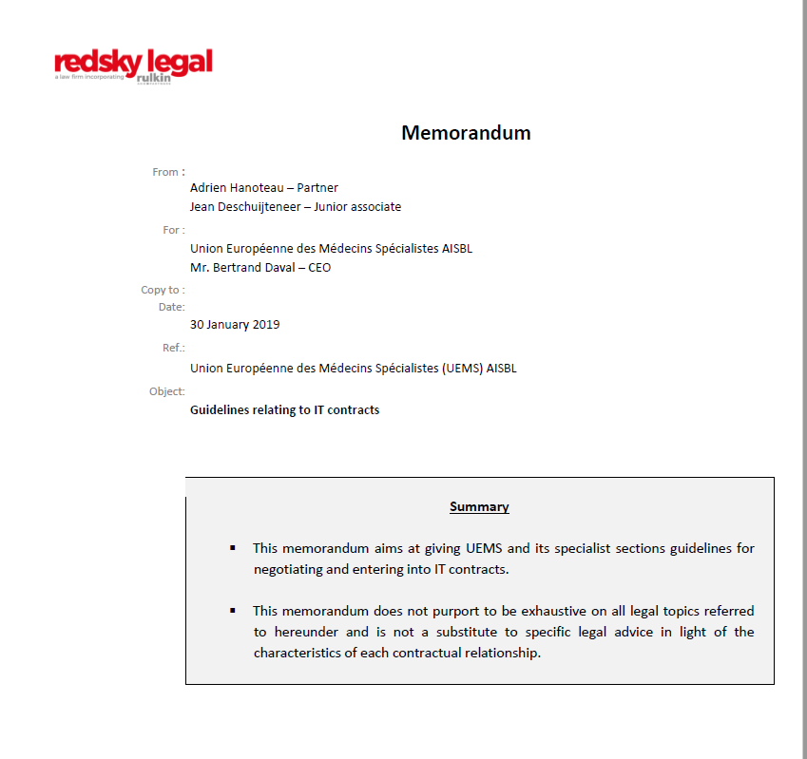
UEMS Legal Team
Remember:
All UEMS agreements are signed by the President and General Secretary.
UEMS legal advice must be followed.

