Slide 1
Workshop of the Council for European Specialist Medical Assessments
UEMS-CESMA Appraisals v2.0:
Training to become UEMS-CESMA appraiser
Danny G.P. Mathysen (MSc, PhD)
Together with: Mark Westwood, Maeve Durkan, Albert Mifsud, Gian Battista Parigi, Zeev Goldik and Marianne Chagnon
University of Antwerp (UAntwerpen), Faculty of Medicine and Health Sciences
Institute for Medical Specialty Education (IZO), Education Coordinator
Universiteitsplein 1, B-2610 Wilrijk (Antwerp), Belgium
 danny.mathysen@uantwerpen.be

Slide 2
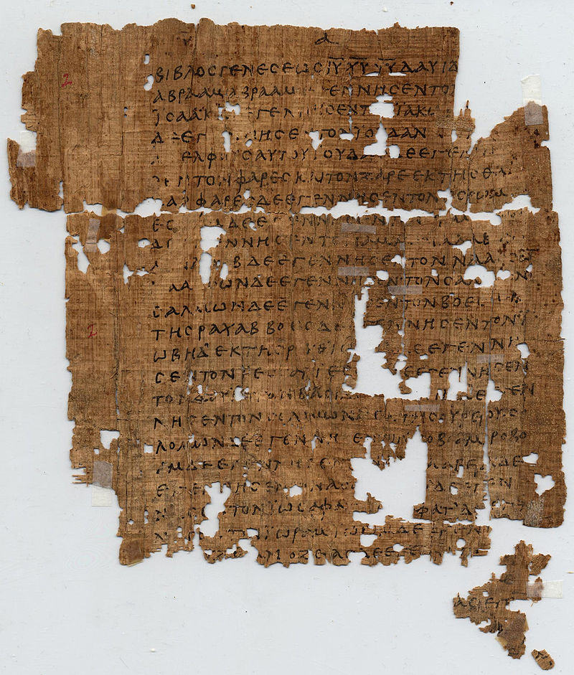
Summary and take home conclusions
The main principles needed for UEMS-CESMA appraisal
were already written down in the bible …
(how else could we describe the appraisal system
when we are in the country of the bible?)
Gospel of Matthew ➼ Chapter 7 ➼ verse 7
Petite, et dabitur vobis (Ask and you shall be given)
Quaerite et invenietis (Search and you will find)
Pulsate, et aperietur vobis (Knock and you will be welcomed)

Slide 3
Will be updated based on the experiences of this UEMS-CESMA workshop

Slide 4
Will be updated based on the experiences of this UEMS-CESMA workshop

Slide 5
Will be updated based on the experiences of this UEMS-CESMA workshop

Slide 6
Will be updated based on the experiences of this UEMS-CESMA workshop

Slide 7
Will be updated based on the experiences of this UEMS-CESMA workshop

Slide 8
Will be updated based on the experiences of this UEMS-CESMA workshop

Slide 9
Will be updated based on the experiences of this UEMS-CESMA workshop

Slide 10
Will be updated based on the experiences of this UEMS-CESMA workshop

Slide 11
Will be updated based on the experiences of this UEMS-CESMA workshop

Slide 12
Will be updated based on the experiences of this UEMS-CESMA workshop

Slide 13
Will be updated based on the experiences of this UEMS-CESMA workshop

Slide 14
Will be updated based on the experiences of this UEMS-CESMA workshop

Slide 15
Will be updated based on the experiences of this UEMS-CESMA workshop

Slide 16
Thank you …
Faleminderit shumë (Albanian) Shterakravetsun (Armenian) Eskerrik asko (Basque)
Mnogo blagodarya (Bulgarian) Dzãkujã (Cassubian) Moltes gràcies (Catalan) Merastawhy (Cornish)
À ringraziavvi (Corsican) Hvala lijepa (Croatian) Dĕkuji (Czech) Mange tak (Danish) Dank u wel (Dutch)
Thank you (English) Ic sæcge eow Þancas (English, old) Dankon al vi (Esperanto) Aitäh (Estonian)
Paljon kiitoksia (Finnish) Merci beaucoup (French) Tanke wol (Frisian) Graciis (Friulian) Grazas (Galician) Mèrczi (Gallo) Merci (Gascon) Besten dank (German) Merci villmahl (German: Zurich Switzerland)
Ευχαριστώ (Greek) Toda raba (Hebrew) Nagyon köszönöm (Hungarian) Takk fyrir (Icelandic)
Gratias (Interlingua) Qujanaq (Inuttut) Go raibh mile maith agaibh (Irish Gaelic) Gratias tibi ago (Latin) Liels paldies (Latvian) Mouchou gratzia (Lingua Franca) Labai achiu (Lithuanian) Merci (Luxembourgish) Grazzi hafna (Maltese) Gura mie mooar ayd (Manx) Merçì (Monegasque) Gràzzie (Napulitano)
Dziękuję (Polish) Obrigado (Portuguese) Mercé plan (Provencal) Nais tuke (Romani: gypsy)
Oven saste (Romani) Mulţumesc (Romanian) Grazia fitgun (Romantsch) Спасибо (Russian)
Giitus eanat (Saami Lappish) Moran taing (Scottish Gaelic) Grazzii (Sicilian) Dakujem vám (Slovak)
Hvala lepa (Slovenian) Dz’akujo so (Sorbian) Muchas gracias (Spanish) Dankeschee (Swabian)
Tackar så mycket (Swedish) Çok tesekkür ederim (Turkish) Moltes gracies (Valencian)
Merci (Walloon) Diolch yn fawr iawn (Welsh) A dank aych (Yiddish)

